Slide 1
Principles of Marketing
Module 3: Segmentation and Targeting
Notes:
All text in these slides is taken from https://courses.lumenlearning.com/wmopen-principlesofmarketing/, where it is published under one or more open licenses.
All images in these slides are attributed in the notes of the slide on which they appear and licensed as indicated.
Cover Image: "Shopping freak." Provided by: freestocks.org. Located at: https://unsplash.com/photos/_3Q3tsJ01nc. Content Type: CC Licensed Content, Shared Previously. License: CC0: No Rights Reserved.

Slide 2
Segmentation and Targeting
Segmentation is the process of dividing potential customers into groups to better understand them
Targeting is determining which segments are most likely to become customers and directing marketing efforts to best satisfy them
Professional tennis players are a specific segment of the market.
Notes:
2014 US Open (Tennis) - Tournament - Dustin Brown. Authored by: Steven Pisano. Located at: https://www.flickr.com/photos/stevenpisano/15140591721/. License: CC BY: Attribution

Slide 3
Five Criteria for a Market
There must be a true need and/or want for the product, service, or idea; this need may be recognized, unrecognized, or latent
The person/organization must have the ability to pay for the product via means acceptable to the marketer
The person/organization must be willing to buy the product
The person/organization must have the authority to buy the product
The total number of people/organizations meeting the previous criteria must be large enough to be profitable for the marketer

Slide 4
Objectives of Segmentation
To improve an organization’s understanding of who their prospective customers are and how to serve them
To reduce risk in deciding where, when, how, and to whom a product, service, or brand will be marketed
To increase marketing efficiency by directing effort toward designated segment(s) in ways that are consistent with that segment’s characteristics

Slide 5
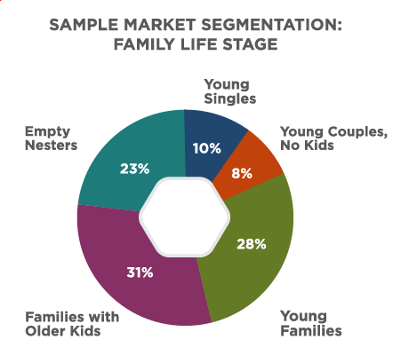
Practice Question
What products or companies would find this market segmentation by family life stage useful?
Notes:
Answers may vary. McDonald’s is an example in the module. Companies that sell foods, clothes, toys, etc. Hot restaurants might want to capture the young couples and empty nesters.
Sample Market Segmentation (Chart). Authored by: Lumen Learning. License: CC BY: Attribution

Slide 6
Choosing a Target Market
The target market should include only those segments of a market that are both:
Profitable to serve
Likely to be receptive to the products a company provides
Notes:
Windsurfing at Gislu00f6vshammar. Authored by: Matthias Weinberger. Located at: https://www.flickr.com/photos/infomastern/10271441954/. License: CC BY-SA: Attribution-ShareAlike

Slide 7
Common Market Segmentation Approaches
Type of Approach | Segmentation Criteria
Geographic | Nations, states, regions, cities, neighborhoods, zip codes, etc.
Demographic | Age, gender, family size, income, occupation, education, religion, ethnicity, and nationality
Psychographic | Lifestyle, personality, attitudes, and social class
Behavioral | User status, purchase occasion, loyalty, readiness to buy
Decision maker | Decision-making role (purchaser, influencer, etc.)

Slide 8
Common Business Segmentation Approaches
Organization size: by revenue, number of employees, geographic reach, etc.
Geography
Industry
User status: usage frequency, volume used, loyalty, longevity, products already in use, readiness to buy, etc.
Benefits sought
End use
Purchasing approaches

Slide 9
Combining Bases for Segmentation
Geo-cluster approach demographic + geographic data
Geographic + behavioral data
Can point companies toward locations where customers are clustered
Demographic + lifestyle or behavioral segments
Notes:
Sophie shopping. Authored by: David Veksler. Located at: https://www.flickr.com/photos/heroiclife/15316262230/. License: CC BY-SA: Attribution-ShareAlike

Slide 10
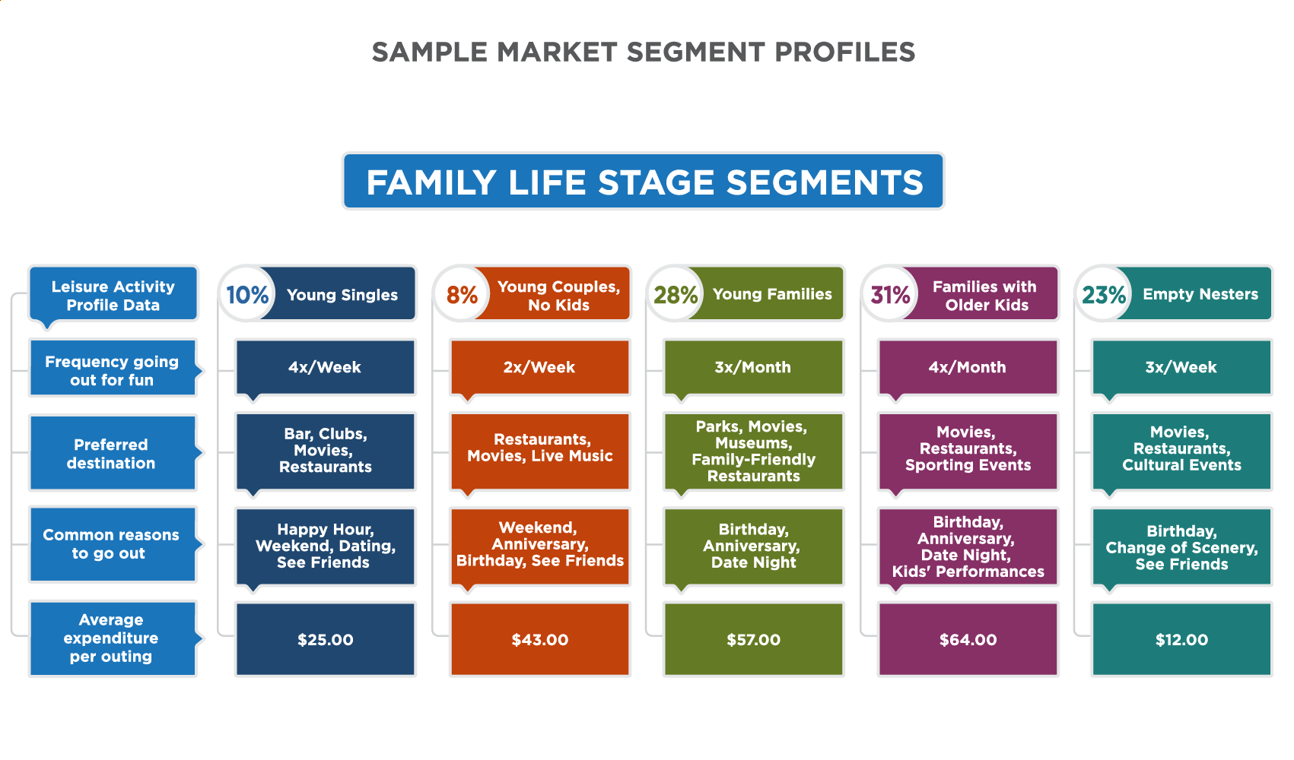
Sample Market Segment Profiles

Slide 11
Ideal Market Segment
Can be measured
Is profitable
Is stable
Is reachable
Is internally homogeneous
Is externally heterogeneous
Is responsive
Is cost-effective
Helps determine the marketing mix

Slide 12
Questions to Consider in Selecting a Target Segment
Whose needs can you best satisfy?
Who will be the most profitable customers?
Can you reach and serve each target segment effectively?
Are the segments large and profitable enough to support your business?
Do you have the resources available to effectively reach and serve each target segment?

Slide 13
Targeting Strategy
Concentration
Multi-segment
Only one marketing mix is developed
Advantage: focus
Disadvantage if demand in segment declines, company will suffer
Marketing mix for each segment
Advantage: may reach more customers
Disadvantage: Costs of multiple campaigns and distribution channels

Slide 14
Targeting Strategies
Strategy | Target Market | Example
Mass marketing | Everybody everywhere | Target
Differentiated marketing | Large groups within the total market | Costco, Sam’s Club
Niche marketing | High penetration within smaller, specialized segments | Trader Joe’s, Whole Foods
Micromarketing | Individual customers or localized microsegments | Groupon

Slide 15
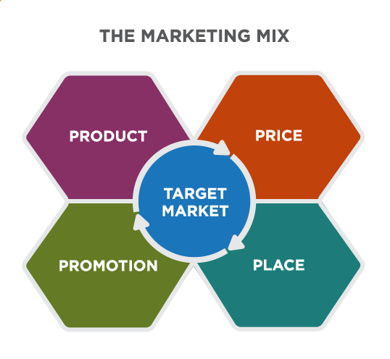
The Marketing Mix
Notes:
Defining the Marketing Mix. Provided by: Lumen Learning. License: CC BY-SA: Attribution-ShareAlike

Slide 16
Shaping Marketing Mix for Target Markets
Marketing Element | Targeting Criteria
Product | What would make the ideal product for your target segment? What special features or capabilities are critical for this segment? What unique problems does your product help them solve?
Promotion | What are the best ways to get your target segment’s attention? What do you want this segment to remember about your product?
Place / Distribution | Where does this segment look or shop for your product? What is the best way to get your product to your target customers?
Price | What price(s) are your target customers willing to pay? How much is too expensive? How much is too cheap?

Slide 17
Quick Review
What is the purpose of segmentation and targeting in marketing?
What are some common segmentation approaches?
How do businesses select an appropriate segmentation approach and decide which customer segments to target for marketing activities?
How does targeting influence each element of the marketing mix?

