Slide 1
Trace elements and health hazards
SAEED HASSAN

Slide 2
Trace elements
Elements are matter that cannot be broken down into simpler substances. On the periodic table, each element is distinguished by its atomic number, which describes the number of protons in the nuclei of its atoms.
Trace elements chemical element present only in minute amounts in a particular sample or environment.
A chemical element required only in minute amounts by living organisms for normal growth.
The human body is made up of different elements.
Essential elements
Trace elements

Slide 3
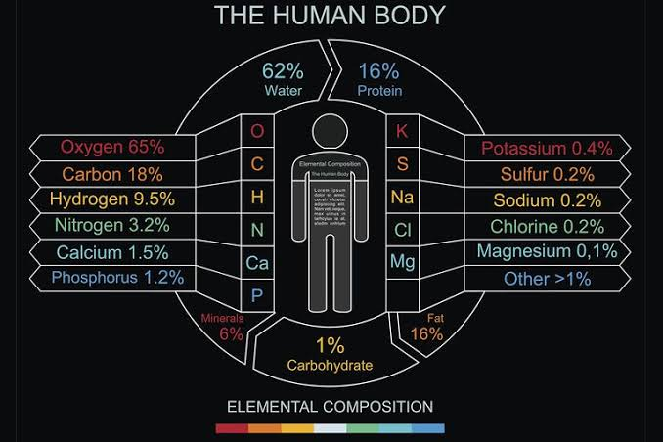

Slide 5
Trace elements (or trace metals) are minerals present in living tissues in small amounts. Some of them are known to be nutritionally essential, others may be essential and the remainder are considered to be non-essential. Trace elements function primarily as catalysts in enzyme systems; some metallic ions, such as iron and copper, participate in oxidation-reduction reactions in energy metabolism. Iron, as a constituent of hemoglobin and myoglobin, also plays a vital role in the transport of oxygen.
All trace elements are toxic if consumed at sufficiently high levels for long enough periods.

