Slide 2
Lecture# 19-20 Conflict management in workplace
(PSYC-6223)

Slide 3
Definition of conflict
A conflict is a clash on interest. The basis of conflict may vary but , it is always a part of society. Basis of conflict may be personal , racial ,class ,caste ,political and international.

Slide 4
Conflict management stages
Latent stage. Participant not yet aware of conflict.
Perceived stage. Participant aware a conflict exists.
Felt stage. Stress and anxiety
Manifest stage. Conflict is open and can be observed
Aftermath stage. Outcome of conflict ,resolution

Slide 5
Five stages of conflict:
Latent stage.
The people who are in conflict are not yet aware that a conflict may exist.
For example:
a project may have been turned in late to a client but the manager is not aware of it yet the participant are not aware there is a conflict brewing.

Slide 6
2. Perceived stage.
when the people involved in a conflict become fully aware that there is a conflict
For example.
such as when the manager discovers that the project has been delivered late and goes to speak to the employee about it.

Slide 7
3. Felt stage
Stress and anxiety are felt by one or more of the participants due to conflict.
4. Manifest stage
During which the conflict can be observed. For example. It can take a number of shapes including ,E. mails , phone cells, face to face meetings or any situation which the conflict can be observed.

Slide 8
Continue…….
5. Aftermath stage.
which take place when there is some outcome of the conflict
For example
such as resolution to, or dissolution of , the problem.

Slide 9
Definition of management conflict
Conflict management is the practice of being able to identify and handle conflicts sensibly, fairly and efficiently.
Conflict is a business are a natural part of the workplace ,it is important that there are people who understand conflicts and know how to resolve them

Slide 10
Conflict management styles
There are five conflict styles.
Accommodating
Accommodating manager is one who cooperates to a high degree. This may be at the manager’s own expense and actually work against the manager’s own goals, objectivities , desire and outcome

Slide 11
Cont…….
2. Avoiding.
It is an issue is one way a manager might attempt to resolve conflict. This type of conflict styles dose not help the other staff members reach their goal and does not help the manager who is avoiding the issue and cannot assertively pursue his or her own goals. In this manager has no chance to win.

Slide 12
Cont……
3. Collaborating .
collaborating managers become partners or pair up with each other to achieve both of their goal in this style. This is how managers break free of the win –lose paradigm and seek the win-win. This can be effective for complex scenarios where manager need to find a novel solution .

Slide 13
Cont….
4 . Competing
This is the win-lose approach, A manger is acting in a very assertive way to achieve his or her own goals without seeking to cooperate with other employee and may be expense of those other employee. This may be appropriate for emergencies when time is essence

Slide 14
5. Compromising.
This is lose-lose scenario where neither person nor manger really achieve what they want . This require a moderate level of assertiveness and cooperation. It may be appropriate for scenarios where you need a temporary solution or where both sides have equally important goals.

Slide 15
Conflicts management in group
Let us learn more about conflict management in group
There are more 6 strategies that we can apply when a conflicts arise in any group
Discuss one by one
One should not impose his idea on individuals in a group
Remember one wrong misinterpretation, and the entire messages gets distorted

Slide 16
Cont……
. Each member of the group must trust the other member and should have confidence in each other
4. Meet everyone with a warm smile and do not forget the handshake
5. Avoid using derogatory sentences in group
6. Counseling can also reduce the conflicts to a large extent

Slide 17
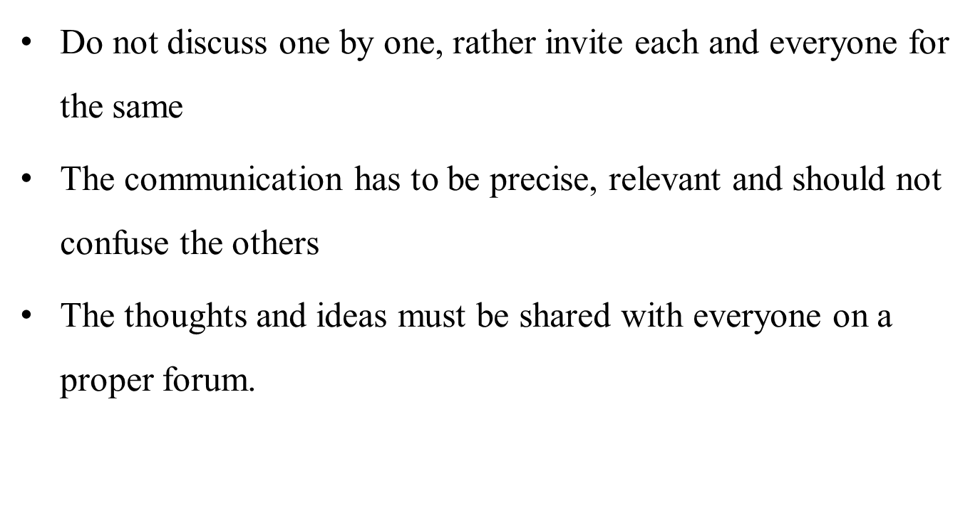
One should not impose his idea

Slide 18
The entire message gets distorted
Do cross check with the group whether they have received the correct information or not.
The information must be shared through email , and must be marked to all the participants to ensure transparency among the group members.
SPOC(single point of contact) must be easily available and the group members have an easy access to him.

Slide 19
Trust the other members
Personal interest must be left out.
Never be selfish or ignore the other members.
Be a good listener and consider everyone's view and opinion. An individual must stay out of criticism to avoid conflicts in a group.
Human beings are bound to make errors but you have no right to make fun of his/her ideas and concepts.

Slide 20
Meet everyone with warm smile
Personal interest must be left out
Never be selfish or ignore the other member
Be a good listener and consider everyone views and opinions
Don’t always support your friends as it might not got well with the other person
Human beings are bound to make errors but you have no right to make fun of his ideas and concepts

Slide 21
Avoid using derogatory sentences
Be a good leader and take everyone along.
Gossips must be avoided as it results in severe conflicts. If uh find anything wrong with a member, discuss the issues with him only
Be very straightforward but gentle.
A leader should one who is able to understand his group members well and support them always.

Slide 22
Counselling can also reduce the conflicts
If any member is upset with other, make both the members face to face to discuss their differences.
Don’t always find fault in in your group members .
Never ever lose your temper .
Never ever provoke any individual to fight, instead make him understand.

Slide 23
How to handle workplace conflicts?
Talk with the person..
Focus on behavior and events ,not on personalities.
Listen carefully.
Identify points of agreement and disagreement.
Prioritize the areas of conflicts.
Develop a plan to work on each conflicts.
Follow through on your plan.
Build on your success.

Slide 24
How employees menage workplace conflicts;
Employers can manage workplace conflicts by creating an organizational culture designed to preclude conflicts as much as possible and by dealing promptly and equitable with conflicts that employees cannot resolve among themselves.to manage conflicts employers should consider the following;
Make certain that policies and communication are clear and consistent and make the rationale for decisions transparent.
Ensure that all employees –not just managers-are accountable for resolving conflicts

Slide 25
Continue……
Do not ignore conflict and do not avoid taking steps to prevent it.
Seek to understand the underlying emotions of the employees in conflict.
Keep in mind that approaches to resolving conflicts may depend on the circumstances of the conflict.

Slide 26
Outcomes of Conflict
Functional Outcomes
Dysfunctional Outcomes
Conflict may cause job stress, burnout, and dissatisfaction.
Communication between individuals and groups may be reduced.
A climate of distrust and suspicion can be developed.
Relationships may be damaged.
Job performance may be reduced.
Resistance to change can increase.
Organizational commitment and loyalty may be affected
Conflict may stimulate innovation, creativity, and growth.
Organizational decision making may be improved.
Alternative solutions to a problem may be found.
Conflict may lead to synergistic solutions to common problems.
Individual and group performance may be enhanced

Slide 27
Levels of Conflict
Inter Group
Intra Group
Inter Personal
Intra
Personal
Intra Organizational
Inter Organizational
Intra-personal conflict
Interpersonal conflict
Intra group conflict
Inter group conflict
Intra organizational conflict
Inter organizational conflict

Slide 28
Levels of Conflict
Levels | Major characteristics
Intra personal conflict | Conflict within an individual.
Inter personal conflict | Conflict between two or more individuals.
Intra group conflict | Conflict within a group.
Inter group conflict | Conflict between two or more groups.
Intra organizational conflict | Conflict within an organization.
Inter organizational conflict | Conflict between two or more organizations.

Slide 29
Any Question????

