Slide 1
Soil Mechanics
(BS-GEOLOGY)
UOS
SAEED HASSAN

Slide 2
This Topic

Slide 3
3
Weight-Volume Relationships
Soil Phase Relationships
Basic Definition and Terminology
Various Unit Weight Relationships
Relative Density

Slide 4
Soil Phase Relationships
Soil mass is generally a three phase system. It consists of solid particles, liquid and gas. For all practical purposes, the liquid may be considered to be water (although in some cases, the water may contain some dissolved salts) and the gas as air.
The inter relationships of the different phases are important since they help
to define the condition or the physical make-up of the soil.
=
Mineral Skeleton
Three Phase Diagram

Slide 5
Soil Phase Relationships
Naturally occurred soil consists of solid particles which make up the soil skeleton and voids which may be full of water if the soil is saturated, may be full of air if the soil is dry, or may be partially saturated as shown:
Mineral Skeleton
Fully Saturated
Dry Soil
Partially Saturated

Slide 6
Weight-Volume Relationships
To develop the weight–volume relationships, we must separate the three
phases (that is, solid, water, and air) as shown:
W_{s} = weight of soil solid W_{w} = weight of water W_{a} = weight of air ≈ 0
V_{s} = volume of soil solid
V_{v} = volume of voids
V_{w} = volume of water
V_{a} = volume of air
V = total volume
W = W_{s} + W_{w}
V = V_{s} + V_{v} = V_{s} + V_{w} + V_{a}

Slide 7
Weight-Volume Relationships
There are three volumetric ratios that are very useful in geotechnical
engineering and these can be determined directly from the phase diagram:
1. Void ratio (e), defined as the ratio of the volume of voids to the volume of
solids:
e = ^{V}
v
V
s
2. Porosity (n), defined as the ratio of the volume of voids to the total volume:
n = ^{V}
v
V
T
3. Degree of saturation (S), defined as the ratio of the volume of water to the volume of voids:
V
S = ^{w} ×100%
V
v
(S) is always expressed as a percentage. When S = 0%, the soil is completely dry, and when S = 100%, the soil is fully saturated.

Slide 8
Weight-Volume Relationships
The relationship between void ratio and porosity can be derived:
⎛V ⎞
⎛V ⎞
v
⎜ v ⎟
⎜⎜ ⎟⎟
V
v
₌ ⎝ V ⎠ ₌
n
V
v
⎝^{V}s ⎠
e
e = ^{Vv} =
n = ^{Vv} =
=
=
V V −V
₁₋ ⎛V ⎞ 1− n
V V + V
T s v
⎛V ⎞
v
1 + e
⎜ v ⎟
1 + ⎜⎜ ⎟⎟
s
v
⎝ V ⎠
⎝^{V}s ⎠
The common terms used for weight relationships are moisture content and unit weight.
1. Moisture content (w), also referred to as water content, is defined as the ratio of the weight of water to the weight of solids in a given volume of soil:
w = ^{W}
w
W
s

Slide 9
Weight-Volume Relationships
2. Unit weight (γ ) is the weight of soil per unit volume. There are several
commonly used unit weights:
W W + W
a) Total unit weight (moisture/wet/bulk unit weight): γ =
₌ s w
V V
W
b) Dry unit weight (when saturation S = 0): γ
d
=
V
s
W
c) Saturated unit weight (when saturation S = 100%):
γ =
sat
V
W
d) Solid unit weight: γ
•
₌ s
s
V
s
The moisture unit weight and the dry unit weight ca also be expressed as:
⎡
⎛W
⎞⎤
W 1 +
⎜
w
⎟
⎥
⎣ s ⎦
s ⎢
⎜
⎟
W (1 + w)
W W + W
W
γ
γ = =
⎝ ⎠
s w
V
=
=
s
V
and
γ =
V
V
d
1 + w

Slide 10
Weight-Volume Relationships
Another very useful concept in geotechnical engineering is the density (equivalent to unit weight) which is expressed as mass per unit volume. There are several commonly used densities:
M
a) Total density :
ρ =
V
₌ M_{s}
b) Dry density (when saturation S = 0):
ρ
d
V
M
c) Saturated density (when saturation S = 100%):
ρ =
M
sat
V
_{ρ =} s
d) Density of solids:
s
V
s
The unit weight can be obtained from densities as:
γ = ρg
M = total mass of the soil sample (kg)
W_{s} = mass of soil solids in the sample (kg)
V = total volume of the soil (m³)
γ = ρ g
d d

Slide 11
Specific Gravity
The Specific Gravity (G) which is defined as the ratio of unit weight (or
density) of a given material to the unit weight (or density) of water.
a) The specific gravity of a mass of soil (including air, water and solids) is
termed as bulk specific gravity (G_{m}). It is expressed as:
₌ γ ₌ ρg ₌ ρ
G
m
γ ρ g ρ
w w w
b) The specific gravity of solids (G_{s}), excluding air and water, is expressed by:
₌ ρ g ₌ ρ
G = ^{γ}
s
s
s
s
γ ρ g ρ
w w w
Note that:
⎛ ⎞⎛ ⎞
γ = ρ g = ⎜1000 ^{kg} ⎟⎜9.81^{m} ⎟ = 9810 ^{kg.m} = 9810 ^{N} = 9.81^{kN}
_{s}2 ⎠
m³ .s²
_{m}3
_{m}3
w w
⎝
m³ ⎠⎝

Slide 12
Specific Gravity
We can use G_{s} to calculate the density or unit weight of the solid particles:
ρ = G ρ
s s w
and
γ = G γ
s s w
and hence the volume of the solid particles if the mass or weight is known:
₌ W M
V = ^{W} = ^{M}
=
s
s
s
s
s
γ ρ G γ G ρ
Expected values for G_{s}:
s
s
s w
s w
Type of Soil | G_{s}
Sand | 2.65 – 2.67
Silty Sand | 2.67 – 2.70
Inorganic Clay | 2.70 – 2.80
Soils with Mica or Iron | 2.75 – 3.00
Organic Soils | < 2.00

Slide 13
Relationships among γ, e, w and G_{s}
By assuming V_{s} = 1, we have:
W = G γ
s s w
W = wW = wG γ
w s s w
e = ^{Vv} = V
V = V + V = 1+ e
s v
V
v
s
_{γ =} W ₌ W + W ₌ G γ + wG γ ₌ (1+ w)G γ
V V
s w s w s w s w
1+ e
1+ e
₌ W ₌ G γ
_{e =} G γ
γ
s
s w
s w
−1
d
V 1 + e
γ
d
₌ wG_{s}γ _{w}
V = ^{Ww}
= wG
w
γ
γ
s
w
w
₌ wG_{s}
Se = wG
S = ^{Vw}
V e
s
v
When the soil is saturated (S = 100%):
₌ (G_{s} + e)γ _{w}
γ
e = wG
sat
1 + e
s

Slide 14
Relationships among γ, e, w and G_{s}
By assuming V = 1, we have:
n = ^{Vv} = V
V = 1 − n
V
v
s
W = γ V = G γ (1− n)
s s s s w
W = wW = wG γ (1− n)
w s s w
W
s
= G γ (1 − n)
γ =
d
V
s w
_{γ =} W_{s} + W_{w}
= G γ (1 − n)(1 + w)
V
s w
₌ W_{s} + W_{w =} (1 − n)G_{s}γ _{w} + nγ _{w}
V 1
γ
= [(1 − n)G + n]γ
sat
s
w
When the soil is saturated (S = 100%):
nγ
n ₌ e
w = ^{W} =
=
w
w
W (1 − n)γ G
(1 − n)G
G
s
w s
s
s

Slide 15
Typical Values of e, w and ^{γ} d
Some typical values of void ratio, moisture content in a saturated condition,
and dry unit weight for soils in a natural state are given

Slide 16
Relative Density (D_{r})
The relative density (D_{r}) is commonly used to indicate the in situ denseness
or looseness of granular soil (cohesionless soil). It is defined as:
D_{r}: relative density, (%)
e − e
_{D =} max
where,
e: in-situ void ratio of the soil
e_{max}: void ratio of the soil in the loosest state
e_{min}: void ratio of the soil in the densest state
r
e − e
max
min
The values of
D_{r} may
vary
from a minimum of 0% for very loose soil to a maximum of 100% for very dense soils.
Relative density (%) | Description of soil deposit
0 -15 25 – 50 50 – 70 70 – 85 85 –100 | Very loose Loose Medium Dense Very dense
Soil engineers
qualitatively granular soil
describe the
deposits according to their
relative densities, as shown.

Slide 17
Grain size Analysis

Slide 18
Grain size Analysis
The knowledge of sizes of solid particles comprising a certain soil type and their relative proportion is useful because it is used in;
Soils classification
Soil filter design
Predictions the behavior of a soil with respect to shear strength, settlement and permeability

Slide 19
Grain size Analysis (Continue)
Two types of grain size analyses are typically
performed
Mechanical analysis also know as sieve
analysis
Hydrometer analysis

Slide 20
Sieve Analysis
ASTM D 421
Applicable for soils that are mostly granular with some or no fines
The U.S. No. 200 sieve (0.074mm or 0.0029in) is the smallest sieve size typically used in practice
Small size is 500g (why?)

Slide 21
Sieve Analysis (Cont.)

Slide 22
Sieve Analysis (Cont.)
3/8”, ¼” sieves is the size
of the opening
No.10 sieve …. has 10
apertures per linear inch
Use sieves No.3/8”, No.4, No.10, No.40, No.140 & No.200

Slide 23
Grain Size Distribution Curves
^{D}60
^{D}30
^{D}10
0.15 mm
0.8 mm
0.15 mm
5.3
0.4 mm
0.8 mm
Civil Engineering - Texas Tech University
0.4
1.33
0.15
0.8

Slide 24
Sieve Analysis (Cont.)
D₆₀ - the diameter corresponding to 60% finer in the particle-size distribution curve
D₁₀ – effective size
C_{u} – coefficient of gradation,
c
₌ ^{D}60
u
D
10
₎2
(D
C_{c} – coefficient of curvature,
Note:
c =
30
c
^{D}60 ^{× D}10
If cu is relatively large, it indicates a well graded soil. Cu = 1 indicates that the soil grains are of approximately equal sizes.

Slide 25
Sieve Analysis (Cont.)

Slide 26
Consistency Limits
Soil consistency
Atterberg Limits
Liquid Limit, LL
Plastic Limit, PL
Plasticity Index, PI

Slide 27
What is Soil Consistency ?
Soil consistence provides a means of describing the degree and kind of cohesion and adhesion between the soil particles as related to the resistance of the soil to deform or rupture.
Since the consistence varies with moisture content, the consistence can be described as dry consistence, moist consistence, and wet consistence.
Consistence evaluation includes rupture resistance and stickiness.

Slide 28
What is Soil Consistency ? (cont.)
The rupture resistance is a field measure of the ability of the soil to withstand an applied stress or pressure as applied using the thumb and forefinger.
Soil consistency is defined as the relative ease with which a soil can be deformed use the terms of soft, firm, or hard.
Consistency largely depends on soil minerals and the water content.

Slide 29
Cohesion & Adhesion
Cohesion is the attraction of one water molecule to another resulting from hydrogen bonding (water-water bond).
Adhesion is similar to cohesion except with adhesion involves the attraction of a water molecule to a non-water molecule (water-solid bond).

Slide 30
Atterberg Limits
Liquid Limit (LL) is defined as the moisture content at which soil begins to behave as a liquid material and begins to flow
Plastic Limit (PL) is defined as the moisture content at which soil begins to behave as a plastic material
Shrinkage Limit (SL) is defined as the moisture content at which no further volume change occurs with further reduction in moisture content.
(SL represents the amount of water required to fully saturate the soil (100% saturation))

Slide 31
Atterberg Limits (cont.)
Wetting
Solid State
Semi Solid
Solid
Plastic
Liquid
Volume, v or e
v_{i}
S = 100 %
v_{f}
SL
PL
LL
PI
Drying
w %

Slide 32
Liquid Limit (LL)
In the lab, the LL is defined as the moisture content (%) required to close a 2-mm wide groove in a soil pat a distance of 0.5 in along the bottom of the groove after 25 blows.
ASTM D 4318
Soil sample size 150g passing # 40 sieve
Equipment: Casagrande liquid limit device

Slide 33
Liquid Limit (Procedure)
150g air dry soil passing # 40 sieve
Add 20% of water - mix thoroughly
Place a small sample of soil in LL device (deepest part about 8-10mm)
Cut a groove (2mm at the base)
Run the device, count the number of blows, N
Stop when the groove in the soil close through a distance of 0.5in
Take a sample and find the moisture content
Run the test three times [N~(10-20), N~(20-30) and N~(35-45)] and
Plot number of blows vs moisture content and determine the liquid limit (LL) (moisture content at 25 blows)

Slide 35
Determining LL

Slide 36
Plastic Limit (PL)
The moisture content (%) at which the soil when rolled into threads of 3.2mm (1/8 in) in diameter, will crumble.
Plastic limit is the lower limit of the plastic stage of soil
Plasticity Index (PI) is the difference between the liquid limit and plastic limit of a soil

Slide 37
Plastic Limit (cont.)

Slide 38
Plasticity Class
Non-Plastic – will not form a 6 mm dia, 4 cm long wire, or if formed , can not support itself if held on end
Slightly Plastic – 6 mm dia, 4 cm long wire wire supports itself, 4 mm dia, 4 cm long wire wire does not
Moderately Plastic – 4 mm dia, 4 cm long wire wire supports itself, 2 mm dia, 4 cm long wire wire does not
Very Plastic – 2 mm dia, 4 cm long wire wire
supports itself

Slide 39
Plastic Limit (Procedure)
Take 20g of soil passing #40 sieve into a dish
Add water and mix thoroughly
Prepare several ellipsoidal-shaped soil masses by quizzing the soil with your hand
Put the soil in rolling device, and roll the soil until the thread reaches 1/8 in
Continue rolling until the thread crumbles into several pieces
Determine the moisture content of about 6g of the crumbled soil.

Slide 40
Plasticity Index, PI
Plasticity Index is the difference between the liquid limit and plastic limit of a soil
PI = LL – PL
After finding LL and PI use plasticity chart to classify the soil

Slide 41
Classification of Soil
Purpose of Soil Classification
Classification Systems
American Association of State Highway and Transportation Officials System (AASHTO)
The Unified Soil Classification System (USCS)

Slide 42
Purpose of Soil Classification
A soil classification system is an arrangement of different soils into soil groups having similar properties.
The purpose of soil classification is to make possible the estimation of soil properties by association with soils of the same class whose properties are known.
Thus with consistent soil classification it is possible to;
Use data of others in predicting foundation performance.
Build the geotechnical engineers data base for application of design.
Maintain a permanent record which can be easily understood by others should problems develop later.

Slide 43
Classification Systems
Soils in nature rarely exist separately as gravel, sand, silt, clay or organic matter, but are usually found as mixtures with varying proportions of these components.
Classifying soils into groups with similar behavior, in terms of simple indices, can provide geotechnical engineers a general guidance about engineering properties of the soils through the accumulated experience.
Two commonly used systems for Classifying soils based on particle
distribution and Atterberg limits:
AASHTO System: American Association of State Highway and Transportation Officials.
USCS: Unified Soil Classification System.

Slide 44
AASHTO Soil Classification System
Origin:
AASHTO system of soil classification was developed by Hogentogler and Terzaghi in 1929 as the Public Road Administration classification system. It has undergone several revisions, with the present version proposed by the Committee on Classification of Materials for Subgrades and Granular Type Roads of the Highway Research Board in 1945 (ASTM designation D-3282; AASHTO method M145).
The system is based on the following three soil properties:
Particle-size distribution (AASHTO T-11 and AASHTO T-27 test)
Liquid Limit (AASHTO T-89 test).
Plasticity Index (AASHTO T-90 test).

Slide 45
AASHTO Soil Classification System
Key Elements:
Grain Size:
Gravel: Fraction passing 75mm sieve and retained on #10 (2mm) US sieve
Sand: Fraction passing #10 sieve and retained #200 sieve
Silt and Clay: Fraction passing #200 sieve
Plasticity:
Term silty is applied when fine fractions have a PI < 10
Term clayey is applied when fine fractions have PI > 11
Groups: (see Tables)
Soils are classified into eight groups, A-1 through A-8.
The major groups A-1, A-2, and A-3 represent the coarse grained soils.
The A-4, A-5, A-6, and A-7 represent fine grained soils.
The A-8 are identified by visual inspection.

Slide 46
AASHTO Soil Classification System
Group Index (GI):
To evaluate the quality of a soil as a highway subgrade material, one must incorporate a number called the Group Index (GI) with the groups and subgroups of the soil. This index is written in parentheses after the group or subgroup designation. The group index is given by the equation:
GI = (F − 35)[0.2 + 0.005(LL − 40)]+ 0.01(F −15)(PI −10)
200 200
The first term is determined by the LL
The second term is
determined by the PI
where:
F₂₀₀: % passing #200 sieves expressed as whole number
LL: liquid limit of soil
PI: Plasticity Index of soil

Slide 47
AASHTO Soil Classification System
It may be noted that:
The higher the value of GI the weaker will be the soil and vice versa. Thus,
quality of performance of a soil as a subgrade material
proportional to GI.
A soil having GI of zero is considered as the best.
If the equation gives negative value for GI, consider it zero.
Always round off the GI to nearest whole number.
GI = 0 for soils of groups A-1-a, A-1-b, A-2-4, A-2-5, and A-3.
For groups A-2-6 and A-2-7 use partial GI for PI only:
is inversely
GI = 0.01(F −15)(PI −10)
200

Slide 48
AASHTO Soil Classification System
Classification of Highway Subgrade Materials:

Slide 49
AASHTO Soil Classification System
Classification of Highway Subgrade Materials:

Slide 50
AASHTO Soil Classification System
DESCRIPTION OF GROUPS & SUBGROUPS:
Group A-1: The typical material of this group is a well-graded mixture of stone fragments or gravels, coarse sand, fine sand, and a non-plastic or slightly plastic soil binder. This group also includes stone fragments, gravels, coarse sand, volcanic cinders etc, without a well-graded binder of fine material.
Subgroup A-1-a: includes those materials consisting predominantly of stone fragments or gravel, either with or without a well-graded binder of fine material.
Subgroup A-1-b: includes those materials consisting predominantly of coarse sand with or without a well-graded soil binder.

Slide 51
AASHTO Soil Classification System
DESCRIPTION OF GROUPS & SUBGROUPS:
Group A-3: The typical material of this group is fine beach sand or fine desert blown sand without silty or clayey fines or with a small amount of non-plastic silt. This group includes also stream-deposited mixtures of poorly graded fine sand and limited amounts of coarse sand and gravel.
Group A-2: This group includes a wide variety of “granular” materials, which are at the borderline between the materials falling in groups A-1 and A-3 and the silty-clay materials of group A-4 through A-7. It include any materials not more than 35% of which passes a #200 sieve and which cannot be classified as A-1 or A-3 because of having fines content or plasticity, or both, in excess of the limitations for those groups.

Slide 52
AASHTO Soil Classification System
DESCRIPTION OF GROUPS & SUBGROUPS:
Group A-4: The typical material of this group is a non-plastic or moderately plastic silty soil 75% or more of which usually passes the #200 sieve. The group also includes mixture of fine silty soil and up to 64% of sand and gravel retained on the #200 sieve.
Group A-5:The typical material of this group is similar to that described under Group A-4, but it may be highly elastic, as indicated by high liquid limit.
GroupA-6: The typical material of this group is a plastic clay soil 75% or more of which usually passes the #200 sieve. The group also includes mixtures of fine clayey soil and up to 64% of sand and gravel retained on the #200 sieve. Materials of this group usually have high volume change between wet and dry states.

Slide 53
AASHTO Soil Classification System
DESCRIPTION OF GROUPS & SUBGROUPS:
Group A-7: The typical material of this group is similar to that described under Group A-6, but it has the high liquid limits characteristics of the A-5 group and may be elastic as well as subject to high volume change.
Subgroup A-7-5: includes those materials which have moderate plasticity indexes in relation to liquid limit and which may be highly elastic as well as subject to considerable volume change.
Subgroup A-7-6: includes those materials which have high plasticity indexes in relation to liquid limit and which are subject to extremely high volume change.
Group A-8: The typical material of this group is peat and muck soil ordinarily
found in obviously unstable, swampy areas. Characterized by:
- low density - high compressibility - high water content and - high organic matter content.

Slide 54
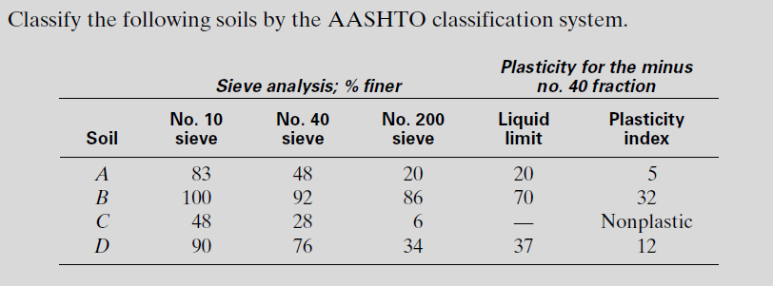
Example

Slide 55
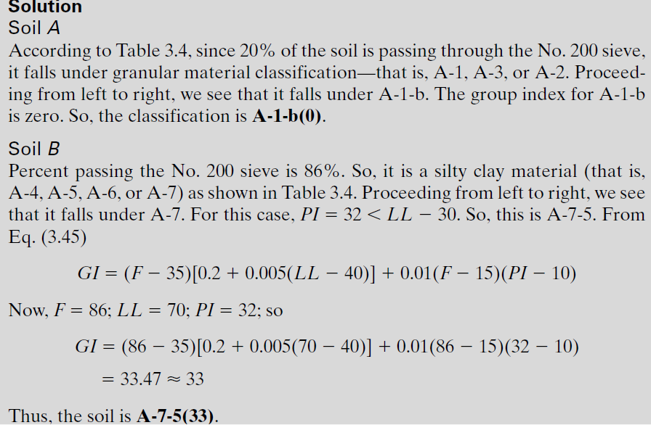

Slide 56
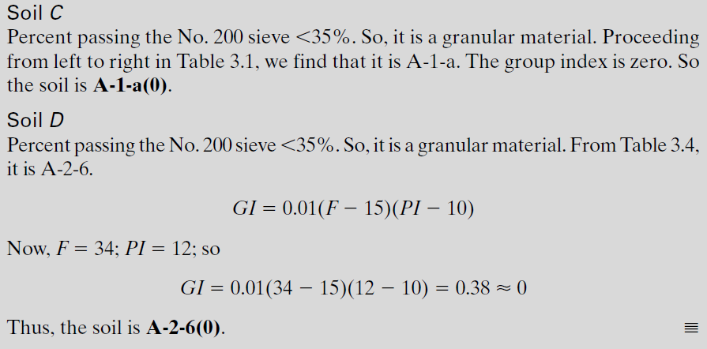

Slide 57
Unified Soil Classification System, USCS
Origin:
The Unified Soil Classification system was first developed by
Professor A. Casagrande in 1942 for the purpose of airfield construction during world War II. Afterwards, it was expended and revised in cooperation with the U.S. Bureau of Reclamation and the U.S. Army Corps of Engineers so that it applies not only to airfields but also to embankments, dams, foundations, and other engineering features. In 1969 the American Society for Testing and Materials (ASTM) adopted the USCS as a standard method for classification for engineering purposes (ASTM Test Designation D-2487).
The USCS is based on the recognition of the type and predominance of the constituents considering grain-size, gradation, plasticity and compressibility. It classifies soils into Four major categories:
Coarse-grained
Fine-grained
Organic soils
Peat

Slide 58
Unified Soil Classification System, USCS
Procedures for Classification:
From sieve analysis and the grain-size distribution curve determine the percent passing as the following:
First, Find % passing # 200.
If 50% or more of the soil passes the # 200 sieve, then conduct Atterberg Limits (LL & PL).
If the soil is fine-grained (≥50% passes #200) follow the guidelines for fine-
grained soils.
If the soil is coarse-grained (<50% passes #200) follow the guidelines for coarse-grained soils: Find % Gravel & Sand, calculate C_{u} & C_{c}, LL, PL &PI

Slide 59
Unified Soil Classification System, USCS
SYMBOLS
Soil symbols:
Liquid limit symbols:
H: High LL (LL>50)
L: Low LL (LL<50)
Gradation symbols:
Well − graded soil
1 < C_{c} < 3 and C_{u} ≥ 4 (for gravels )
1 < C_{c} < 3 and C_{u} ≥ 6
(for sands)
G: Gravel
S: Sand
M: Silt
C:
O:
Pt:
Clay Organic Peat
W: Well-graded
P:
Poorly-graded
GROUP SYMBOLS
The group symbols for coarse-grained gravelly soils are: GW, GP, GM, GC, GC-GM, GW-GM, GW-GC, GP-GM, and GP-GC.
The group symbols for fine-grained soils are: CL, ML, OL, CH, MH, OH, CL-ML, and Pt.
Example:
SW, Well-graded sand
SC, Clayey sand SM, Silty sand, MH, Elastic silt

Slide 60
Unified Soil Classification System, USCS
Plasticity Chart :

Slide 61
Unified Soil Classification System, USCS
Plasticity Chart :

