Slide 1
Chapter 13: Introduction to Analysis of Variance

Slide 2
The Logic and the Process of Analysis of Variance
Chapter 13 presents the general logic and basic formulas for the hypothesis testing procedure known as analysis of variance (ANOVA).
The purpose of ANOVA is much the same as the t tests presented in the preceding three chapters: the goal is to determine whether the mean differences that are obtained for sample data are sufficiently large to justify a conclusion that there are mean differences between the populations from which the samples were obtained.

Slide 3
The Logic and the Process of Analysis of Variance (cont.)
The difference between ANOVA and the t tests is that ANOVA can be used in situations where there are two or more means being compared, whereas the t tests are limited to situations where only two means are involved.
Analysis of variance is necessary to protect researchers from excessive risk of a Type I error in situations where a study is comparing more than two population means.

Slide 4
The Logic and the Process of Analysis of Variance (cont.)
These situations would require a series of several t tests to evaluate all of the mean differences. (Remember, a t test can compare only 2 means at a time.)
Although each t test can be done with a specific α-level (risk of Type I error), the α-levels accumulate over a series of tests so that the final experimentwise α-level can be quite large.

Slide 5
The Logic and the Process of Analysis of Variance (cont.)
ANOVA allows researcher to evaluate all of the mean differences in a single hypothesis test using a single α-level and, thereby, keeps the risk of a Type I error under control no matter how many different means are being compared.
Although ANOVA can be used in a variety of different research situations, this chapter presents only independent-measures designs involving only one independent variable.

Slide 6
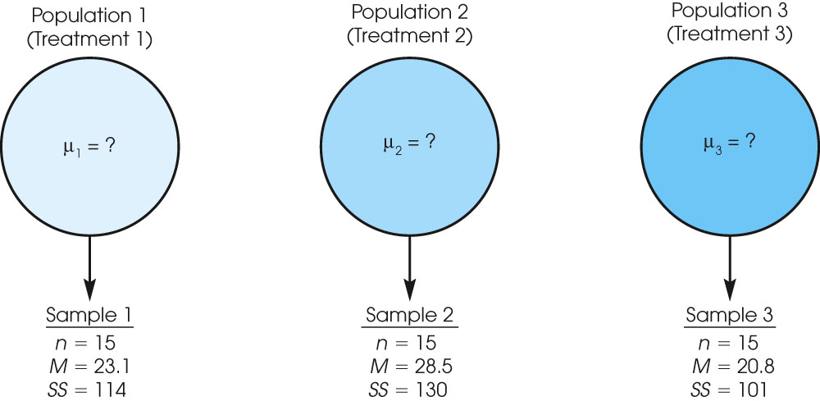
Notes:
Figure 13.2
A typical situation in which ANOVA would be used. Three separate samples are obtained to evaluate the mean differences among three populations (or treatments) with unknown means.

Slide 7
The Logic and the Process of Analysis of Variance (cont.)
The test statistic for ANOVA is an F-ratio, which is a ratio of two sample variances. In the context of ANOVA, the sample variances are called mean squares, or MS values.
The top of the F-ratio MS_{between} measures the size of mean differences between samples. The bottom of the ratio MS_{within} measures the magnitude of differences that would be expected without any treatment effects.

Slide 8
The Logic and the Process of Analysis of Variance (cont.)
Thus, the F-ratio has the same basic structure as the independent-measures t statistic presented in Chapter 10.
obtained mean differences (including treatment effects) MS_{between}
F = ────────────────────────────────────── = ───────
differences expected by chance (without treatment effects) MS_{within}

Slide 9
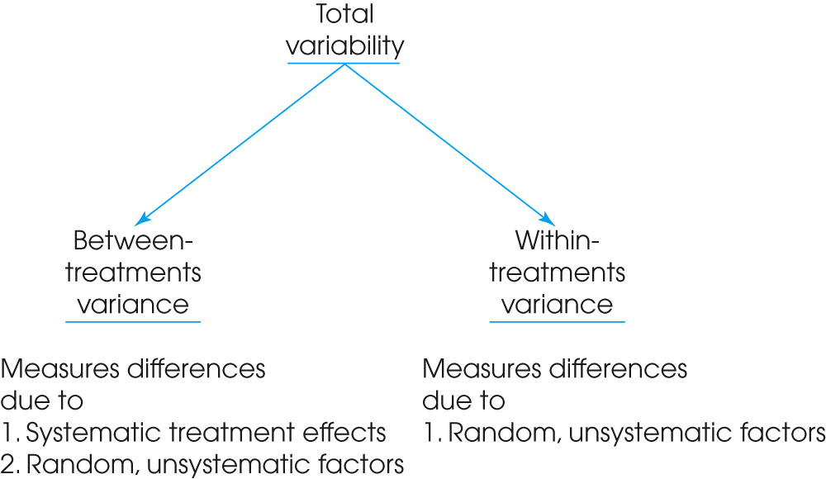
Notes:
Figure 13.4
The independent-measures ANOVA partitions, or analyzes, the total variability into two components: variance between treatments and variance within treatments.

Slide 10
The Logic and the Process of Analysis of Variance (cont.)
A large value for the F-ratio indicates that the obtained sample mean differences are greater than would be expected if the treatments had no effect.
Each of the sample variances, MS values, in the F-ratio is computed using the basic formula for sample variance:
SS
sample variance = MS = ──
df

Slide 11
The Logic and the Process of Analysis of Variance (cont.)
To obtain the SS and df values, you must go through an analysis that separates the total variability for the entire set of data into two basic components: between-treatment variability (which will become the numerator of the F-ratio), and within-treatment variability (which will be the denominator).

Slide 12
The Logic and the Process of Analysis of Variance (cont.)
The two components of the F-ratio can be described as follows:
Between-Treatments Variability: MS_{between} measures the size of the differences between the sample means. For example, suppose that three treatments, each with a sample of n = 5 subjects, have means of M₁ = 1, M₂ = 2, and
M₃ = 3.
Notice that the three means are different; that is, they are variable.

Slide 13
The Logic and the Process of Analysis of Variance (cont.)
By computing the variance for the three means we can measure the size of the differences.
Although it is possible to compute a variance for the set of sample means, it usually is easier to use the total, T, for each sample instead of the mean, and compute variance for the set of T values.

Slide 14
The Logic and the Process of Analysis of Variance (cont.)
Logically, the differences (or variance) between means can be caused by two sources:
Treatment Effects: If the treatments have different effects, this could cause the mean for one treatment to be higher (or lower) than the mean for another treatment.
2. Chance or Sampling Error: If there is no treatment effect at all, you would still expect some differences between samples. Mean differences from one sample to another are an example of random, unsystematic sampling error.

Slide 15
The Logic and the Process of Analysis of Variance (cont.)
Within-Treatments Variability: MS_{within} measures the size of the differences that exist inside each of the samples.
Because all the individuals in a sample receive exactly the same treatment, any differences (or variance) within a sample cannot be caused by different treatments.

Slide 16
The Logic and the Process of Analysis of Variance (cont.)
Thus, these differences are caused by only one source:
1. Chance or Error: The unpredictable differences that exist between individual scores are not caused by any systematic factors and are simply considered to be random chance or error.

Slide 17
The Logic and the Process of Analysis of Variance (cont.)
Considering these sources of variability, the structure of the F-ratio becomes,
treatment effect + chance/error
F = ──────────────────────
chance/error

Slide 18
The Logic and the Process of Analysis of Variance (cont.)
When the null hypothesis is true and there are no differences between treatments, the F-ratio is balanced.
That is, when the "treatment effect" is zero, the top and bottom of the F-ratio are measuring the same variance.
In this case, you should expect an F-ratio near 1.00. When the sample data produce an F-ratio near 1.00, we will conclude that there is no significant treatment effect.

Slide 19
The Logic and the Process of Analysis of Variance (cont.)
On the other hand, a large treatment effect will produce a large value for the F-ratio. Thus, when the sample data produce a large F-ratio we will reject the null hypothesis and conclude that there are significant differences between treatments.
To determine whether an F-ratio is large enough to be significant, you must select an α-level, find the df values for the numerator and denominator of the F-ratio, and consult the F-distribution table to find the critical value.

Slide 20
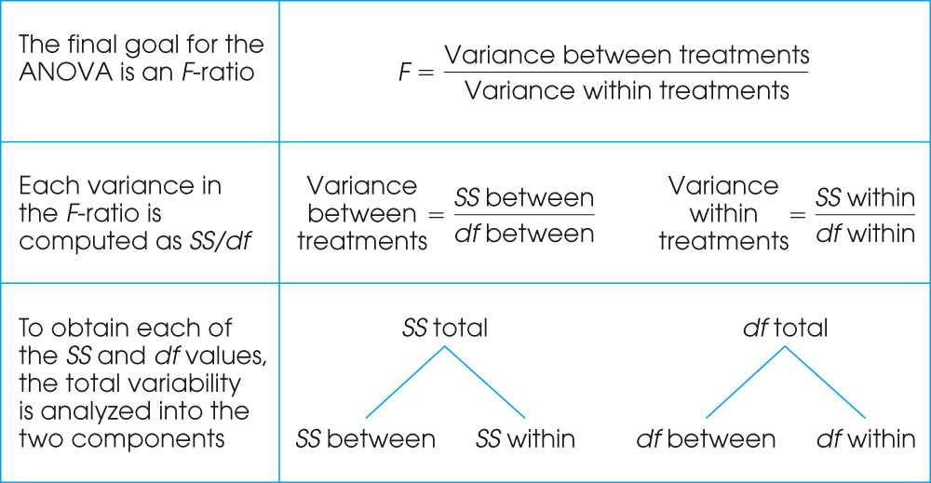
Notes:
Figure 13.5
The structure and sequence of calculations for the ANOVA.

Slide 21
Analysis of Variance and Post Tests
The null hypothesis for ANOVA states that for the general population there are no mean differences among the treatments being compared; H₀: μ₁ = μ₂ = μ₃ = . . .
When the null hypothesis is rejected, the conclusion is that there are significant mean differences.
However, the ANOVA simply establishes that differences exist, it does not indicate exactly which treatments are different.

Slide 22
Analysis of Variance and Post Tests (cont.)
With more than two treatments, this creates a problem. Specifically, you must follow the ANOVA with additional tests, called post tests, to determine exactly which treatments are different and which are not.
The Scheffe test and Tukey=s HSD are examples of post tests.
These tests are done after an ANOVA where H₀ is rejected with more than two treatment conditions. The tests compare the treatments, two at a time, to test the significance of the mean differences.

Slide 23
Measuring Effect Size for an Analysis of Variance
As with other hypothesis tests, an ANOVA evaluates the significance of the sample mean differences; that is, are the differences bigger than would be reasonable to expect just by chance.
With large samples, however, it is possible for relatively small mean differences to be statistically significant.
Thus, the hypothesis test does not necessarily provide information about the actual size of the mean differences.

Slide 24
Measuring Effect Size for an Analysis of Variance (cont.)
To supplement the hypothesis test, it is recommended that you calculate a measure of effect size.
For an analysis of variance the common technique for measuring effect size is to compute the percentage of variance that is accounted for by the treatment effects.

Slide 25
Measuring Effect Size for an Analysis of Variance (cont.)
For the t statistics, this percentage was identified as r², but in the context of ANOVA the percentage is identified as η² (the Greek letter eta, squared).
The formula for computing effect size is:
SS_{between treatments}
η² = ───────────
SS_{total}

Slide 26
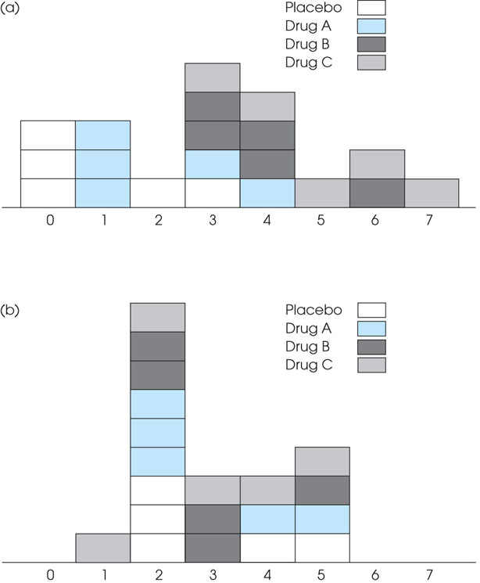
Notes:
Figure 13.10
(a) The four samples from Example 13.1 combined as a single distribution of scores with a mean of M = 3. Note that the treatment effects tend to move the samples away from M = 3 which increases the variability. For these scores, SS = 82. (b) The same four samples after the treatment effects have been removed so that all four samples now have M = 3. For these scores, SS = 32. Removing the treatment effects reduces the variability by 50 points (from SS = 82 to SS = 32).

