Slide 1
ESTABLISHMENT AND MAINTENANCE OF LAWNS
HORT-202
SHAHID IQBAL
Assistant Professor (Horticulture)
College of Agriculture,
University of Sargodha

Slide 2
Lawns
“Green Carpet for the landscape maintained by growing and mowing grasses”
It is heart of a garden
Source of continuing pleasure
Soothing (Calm) to eyes
Consoling to mind
Recreation grounds and playing fields are all planted and maintained as lawns

Slide 3
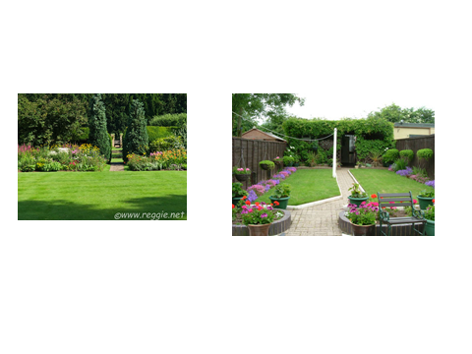
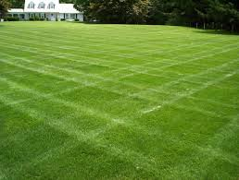
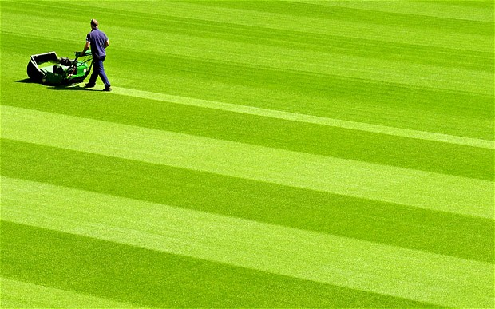
Lawns

Slide 4
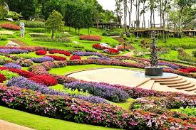
Gardens

Slide 5
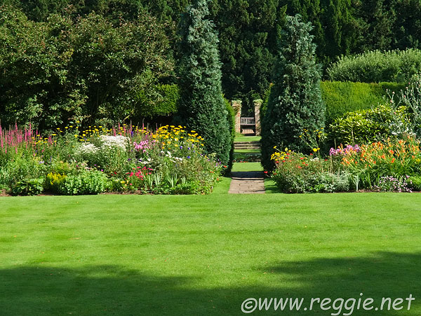
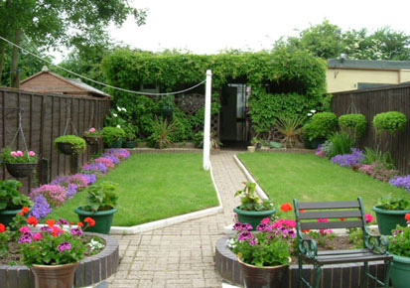

Slide 6
Varieties
Grasses are used in lawn according to soil and climate
In subtropical climate mostly Bermuda grass (Cynodon dactylon)
It grows well in summer, high Temperature and full shine
Very resistance to drought ad high Temperature
But frost damage and windbreak
It develop quickly and need regular mowing.

Slide 7
Varieties
Tifway
Tifton
Tifdwarf
Tifgreen
Dhaka

Slide 8
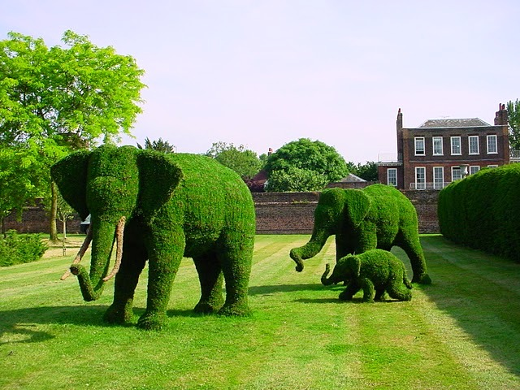
Topiary

Slide 9
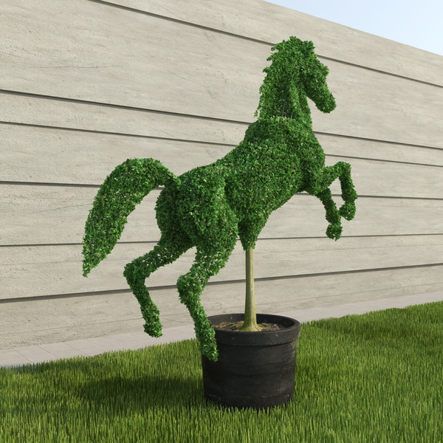

Slide 11
Establishment of new Lawn
Preparation of Land
Land used for lawn is thoroughly dug up and deeply plough many times
All debris, rubbish and stones should be removed
Land should be level
Then irrigate the land to check the level
Minor depressions and irregularities corrected

Slide 12
Land is again ploughed and mixed FYM 1Ton/ 100 sq m
Super phosphate 10-12.5 KG/ 10 sq m
Ammonium sulphate 5 KG/ 10 sq m
Broadcasted and properly mixed
Taking care final leveling is not disturb
Leveling is important step in establishing a lawn

Slide 13
Time of Planting
Best time is July at the beginning of rainy season before the onset of winter
Planting may be done in March-April
There should be shortage of water

Slide 14
Planting Methods
Sprigging
Sodding or turfing
Seeding

Slide 15
Sprigging
Economical and commonly used method in Pakistan
Sprigs of well-grown grass are taken from any established lawn or grass nursery
Cluster of 3-5 springs are planted at a distance of 10-15 cm each way
In this case grass of 1 sq m is enough to plant 15 sq m lawn
Irrigation is given immediately after planting

Slide 16
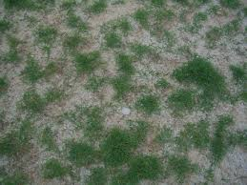

Slide 17
SODDING
Costly and is applied to achieved immediate results
Blocks of suitable size are cut from grass-nursery lawns and removed along with 3.5-5 cm of soil
Blocks are set together on the prepared soil in the same fashion as flooring is done with tiles
Pressed the blocks down so that they do not float when irrigated

Slide 18
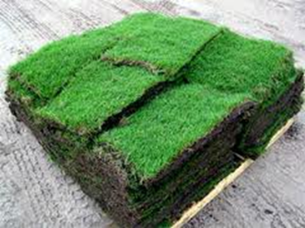
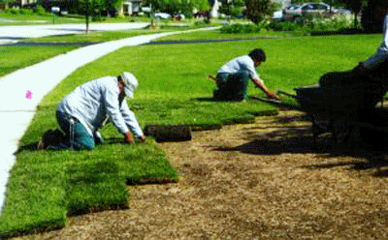
Sodding

Slide 19
SEEDING
For seeding bed is prepared as other crops
Ideal seedbed does not show deep footprint
Surface of bed is crumbly
Best time of seeding early summer
For 1000 sq m of lawn, 2-3 kg seed is sufficient
Seed is sown on plot which finally prepared

Slide 20
At sowing plot should be slightly moist- neither dry nor wet
Plot is divided 2-3 m width and seed also divided into same number of lots
Seed is mixed with ample of sand and broadcast evenly in plots
Half seed sown in east-west
Other half north-south
So that no gaps are left
Seed is covered with 0.5 cm layer of leaf mold
After seed sowing light weight roller is run over the field and plots are irrigated, preferably light sprinklers are used for this purpose
Field must be kept moist until the seed germinates in two to three weeks

Slide 21
Maintenance of Lawn
Rolling
After first irrigation, when soil is moist,
Then lawn is rolled with medium weight roller
Rolling is carried out after each irrigation until the lawn established

Slide 22
Mowing
Removal of grass or turf is called mowing
First moving is delayed until swards have grown 10-15 cm height
First cutting is preferable done with sickle
After first cutting is done with lawn mover
Second cutting is done when swards are about 5 cm tall
Close mowing is not recommended
Mower should set at 12 mm and should have a grass catcher so that cut grass does not fall on lawn

Slide 23
Weeding
FYM and Irrigation canal water have weed seeds
Two approaches to keeping lawn free from weed seeds
A) Weed inhibiting practices
B) Weed eradication practices

Slide 24
A) Weed inhibiting practices
Application of fertilizer instead of compost or FYM
Occasional sprinkling and raking so that weeds are uprooted and raked out
Controlling earth worms and other pests

Slide 25
Weed Eradication
Application of agro chemicals
Weedicides/herbicides

Slide 26
Irrigation
Bermuda grass is fast growing and need frequent watering for healthy and beautiful appearance
If irrigation is delayed then grass becomes course and looks shabby
During summer, irrigation is needed frequently (5-7 days interval)
But during winter irrigation intervals are longer period
Lawn sprinklers are very useful for lawn irrigation

Slide 27
Fertilizer
2.5 kg ammonium sulphate for each 100 sq meter of lawn
In the beginning of spring and then after the rainy season

Slide 28
Aeration
Unlike other agri. Crop lawns are not hoed
Aeration however, must be provided to the roots once a year
In the fall, after a close mowing, lawns are rolled with peg/prick rollers
Pegs or pricks are penetrate the soil to a a depth of about 1 cm
Super phosphate is also applied in peg holes
Aeration shold be followed by irrigation

Slide 29
Thatching
Bermuda grass spread on surface by means of stolons
Stolons make roots at each joints so that after few months the whole lawn surface is covered by thick mat of stolons and looks coarse and whitish
To remedy this situation, lawns are scraped once a year
Best time is beginning rainy season
After it well rotted FYM @ 500kg/sq m
Ammonium sulphate 2.5 kg/sq m

