Slide 1
Web System and Technologies (WST)
HTML
CSS
JavaScript
PHP
Bootstrap
Ajax

Slide 2
JavaScript Course Overview
Basics and Fundamentals
Syntax and Features
Client Side Validation
GUI Visual Effects
May be more…..

Slide 3
What is JavaScript?
Dynamic computer programming language
Introduced by Brendan Eich in 1995
Event driven/event handling language
Case sensitive
Loosely-typed language
No need to tell data type
Automatically recognize data and set data type
Already defined in web browsers
JavaScript was first known as LiveScript, but Netscape changed its name to JavaScript

Slide 4
Advantages of JavaScript
Less server interaction
Immediate feedback to the visitors/users
Increased interactivity
Richer interface

Slide 5
Limitations of JavaScript
Client Side JavaScript Does not allow the reading or writing of files
No support for networking applications
It does not have any multithreading or multiprocessing capabilities

Slide 6
JavaScript Frameworks

Slide 7
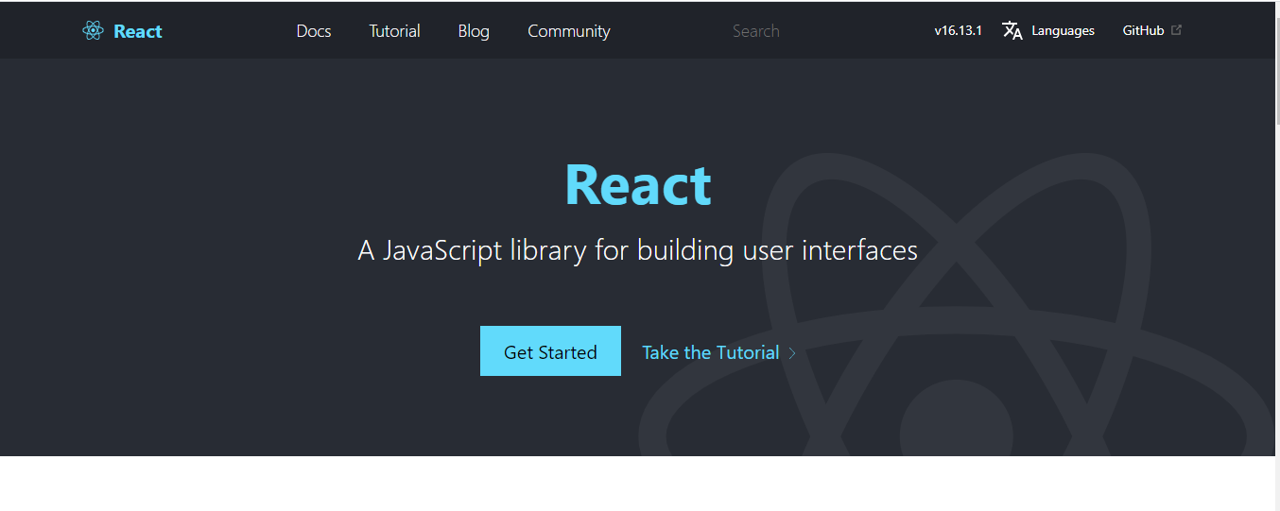
JavaScript Frameworks

Slide 8
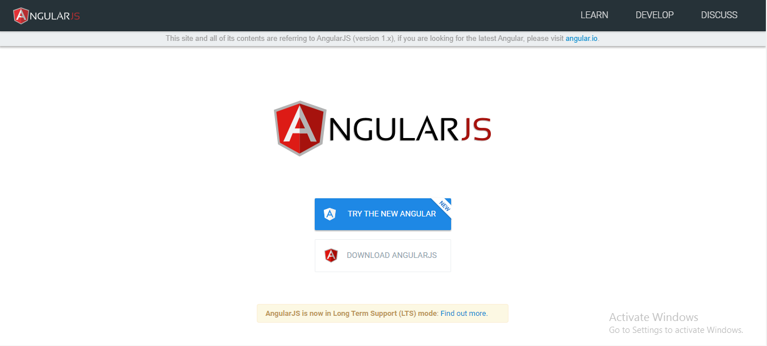
JavaScript Frameworks

Slide 9
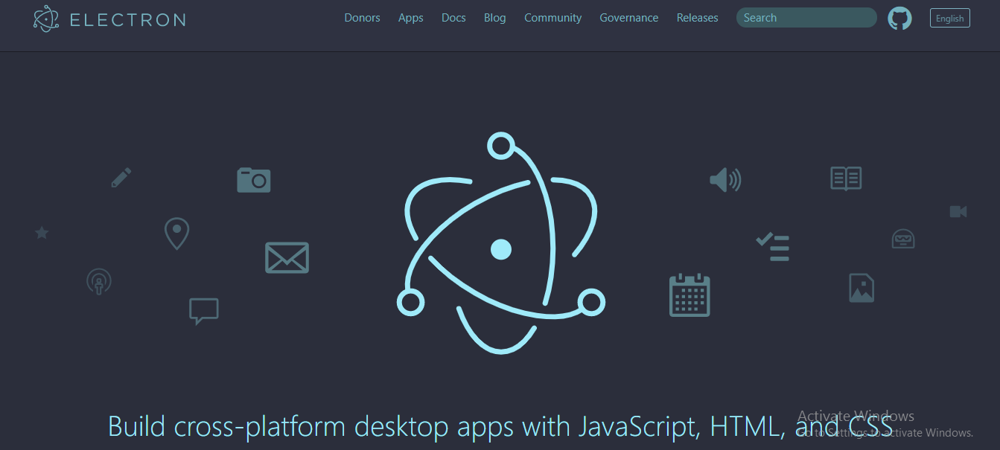
JavaScript Frameworks

Slide 10
JavaScript Syntax
<script ...> JavaScript code </script>
The script tag takes two important attributes:
Language
Type

