Slide 1
Introduction to PR
Instructor
Amara Saeed

Slide 2
DEFINITION
Public relations (PR) is the practice of deliberately managing the release and spread of information between an individual or an organization (such as a business, government agency, or a nonprofit organization) and the public.

Slide 4
What is trend analysis?
Trend analysis gives you the ability to take a look at data over time for a long-running survey. It can be useful for comparing product.

Slide 6
Activities aimed at reducing a firms risk of failure.

Slide 7
What is public relations?
The Public Relations Society of America (PRSA) defines public relations as “a strategic communication process that builds mutually beneficial relationships between organizations and their publics” (2016, para. 4).

Slide 8
EXAMPLES
Public relations materials include press releases, publicity, and news conferences. Companies also use PR to promote products and to supplement their sales efforts.

Slide 9
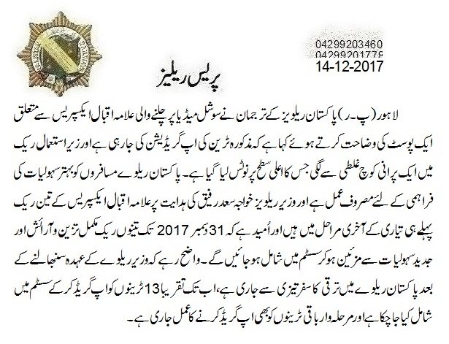
Press Release

Slide 10
News conferences

Slide 11
Objective Of Public Relations

Slide 12
The main objective of public relations is to maintain a positive reputation of the brand and maintain a strategic relationship with the public, prospective customers, partners, investors, employees and other stakeholders which leads to a positive image of the brand and makes it seem honest, successful, important, and relevant.

Slide 13
What Is Brand Image?
A simple definition of brand image could be – the customers’ perception of the brand based on their interactions and experience with the brand or their beliefs of what the brand could be.

Slide 15
Building Product Awareness:
When introducing a new product or re-launching an existing product, marketers can use a public relation element that generates consumer attention and awareness through media placements and special events.

Slide 16
Creating Interest:
Knowing the audience properly
“What are their interests?”, “What issues do they face?” and “What differentiates your product from the competition?”.

Slide 17
Providing Information
PR can be used to provide customers with more in depth information about products and services. Through articles, collateral materials, newsletters and websites, PR delivers information to customers that can help them gain understanding of the product.

Slide 18
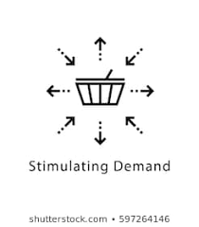
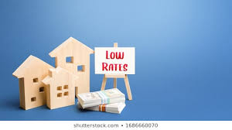
Stimulating Demand
A positive article in a newspaper, on a TV news show or mentioned on the Internet, often results in a discernible increase in product sales.

Slide 19
Reinforcing the Brand
In many companies the public relations function is also involved with brand reinforcement by maintaining positive relationships with key audiences, and thereby aiding in building a strong image.

