Slide 1
Islamic calligraphy
Islamic calligraphy is the artistic practice of handwriting and calligraphy, in the languages which use Arabic alphabet or the alphabets derived from it. It includes Arabic, Persian, Ottoman, Afghan, Pakistan and Indian calligraphy. It is known in Arabic as khatt Arabi , which translates into Arabic line, design, or construction.
Islamic calligraphy developed from two major styles: Kufic and Naskh. There are several variations of each, as well as regionally specific styles.
Instruments and media
The traditional instrument of the Islamic calligrapher is the qalam, a pen normally made of dried reed or bamboo. The ink is often in color and chosen so that its intensity can vary greatly, creating dynamism and movement in the letter forms. Some styles are often written using a metallic-tip pen.

Slide 2
Islamic calligraphy can be applied to a wide range of decorative mediums other than paper, such as tiles, vessels, carpets, and stone.
Arabic calligraphic cursive styles:
kufic
Naskh
Nasta‘liq
Diwani
Thuluth
Reqa
kufic
Kufic is the oldest form of the Arabic script. The style emphasizes rigid and angular strokes, which appears as a modified form of the old Nabataean script.
Common varieties include square Kufic, a technique known as banna‘.Contemporary calligraphy using this style is also popular in modern decorations.

Slide 3
Thuluth was developed during the 10th century and later refined by Ahmad Tayyib Shah. Letters in this script have long vertical lines with broad spacing. The name, meaning "third," is in reference to the x-height, which is one-third of the 'alif.
Reqa is a handwriting style derived from Naskh and thuluth, first appeared in the 10th century. The shape is simple with short strokes and small flourishes.

Slide 4
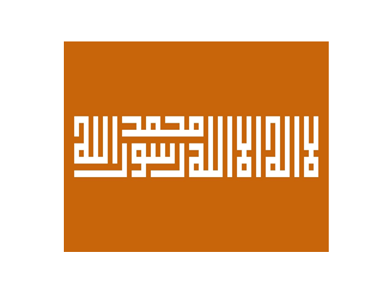
Square kufic

Slide 5
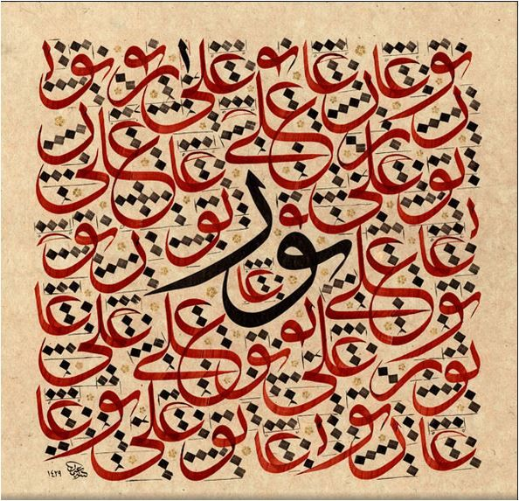
Tuluth calligraphy

