Slide 1
Idealism BS Education-III Philosophy of Education (EDU-203)
Department of Education University of Sargodha

Slide 2
Submitted by :
Hamda Nasir BEDF19E009
Saba Qasim BEDF19E019
Afsah Riaz BEDF19E042
Session :
2019 - 2023
Semester:
BS 3 Self Support
Course :
Philosophy of Education
Topic :
Idealism

Slide 3
Content Page:
What is Philosophy ?
Major schools of Philosophy
Proponent of Idealism
What is Idealism
Metaphysics
Epistemology
Axiology

Slide 4
What is Philosophy:
“Philosophy is concered with everything as a universal science”
Herbert Spencer
“Philosophy is essentially a spirit or method of approaching experience rather than a body of conclusion and results.”
Edgar S Bright man

Slide 5
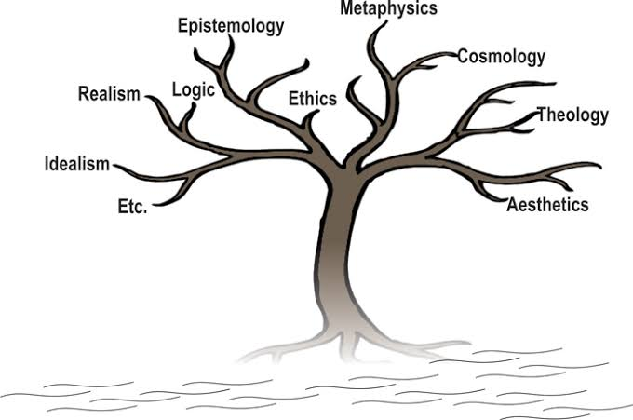
Major Schools of Philosophy:
At the metaphysical level, there are four broad philosophical schools of thought that apply to education today. They are
Idealism
Realism
Pragmatism (sometimes called experientialism)
Existentialism

Slide 6
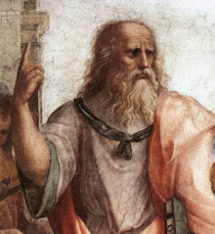
Proponent of Idealism :
What is a proponent:
“A person who puts forward a proposition
or proposal. a person who argues in
favor of something; an advocate.
a person who supports a cause or doctrine; adherent.”
Plato is considered by many to be the most important philosopher who ever lived. He is known as the father of idealism in philosophy. His ideas were elitist, with the philosopher king the ideal ruler. Plato is perhaps best known to college students for his parable of a cave, which appears in Plato's Republic

Slide 7
What is Idealism?
Idealism is the metaphysical view that associates
reality to ideas in the mind rather than to
material objects. It lays emphasis on the mental
or spiritual components of experience, and
renounces the notion of material existence.
In philosophy, idealism is a diverse group of metaphysical views which all assert that "reality" is in some way indistinguishable or inseparable from human perception and/or understanding, that it is in some sense mentally constituted, or that it is otherwise closely connected to ideas

Slide 8
Metaphysics of Idealism:
Metaphysical idealism is an ontological doctrine that holds that reality itself is incorporeal or experiential at its core. ... Objective idealists make claims about a transempirical world, but simply deny that this world is essentially divorced from or ontologically prior to the mental.
In its metaphysics, idealism is thus directly opposed to materialism—the view that the basic substance of the world is matter and that it is known primarily through and as material forms and processes.

Slide 9
Epistemology of Idealism:
Epistemological idealism is a subjectivist position in epistemology that holds that what one knows about an object exists only in one's mind. It is opposed to epistemological realism.
In its epistemology, it is opposed to realism, which holds that in human knowledge objects are grasped and seen as they really are—in their existence outside and independently of the mind.

Slide 10
Axiology of Idealism:
Values are real existents.
Evil is not real existent.
The values of human life are what they are largely because there are individual persons to possess and enjoy them
The individual person can realise value by actively relating parts and wholes.

Slide 11
Link:
https://en.m.wikipedia.org/wiki/User:WikiCleanerBot
Idealism Philosophy Written By:
(Daniel Sommer Robinson Professor and Director, School of Philosophy, University of Southern California, Los Angeles, 1946–54. Author of Royce and Hocking: American Idealists and others. Last Updated: Nov 1, 2020 )
Idealism:
(Stanford Encyclopedia of Philosophy)
Introduction to Philosophy:
By Philip A. Pecorino
Platonic Idealist:
By Tom. Reding

