Slide 1
Flyweight Design Pattern

Slide 2
contents
What is Flyweight design pattern?
Intent
Examples
Problems
Applicability
Structure

Slide 3
Flyweight Design Pattern
Pattern Name
flyweight Design Pattern
Intent
Mostly used when we want to create large number of similar objects.
Flyweight pattern is primarily used to reduce the number of objects created and to decrease memory requirements.

Slide 4
Example
Cache
Triangle
5000
7000
9000

Slide 5
Problem
reduces the number of objects created by introducing the concept of sharing the objects that are similar instead of creating new one.

Slide 6
Applicability
When we want to create large number of similar objects.

Slide 7
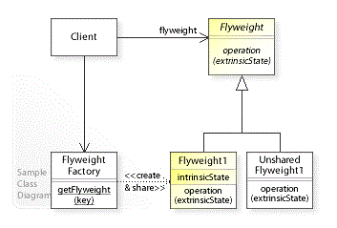
Structure
In the UML class diagram, the Client class refers (1) to the FlyweightFactory class to create/share Flyweight objects and (2) to the Flyweight interface to perform an operation by passing in extrinsic (variant) state (flyweight.operation(extrinsicState)). The Flyweight1 class implements the Flyweight interface and stores intrinsic (invariant) state that can be shared.
Notes:
intrinsic constant stored in memory
Extrinsic not constant and needs to be calculated on fly therefor not stored in memory

Slide 8
Consequences
Flyweights may introduce run-time costs associated with transferring, finding, and/or computing extrinsic state, especially if it was formerly stored as intrinsic state.
However, such costs are offset by space savings, which increase as more flyweights are shared.
The Flyweight pattern is often combined with the Composite (183) pattern to implement a logically hierarchical structure in terms of a directed-acyclic graph with shared leaf nodes.
It's often best to implement State and Strategy objects as flyweights.

