Slide 1
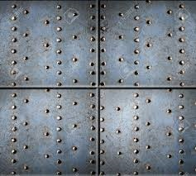
Riveted Joints

Slide 2
Rivet

Slide 3
Method of Riveting

Slide 4
Method of Riveting

Slide 5
Method of Riveting

Slide 7
Rivet heads for general purpose

Slide 9
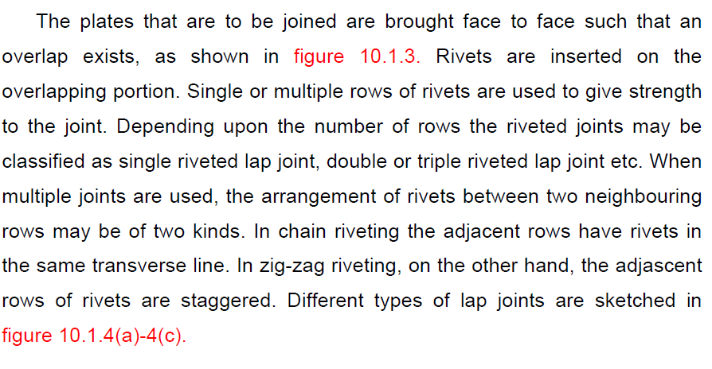
Type of riveted joint
Lap Joint

Slide 10
Lap joint

Slide 12
Types of Riveted joints
Butt joint

Slide 13
Butt joint

Slide 14
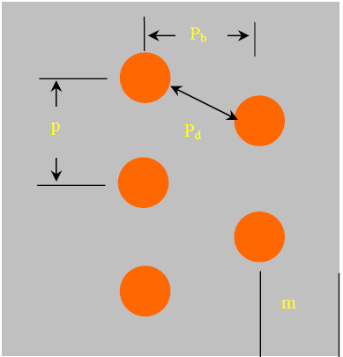

Slide 15
Failure of rivet joints

Slide 16
Failures of rivets

Slide 17
Shearing of rivets
3. Shearing of the rivets. The plates which are connected by the rivets exert tensile stress on the rivets, and if the rivets are unable to resist the stress, they are sheared off as shown in Fig. 9.15.It may be noted that the rivets are in *single shear in a lap joint and in a single cover butt joint,as shown in Fig. 9.15. But the rivets are in double shear in a double cover butt joint as shown in Fig 9.16. The resistance offered by a rivet to be sheared off is known as shearing resistance or shearing strength or shearing value of the rivet.

Slide 19
Crushing of plate & rivets

Slide 20
Strength of Rivet
The strength of a joint may be defined as the maximum force, which it can transmit, without causing it to fail. We have seen in Art. 9.12 that Pt, Ps and Pc are the pulls required to tear off the plate, shearing off the rivet and crushing off the rivet. A little consideration will show that if we go on increasing the pull on a riveted joint, it will fail when the least of these three pulls is reached, because a higher value of the other pulls will never reach since the joint has failed, either by tearing off the plate, shearing off the rivet or crushing off the rivet.
If the joint is continuous as in case of boilers, the strength is calculated per pitch length. But if the joint is small, the strength is calculated for the whole length of the plate.

Slide 21
Efficiency
The efficiency of a riveted joint is defined as the ratio of the strength of riveted joint to the strength of the un-riveted or solid plate.
We have already discussed that strength of the riveted joint
= Least of Pt, Ps and Pc
Strength of the un-riveted or solid plate per pitch length,
P = p × t × σt

