Slide 1
What is Class Diagram?

Slide 3
What is class?
A class diagram in the Unified Modeling Language (UML) is a type of static structure diagram that describes the structure of a system by showing the system's classes, their attributes, operations (or methods), and the relationships among objects.

Slide 4
Example of a class

Slide 5
What is a Class?
A description of a group of objects all with similar roles in the system, which consists of:
Structural features (attributes) define what objects of the class "know"
Represent the state of an object of the class
Are descriptions of the structural or static features of a class
Behavioral features (operations) define what objects of the class "can do"
Define the way in which objects may interact
Operations are descriptions of behavioral or dynamic features of a class

Slide 6
What is a Class?
A UML class diagram is made up of:
A set of classes and
A set of relationships between classes

Slide 7
Class Notation
A class represent a concept which encapsulates state (attributes) and behavior (operations). Each attribute has a type. Each operation has a signature. The class name is the only mandatory information.

Slide 8
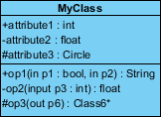
Class Notation
A class notation consists of three parts:
Class Name
The name of the class appears in the first partition.
Class Attributes
Attributes are shown in the second partition.
The attribute type is shown after the colon.
Attributes map onto member variables (data members) in code.
Class Operations (Methods)
Operations are shown in the third partition. They are services the class provides.
The return type of a method is shown after the colon at the end of the method signature.
The return type of method parameters is shown after the colon following the parameter name.
Operations map onto class methods in code

Slide 9
Class Notation

Slide 10
Class Notation
The graphical representation of the class - MyClass as shown above:
MyClass has 3 attributes and 3 operations
Parameter p3 of op2 is of type int
op2 returns a float
op3 returns a pointer (denoted by a *) to Class6

Slide 11
Class Relationships
A class may be involved in one or more relationships with other classes.
A relationship can be one of the following types:
(Refer to the figure on the right for the graphical representation of relationships).

Slide 12
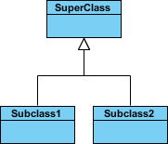
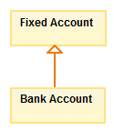
Class Relationships
Relationship Type
Inheritance (or Generalization):
Represents an "is-a" relationship.
An abstract class name is shown in italics.
SubClass1 and SubClass2 are specializations of Super Class.
A solid line with a hollow arrowhead that point from the child to the parent class
Graphical Representation

Slide 13
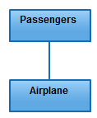
Class Relationships
Relationship Type
Simple Association:
A structural link between two peer classes.
There is an association between Class1 and Class2
A solid line connecting two classes
Graphical Representation

Slide 14
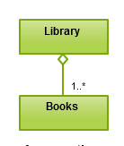
Class Relationships
Relationship Type
Aggregation:
A special type of association. It represents a "part of" relationship.
Class2 is part of Class1.
Many instances (denoted by the *) of Class2 can be associated with Class1.
Objects of Class1 and Class2 have separate lifetimes.
A solid line with an unfilled diamond at the association end connected to the class of composite
Graphical Representation

Slide 15
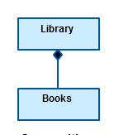
Class Relationships
Relationship Type
Composition:
A special type of aggregation where parts are destroyed when the whole is destroyed.
Objects of Class2 live and die with Class1.
Class2 cannot stand by itself.
A solid line with a filled diamond at the association connected to the class of composite
Graphical Representation

Slide 16
Class Relationships
Relationship Type
Dependency:
Exists between two classes if the changes to the definition of one may cause changes to the other (but not the other way around).
Class1 depends on Class2
A dashed line with an open arrow
Graphical Representation

Slide 17
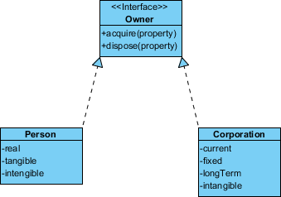
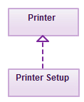
Class Relationships
Relationship type
Realization is a relationship between the blueprint class and the object containing its respective implementation level details.
This object is said to realize the blueprint class. In other words, you can understand this as the relationship between the interface and the implementing class.
For example, the Owner interface might specify methods for acquiring property and disposing of property. The Person and Corporation classes need to implement these methods, possibly in very different ways.
Graphical Representation

Slide 18
Relationship Names
Names of relationships are written in the middle of the association line.
Good relation names make sense when you read them out loud:
"Every spreadsheet contains some number of cells",
"an expression evaluates to a value"
They often have a small arrowhead to show the direction in which direction to read the relationship, e.g., expressions evaluate to values, but values do not evaluate to expressions.

Slide 19
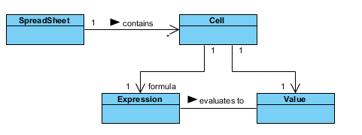
Relationship Names

Slide 20
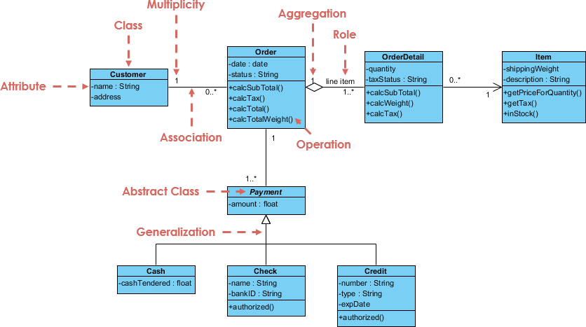
Class Diagram Example: Order System

Slide 21
Navigability
The arrows indicate whether, given one instance participating in a relationship, it is possible to determine the instances of the other class that are related to it.

Slide 22
Visibility of Class attributes and Operations
In object-oriented design, there is a notation of visibility for attributes and operations.
UML identifies four types of visibility: public, protected, private, and package.
The +, -, # and ~ symbols before an attribute and operation name in a class denote the visibility of the attribute and operation.
+ denotes public attributes or operations
- denotes private attributes or operations
# denotes protected attributes or operations
~ denotes package attributes or operations

Slide 23
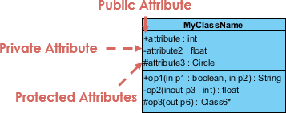
Visibility of Class attributes and Operations

Slide 24
Class Visibility Example
In the example above:
attribute1 and op1 of MyClassName are public
attribute3 and op3 are protected.
attribute2 and op2 are private.

Slide 25
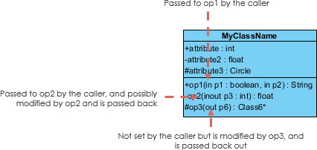
Parameter Directionality
Each parameter in an operation (method) may be denoted as in, out or inout which specifies its direction with respect to the caller. This directionality is shown before the parameter name.

Slide 26
Multiplicity
How many objects of each class take part in the relationships and multiplicity can be expressed as:
Exactly one - 1
Zero or one - 0..1
Many - 0..* or *
One or more - 1..*
Exact Number - e.g. 3..4 or 6
Or a complex relationship - e.g. 0..1, 3..4, 6.* would mean any number of objects other than 2 or 5

Slide 27
Multiplicity Example
Requirement: A Student can take many Courses and many Students can be enrolled in one Course.
In the example below, the class diagram (on the left), describes the statement of the requirement above for the static model while the object diagram (on the right) shows the snapshot (an instance of the class diagram) of the course enrollment for the courses Software Engineering and Database Management respectively)

Slide 28
Multiplicity Example

Slide 29
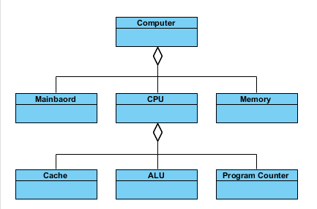
Aggregation Example- Computer and parts
An aggregation is a special case of association denoting a "consists-of" hierarchy
The aggregate is the parent class, the components are the children classes

Slide 30
Inheritance Example - Cell Taxonomy
Inheritance is another special case of an association denoting a "kind-of" hierarchy
Inheritance simplifies the analysis model by introducing a taxonomy
The child classes inherit the attributes and operations of the parent class.

Slide 31
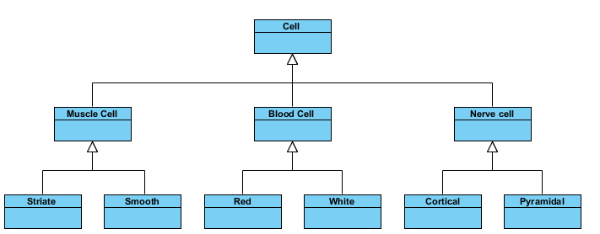
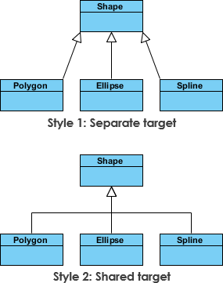
Inheritance Example - Cell Taxonomy

Slide 32
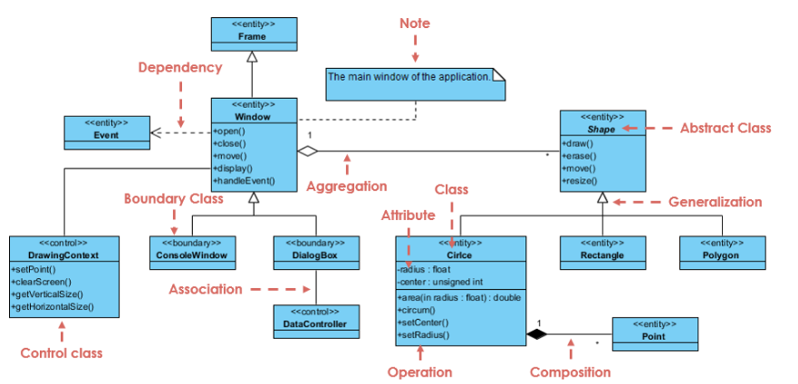
Class Diagram - Diagram Tool Example
A class diagram may also have notes attached to classes or relationships. Notes are shown in grey.

Slide 33
Class Diagram - Diagram Tool Example
In this example:
We can interpret the meaning of the above class diagram by reading through the points as following.
Shape is an abstract class. It is shown in Italics.
Shape is a superclass. Circle, Rectangle and Polygon are derived from Shape. In other words, a Circle is-a Shape. This is a generalization / inheritance relationship.
There is an association between DialogBox and DataController.
Shape is part-of Window. This is an aggregation relationship. Shape can exist without Window.
Point is part-of Circle. This is a composition relationship. Point cannot exist without a Circle.
Window is dependent on Event. However, Event is not dependent on Window.
The attributes of Circle are radius and center. This is an entity class.
The method names of Circle are area(), circum(), setCenter() and setRadius().
The parameter radius in Circle is an in parameter of type float.
The method area() of class Circle returns a value of type double.
The attributes and method names of Rectangle are hidden. Some other classes in the diagram also have their attributes and method names hidden.

Slide 34
Dealing with Complex System - Multiple or Single Class Diagram?
Inevitably, if you are modeling a large system or a large business area, there will be numerous entities you must consider. Should we use multiple or a single class diagram for modeling the problem? The answer is:
Instead of modeling every entity and its relationships on a single class diagram, it is better to use multiple class diagrams.
Dividing a system into multiple class diagrams makes the system easier to understand, especially if each diagram is a graphical representation of a specific part of the system.

Slide 35
Perspectives of Class Diagram in Software Development Lifecycle
We can use class diagrams in different development phases of a software development lifecycle and typically by modeling class diagrams in three different perspectives (levels of detail) progressively as we move forward:
Conceptual perspective: The diagrams are interpreted as describing things in the real world. Thus, if you take the conceptual perspective you draw a diagram that represents the concepts in the domain under study. These concepts will naturally relate to the classes that implement them. The conceptual perspective is considered language-independent.

Slide 36
Perspectives of Class Diagram in Software Development Lifecycle
Specification perspective: The diagrams are interpreted as describing software abstractions or components with specifications and interfaces but with no commitment to a particular implementation. Thus, if you take the specification perspective we are looking at the interfaces of the software, not the implementation.
Implementation perspective: The diagrams are interpreted as describing software implementations in a particular technology and language. Thus, if you take the implementation perspective we are looking at the software implementation.

Slide 37
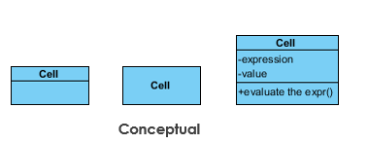
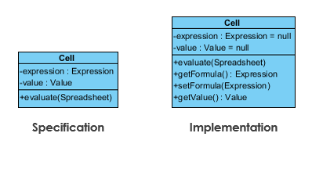
Perspectives of Class Diagram in Software Development Lifecycle

