Slide 1
Introduction to ICT
Software
Types of Software
Difference between system and application software
Operating Systems
Types of Operating systems
Utility programs

Slide 2
Software
A set of instructions given to the computer to solve a program is called software.
It is also known as program.
A computer works according to the instructions written in software.

Slide 3
Types of Software
Two main types of software are
System software
Application software
System software is set of programs to control and manage the actual operations of a computer hardware by
Controlling the usage and allocation of hardware resources.
Enabling application programs to execute properly.
Systems software carries out middleman tasks to ensure communication between other software and hardware.

Slide 4
System Software
Two main types of system software are
Operating system
Utility programs
Operating system is a software that communicates with the hardware and allows other software to run.
Utility program is a software that is used for effective management of computer system, it keeps the computer system running smoothly.

Slide 5
Application software
Application software is a program or group of programs designed for end users.
People use application software according to their needs.
Examples of an application include a word processor, a spreadsheet, a web browser, a media player or a photo editor.

Slide 6
Difference between system and application software

Slide 7
Operating System
An operating system (OS) is a set of programs that manages all computer components and operations.
Users interact with computer through operating systems.
Operating systems must be installed on every computer, a computer can do nothing without an operating system.
Some examples are Windows, Linux, Unix and Mac OS.

Slide 8
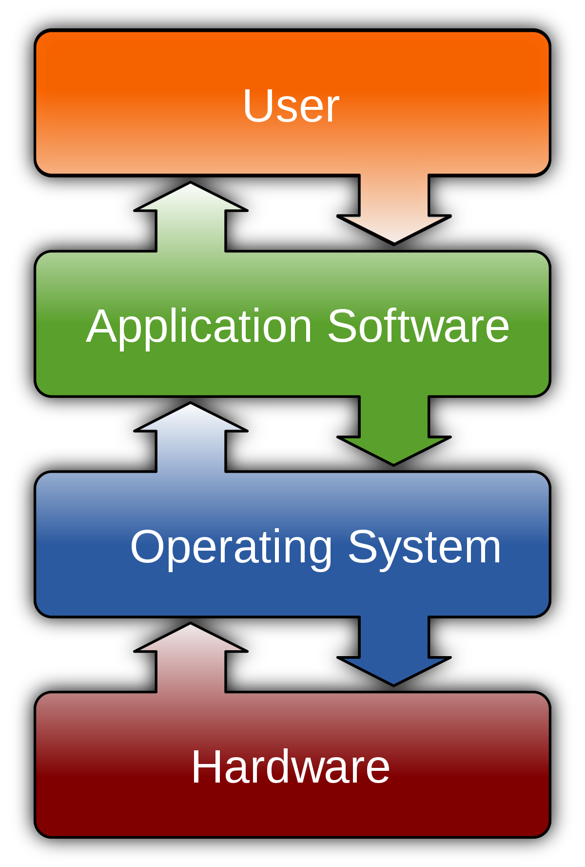
Operating System
When a computer is turned on, the OS runs and checks that all parts of computer are functioning properly.

Slide 9
Operating System
Multiuser operating system
It allows multiple users to use same computer at same time e.g. Linux, Unix and Windows server 2008.
Multiprocessor operating system
It supports two or more processors running programs at the same time e.g. Linux, Unix and Windows server 2008.

Slide 10
Operating System
Multitasking operating system
It can execute more than one programs at the same time e.g. Unix and windows 8.1
Time sharing operating system
It allows many users to share the computer simultaneously. It is used when several users are linked through communication networks to a single computer.

Slide 11
Functions of Operating System
An OS performs following functions
Booting
A process of starting or restarting the computer.
Memory management
A process of optimizing the use of main memory.
Job scheduling
Any operation managed by processor is called job. An OS determines the order in which these jobs are processed.

Slide 12
Functions of Operating System
Device controlling
OS controls all devices attached to the computer.
Accessing the web
OS provides the facility to connect to the web.
Monitoring performance
OS checks and reports information about different system resources and devices.

Slide 13
Functions of Operating System
Housekeeping services
OS performs different functions related to storage and file management by using a special program “File manager”. These functions include
Formatting and copying disks
Displaying a list of files on a storage medium
Checking the amount of used or free space on a storage medium
Organizing, copying, renaming, deleting, moving and sorting files
Creating shortcuts

Slide 14
Functions of Operating System
Administrating security
OS manages the security of computer system as well as data and programs stored on it.
Providing user interface
User interface Is used to interact with the computer. UI controls how you enter data and instructions and how information is displayed on the screen.

Slide 15
Types of operating systems
Different types of operating system are as follows
Stand alone operating systems
Server operating systems
Mobile operating systems

Slide 16
Types of operating systems
A stand alone operating system works on a desktop or laptop computer.
Some stand alone operating systems can work with a server operating system and are called client operating system.
Some examples are DOS, Windows, Unix, Linux and Mac OS.
Windows is the most widely used OS developed by Microsoft.

Slide 17
Types of operating systems
A server operating system is an operating system that is designed to support a network.
It is also called network operating system.
It usually resides on a server and client computers on the network depend on the server for resources.
Some examples are Windows Server 2012, OS X Server, Sun Solaris, NetWare,

Slide 18
Types of operating systems
Mobile operating system is an operating system that is used in handheld computers and mobile devices.
It provides graphical user interface (GUI) and other features such as touch screen support, navigation systems, speech recognition, wireless connectivity etc.
Some examples are Android, iOS, Windows phone and BlackBerry.

Slide 19
Utility Programs
Utility program is a software that is used for effective management of computer system.
It keeps the computer system running smoothly.
Users can use utility programs to perform maintenance tasks related to different devices and programs.
Most operating systems include different built-in utility programs.

Slide 20
Types of Utility Programs
Different types of utility programs are
Antivirus
It is an application that is certain to be installed on every operating system, especially in the operating system Windows. Because without Anivirus, the operating system will be very high risk of loss or damage to a number of data and theft of sensitive data can occur with all hacking techniques.
Examples of popular antivirus applications such as Avast, SmAdav, AVG, BitDevender, and so forth. The variants of antivirus are also varied, some are paid and some are free.

Slide 21
Types of Utility Programs
Archivers and Data Compression
Software that can make a file into an archive and can also reduce or compress its size.
An example is when you have 80 pdf files that you will send via email to your co-workers. If you want to send one file at a time, as many as 80 pdf files through attachment tools in the email, then that will be very troublesome for you. You can send as many as 80 pdf document files by archiving them in a .zip file and sending them via email.
Some examples are WinZip, WinRAR, 7-Zip, FilZip

Slide 22
Types of Utility Programs
Backup Software
If the WinZip and FilZip software as above can be used to create an archive of a file, then the backup software can be used to create an archive from the hard disk drive partition.
That way it can also be said that the data to be archived is the entire partition. As for some software that can perform backup needs, such as Nova Backup software, Norton Ghost and others.

Slide 23
Types of Utility Programs
Recovery Software
Data is an asset that is very important for today's technological life. Indeed a number of data that you have deleted or when you do quick form disk, that means only the database table is left blank.
Some of your actual old data is still in storage and has not been completely erased. So because of that, we can still restore power that has been erased by using data recovery software. Some data recovery software, such as Recuva, TestDisk, and so forth.

Slide 24
Types of Utility Programs
Software Uninstaller
You all must have uninstalled some of the software that is on your computer. By uninstalling the software, you no longer need the application. But have you ever found an application that cannot be uninstalled? If true, then you can overcome it with an uninstaller software.
Some kinds of uninstaller software such as REVO uninstaller, IObit Uninstaller, Geek Uninstaller, and so on.

Slide 25
Types of Utility Programs
Disk Cleaner
Disk cleaner software works to clean the files on the hard disk drive that is no longer useful. Usually we mention it with junk files, that way, the free space on the hard disk drive can be optimized.
An example of this Disk Cleaner application is CCleaner. Where the application has the main feature to clean disk files that are no longer useful.

Slide 26
Types of Utility Programs
Disk Defragmenter
On an operating system Windows There is already a built-in app that has the name Disk Defragmenter. The tool is useful for defragmenting a hard disk drive partition, so that the free space on the hard disk drive can be optimized and then the process of reading data inside will be faster.
To defragment, you can also use the application. Examples of applications for disk defragmenter are smart defrag, spin defrag, disk speed up and so on.

Slide 27
Types of Utility Programs
Driver Scanner
Driver Scanner is a tool that is easily used to be able to scan a computer for drivers, identify those who are out of date, incompatible, or damaged. Application to scan the driver is the Scanner Driver.

Slide 28
Types of Utility Programs
Task Manager Utility
Windows task manager appears when the user presses CTRL+ALT+DEL keys.
It displays information about programs and processes running on the computer.
It also displays data about CPU and memory usage.

Slide 29
Types of Utility Programs
Personal firewall
It is used to detect and protect a personal computer from unauthorized intrusions.
Built-in personal firewall is automatically enabled when windows is installed.

