Slide 1
Depreciation
By Hanzala Zulfiqar

Slide 4
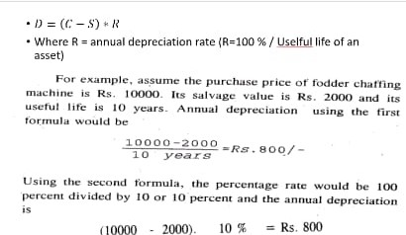

Slide 7
