Slide 1
Sex-Linked and Nontraditional Modes of Inheritance
Dr. Waqas Ahmed Khan
Assistant Professor
Dept. of Biotechnology

Slide 2
The human X chromosome is large, containing about 5% of the nuclear genome’s DNA. More than 1200 genes have been localized to the X chromosome, and the diseases caused by these genes are said to be X-linked
The Y chromosome is quite small and contains only a few dozen genes
Mitochondrial diseases which is inherited only from one’s mother display unique pattern of inheritance in families
Anticipation refers to earlier age-of-onset of some genetic diseases in more recent generations of families
Imprinting refers to the fact that some genes are expressed only on paternally transmitted chromosomes and others are expressed only on maternally transmitted chromosome

Slide 3
X INACTIVATION
The females have two X-chromosomes while males have only one so females have two copies of X-linked genes while males have one copy. Yet males and females do not differ in terms of the amounts of protein products encoded by most of these genes. What could account for this?
In 1960s Mary Lyon hypothesized that one X chromosome in each somatic cell of the female is inactivated. This would result in dosage compensation, an equalization of the amount of X-linked gene products in males and females.
X-inactivation is a randomly determined, but fixed process.

Slide 4
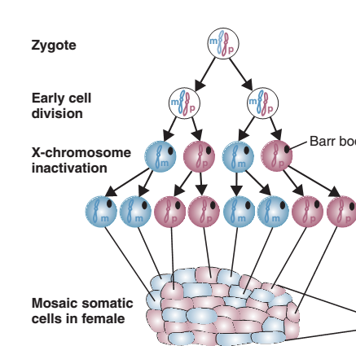

Slide 5
Females are typically mosaics for some X-linked traits and males are not. For example, female “calico” cats have alternating black and orange patches of fur that correspond to two populations of cells
Another example, seen in humans, is X-linked ocular albinism. The Lyon hypothesis was also supported by biochemical evidence.
Inactivation is initiated in a single 1-Mb region on the X chromosome long arm, the X inactivation center, and then spreads along the chromosome.
An important implication of the Lyon hypothesis is that the number of Barr bodies in somatic cells is always one less than the number of X chromosomes. Females with Turner syndrome having only one X chromosome, have no Barr bodies. Males with Klinefelter syndrome have one Barr body in their somatic cells, and females who have three X chromosomes per cell have two Barr bodies in each somatic cell.
The X inactivation center contains a gene, XIST, that is transcribed only on the inactive X chromosome; its 17-kb mRNA transcripts are detected in normal females but not in normal males.
Methylation and histone deacetylation are additional features of the inactive X chromosome.

Slide 6
X-Linked Recessive Inheritance
X-linked recessive inheritance is a mode of inheritance in which a mutation in a gene on the X chromosome causes the phenotype to be always expressed in males and in females who are homozygous for the gene mutation
Females with one copy of the mutated gene are carriers
An X-linked recessive disease with gene frequency q will be seen in a fraction q of males
Females, needing two copies of the mutant allele to express the disease, will have a disease frequency of only q2
An X-linked disease allele can be transmitted through a series of phenotypically normal heterozygous females, causing the appearance of skipped generations

Slide 7
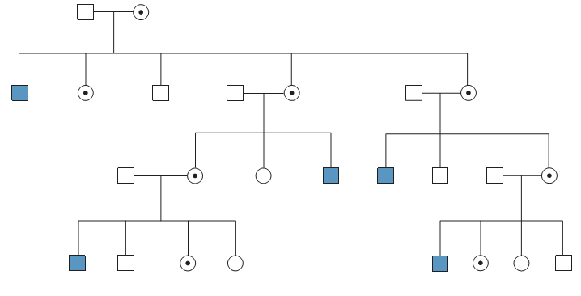

Slide 8
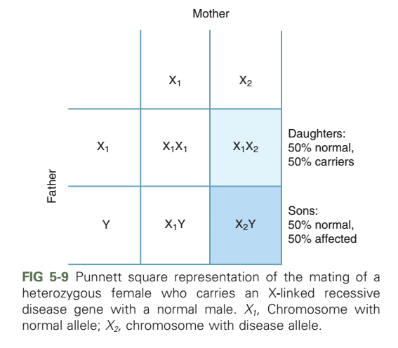

Slide 9
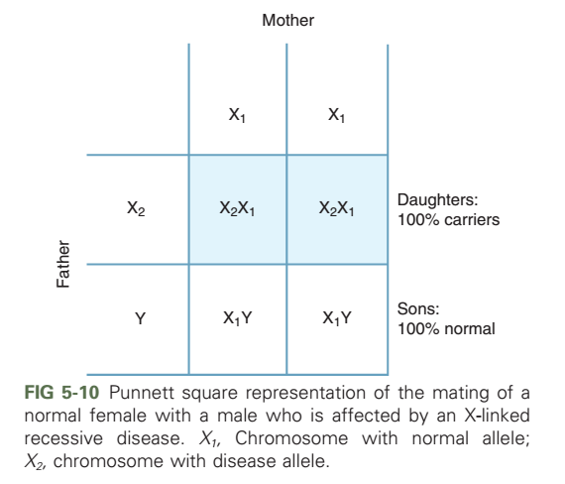

Slide 10
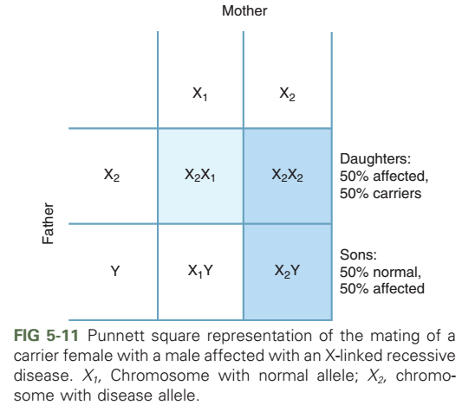

Slide 11
Occasionally, females who inherit only a single copy of an X-linked recessive disease allele can be affected with the disease
About 5% of female heterozygotes exhibit hemophilia A and are termed manifesting heterozygotes
Because they usually maintain at least a small fraction of active normal X chromosomes, manifesting heterozygotes tend to be relatively mildly affected
A number of well-known diseases and traits are caused by X-linked recessive genes. These include hemophilia A, Duchenne muscular dystrophy and red–green colorblindness

Slide 12
X-Linked Dominant Inheritance
X-linked dominant inheritance indicates that a gene responsible for a genetic disorder is located on the X chromosome, and only one copy of the allele is sufficient to cause the disorder when inherited from a parent who has the disorder
An example is hypophosphatemic rickets and results in abnormal ossification and rickets
Another example is incontinentia pigmenti type 1 and is seen only in females

Slide 13
X-linked dominant inheritance is also observed in Rett syndrome, a neurodevelopmental disorder seen in 1 in 10,000 females and in a much smaller fraction of males characterized by autistic behavior, intellectual disability, seizures, and gait ataxia
About 95% of classic Rett syndrome cases are caused by mutations in the MECP2 gene
Loss-of-function mutations in MECP2 result in the inappropriate expression of genes thought to be involved in brain development
Because females have two X chromosomes, either of which can potentially carry the disease gene, they are about twice as commonly affected as males

Slide 14
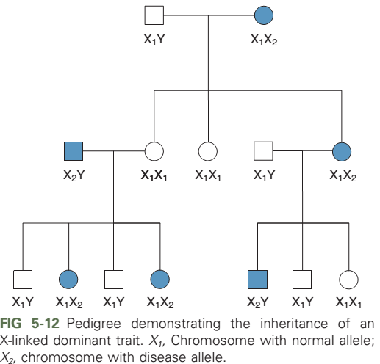

Slide 16
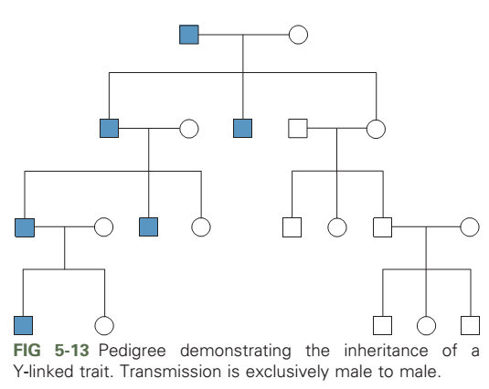

Slide 17
MITOCHONDRIAL INHERITANCE
A small but significant number of diseases can be caused by mutations in mitochondrial DNA
Each human cell contains several hundred or more mitochondria in its cytoplasm
The mitochondria have their own DNA molecules, which occur in several copies per mitochondria
Because mitochondria is located in the cytoplasm, mtDNA is inherited exclusively through the maternal line
The mutation rate of mtDNA is about 10 times higher than that of nuclear DNA

Slide 18
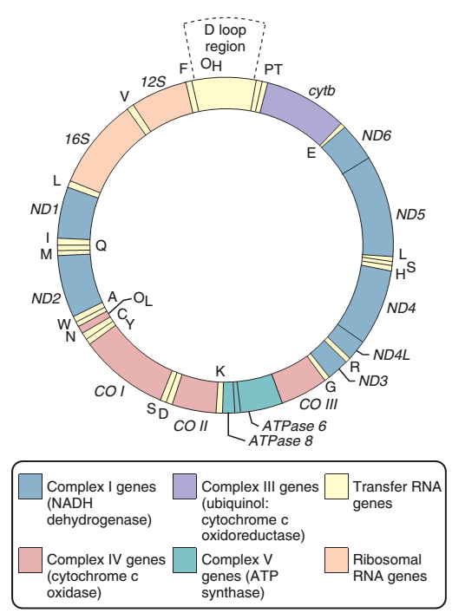

Slide 19
The heterogeneity in DNA composition of mitochondria, termed heteroplasmy, is an important cause of variable expression in mitochondrial diseases
Each tissue type requires a certain amount of ATP for normal function
The central nervous system consumes about 20% of the body’s ATP production and therefore is often affected by mtDNA mutations
Like the globin disorders, mitochondrial disorders can be classified according to the type of mutation that causes them

Slide 20
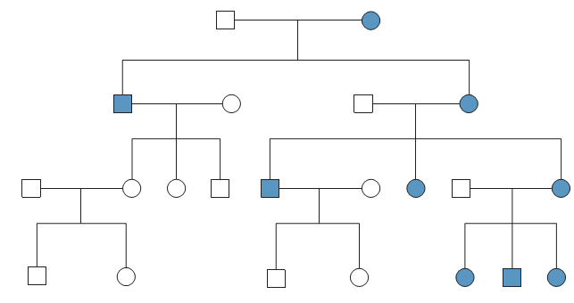
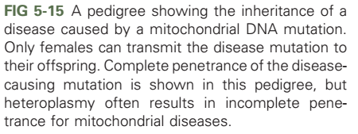

Slide 21
Missense mutations in protein-coding mtDNA genes cause one of the best-known mtDNA diseases, Leber hereditary optic neuropathy (LHON) which shows minimal heteroplasmy
Single-base mutations in a tRNA gene can result in myoclonic epilepsy with ragged-red fier syndrome (MERRF) and mitochondrial encephalomyopathy and stroke-like episodes (MELAS). Both these diseases are heteroplasmic
The final class of mtDNA mutations consists of duplications and deletions. These can produce Kearns–Sayre disease, Pearson syndrome and chronic progressive external ophthalmoplegia (CPEO)
Mitochondrial mutations are also associated with some common human diseases
mtDNA mutations, which accumulate through the life of an individual as a result of free radical formation, could contribute to the aging process

Slide 22
GENOMIC IMPRINTING
A process in which genetic material is expressed differently when inherited from the mother than when inherited from the father
Imprinted alleles tend to be heavily methylated
This process is similar in many ways to X inactivation
At least 100 human genes are known to be imprinted

Slide 23
Prader–Willi and Angelman Syndromes
A striking disease example of imprinting results from a deletion of about 4 Mb of the long arm of chromosome 15
When this deletion is inherited from the father, the child manifests Prader–Willi syndrome (PWS)
When the same deletion is inherited from the mother, the child develops Angelman syndrome (AS)
Both diseases are seen in about 1 of every 15,000 persons and chromosome deletions are responsible for about 70% of cases of both diseases

Slide 24
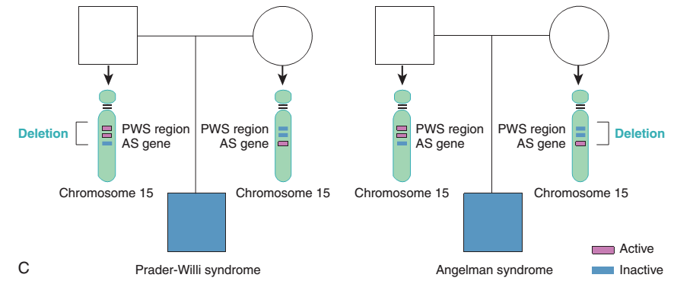

Slide 25
Several mechanisms in addition to chromosome deletions can cause PWS and AS. One of these is uniparental disomy
When two copies of the maternal chromosome 15 are inherited, PWS results because no active paternal genes are present in the critical region
When two copies of the maternal chromosome 15 are inherited, PWS results because no active paternal genes are present in the critical region
Finally, a small percentage of PWS and AS result from defects in the imprinting control center on chromosome 1

Slide 26
Beckwith–Wiedemann Syndrome
A second example of imprinting in the human genome is given by Beckwith–Wiedemann syndrome, an overgrowth condition accompanied by an increased predisposition ton cancer
Children with Beckwith–Wiedemann syndrome have an
increased risk for developing Wilms tumor and hepatoblastoma
As with Angelman syndrome, a minority of Beckwith-Wiedemann syndrome cases (about 20-30%) are caused by uniparental disomy
In 50% to 60% of cases, Beckwith–Wiedemann syndrome is caused by a loss of methylation or other alterations of DMR2
whereas up-regulation or extra copies of active IGF2 cause overgrowth in Beckwith–Wiedemann syndrome, down-regulation of IGF2 causes diminished growth in Silver–Russell syndrome

Slide 27
