Slide 1
Intro to sports psychology
Anam Yousaf

Slide 2
Define
Sport psychology is a proficiency that uses psychological knowledge and skills to address optimal performance and well-being of athletes, developmental and social aspects of sports participation, and systemic issues associated with sports settings and organizations.

Slide 3
APA recognizes sport psychology as a proficiency acquired after a doctoral degree in one of the primary areas of psychology and licensure as a psychologist. This proficiency does not include those who have earned a doctoral degree in sport psychology but are not licensed psychologists

Slide 4
History of Sports Psychology
In 1920, Carl Diem founded the world’s first sports psychology laboratory at the Deutsche Sporthochschule in Berlin, Germany.
n 1925, two more sports psychology labs were established—one by A.Z. Puni at the Institute of Physical Culture in Leningrad and the other by Coleman Griffith at the University of Illinois.

Slide 5
Griffith began offering the first course in sports psychology in 1923 and later published the first book on the subject titled The Psychology of Coaching (1926). Unfortunately, Griffith’s lab was closed in 1932 due to a lack of funds. After the lab was shut down, there was very little research on sports psychology until the subject experienced a revival of interest during the 1960s.

Slide 6
Ferruccio Antonelli established the International Society of Sport Psychology (ISSP) in 1965 and by the 1970s sports psychology had been introduced to university course offerings throughout North America. The first academic journal, the International Journal of Sport Psychology, was introduced in 1970, which was then followed by the establishment of the Journal of Sport Psychology in 1979.

Slide 7
By the 1980s, sports psychology became the subject of a more rigorous scientific focus as researchers began to explore how psychology could be used to improve athletic performance, as well as how exercise could be utilized to improve mental well-being and lower stress levels.

Slide 8
Major Topics of Sports Psychology
There are a number of different topics that are of special interest to sports psychologists. Some professionals focus on a specific area, while others study a wide range of techniques.
Attentional focus
Imagery:
Motivation

Slide 9
Attentional focus
Involves the ability to tune out distractions, such as a crowd of screaming fans, and focus attention on the task at hand.

Slide 10
Imagery
involves visualizing performing a task, such as participating in an athletic event or successfully performing a particular skill.

Slide 11
Motive vs moivation
Motive is the psychological feature that arouses an organism to action toward a desired goal; the reason for the action; that which gives purpose and direction to behavior
E.g. Your motive to go to school every day is to learn. Or maybe the thought of your parents' anger
Primary motives (innate or biological).
Secondary motives (acquired or social).

Slide 12
Motive vs motivation
motivation is the psychological process that initiates, guides and maintains goal directed behavior. Motivation is different from behavior
Motivation is a psychological process and behavior is the outcome or result of that motivation. Motive, on the other hand, is the concrete cause of said behavior. Thus, motivation is the process itself and the motive is the concrete reason for taking action.

Slide 13
Primary motives
Primary motives are related to survival. Hunger, thirst, sleep, and sex are some of the primary motives. These are essential processes that ensure an individual’s survival and the survival of the species as a whole. Other primary motives are fleeing from danger, looking for protective shelter, and fighting to defend yourself.

Slide 14
Secondary motives
Secondary motives are related to people’s general growth after a learning experience. They develop through the interaction between individuals. Just like primary motives, they activate and direct behavior. They aren’t necessary for human survival, but they play an important role in emotional development and are unique to human beings. Achievement, belonging, and power are examples of secondary motives.

Slide 15
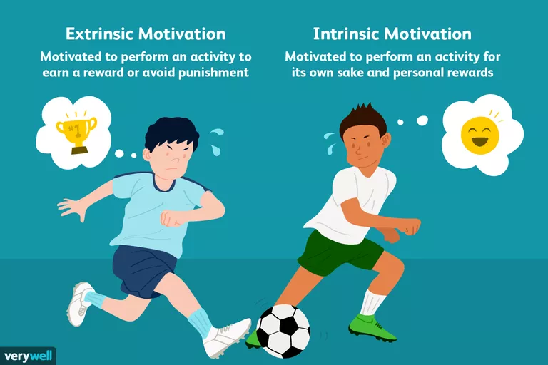

Slide 16
Extrinsic motivation
Extrinsic motivation is when external stimuli determine your behavior. In other words, it refers to environmental factors that lead you to give a particular response, repeat it, and finally acquire it.
You perform a behavior or engage in an activity because you want to earn a reward or avoid punishment.﻿ You will engage in behavior not because you enjoy it or because you find it satisfying, but belcause you expect to get something in return or avoid something unpleasant.

Slide 17
Intrinsic motivation
Intrinsic motivation is when you engage in a behavior because you find it rewarding. You are performing an activity for its own sake rather than from the desire for some external reward. The behavior itself is its own reward.

Slide 18
Extrinsic
1. Participating in a sport to win awards
Cleaning your room to avoid being reprimanded by your parents
Competing in a contest to win a scholarship
Studying because you want to get a good grade

Slide 19
intrinsic
Participating in a sport because you find the activity enjoyable
Cleaning your room because you like tidying up
Solving a word puzzle because you find the challenge fun and exciting
Studying a subject you find fascinating

