Slide 1
Advanced Analysis of Algorithms
Dr. Qaiser Abbas
Department of Computer Science & IT,
University of Sargodha, Sargodha, 40100, Pakistan
qaiser.abbas@uos.edu.pk

Slide 2
Shortest Path Problem
In a shortest-paths problem, we are given a weighted, directed graph G = (V,E) with weight function w: E→R mapping edges to real-valued weights. The weight w(p) of path p = (v₀,v₁,…v_{k}) is the sum of the weights of its constituent edges:
We define the shortest-path weight δ(u,v) from u to v by
Notes:
1

Slide 3
Shortest Path Problem
Variants
In this Lecture, we shall focus on the single-source shortest-paths problem: given a graph G=(V,E), we want to find a shortest path from a given source vertex s ε V to each vertex v ε V . The algorithm for the single-source problem can solve many other problems, including the following variants.
Single-destination shortest-paths problem: Find a shortest path to a given destination vertex t from each vertex v􏰍. By reversing the direction of each edge in the graph, we can reduce this problem to a single-source problem.
Single-pair shortest-path problem: Find a shortest path from u to v for given vertices u and v􏰍. If we solve the single-source problem with source vertex u, we solve this problem also.
All-pairs shortest-paths problem: Find a shortest path from u to v for every pair of vertices u and v􏰍. Although we can solve this problem by running a single- source algorithm once from each vertex, we usually can solve it faster. (see Chapter 25).

Slide 4
Shortest Path Problem
Optimal substructure of a shortest path
Shortest-paths algorithms typically rely on the property that a shortest path between two vertices contains other shortest paths within it. (The Edmonds-Karp maximum-flow algorithm in Chapter 26)
Recall that optimal substructure is one of the key indicators that dynamic programming (Chapter 15) and the greedy method (Chapter 16) might apply.
Dijkstra’s algorithm, which we shall see next, is a greedy algorithm, and the Floyd- Warshall algorithm, which finds shortest paths between all pairs of vertices (will see next), is a dynamic-programming algorithm.

Slide 5
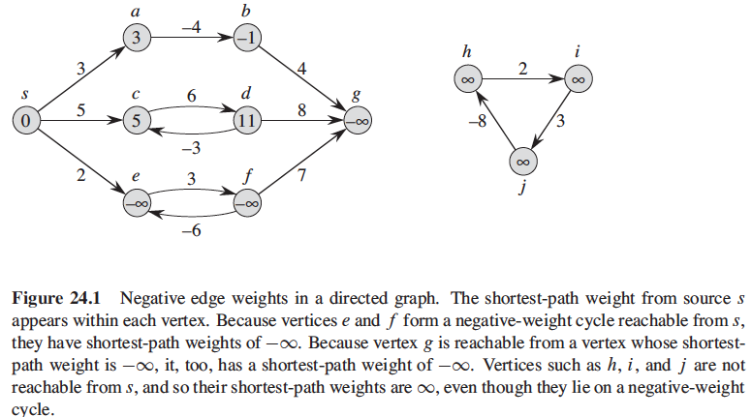
Shortest Path Problem
Negative Weight Edges:
Notes:
2

Slide 6
Shortest Path Problem
Cycles:
when we are finding shortest paths, they have no cycles, i.e., they are simple paths. Since any acyclic path in a graph G = (V,E) contains at most |V| distinct vertices, it also contains at most |V|- 1 edges.
Notes:
3

Slide 7
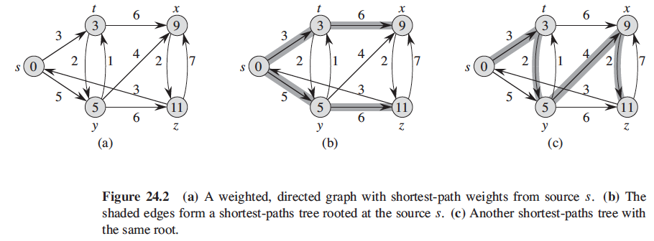
Shortest Path Problem
Representing shortest paths
Shortest paths are not necessarily unique, and neither are shortest-paths trees. For example, Figure 24.2 shows a weighted, directed graph and two shortest-paths trees with the same root.
Notes:
4

Slide 8
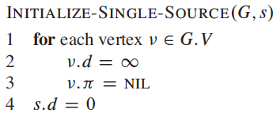
Shortest Path Problem
Relaxation
For each vertex 􏰍 v ε V , we maintain an attribute v.d, which is an upper bound on the weight of a shortest path from source s to v􏰍.
We call v.d a shortest-path estimate. We initialize the shortest-path estimates and predecessors by the following O(V)-time procedure:
Notes:
5

Slide 9
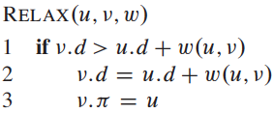
Shortest Path Problem
Relaxation
The process of relaxing an edge (u,v) consists of testing whether we can improve the shortest path to v found so far by going through u and, if so, updating v.d and v.π. A relaxation step may decrease the value of the shortest-path estimate v.d and update v􏰍’s predecessor attribute v.π.
The following code performs a relaxation step on edge (u,v) in O(1) time:
Notes:
6

Slide 10
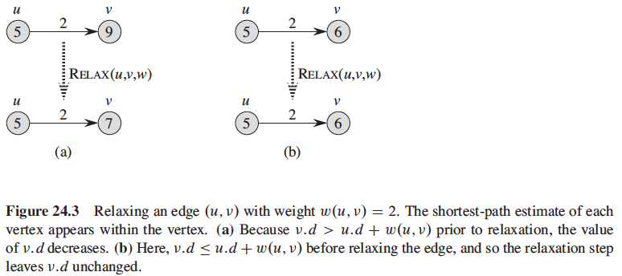
Shortest Path Problem
Dijkstra’s algorithm and the shortest-paths algorithm for directed acyclic graphs relax each edge exactly once. The Bellman-Ford algorithm relaxes each edge |V|-1 times.

Slide 11
The Bellman-Ford algorithm
The Bellman-Ford algorithm solves the single-source shortest-paths problem in which edge weights may be negative.
Given a weighted, directed graph G = (V,E) with source s and weight function w: E→R, the Bellman-Ford algorithm returns a boolean value indicating whether or not there is a negative-weight cycle that is reachable from the source.
If there is such a cycle, the algorithm indicates that no solution exists. If there is no such cycle, the algorithm produces the shortest paths and their weights.

Slide 13
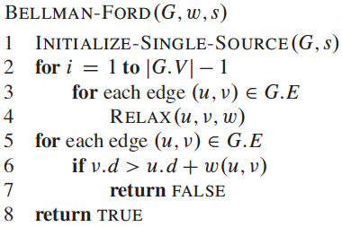
The Bellman-Ford algorithm

Slide 14
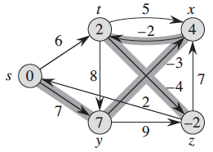
The Bellman-Ford algorithm
Steps | s.d/s.π | t.d/t. π | x.d/x. π | y.d/y. π | z.d/z. π
init | 0/Nil | ∞/Nil | ∞/Nil | ∞/Nil | ∞/Nil
S,t |  | 6/s
S,y |  |  |  | 7/s
T,x |  |  | 11/t
T,y |  |  |  | 7/s
T,z |  |  |  |  | 2/t
X,t |  | 6/s
Y,x |  |  | 4/y
Y,z |  |  |  |  | 2/t
Z,s | 0/nil
Z,x |  |  | 4/y
. . | . . | . . | . . | . . | . .

Slide 15
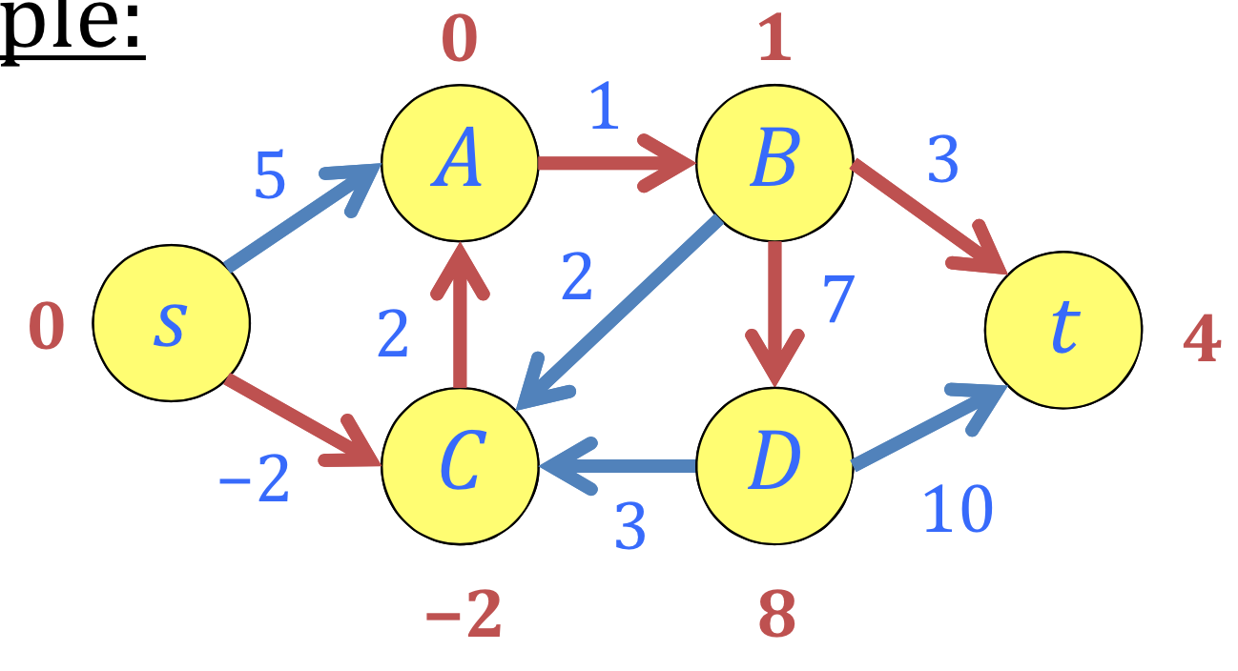
The Bellman-Ford algorithm
How did it become?

Slide 16
Slide Adopted From the Work of An MIT Professor, Erik Demaine
Distance‐vector routing protocol
Repeatedly relax edges until convergence
Relaxation is local!
On the Internet:
Routing Information Protocol (RIP)
Interior Gateway Routing Protocol (IGRP)

Slide 17
Slide Adopted From the Work of An MIT Professor, Erik Demaine

Slide 18
Single-source shortest paths in directed acyclic graphs
Section 24.2 (Read it yourself)

Slide 19
Dijkstra’s algorithm
Dijkstra’s algorithm solves the single-source shortest-paths problem on a weighted, directed graph G=(V, E) for the case in which all edge weights are nonnegative.

Slide 20
Dijkstra’s algorithm

Slide 21
Dijkstra’s algorithm
Dijkstra’s algorithm maintains a set S of vertices whose final shortest-path weights from the source s have already been determined.
The algorithm repeatedly selects the vertex u ε V-S with the minimum shortest-path estimate, adds u to S, and relaxes all edges leaving u.
In the following implementation, a min-priority queue Q of vertices is used, keyed by their d values.

Slide 22
Dijkstra’s algorithm

Slide 23
Dijkstra’s algorithm

Slide 24
Dijkstra’s algorithm
Dijkstra’s algorithm always chooses the “lightest” or “closest” vertex in V-S to add to set S , and hence uses the greedy strategy.
Dijkstra’s algorithm resembles both breadth-first search (Read Section 22.2 by yourself) and Prim’s algorithm for computing minimum spanning trees (Read Section 23.2 by yourself).
Time Complexity of the implementation is O(V^2). If the input graph is represented using adjacency list, it can be reduced to O(E log V) (Section 6.5) with the help of binary heap and O(E+VlogV) (Chapter 19) in case of Fibonacci heap.

Slide 25
Analysis of Dijkstra’s algorithm
ShortestPath(G, v)
For all v∈V, D[v]=∞
D[s]=0
For all v∈V, P[v]=Nil
Put all v∈V into a data structure Q, using Q.Insert(v, D[v])
while (!Q.Empty()) // Q.Empty() return Boolean value
c = Q.removeMin()
for each neighbors c of v in Q do
w= weight of (c,v) ∈ E
if D[c] + w < D[v] then
D[v] = D[c] + w
P[v] = c
Q.DecreaseKey(v,D[v])
return D[t] and optionally P

Slide 26
Analysis of Dijkstra’s algorithm
Running time using an array as a priority queue Q
= O(|V|) + O( |V|.time of Q.Insert()) + O( |V| . (time of Q.Empty() + time of Q.RemoveMin()) + |E| . ( O(1) + time of Q.DecreaseKey())) + O(|V|)
= O( |V| . (time of Q.Insert() + time of Q.Empty() + time of Q.RemoveMin()) + O ( |E| . time of Q.Decreasekey())
In case of an array, Q.Insert(), Q.Empty(), and Q.DecreaseKey() take O(1) time, and Q.RemoveMin() takes O(V) time, so
= O( |V|. ( O(1)+O(1)+O(V)) + O( |E|. O(1))
= O(V²+E) = O(V²)

Slide 27
Analysis of Dijkstra’s algorithm
Running time using a heap as a priority queue Q
= O( |V| . (time of Q.Insert() + time of Q.Empty() + time of Q.RemoveMin()) + O ( |E| . time of Q.Decreasekey())
In case of a heap, Q.Insert, Q.RemoveMin(), and Q.DecreaseKey() take O(logV) time, and Q.Empty() takes O(1) time, so
= O( |V|. ( O(logV)+O(1)+O(logV)) + O( |E|. O(logV))
= O(VlogV+ElogV) = O(V+E)logV
If the graph is sparse, then |E| = |V|, otherwise, E logV wins in comparison of V logV and E logV which beats the complexity of O(V²)

Slide 28
Analysis of Dijkstra’s algorithm
Running time using a Fibonacci heap as a priority queue Q
= O( |V| . (time of Q.Insert() + time of Q.Empty() + time of Q.RemoveMin()) + O ( |E| . time of Q.Decreasekey())
In case of a Fibonacci heap, Q.Insert and Q.Empty() take O(1) time, similarly, Q.DecreaseKey() takes O(1) amortized time, and Q.RemoveMin() takes O(logV) time, so
= O( |V|. ( O(1)+O(1)+O(logV)) + O( |E|. O(1))
= O(VlogV+E)
If |E| = |V|, then O(VlogV+E) becomes E logE which is equal to previous binary heap approach.
If |E| = |V²|, then O(VlogV+E) becomes O|V²|which equal to the first version of array
Etc.

Slide 29
Term Paper
Have a look over the state-of-the-art algorithms and their issues.
Build a comparative study if you find similar algorithms to solve a same problem.
After understanding a state-of-the-art algorithmic model with its issue, try to propose a solution.
Criticize or negate the way, a state-of-the-art algorithm is designed.
Your term paper should include the following as a sample:
Title, authors profiles, abstract, keywords, introduction, methodology or design, etc; implementation, etc; discussion and issues, etc; conclusion and references.
Deadline: before the final term paper.

