Slide 1
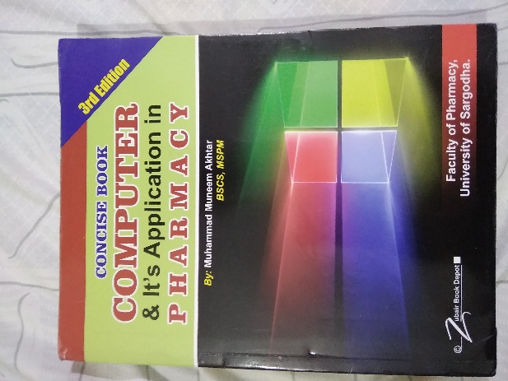
Data Processing
21
Recommended For
Pharmacy Student!
Part
Pharm-D (Doctor of Pharmacy),
DPT (Doctor of Physiotherapy) &
Pharmacy Technician.
Muhammad Munim Akhtar

Slide 2
Welcome to
Computer & its Application in Pharmacy with Munim Akhtar
Free online quality educational tutorials about Computer in Pharmacy

Slide 4
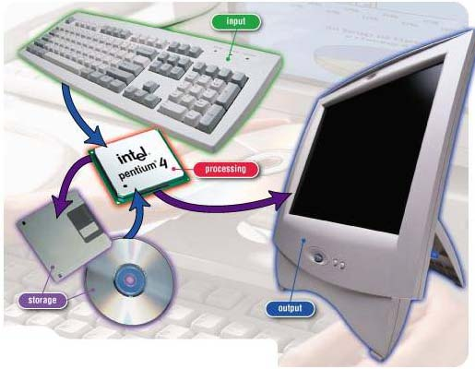
Data Processing

Slide 5
What is Data
A Latin word.
Data is a collection of raw facts & figures.
A raw material to be processed by a computer.
Example
NAMES of students,
Marks obtained in the examination,
Designation of employees, addresses,
Quantity, rate, sales figures, photographs, drawings, charts and maps
can be treated as data.

Slide 6
Information
A processed data which conveys some meaningful idea is called information. Or
When data is organized into meaningful form is called information.

Slide 7
Types of Data
Mainly Data is divided into two types:
1. Numeric Data
2. Character Data

Slide 8
Types of Data…
Numeric Data:
Which represented in the form of numbers sign and symbols etc.
e.g. 0-9 digits, Symbols like (.), +, /, –
Character Data:
Alphabets Character data falls into two groups.
String Data,
Graphical Data

Slide 9
Types of Data…
i- String Data: String data consists of the sequence of
characters.
The string data is further divided into two types. a. Alphabetic Data: Only a to z
b. Alphanumeric Data: A to z & decimal numbers
ii- Graphical Data: A pictures, charts and maps can be treated as graphical data.
e.g. Scanned ID card
The scanner used to enter this type of data.

Slide 10
What is data processing
Data Processing is a manipulation of data by a computer includes:
The conversion of raw data to machine-readable form,
Flow of data through the CPU
Flow of data from memory to output devices,
Flow of data for transformation to output.
Any other use of computers perform defined operations on data can be included under data processing.

Slide 11
Data Processing…
A set of operations performed upon data,
Data processing involves few steps like
collection,
recording,
organization,
storage or
Alteration
to convert it into useful information.

Slide 12
The Data Processing Cycle
Data storage
Input
Processing
Output

Slide 13
Data Processing Cycle
Once data is collected, it is processed to convert it into useful information.
The data is processed again and again until the accurate result is achieved, called data processing cycle.
It is an important activity
It involves a very careful planning.
Data processing basic activities.
Input
Processing
Output
Storage

Slide 14
Step 1: INPUT DATA
Input: is the process to put data into a computer.
It is very important step because correct output result totally depends on the input data.
A following activities performed.
i) Coding:
ii) Verification:
iii) Storing:

Slide 15
Step-1…
i) Coding: The data is coded or converted into machine readable form so that it can be processed through computer.
ii) Verification: The collected data is verified to determine whether it is correct as was required.
e.g. Students that appeared in final examination.
Are university verified.
If errors occur in collected data then data is corrected or it is collected again.
iii) Storing: The data is stored on the secondary storage into a file. The stored data on the storage media will be given to the program as input for processing.

Slide 16
Step-2: Processing
A data manipulation techniques such as classifying, sorting, calculating, summarizing, comparing, etc. that convert data into information.
1- Classification: Data is categories into different groups
Each group of data can be handled separately.
2- Sotring: The arrangement of data into an order so that it can be accessed very quickly as and when required.
3- Calculations: The arithmetic operations are performed on the numeric data to get the required results.
e.g. Total marks of each student are calculated.
4- Summarizing: The processed data is represent in a summarized form for top management.
e.g. A student data is prepared to show the percentage of pass and fail student examination etc.

Slide 17
Step-3: Output
A processed data is generated.
The processing is to get result.
Output is stored on the storage media for later user.
Output have following steps.
i) Retrieval: Output stored on the storage media can be retrieved at any time. e.g. result of students. This result can be retrieved when required for different purposes.
ii) Conversion: The generated output can be converted into different forms. e.g. it can be represented into graphical form.
iii) Communication: The output is sent to different places. e.g. weather forecast is prepared & sent to different agencies and newspapers etc.

Slide 18
Data Processing Stages/Operations
A process is a computer program that is being executed.
A computer can perform four operations which
enable computers to carry out the various data
processing activities.
Input / Output operations
Calculation and text manipulation Operations
Logic / Comparison Operations
Storage and Retrieval Operations

Slide 19
(A) Input/Output operations
A computer can accept data (input)
Can output processed data (output) to a wide range of input/output devices.
Input devices like
keyboards,
display screens,
printers

Slide 20
(B) Calculation & Text manipulation Operations
Computer circuits perform calculations on numbers.
They are also capable of manipulating numeric and other symbols used in text with equal efficiency.

Slide 21
(C) Logic/Comparison Operations
A computer have the ability to perform logical operations.
For example, Compare two items represented by the symbols A and B,
there are only three possible outcomes.
A is less than B (A<B)
A is equal to B (A=B)
A is greater than B (A>B)

Slide 22
(D) Storage and Retrieval Operations
Both data and program instructions are stored internally in a computer.
Once they are stored in the internal memory,
It can be called up quickly or
retrieved for further use.

Slide 23
Types of Data Processing
Manual Data Processing
Real time processing
Batch processing system
Online processing system
Centralized Data processing system
Distributed Data processing system
EDP

Slide 24
1- Manual Data Processing:
Definition: A traditional way, where processing is done with pen & paper.
The manual process of data entry may implies errors, such as
Delays in data capture,
A high amount of operator misprints,
High labor costs from the amount of manual labor required etc.

Slide 25
2.Real time data processing
Definition: A continual input, process and output of data. Data has to be processed in a small time period (real time), otherwise it will create problems for the system.
Example:
A bank customer withdraws money from account
The transaction can be processed
The account balance updated as soon as possible, allowing both the bank and customer to keep track of funds. Etc.

Slide 26
3.Batch processing
Definition: A group of transactions collected over a period of time, entered, processed and then send to destination
example: Credit card companies process billing.
The customer does not receive a bill for each separate credit card purchase but one monthly bill.
The bill is created through batch processing,
All of the data are collected and held until the bill is processed as a batch at the end of the billing cycle.
Payroll system, Examination system and billing system etc.

Slide 27
4- Online processing
The input data enters in the system from the point of origin
And output is transmitted directly back to the user.
This system implies direct communication b/w CPU and the user for both input and output.
e.g. PIA reservation system etc.

Slide 28
Online system applications:
Banking system:
Airline reservation system:
Stock exchanges:

Slide 29
Benefits of Online Systems
Information is centralized
Reduction in paper works
Improved accuracy:
Elimination of tedious tasks:
Routine clerical tasks are replaced by terminal operations providing a greater degree of job interest, operating efficiency and job satisfaction.

Slide 30
5- Centralize Data processing system
CDP uses Centralized computers, processing, data, control and support. Or
A processing in which all components run on the same computer.
e.g. Airplane ticket reservation service
NADRA etc.

Slide 31
5- Centralize Data processing system…
Advantages:
Security.
Lack of duplication,
Ease in enforcing standards,
Economy for equipment and personnel,

Slide 32
Centralized System

Slide 33
6- Distributed Data processing system
A system in which one or more components run on separate computers and communicate across a network.
In DDPS Computers are dispersed throughout organization,
Which allows greater flexibility in structure.
Interacting with each other
A vast database through a larger computer that oversees the entire network.

Slide 34
Example of DDPS
www: information, resource sharing
Distributed manufacturing system (e.g. automated assembly line)
Network of branch office computers: information system to handle automatic processing of orders

Slide 35
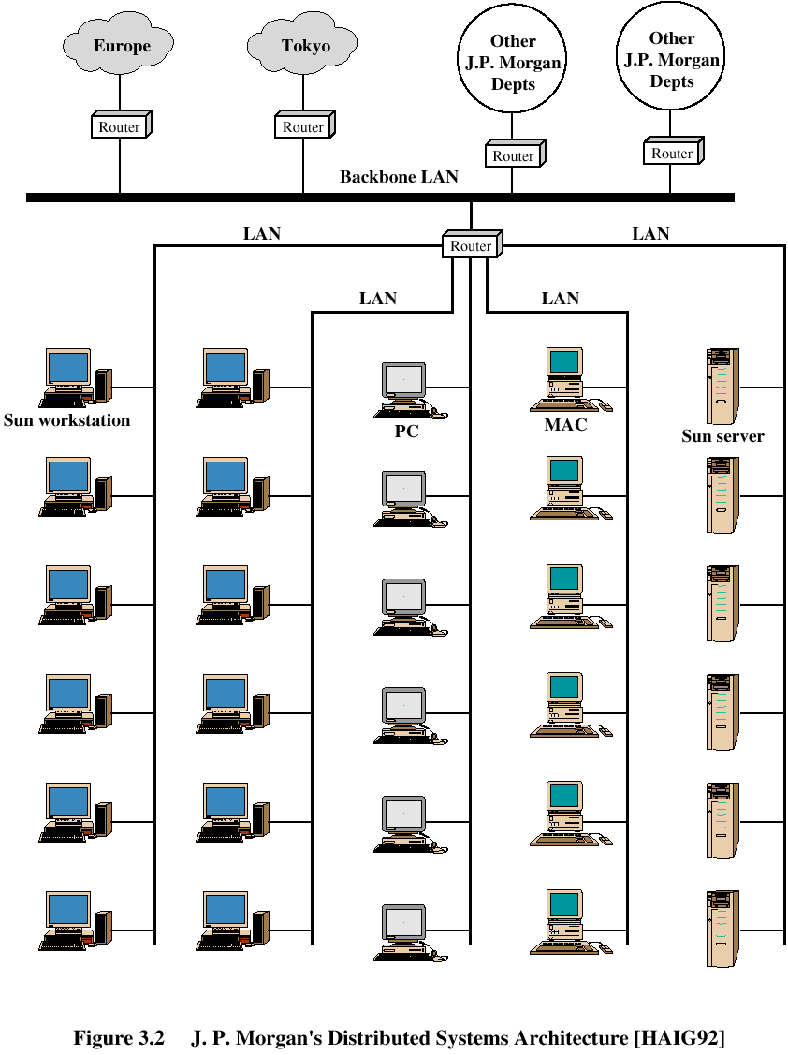

Slide 36
7- Electronic Data Processing
A Use of computers in
recording,
classifying,
manipulating, and
summarizing data,
Also called Automatic data processing.
EDP is done on computer it is effective and consumes less amount of pages and filing as the data can be stored in computer memory.
e.g.
Payroll system
Mailing system
Electronic funds transfer etc.

Slide 37
Today quote:
“Education is what remains after one has forgotten what one has learned in school. “
- Albert Einstein

Slide 38
?

