Slide 1
WATER STATUS IN SOIL

Slide 2
CONTENTS:
Water content
Gravimeteric water content
Volumeteric water content
Water potential
Classification of soil water.
Levels of water in the soil.
Water holding capacity of soil.
Availabilty of water in different soil forms

Slide 3
The status of water in soil is descirbed in terms of the amount of water and the energy associated with the forces which hold the water in the soil.
The amount of energy is described by water content and the energy is described by water potential. These are the physical properties.

Slide 4
Water contents
Soil water content is expressed on a gravimeteric or volumetric basis:
Gravimeteric water content:
It is the mass of water per mass of dry soil.

Slide 5
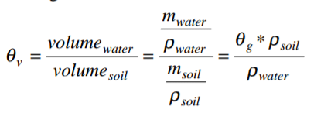
Conti.....
Volumeteric water content:
It is the volume of liquid water per volume of soil.

Slide 6
Conti....
Water content indicates how much water is present in the soil. It can be used to estimate the amount of stored water in a profile or how much irrigation is required to reach a desired amount of water.

Slide 7
Water potential
Soil water potential is an expression of the energy state of water in soil and must be known or estimated to describe water flux.
Soil water potential accounts for adhesive and cohesive forces and describes the energy status of soil water.

Slide 8
Conti....
The fundamental forces acting on soil water are:
Gravitational force.
Matrix force.
Osmotic force.

Slide 9
Conti...
The potential energy is described by gravitational potential component of the total water potential. When attractive forces between water and soil are less than the gravitational forces acting on the water molecules then water moves downwards.

Slide 10
Conti...
The matrix arrangement of soil solid particles results in capillary and electrostatic forces and determines the soil water matric potential.
The magnitude of the forces depends on the texture and the physical and chemical properties of the soil solid matter.

Slide 11
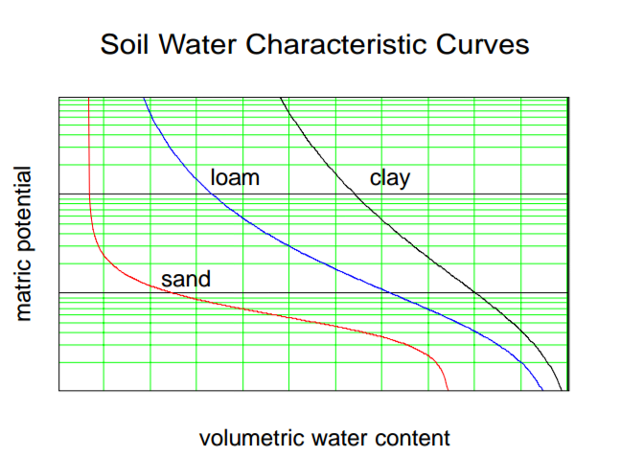
Conti....
Soil water is a solution. The polar nature of the water molecule results in interaction with other electrostatic poles present in the solution as free ions. This component of energy status is the osmotic pressure.

Slide 12
Classification of soil water:
Soil water can be classified as:
Gravitational water:
This is the water that drains out of the soil after it has been wetted.
Capillary water:
The water that is move into and is held in the soil by capillary forces.
Hygroscopic water:
This water has thin water films around the soil particles.

Slide 13
Levels of water in the soil:
Following are the levels of water in the soil:
Saturation point:
The moisture point at which all of the pore spaces are filled with water.
Field capacity:
The maximum amount of water left in the soil after losses of water through the forces of gravity have ceased.

Slide 14
Conti....
Wilting point:
The point at which the plant can no longer obtain sufficient water from the soil to meet its needs.
Availble soil water:
That amount present in a soil which can be move by plants. It is designated as the difference between the field capacity and wilting point.

Slide 15
Water holding capacity of soil.
It is the property of soil which represents the amount of water, a soil can retain after it has been saturated by rain and downward movement has ceased.
The amount of water a soil can retain is refference by soil texture, soil structure and organic matter.

