Slide 1
SPINAL INJURIES
BY
DR ALLAH NAWAZ
ASSISTANT PROFESSOR
TSU,DHQ HOSPITAL
SARGODHA MEDICAL COLLEGE

Slide 2
SPINAL INJURIES
BY
DR ALLAH NAWAZ
ASSISTANT PROFESSOR
TEACHING SURGICAL DEPARTMENT
SMC DHQ HOSPITAL

Slide 63
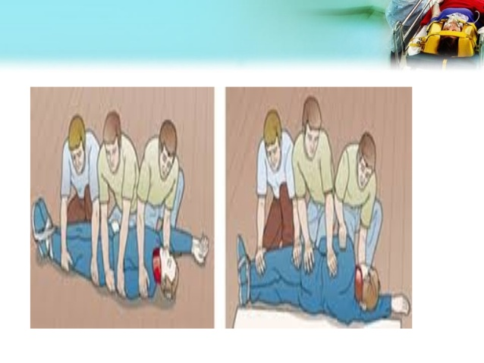

Slide 64
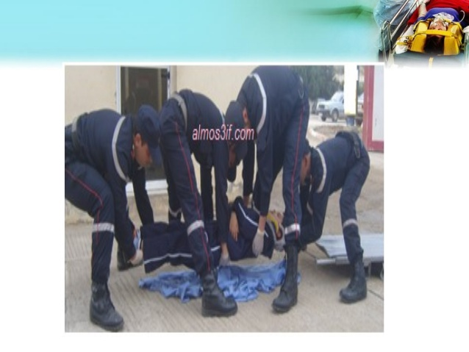

Slide 65
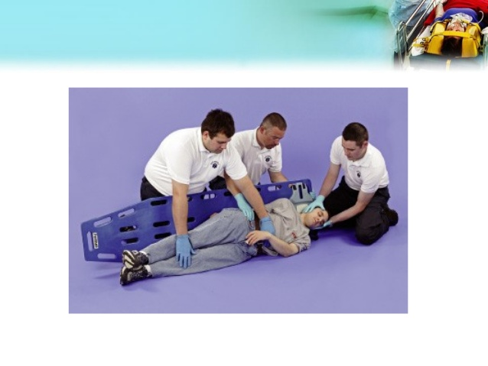

Slide 66
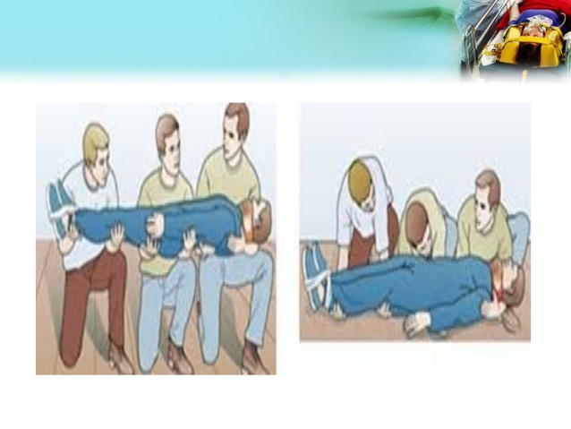

Slide 88
