Slide 2
Water cycle..
Water never leaves the earth , it constantly being cycled through the atmosphere , ocean and land , this process is know water cycle.
This cycle is driven by energy from sun.

Slide 3
Water cycle

Slide 4
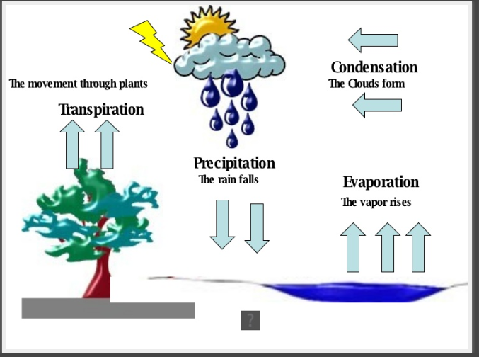
Water cycle composed of many parts..
Evaporation
Transpiration
Condensation
Precipitation
Runoff

Slide 5
Evaporation…
During plant of water cycle sun heat up liquid water and changes it to a gas by the process of evaporation.
Water that evaporates from earth’s oceans , lakes , rivers and moist soil rises up into the atmosphere.

Slide 7
Transpiration..
The process of evaporation from plant is called transpiration.
OR
The process by which water absorb by plants (usually through roots) is evaporated into the atmosphere from the plant surface .(principally from the leaves)

Slide 8
Cont….

Slide 10
Precipitation….
When the water in the clouds gets too heavy, the water fall back to the earth this called precipitation.
OR
Precipitation is the process of when water in the atmosphere falls to the earth’s surface.

Slide 12
Precipitation can be…
Rain
Snow
Sleet
Hail

Slide 13
Precipitation can collect in
Rivers
Lakes
Oceans

Slide 14
Runoff…
When rain falls on the land, some of the water is absorbed into ground forming pockets of water called ground water most groundwater eventually returns to the oceans .
Other precipitation runs directly into streams, and ocean called runoff.

