Slide 1
Gram Blight (Also known as chickpea blight)
Dr. Salman Ahmad
April 13, 2020

Slide 2
History and Importance:
Reported in 26 countries
In 1930s it caused total loss of crop in Spain
In Sub-continent (Pak) appeared in epidemic form in 1922-33 & caused losses about 70 %

Slide 3
Etiology:
Causal organism: Ascochyta rabei

Slide 4
Symptoms:
Circular spots appear on leaves & pods, elongated spots on petioles & stem
Brown dots formed in the spots
Seeds in pods may also show lesions
In severe attack stem girdled (trapped) at base & plants die

Slide 5
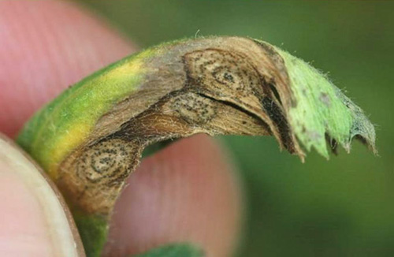
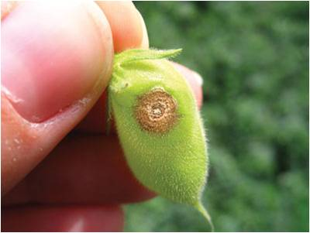
Symptoms:
Circular spots along with dots

Slide 6
Symptoms on stem:

Slide 7
Disease cycle:
Survive as pycnidia on debris in soil & also on seed
Secondary spread is through rain drops & splashes, by insects & strong wind

Slide 8
Epidemiology:
High rain fall & Temp. 22-26°C are conducive for epidemic

Slide 9
Management:
Removal & destruction of plant debris
Crop rotation & deep sowing
Intercropping with cereals
Seed treatment with Agrosan, copper sulphate
Spray Zineb, Mineb, Captan, Dacnil
Resistant varieties (F-8, C-325, C-727, Kabli)

