Slide 1
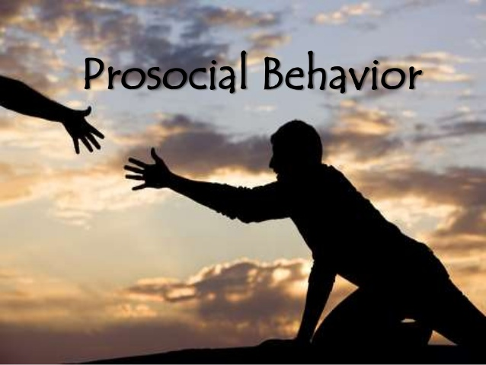
Chapter 9
Prepared by
Ms. Shahida Perveen
Department of Psychology, University of Sargodha

Slide 2
What is Prosocial Behavior?
Any act performed with the goal of benefiting another person
Altruism: The desire to help another person even if it involves a cost to the helper and where there is not any expectation of personal gain
Egoistic helping
Wanting something in return for helping
Negative state relief theory – help to reduce your own distress
Altruistic helping
Expecting nothing in return for helping
Motivated by empathy

Slide 3
Altruistic helping
Expecting nothing in return for helping
Motivated by empathy
Empathy-altruism hypothesis
Empathy motivates people to reduce other’s distress
Low empathy, people can reduce their own distress by escaping the situation
competitive altruism:
Individuals may behave altruistically for reputation reasons because selective benefits (associated with status) accrue to the generous.

Slide 4
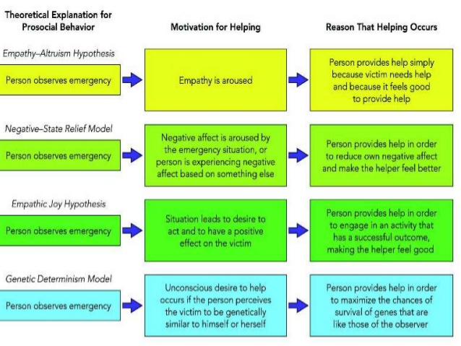

Slide 5
Why people help? Motives of prosocial behavior
Empathy: The ability to put oneself in the shoes of another person and to experience events and emotions
negative state relief, states that human beings have an innate drive to reduce negative moods. They can be reduced by engaging in any mood-elevating behavior, including helping behavior
empathetic joy, Helping others is a reward in itself because it brings a person happiness and joy when they commit a helping behavior.
kin selection theory: tendency to help genetic relative to enhance survival of mutually shared genes.
genetic determinism model: unconscious tendency to help for survival of specie.

Slide 6
Responding to an emergency: does bystander help?
defensive helping: by extending help to an outgroup member whose achievements jeopardize their status
SOCIAL NORMS Adaptive for individuals to learn social norms from other members of a society (Simon, 1990)
Norm of Reciprocity The expectation that helping others will increase the likelihood that they will help us in the future.
Bystander effect – tendency of people to become less likely to assist a person in distress where number of other people are also present people less likely to help when they are in the presence of others

Slide 7
Belief in a Just World
a person's actions are inherently inclined to bring morally fair and fitting consequences to that person, to the end of all noble actions being eventually rewarded and all evil actions eventually punished.
Life is essentially fair and people generally get what they deserve
Blaming the victim
People who hold belief in a just world will help if they think those people deserve help

Slide 8
Key steps in deciding to help
Notice that something is happening
Interpret meaning of event
Pluralistic ignorance: we look to others to see how to act
Taking responsibility for providing help
Diffusion of responsibility: burden of helping is shared with others.
Know how to help
Provide help

Slide 9
Factors that increase or decrease the tendency to help
Helping can be increased by
Reducing distractions
Reducing pluralistic ignorance
Reducing diffusion of responsibility
Reducing social inhibitions (we don’t want to draw negative attention to our self)
Reducing uncertainties of obstacles
Reducing bystander effect
Modeling helping behavior
Teach moral inclusion

Slide 10
How people react to being helped?
Mood:
When people are in a good mood, they are more helpful
Helping others can prolong our good mood.
Feelings/emotions
Positive feelings increase helping,
Negative emotions may or may not increase helping
Gender:
Males are more helpful in broader public sphere, toward strangers and in emergencies
Females are more helpful in family sphere, toward close relationships and in repeated contact
Female are more likely to get help.

Slide 11
END OF CHAPTER

