Slide 1
CLINICAL GUIDELINES
A SOURCE OF EVIDENCE BASED PHYSICAL THERAPY

Slide 2
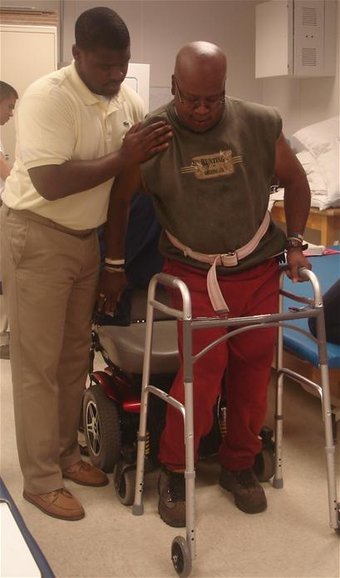

Slide 3
What are clinical guidelines?
Clinical condition of interest e.g
Intervention
Prognosis
Diagnosis
Experience
What will be point / mode of action in such a situation

Slide 4
Single source of information
Evidence based clinical guidelines integrate high-quality clinical research with contributions from clinical experts and patients, in order to formulate reliable recommendations for practice.

Slide 5
Purpose of clinical guidelines
A readymade resource of high-quality information for both practitioner and patient
so they can discuss together the different options for treatment and the different degrees of benefit or risk that interventions may have for that patient

Slide 6
Defination
Clinical guidelines are systematically developed
statements to assist practitioner and patient decisions about appropriate health care for specific circumstances

Slide 7
Systematic review Vs Guidelines
Single clinical question
Almost no rule of patients in designing SR
Quicker
Published as report for practice
many aspects
Pt’s preferences , experiences etc.
Take time
Patient version is also published

Slide 8
EBPT
1990s
Increasing # of literature
Quality care , patient expectation
Experience / peers > reliability
Source for guidelines

