Slide 1
Self Potential Method

Slide 2
Self‐potential (SP) Method
Spontaneous polarization method is based on the surface measurement of natural potentials resulting from electrochemical reactions in the subsurface.
Does not require electric currents to be injected into the ground as in the RESISTIVITY & IP methods.
Has been used in base metal exploration, to detect the presence of massive ore bodies, in contrast to the IP method which is used to predominantly to investigate disseminated ore bodies.
Has been increasingly used in groundwater & geothermal investigations, environmental and engineering applications‐‐‐> mapping seepage flow associated with dams, geological mapping, delineate shear zones and near‐ surface faults.
Ranks as the cheapest of surface geophysical methods in terms of equipment necessary and amongst the simplest to operate in the field.

Slide 3
Occurrence of Self‐potentials
SP method is passive, i.e. differences in natural ground potentials are measured between any two points on the ground surface.
The potentials measured can range from < a millivolt (mV) to > 1 Volt.
+ or – sigh of the potential is an important diagnostic factor in the interpretation of SP anomalies.
Self‐potentials are generated by a number of natural sources (exact physical processes still unclear).

Slide 4
Occurrence of Self‐potentials
Natural ground potentials consist of 2 components
Background Potentials‐‐‐fluctuate with time caused by different processes ranging from AC currents induced by thunderstorms, variations in Earth’s magnetic fields, effects of heavy rainfalls
Mineral Potentials‐‐‐constant due to electrochemical processes

Slide 5
Types of SP Anomalies and their Geological Sources
Source
Type of anomaly
Mineral potentials
Sulphid<: ore bodies
(pyrite, chalcopyrite, pyrrhotite,
sphalerite, galena)
Graphite ore bodies Magnetite+ other electronically
conducting minerals
Coal
Manganese
Quartz veins Pegmatites
Background potentials
Negative hundreds of mV
}
Positive tens of mV
Fluid streaming, geochemical reactions, etc.
Positive +I- negative lOOmV
Bioelectric (plants, trees) Groundwater movement
Negative,
300mV or so
Positive or negative,
up to hundreds of mV
Negative, up to 2 V
Topography

Slide 6
Mechanism of Self‐potentials
Some physical processes caused sources of SP are still unclear.
Groundwater is thought to be common factor responsible for SP.
Potentials are generated by the flow of water, by water reacting as an electrolyte and as a solvent of different minerals.
Electrical conductivity to produce potentials of porous rocks depends on porosity and on mobility of water to pass through the pore spaces
‐‐‐depend on ionic mobilities, solution concentrations, viscosity, temperature & pressure.
There are a few types of SP :
Electrokinetic Potential
Thermoelectric Potential
Electrochemical Potential
Mineral/Mineralization Potential

Slide 7
Mineral Potential
is the most important in mineral exploration of SP associated with massive sulphide ore bodies.
Large negative (‐) SP anomalies (100‐1000mV)can be observed particularly over deposits of pyrite, chalcopyrite, pyrrhotite, magnetite, and graphite.
The potentials are almost invariably negative over the top of the deposit and are quite stable in time.
Sato and Mooney (1960) have provided the most complete explanation of the electrochemical processes caused the observed SP anomalies.
However this hypothesis does not explain all the occurrences of the SP indicates that the actual physical processes are more complicated and no yet truly understood.

Slide 8
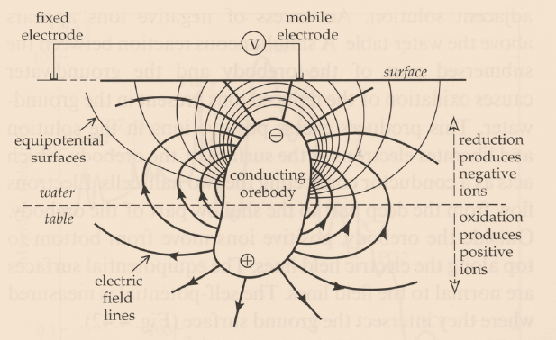
A schematic model of the origin of the self-potential anomaly of an orebody. The mechanism depends on differences in oxidation potential above and below the water table.

Slide 9
Measurement of Self‐potentials
Simple and inexpensive.
2 non‐polarizable porous‐pot electrodes connected to a precision voltmeters capable of measuring to at least 1 mV
Each electrode is made up of a copper electrode dipped in a saturated solution of copper sulphate which can percolate through the porous base to the pot.
An alternate zinc electrode in saturated zinc sulphate solution or silver in silver chloride can be used.
Maximum depth of sensitivity of SP method = ~60‐100m depending on ore body and nature of overburden.

Slide 11
Measurement of Self‐potentials
2 field techniques or 2 electrode configurations
1.Potential gradient method (dipole/leap frog/gradient configuration)
‐fix separation of 2 electrodes (5 or 10 m)
‐measure potential difference between 2 electrodes = potential gradient [mV/V]
‐2 porous are leap‐frogged along traverse with care of correct polarity of potential recorded
‐observation points = midpoint between 2 electrodes

Slide 13
Measurement of Self‐potentials
Potential amplitude, or total field method (fixed‐base) configuration
Keep one electrode fixed at a base station
Measure potential difference [mV] between base & 2nd
Electrodes moving along traverse
Lower level of cumulative errors & confusing polarity
Disadvantages of transporting long wire

Slide 14
Interpretation of Self‐Potential Data
SP anomalies are often interpreted qualitatively by
Profile shape
Amplitude
Polarity (+ or ‐)
Contour pattern
Top of ore body is assumed to lie directly beneath position of minimum potential.
For quantitative interpretation, it is possible to calculate the potential distributions around polarized bodies of simple shape, such as sphere, ellipsoid, and dipole, by making some simplifications and assumptions concerning the potential on the surface of the sources.

Slide 15
SP [mV]
SP anomalies generated by buried metal pipelines and well casings at Meso, California, USA

Slide 16
0
SP
(mV)
Profile A-A
Surface
Typical SP profile and contours over sul6de body.

