Slide 1
Water Relations of Halophytes

Slide 2
Absorption of water
Halophytes face a two-fold problem:
they must tolerate the high salt concentrations of their habitats,
and they must absorb water from a soil solution that has a low water potential

Slide 3
To maintain water uptake and turgor under these conditions halophytes need to maintain a water potential that is more negative than that existing in the soil solution
It is advantageous if this is achieved mainly by accumulation of inorganic ions that can easily be taken up from the soil

Slide 4
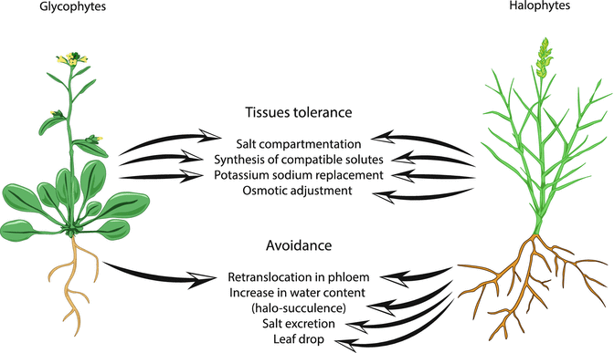

Slide 5
Most halophytes utilize the controlled accumulation and sequestration of inorganic ions as the basic mechanism by which they adjust the osmotic potential of their internal tissues to the external salinity
Halophytic species differ widely in the extent to which they accumulate ions and their overall degree of salt tolerance

Slide 6
Role of sodium and potassium
Both K+ and Na+ are involved in the osmotic adjustment of the leaf tissue to low external water potential, which can be caused by low soil moisture or high soil salinity
In general, K+ is accumulated in response to low soil moisture, while Na+ is accumulated under saline conditions
Cells are able to increase salt levels in the vacuoles by intracellular compartmentalization of ions and thus avoid high levels in the cytoplasm.

Slide 7
Osmolytes
Another means of osmotic adjustment is the synthesis and concentration of non-toxic osmolytes in the cytoplasm
Species of Chenopodiaceae commonly accumulate glycinebetaine in the cytoplasm, which acts as an osmoprotectant and can offset the high salinity concentration in the vacuole

Slide 8
Halophytes such as Atriplex spp. show a stimulation of growth at NaCl concentrations that are inhibitory to the growth of non-halophytes

Slide 9
Water Potential
Water potential is a measure of the free energy (or potential energy) of water in a system relative to the free energy of pure water
The water potential symbol is psi, Ψ
Unit of measure (pressure) = megapascals (Mpa) (10 Mpa = 1 bar [approx. 1 atmosphere])
Pure, free water Ψ_{w} = 0 (the highest water potential value)

Slide 10
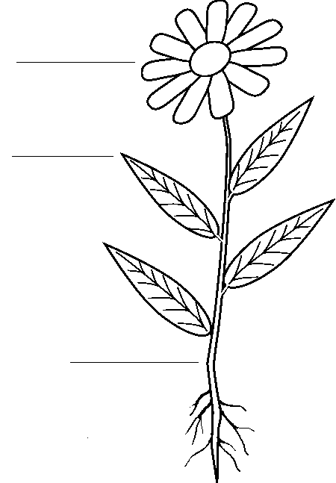
Typical Glycophyte
Ψ_{w} = Ψ_{s} + Ψ_{p}
Plant
Ψ_{w} =(-0.2) + 0.5
Ψ_{w} = -0.3
Water
Ψ_{w} = Ψ_{s} + Ψ_{p}
Soil
Ψ_{w} = (-0.2) + 0
Ψ_{w} = -0.2

Slide 11
Typical Halophyte
Ψ_{w} =Ψ_{s} + Ψ_{p}
Plant
Ψ_{w} = (-4.5) + 1.0
Ψ_{w} = -3.5
Water
Ψ_{w} = Ψ_{s} + Ψ_{p}
Soil
Ψ_{w} = (-3.0) + 0
Ψ_{w} = -3.0

