Slide 1
Search for the genetic material:
Timeline of events:
1890 Weismann - substance in the cell nuclei controls development.
1900 Chromosomes shown to contain hereditary information, later shown to be composed of protein & nucleic acids.
1928 Griffith’s Transformation Experiment
1944 Avery’s Transformation Experiment
1953 Hershey-Chase Bacteriophage Experiment
1953 Watson & Crick propose double-helix model of DNA
1956 First demonstration that RNA is viral genetic material.

Slide 2
DNA: The Genetic Material
Search for genetic material---is it composed of nucleic acid or protein/DNA or RNA?
Griffith’s Transformation Experiment
Avery’s Transformation Experiment
Hershey-Chase Bacteriophage Experiment

Slide 3
Structure of a nucleotide
A nucleotide is made of 3 components:
A Pentose sugar
This is a 5 carbon sugar
The sugar in DNA is deoxyribose.
The sugar in RNA is ribose.

Slide 4
Structure of a nucleotide
A Phosphate group
Phosphate groups are important because they link the sugar on one nucleotide onto the phosphate of the next nucleotide to make a polynucleotide.

Slide 5
Structure of a nucleotide
A Nitogenous base
In DNA the four bases are:
Thymine
Adenine
Cytosine
Guanine
In RNA the four bases are:
Uracil
Adenine
Cytosine
Guanine

Slide 6
Nitrogenous bases – Two types
Pyramidines
Thymine - T
Cytosine - C
Uracil - U
Purines
Adenine - A
Guanine - G

Slide 7
DNA and RNA are polynucleotides
Both DNA and RNA are polynucleotides.
They are made up of smaller molecules called nucleotides.
DNA is made of two polynucleotide strands:
RNA is made of a single polynucleotide strand:
Nucleotide
Nucleotide
Nucleotide
Nucleotide
Nucleotide
Nucleotide
Nucleotide
Nucleotide
Nucleotide
Nucleotide
Nucleotide
Nucleotide
Nucleotide
Nucleotide
Nucleotide
Nucleotide

Slide 8
Structure of a nucleotide
A nucleotide is made of 3 components:
A Pentose sugar
This is a 5 carbon sugar
The sugar in DNA is deoxyribose.
The sugar in RNA is ribose.

Slide 9
Structure of a nucleotide
A Phosphate group
Phosphate groups are important because they link the sugar on one nucleotide onto the phosphate of the next nucleotide to make a polynucleotide.

Slide 10
Structure of a nucleotide
A Nitogenous base
In DNA the four bases are:
Thymine
Adenine
Cytosine
Guanine
In RNA the four bases are:
Uracil
Adenine
Cytosine
Guanine

Slide 11
Nitrogenous bases – Two types
Pyramidines
Thymine - T
Cytosine - C
Uracil - U
Purines
Adenine - A
Guanine - G

Slide 12
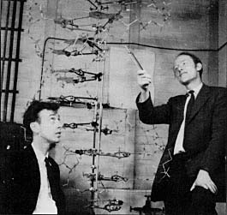
James Watson (L) and Francis Crick (R), and the model they built of the structure of DNA

Slide 13
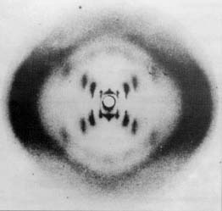
X-ray diffraction photograph of the DNA double helix

Slide 14
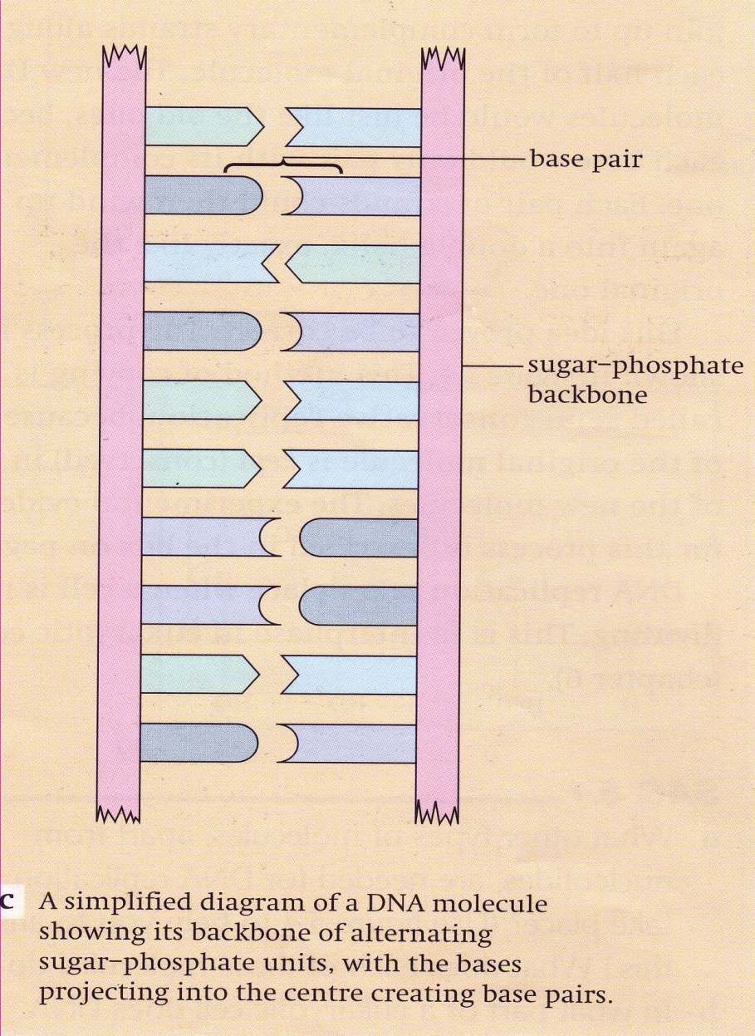
Base pairing
The Nitrogenous Bases pair up with other bases. For example the bases of one strand of DNA base pair with the bases on the opposite strand of the DNA.

Slide 15
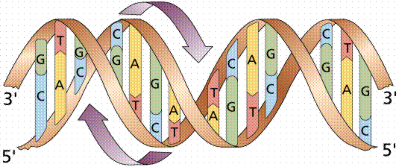

Slide 16
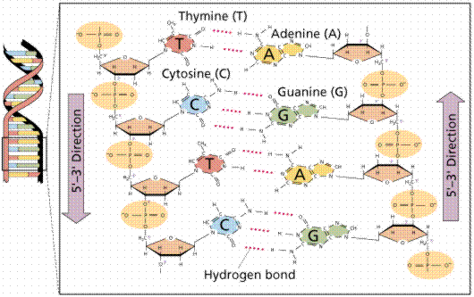

Slide 17
Maintenance and expression of genetic information
Central Dogma:
DNA RNA Protein

Slide 18
Gene Expression
The process by which a gene's information is converted into a biologically functional molecule of either protein or RNA (gene product).
Gene expression is assumed to be controlled at various points in the sequence leading to protein synthesis.

Slide 19
Gene Structure
Eukaryotic gene structure: Most eukaryotic genes in contrast to typical bacterial genes, the coding sequences (exons) are interrupted by noncoding DNA (introns). The gene must have (Exon; start signals; stop signals; regulatory control elements).
The average gene 7-10 exons spread over 10-16kb of DNA.

Slide 20
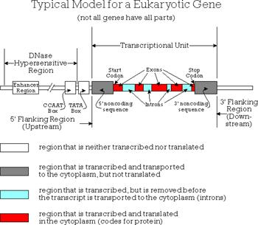

Slide 21
Protein Synthesis: Four stages
Transcription
RNA processing
Translation
Post-translation processing

Slide 23
Gene Expression
Transcription
Synthesis of an RNA that is complementary to one of the strands of DNA.
Translation
Ribosomes read a messenger RNA and make protein according to its instruction.

Slide 24
Protein Synthesis

Slide 25
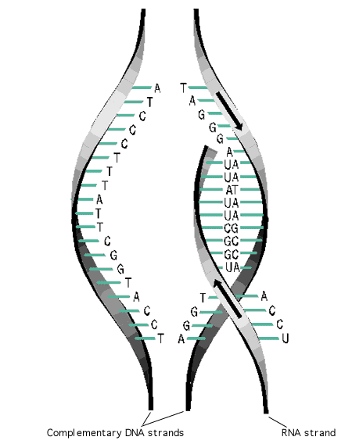
Transcription

Slide 26
Transcription Enzymes
RNA polymerase: The enzyme that controls transcription and is characterized by:
Search DNA for initiation site,
It unwinds a short stretch of double helical DNA to produce a single-stranded DNA template,
It selects the correct ribonucleotide and catalyzes the formation of a phosphodiester bond,
It detects termination signals where transcript ends.

Slide 27
Eukaryotic RNA polymerases have different roles in transcription
Polymerase I | nucleolus | Makes a large precursor to the major rRNA (5.8S,18S and 28S rRNA in vertebrates
Polymerase II | nucleoplasm | Synthesizes hnRNAs, which are precursors to mRNAs. It also make most small nuclear RNAs (snRNAs
Polymerase III | Nucleoplasm | Makes the precursor to 5SrRNA, the tRNAs and several other small cellular and viral RNAs.

