Slide 1
Multimedia Systems And Design
Overview of Sound as Multimedia Element
1

Slide 2
What is SOUND?
•
•
Sound comprises the spoken word, voices, music and even noise. It is a complex relationship involving:
a vibrating object (sound source)
a transmission medium (usually air)
a receiver (ear) and;
a preceptor (brain).
2

Slide 3
The Power of Sound
Something vibrates in the air
Waves of pressure Ear drums will translate
these changes in wave Forms as sound
•
•
Sound pressure is measured in ◊ dB (decibel)
Sound waves are known as waveforms.
3

Slide 4
Use of Sound
Providing controls (such as skip, pause, mute, volume adjustment) is an effective way of keeping users involved and motivated.
The decision to incorporate sound into a multimedia product should have solid reasoning behind it.

Slide 5
Use of Sound
Sounds are either content sounds or ambient sounds.
Content sounds furnish information
Narration, dialogue are content sounds.
Music and other sounds can be considered as content sounds if they are parts of the topic themselves.
Ambient sounds reinforce messages and set the mood
Background sounds and special effects are ambient sounds.
Special sound effects can reinforce or enliven a message.

Slide 6
Guidelines for Using Sound
Use the same style of music (if multiple sound files are needed) to maintain a sense of unity
Coordinate sound files with other media elements
Sound quality should be kept consistent
Record at a rate and resolution that is appropriate to the delivery mode
6

Slide 7
Guidelines for Using Sound
Use the same voice for narration and voiceovers, but different voices for different characters
Optimize files for background music
Use sound cues for specific events
During voice-overs, background music should be turned off or adjusted to a low volume such that the spoken words can be understood without difficulty
7

Slide 8
Example of Waveforms
Piano
Pan flute
Snare drum
5

Slide 9
Sound
•
A pleasant sound has a regular wave pattern. The pattern is repeated over and over.
^{λ} But the waves of noise are irregular. They do not have a repeated pattern.

Slide 10
Basic Principles of Sound
When we speak, vibrations, called sound waves, are created.
Sound waves have a recurring pattern or an analog wave pattern called a waveform.
This analog wave pattern represents the volume and frequency of a sound.

Slide 11
Basic Principles of Sound
Amplitude: Distance between the valley and the peak of a waveform; determines volume
Volume is measured in decibels (dB)
Decibel (dB) is a logarithmic unit used to describe a ratio.
One dB is close to Just Noticeable Difference (JND) for sound level.
Frequency: Number of peaks that occur in one second measured by the distance between the peaks; determines pitch

Slide 12
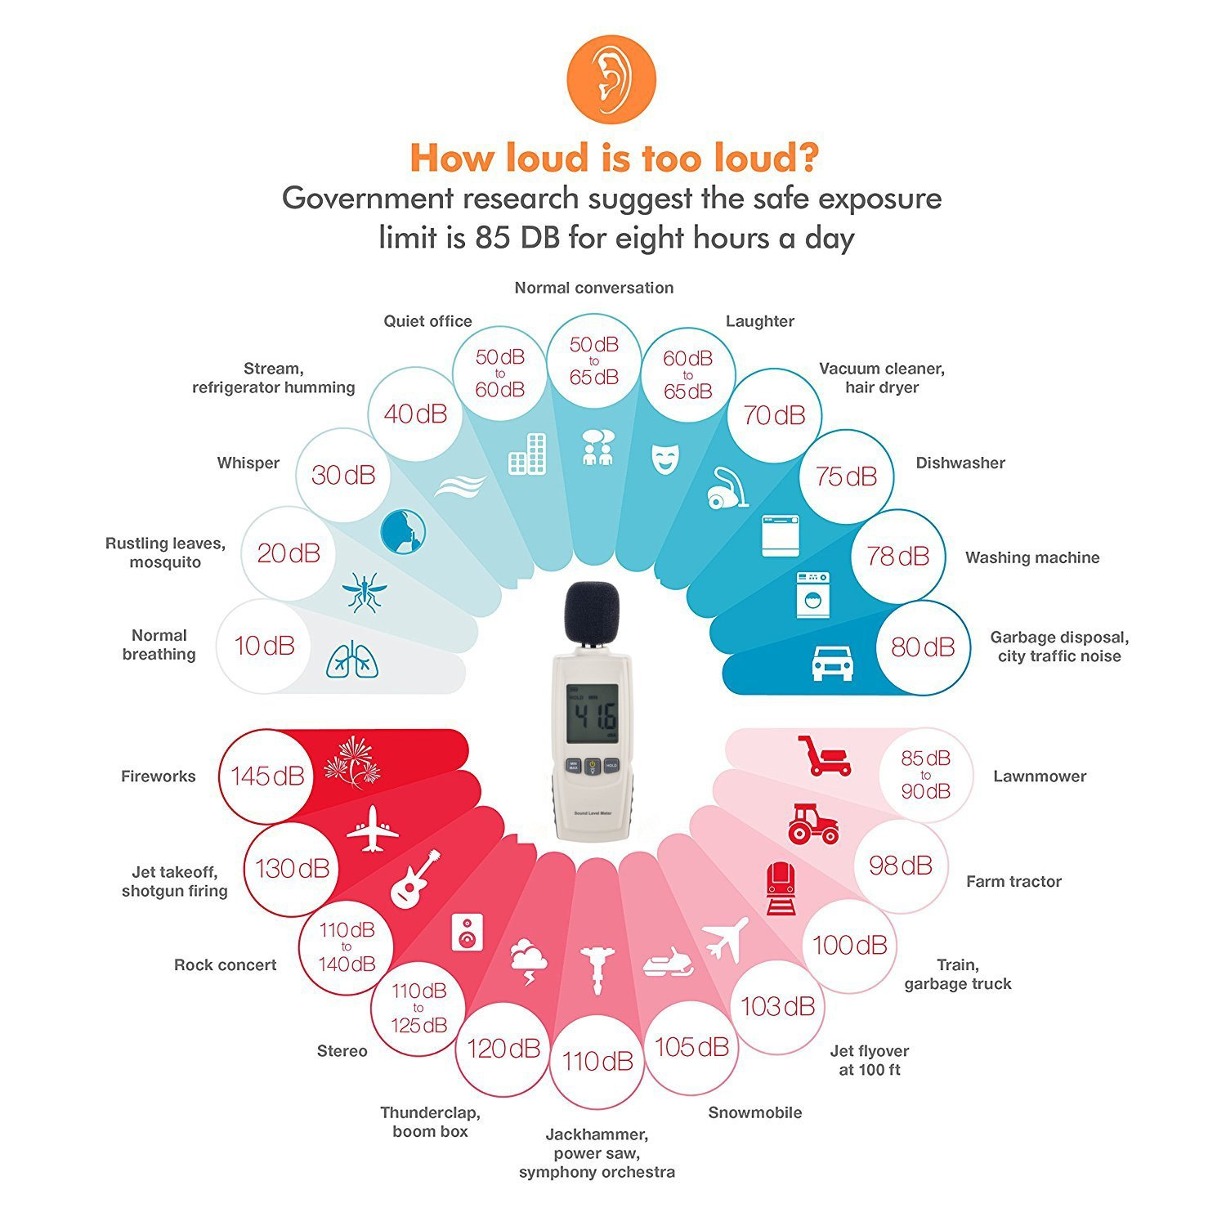
Decibel Table

Slide 13
dB Watts Example
195 25–40 million Saturn rocket
170 100,000 Jet engine with afterburner
160 10,000 Turbojet engine at 7,000-pounds thrust
150 1,000 ALSETEX splinter less stun grenade
140 100 2 JBL2226 speakers
130 10 75-piece orchestra, at fortissimo
120 1 Large chipping hammer
110 0.1 Riveting machine
100 0.01 Automobile on highway
90 0.001 Subway train; a shouting voice
80 0.0001 Inside a 1952 Corvette at 60 mph
70 0.00001 Voice conversation; freight train 100 feet away
60 0.000001 Large department store
50 0.0000001 Average residence or small business office
40 0.00000001 Residential areas of Chicago at night
30 0.000000001 Very soft whisper
20 0.0000000001 Sound studio

Slide 14
Basic Principles of Sound
Analog sound is a continuous stream of sound waves. For sound to be included in multimedia applications, analog sound must be converted to digital form.
Digitizing (or sound sampling): the process of converting analog sound to numbers
Digital Audio: An analog sound that has been converted to numbers

Slide 15
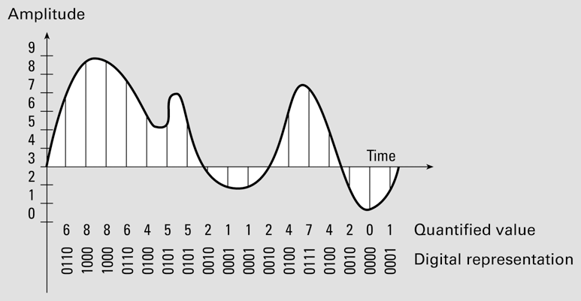
Basic Principles of Sound
Sound sampling converts analog sound to digital audio.

Slide 16
Basic Principles of Sound
Quantization of Sound: The process of converting a continuous range of values into a finite range of discreet values.
- This is a function of analog-to-digital converters, which create a series of digital values to represent the original analog signal.
- bit depth (number of bits available) determines the accuracy and quality of the quantized value.

Slide 17
Basic Principles of Sound
During digitizing, sound samples are taken at regular time instants.
Time instants are discrete.
Sound samples (the volumes of sound at time instants) cannot be stored precisely. Instead, only quantified values can be stored.
The feasible quantified values are known as quantization levels.
17

Slide 18
Basic Principles of Sound
The number of quantization levels is related to the quality of digital audio.
If more quantization levels are allowed, the difference between the original value and the quantified value will be smaller and we will get a better quality of the digital representation.
However, this would also mean a higher cost for storage and processing of these values inside a computer (disks of larger capacity and more powerful CPUs are required)
18

Slide 19
Characteristic of Sound Waves
•
Sound is described in terms of two characteristics:
Frequency (or pitch)
Amplitude (or loudness)

Slide 20
Frequency
•
Frequency is a measure of how many vibrations occur in one second. This is measured in Hertz (abbreviation Hz) and directly corresponds to the pitch of a sound.
– The more frequent vibration occurs the higher the pitch of the sound.
Low pitch High pitch
^{λ} Optimally, people can hear from 20 Hz to 20,000 Hz (20 kHz)
λ
λ
Sounds below 20 Hz are infrasonic sounds above 20 kHz are ultrasonic.

Slide 21
Amplitude
Amplitude is the maximum displacement of a wave from an equilibrium position.
– The louder a sound, the more energy it has. This means loud sounds have a large amplitude.
Quiet
Loud
Low amplitude High Amplitude The amplitude relates to how loud a sound is.

Slide 22
Characteristic of Sound Waves
Time for one cycle
Amplitude
wavelength
distance along wave
Cycle

Slide 23
Sound Quality
Factors that determine the sound quality of digital audio
sample rate
audio resolution
Sample rate
Number of sound samples taken per second
Also known as sampling rate
Measured in kilohertz (kHz),
Common values: 11 kHz, 22 kHz, 44 kHz
CD quality: 44 kHz

Slide 24
Sound Quality
Audio resolution
Also known as sample size or bit resolution
Number of binary bits used to represent each sound sample
As the audio resolution increases, the quality of the digital audio also improves.
Audio resolution determines the accuracy with which sound can be digitized.
Common values: 8 bits, 16 bits
CD quality: 16 bits

Slide 25
Sound Quality
Audio Resolution | Number of Quantization Levels
16-bit | 2¹⁶ | 65536 possible values for the sound sample
8-bit | 2⁸ | 256 possible values for the sound sample
4-bit | 2⁴ | 16 possible values for the sound sample
2-bit | 2² | 4 possible values for the sound sample

Slide 26
Downloaded vs. Streamed
Web audio: downloaded or streamed
Downloaded audio file must be entirely saved to the user’s computer before it can be played.
Streaming: a more advanced process that allows audio file to be played as it is downloading (i.e. before the entire file is transferred to the user’s computer)
If we want our audio files to be streamed over the Internet, the web-hosting service must support streaming.

Slide 27
Downloaded vs. Streamed
If the user’s computer receives streaming audio data more quickly than required, the excess data will be stored in a buffer.
If the user’s computer receives streaming audio data slower than required, the data stored in the buffer will be used. If the buffer becomes empty, the user will experience a break.
27

Slide 28
Monophonic vs. Stereo Sound
Monophonic sounds: flat and unrealistic when compared to stereo sounds
Stereo sounds: much more dynamic and lifelike
Monophonic sound files are sometimes a more appropriate choice where storage and transfer time are major concerns.
Narration and voiceovers can effectively be saved in a monophonic format.
Music almost always must be recorded and saved in stereo.

Slide 29
Digital Audio File Size
File size of a digital audio recording (in bytes) (assume that there is no compression)
* Where number of channels, either 1 for monophonic or 2 for stereo
File size of a monophonic digital audio recording (in bytes) (assume that there is no compression)
File size of a stereo digital audio recording (in bytes) (assume that there is no compression)

Slide 30
Digital Audio
•
Digital audio data is the representation of sound, stored in the form of samples point.
Quality of digital recording depends on the sampling rate, that is, the number of samples point taken per second (Hz).
•
High Sampling Rate
Samples stored in digital form
waveform
Low Sampling Rate

Slide 31
Sampling rates diagram
It is impossible to reconstruct the original waveform if the sampling frequency is too low.

Slide 32
Digital Audio
•
The three sampling frequencies most often used in multimedia are 44.1
kHz, 22.05 kHz and 11.025 kHz.
The higher the sampling rate, the more the measurements are taken (better quality).
The lower the sampling rate, the lesser the measurements are taken (low quality).
High Sampling Rate
Low Sampling Rate

Slide 33
Principles of Digitization
Sampling: Divide the horizontal axis (time) into discrete pieces
Quantization: Divide the vertical axis (signal strength - voltage) into pieces. For example, 8-bit quantization divides the vertical axis into 256 levels. 16 bit gives you 65536 levels. Lower the quantization, lower the quality of the sound
Linear vs. Non-Linear quantization:
If the scale used for the vertical axis is linear we say its linear quantization;
If its logarithmic then we call it non-linear (μ-law or A-law in Europe).
-The non-linear scale is used because small amplitude signals are more likely to occur than large amplitude signals, and they are less likely to mask any noise.
Notes:
Digitization is achieved by recording or sampling the continuous sound wave at discrete points. The more frequently one samples the closer one gets to capturing the continuity of the wave.
Therefore, sampling is the process of dividing the horizontal (time-axis) into discrete points.
The other aspect of digitization is the measurement of the voltages at these discrete sampling points. As it turns out these values may be of arbitrary precision, that is we could have values containing small fractions or decimal numbers that take more bits to represent.
To cope with this arbitrary precision we use quantization which divides the vertical axis (signal strength or voltage) into discrete points.
For example, 8-bit quantization divides the axis into 256 discrete voltage levels.
While we are on the topic of quantization, it is important to note that not all quantization is uniform or linear. That is the vertical axis need not always be a linear scale, a non-linear logarithmic scale is used in mu-law encoding.

Slide 34
Sampling and Quantization
Sampling
3-bit quantization
Sampling rate: Number of samples per second (measured in Hz)
E.g., CD standard audio uses a sampling rate of 44,100 Hz (44100 samples per second)
3-bit quantization gives 8 possible sample values
E.g., CD standard audio uses 16-bit quantization giving 65536 values.
Why Quantize?
To Digitize!
Notes:
Here is a demonstration of the concepts of sampling and quantizaion.
Again we consider a sinusoidal sound wave and sample it at discrete points. We notice that the resulting sampled values could be of arbitrary precision. Therefore we use a 3-bit quantization to discretize these values to finite values.
One important observation to make is the process of quantization gives us discrete finite precision values which are needed for representation on a computer.
Another important question to ask ourselves is: How often should we sample the signal so as achieve a faithful digital representation of the analog signal. This question will be answered by the Nyquist Sampling theorem which we will look at momentarily.

Slide 35
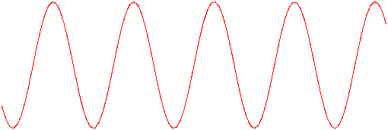
Nyquist Theorem
Consider a sine wave
Sampling once a cycle
Appears as a constant signal
Sampling 1.5 times each cycle
Appears as a low frequency
sine signal
For Lossless digitization, the sampling rate should be at least twice the maximum frequency component
Notes:
Once again lets consider a sinusoidal sound wave. If we were to sample it once every cycle. It would appear as a constant signal.
On the other hand lets say we sample it twice every three cycles or 1.5 times a cycle then it would appear low frequency sine wave with some extrapolation. As a matter of fact it may appear as a saw tooth wave without extrapolation.
Nyquist sampling theorem suggests that in order to get lossless digitization that is a faithful digital representation of the analog signal one has to sample at twice the rate of the maximum frequency component. Thus in this example one would have to sample the wave two times each cycle.

Slide 36
Digital Audio
Other than that, it also depends on:
The quality of original audio source.
The quality of capture device & supporting hardware.
The characteristics used for capture.
The capability of the playback environment.

Slide 37
Editing Digital Recordings
Once a recording has been made, it will almost certainly need to be edited.
Audacity is a free open-source sound editing application for Windows
The basic sound editing operations that most multimedia producers need are described in the paragraphs that follow:
Trimming
Splicing and Assembly
Volume Adjustment
Format Conversion
Resampling or Down sampling
Fade-ins and Fade-outs
Equalization
Time Stretching
Digital Signal Processing (DSP)

Slide 38
Trimming
Trimming Removing “dead air” or blank space from the front of a recording and any unnecessary extra time off the end is your first sound editing task.
Trimming even a few seconds here and there might make a big difference in your file size.
Trimming is typically accomplished by dragging the mouse cursor over a graphic representation of your recording and choosing a menu command such as Cut, Clear, Erase, or Silence.

Slide 39
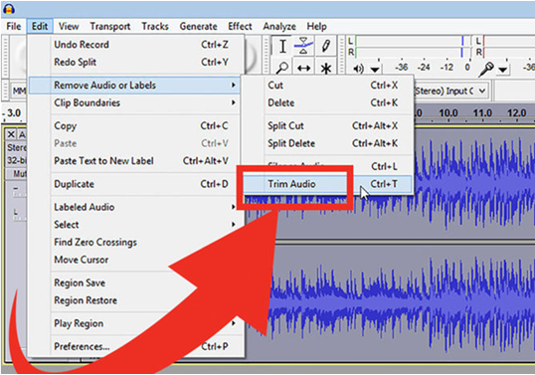
Trimming (Audacity)

Slide 40
Splicing and Assembly
Splicing and Assembly Using the same tools mentioned for trimming, you will probably want to remove the extraneous noises that certainly creep into a recording.
Even the most controlled studio voice-overs require touch-up Also, you may need to assemble longer recordings by cutting and pasting together many shorter ones.
In the old days, this was done by splicing and assembling actual pieces of magnetic tape.

Slide 41
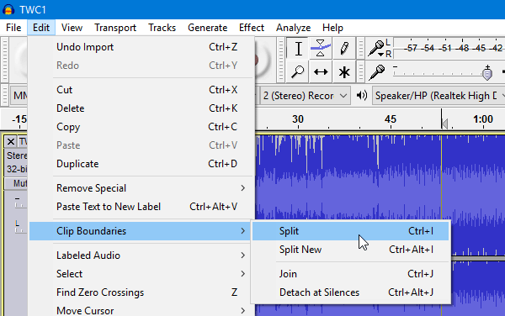
Split & Merge

Slide 42
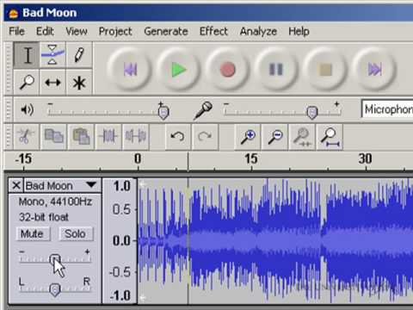
Volume Adjustments
Volume Adjustments
If you are trying to assemble ten different recordings into a single sound track, there is little chance that all the segments will have the same volume.
To provide a consistent volume level, select all the data in the file, and raise or lower the overall volume by a certain amount. Don’t increase the volume too much, or you may distort the file.
It is best to use a sound editor to normalize the assembled audio file to a particular level, say 80 percent to 90 percent of maximum (without clipping), or about –16 dB

Slide 43
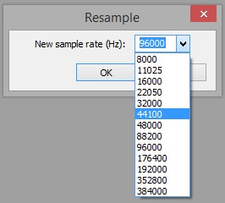
Resampling or Down sampling
Resampling or Down sampling If you have recorded and edited your sounds at 16-bit sampling rates but are using lower rates and resolutions in your project, you must resample or down sample the file.
Your software will examine the existing digital recording and work through it to reduce the number of samples. This process may save considerable disk space.

Slide 44
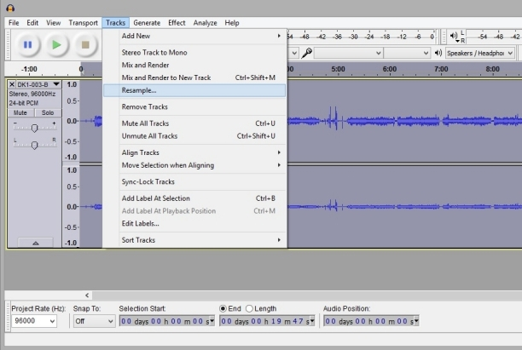
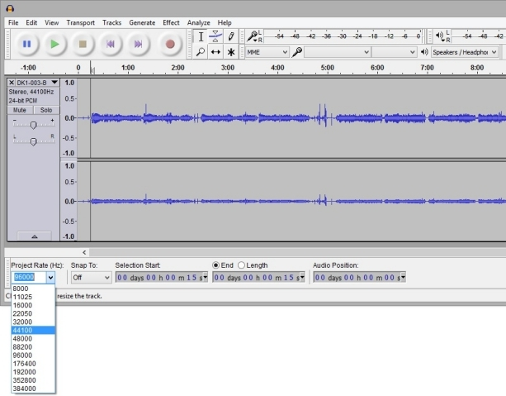
Resampling

Slide 45
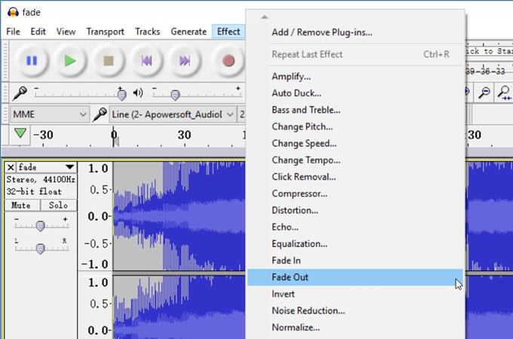
Fade-ins and Fade-outs
Fade-ins and Fade-outs
Most programs offer enveloping capability, useful for long sections that you wish to fade in or fade out gradually.
This enveloping helps to smooth out the very beginning and the very end of a sound file.

Slide 46
Smooth Transition

Slide 47
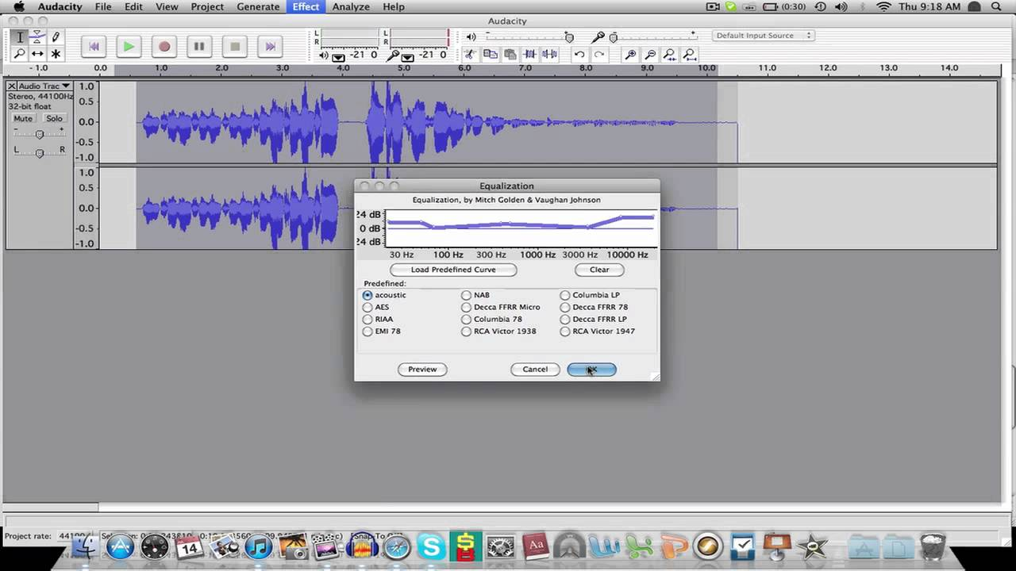
Equalization
Some programs offer digital equalization (EQ) capabilities that allow you to modify a recording’s frequency content so that it sounds brighter (more high frequencies) or darker (low, ominous rumbles).

Slide 48
Equalization

Slide 49
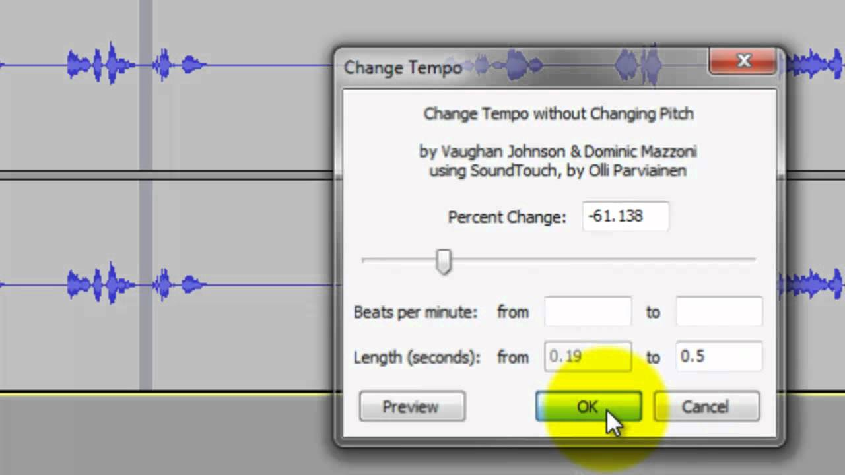
Time Stretching
Time Stretching Advanced programs let you alter the length (in time) of a sound file without changing its pitch.
This feature can be very useful, but watch out: most time-stretching algorithms will severely degrade the audio quality of the file if the length is altered more than a few percent in either direction.

