Slide 1
Maintenance And Repair Of Buildings.

Slide 2
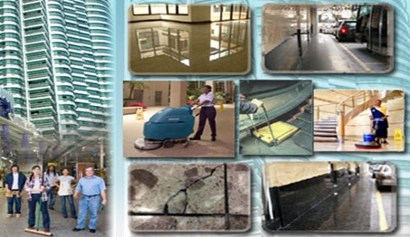
What is maintenance ?
It is the work undertaken to restore or improve every facility in every part of a building , its services and surroundings to currently accepted standards and to sustain utility values of the facility.

Slide 3
Objectives Of Maintenance :
To preserve in good condition buildings and services.
When deterioration occurs due to any reason it is inevitable to restore it to its original standard.
To make improvements whenever required.
To sustain utility value.
A good maintenance team has to ensure
1. Safety
2. Efficiency
3. Reliability

Slide 4
Maintenance operations have many facets such as :
Condition based maintenance :
Fixed time maintenance :
3. Preventative maintenance :
Opportunity maintenance :
Day to day maintenance :
Shutdown maintenance :
It is the work initiated after inspection.
Activities repeated at predetermined intervals.
This is intended to preserve by preventing failure and detecting incipient faults.
Work done as and when possible within the limits of operational demand.
Its involves maintenance that has to be performed daily.
Through overhaul and maintenance after closing.

Slide 5
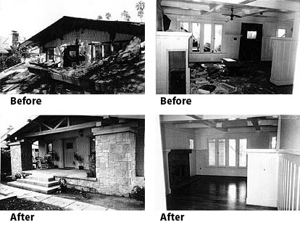
Maintenance operations have many facets such as :
Emergency maintenance : Necessitated by unforeseen breakdown damage or a damage caused by natural calamity like earthquakes, floods ,etc.

Slide 6
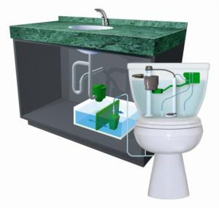
Examples of some common maintenance works in a building are as follows : -
Maintenance Survey for water supply and sanitary system :
In case of water supply and sanitary system , periodic surveys are necessary to observe how the system is functioning. Normally inspection should start from the top and proceeded downwards. Drawings which indicate various services as laid should be obtained to facilitate survey.

Slide 7
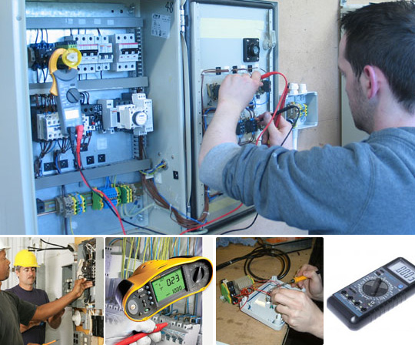
Maintenance of Electrical Installations :
The electrical installation is made safe by getting it installed and maintained through licensed persons. Its necessary that the installation is checked periodically and a proper record of such work is maintained. Recommended periodicity of checking is as follows :
Earthing test - Once a year
Insulation - Twice a year
Polarity - Once in five years.

Slide 8
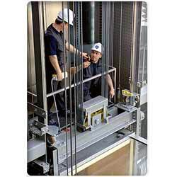
Maintenance of Elevators
In multi storeyed buildings vertical transportation is an essential service. The vertical transportation is effected by lifts which could be of various types such as passenger lifts , goods lifts special lifts in hospitals , etc. Without adequate vertical transportation the entire activity in the multi storeyed building would come to a standstill.

Slide 9
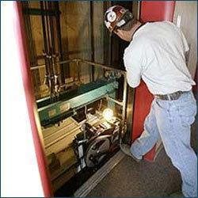
Lift maintenance should cover :
All mechanical equipments such as sheaves , buffers door closers , floor selectors , limit switches , door hangers ,etc.
Interlocks – mechanical fastenings to the base and latching head is locked securely when door is closed. The electrical contact should not get made unless the door is fully closed and locked.
Hoist and governor ropes for wear and rust
Travelling cables – Make sure that they are properly hung and outer wrapping is not worn out to avoid short circuit.
Rails – Alignment , tightness of all plates brackets.

Slide 10
Maintenance of walls to avoid efflorescence
Efflorescence is caused due to entry of moisture into the brickwork and soaking it to saturation. Once the moisture has entered it moves upward due to capillary action; reasons for entry of moisture are-
Porous nature of structure
Cracks in the wall
Existing voids left due to bad workmanship
Small trees and plants in the wall
Nonexistence of damp proof course or failure of DPC

Slide 11
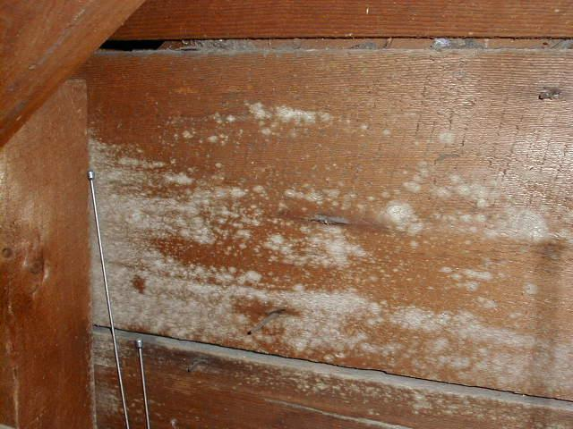
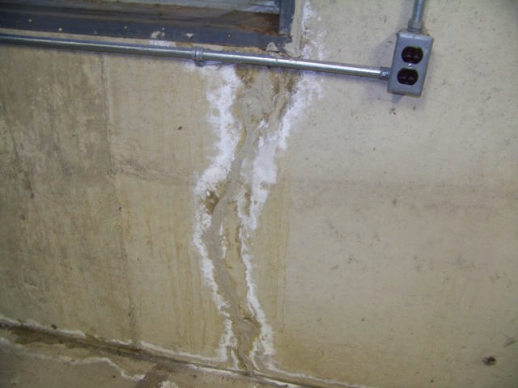
EFFECTS OF EFFLORESCENCE
Dry rot of woodwork
Disintegration of masonry
Damage to furniture
Crumbling of plaster

Slide 12
STEPS TO AVOID EFFLOROSCENCE
Eradication of efflorescence is quite difficult and it is often termed as cancer of buildings .The first step to check efflorescence is to check the ingress of moisture in buildings if there is no failure of DPC efflorescence can be checked easily .
Step one- ingress of water is checked
Step two- plaster is removed both inside and outside and is left to dry
Step three- voids in the wall are filled
Step four- walls are washed with tamarind water to remove stains
Step five- walls are replastered with cement mortar not leaner than 1:4 and a water proofing admixtures

Slide 13
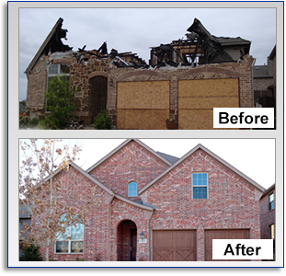
What is repair ?
It is defined as the process of restoration of a broken, damaged, or failed device, equipment, part, or property to an acceptable operating or usable condition or state.

Slide 14
Some common types of repairs are as follows :
1. Patching up of defects such as cracks and fall of plaster.
2. Repairing doors, windows, replacement of glass panes.
3. Checking and repairing electric wiring.
4. Checking and repairing gas pipes, water pipes and plumbing services.
5. Re-building non-structural walls, smoke chimneys, boundary walls, etc.
6. Re-plastering of walls as required.
7. Rearranging disturbed roofing tiles.
8. Relaying cracked flooring at ground level.
9. Redecoration — whitewashing, painting, etc.

Slide 15
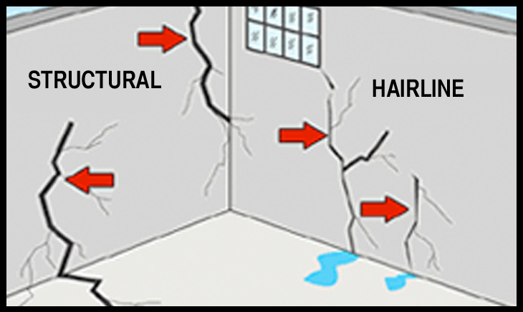
Examples of some common repair works in a building are as follows : -
REPAIR OF CRACKS IN WALLS
Cracks are signs of distress in structural and non-structural members caused due to separation of joints , development of fissures , shearing, separation of members built with different materials . Cracks may be at different locations like – vertical, horizontal, inclined ,separation at the roof level just below the junction of RCC slab and masonry wall , in parapet , at junctions of RCC columns etc. They may be wide narrow or hairline and can be of varying depths. They are classified broadly as structural and non structural cracks; with structural cracks forming due to incorrect design faulty construction, and non structural cracks forming due to internal stresses .

Slide 16
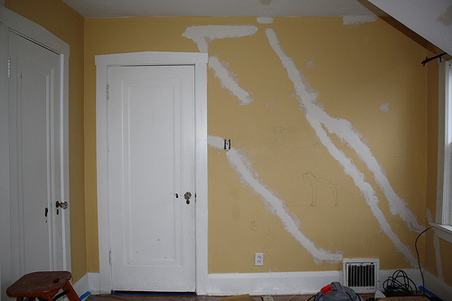
DIFFERENT METHODS OF REPAIR OF CRACKS
1. Non structural or surface cracks -They do not require elaborate measures as they prevail on the surface only. After removal of the rendering, cracks if observed in masonry are cut v shaped upto a depth of 12-30 mm and filled with cement mortar 1:4and then the surface is replastered.

Slide 17
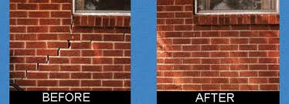
2. Very heavy cracks – If there are very heavy cracks all over the external load bearing wall along with signs of settlement, the wall is considered beyond repair and needs replacement. The load carried by the wall is supported on props , the old wall is demolished part by part and then rebuilt either in brickwork or suitable RCC framework.

Slide 18
3. RCC band (crack arrestor) – an active crack in progress may be arrested by providing an RCC band along the line of crack. RCC band helps in checking further cracking and provide adequate strengthened sections for brickwork. The brickwork has to be opened on either side of the crack upto a depth of 100 to 150mm or one third the thickness of the wall ; the exposed surface is roughened and cleaned , the reinforcement mesh is placed and filled with good concrete . The procedure is repeated on both sides of the wall

Slide 19
3. Cracks over arch openings – In old buildings we can see cracks over arch openings . It indicates that the arch has reached the limit of its load transfer mechanism. If the cracks are not severe they are repaired by driving metallic wedges from below. 4. Stitching – stitching is done to repair cracks of brickwork. 5. Cracks observed at junctions of two different materials RCC columns and masonry walls a. RCC columns and masonry wall - cracks appear due to difference in thermal coefficients of the two materials and can be prevented by inserting GI butterfly ties between RCC column and brickwork. The ties are provided at alternate layers of brickwork. b. In buildings having this problem and water entering from the crack and causing dampness of thewall , the external plaster on the outer face 100mm on either side of the crack may be taken out and replastered after fixing chicken wire mesh over the crack. In all cases of junctions rendering should be one after fixing chicken wire mesh.

Slide 20
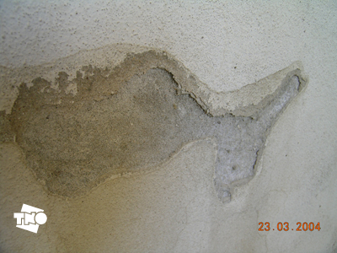
REPAIR OF PLASTERING WORKS
DEFECTS WHICH OCCUR IN PLASTERING WORKS-
Blistering- this occurs due local relative expansion of the finishing coat
Bond failure or loss of adhesion – this causes hollow patches , flaking of top coats , bulging or peeling of areas.
Cracking – caused due to structural movement , exposure to direct sun or shrinkage

Slide 21
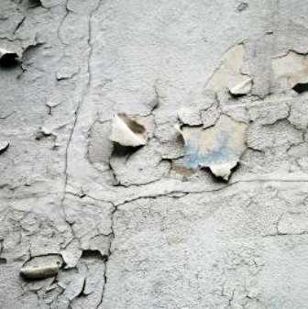
Crazing – caused due to tensile stress Efflorescence – caused due to presence of salts in masonry which dissolve in moisture entering in it Irregularity of surface - caused due to faulty workmanship. Recurrent surface dampness – due to presence of deliquescent salts in sands used in plastering

Slide 22
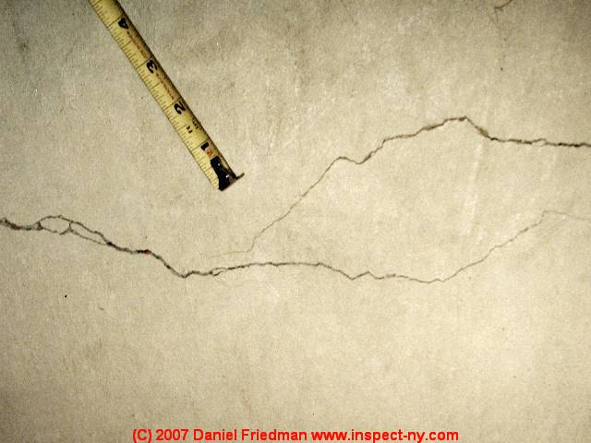
CRACKS IN RENDERING AND PLASTER ALONGWITH REMEDIAL MEASURES 1. Shrinkage cracks – shrinkage cracks in rendering plaster occur after the first dry spell . They may occur due to lack of bond with the masonry surface and is identified by tapping the affected surface which would produce a hollow sound. Crack due to sulphate action occur after 2 to 3 years from construction. Remedial measure would be to remove the plaster and renewing it after raking the joints 10 mm deep.

Slide 23
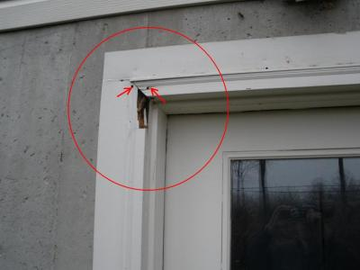
2. Cracks around door frames – this type of cracks occur due to shrinkage of wooden frames or due to loose fixing of door frames . Loose fixing causes vibration of frame and cracks develop at the junction . Cracks may also develop when the timber of the frame is not properly seasoned. As a preventative measure the timber should be properly seasoned and the frame should be rigidly fixed. As a remedial measure the junction of frame and masonry should be concealed by architraves.

Slide 24
REPAIR OF CRACKS IN RCC MEMBER OF A STRUCTURE
NATURE AND TYPE OF CRACKS
Random cracks in structure exposed to weather –these cracks occur after many years of construction maybe 15to 20 years ; they are likely to be caused due to shrinkage from carbonation of concrete.
Straight cracks in columns, beams and slabs – these cracks are parallel to reinforcement along with spalling of cover . Exposure of reinforcement may occur at places
Straight cracks in RCC sun shades and balconies – these cracks are straight and along the length occurring at intervals of 3 to 5 metres
They are due to shrinkage along with thermal action
Straight cracks in RCC slabs of long open verandahs – these cracks may occur at intervals of 6 to 8 metres parallel to the reinforcement. They are caused due to shrinkage and thermal contraction. These cracks are wider in winters

Slide 25
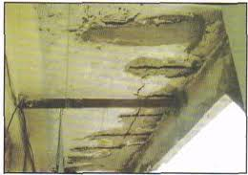
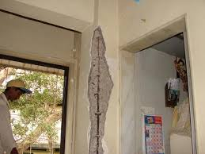
INSPECTION OF THE CRACKS Close inspection of the cracks is necessary to ascertain the nature of the damage. This may be done by sophisticated instruments or by visual comparing. Cracks are defined according to the width of separation : Fine – width less than 0.1mm Thin – width 0.1 to 0.3 mm Medium – width 0.3 to 0.7 mm Wide – width 0.7 to 2.0 mm Very wide – width >2.0 mm

Slide 26
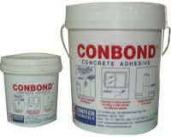
REPAIRS FOR STRENGTHENING OF RCC STRUCTURAL MEMBERS 1. Cracks in the RCC member – when we see cracks due to excessive bending moment , then the member is strengthened by adding reinforcing steel with proper key and bonding with the old member is done. 2. Cracks due to shear – these cracks are at 45 deg. To the axis of the member and are corrected by adding diagonal shear reinforcement in the form of stitching dowels 3. Cracks at support or at midspan bottom – they occur due to insufficient steel or insufficient provision of displacement of steel. They are corrected by addition of steel as required. The ends of the added steel are bent and inserted in the member by drilling.

Slide 27
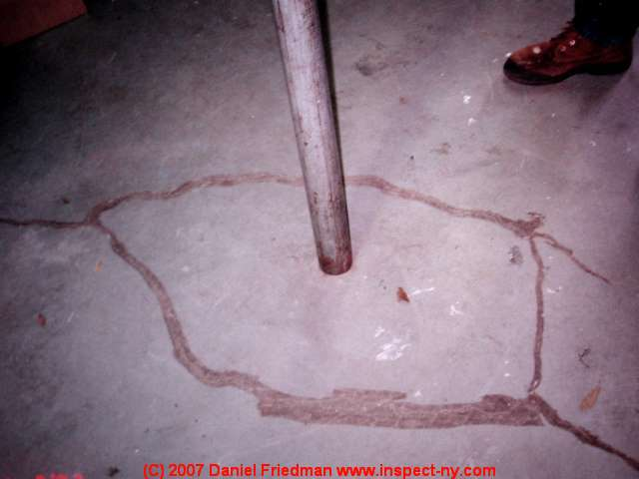
4. Pressure grouting - this method is used when the concrete has become porous but has not decayed. To check this, holes are drilled in the member as per requirement and cement slurry and/or chemicals are grouted under pressure and forced in the holes.

Slide 28
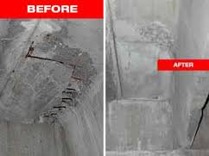
5. Cracks in foundation due to settlement – these when detected is often beyond repair , the foundation has to be redesigned with a wider base and/or the foundation has to be taken on soil having adequate bearing capacity. Cement slurry grouting is often used to increase the bearing capacity of soil. 6.Load relieving techniques – the member can be prestressed externally by placing prestressing wires on both sides and then inducing tension.

