Slide 1
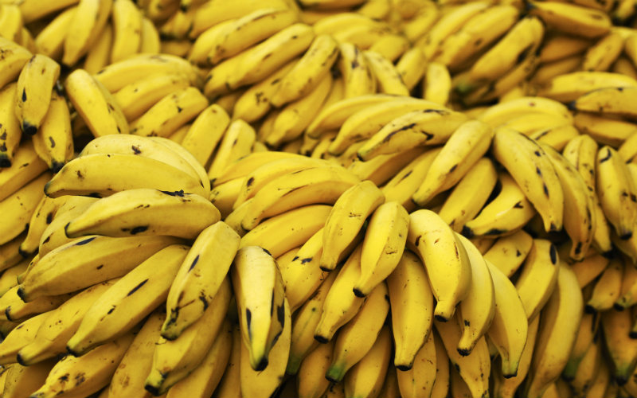
Banana
Prof. Dr. Sarfraz Hussain

Slide 2
Introduction
Most cultivars of edible bananas are derived from two members of the family Musaceae: Musa acuminate and Musa balbisiana
Bananas are eaten mainly raw as a dessert fruit because they are sweet when ripe.
The edible cultivars of bananas are seedless
The two obvious tissues that constitute the fruit are the pulp and the peel.
The peel is the ovary wall

Slide 3
Continued . .
The pulp originates from cell division of the innermost layers of the pericarp. The growth of the peel begins to slow down as the fruit matures but the growth of the pulp continues.
Consequently, peel splitting often occurs in very mature green fruit (Turner 1997)

Slide 4
Nutritional Composition

Slide 5
Quality Characteristics and Criteria
A premium quality banana is very clean (free from defects such as scars, physical damage, insect injury, and latex staining)
free from decay, has an adequate finger length and diameter, does not have excess curvature, and, upon ripening, has the desired uniform bright-yellow color and sensory attributes in flavor (sweetness and acidity) and aroma
Attributes are defined by consumer preference.

Slide 6
Horticultural maturity indices
Commercially, bananas must be harvested while mature green and they are transported to destination markets where they are ripened under controlled conditions
The stage of maturity for harvesting the fruit depends on the market for which it is intended
One very useful criterion for harvesting fruit that is used commercially is age of the bunch after emergence from the pseudostem.

Slide 7
Continued . . .
Because bananas are growing rapidly when harvested, fruit size (finger length and diameter) and finger fullness (angularity) are suitable measures of harvest maturity

Slide 8
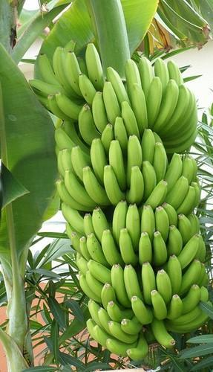

Slide 9
Grades, Sizes, and Packaging
Minimum acceptable size (length and diameter) grade standards for export markets vary depending on banana
Hands, clusters, or single fingers not meeting these fresh market grades are used for processing products or discarded.

Slide 10
Precooling Conditions
Precooling of bananas is not generally done. Adequate cooling is not initiated until fruit are loaded into containers or cargo holds aboard ships.

Slide 11
Optimum Storage Conditions
Optimum temperatures for storage and holding of green bananas are 13 to 14 ºC (56 to 58 ºF)
Optimum RH for holding and transporting fruit is 90 to 95%. Holding of ripe fruit should be kept to a minimum

Slide 12
Controlled Atmosphere (CA) Considerations
Bananas respond well to CA
CA is used commercially during ocean transport of green bananas
Modified atmosphere packaging using polyethylene bags (banavac) is used for bananas
Optimum gas levels for most cultivars range between 2 to 5% O₂ and 2 to 5% CO₂

Slide 13
Continued . . .
Main benefits of controlled atmosphere include delaying of ripening, reduction of crown rot incidence and a much fresher condition
O₂ levels below 1 to 1.5% may cause grayish or brown peel discoloration, failure to ripen properly, and off flavor

Slide 14
Retail Outlet Display considerations
Fruit should be displayed at retail in non refrigerated areas in the produce section
Existing refrigerated shelf space in supermarkets normally is below the minimum safe temperature for bananas and chilling injury can still occur in ripe fruit.
Displaying surfaces should be cushioned to avoid physical damage to the fruit.

Slide 15
Chilling Sensitivity
Chilling injury is an important disorder of bananas
Chilling injury results from exposing fruit to temperatures below about 13 ºC (56 ºF) for a few hours to a few days, depending on cultivar, maturity, condition of the fruit, temperature, and duration of exposure

Slide 16
Suitability as Fresh-Cut Product
Bananas are not good candidates for fresh-cut processing because of their very high oxidation and browning potential

Slide 17
Special Considerations
Mechanical damage in bananas takes several forms that vary in importance depending on the perceptions of consumers.
Banana peel is very sensitive to mechanical damage. Export markets for bananas require a blemish-free fruit
Great care during handling is needed at all times. Bruising of the pulp is undesirable and cannot always be detected from damage to the peel
RH levels below 85 to 90% accentuate symptoms of mechanical damage

