Slide 1
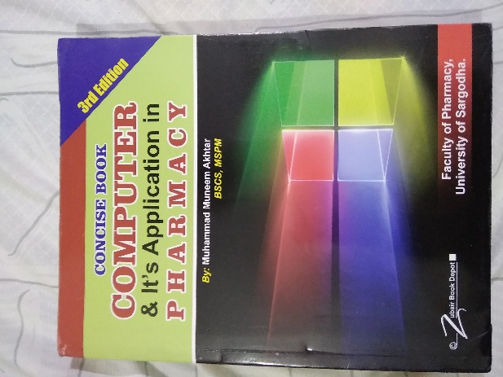
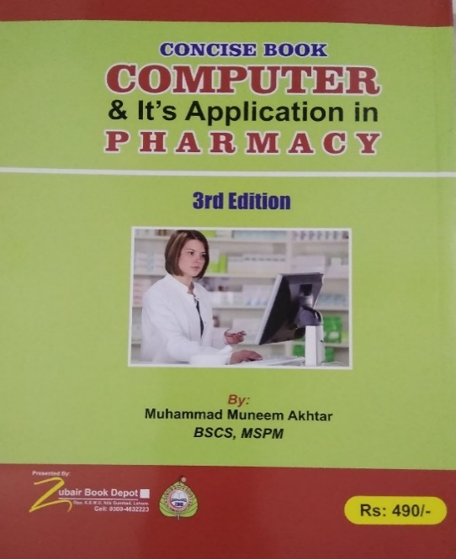
Componets of Computer
03
Recommended For
Part
Pharmacy Student!
Pharm-D (Doctor of Pharmacy),
DPT (Doctor of Physiotherapy) &
Pharmacy Technician.
Muhammad Munim Akhtar

Slide 2
Welcome to
IT Expertise
with
Munim akhtar
Free online quality educational tutorials.

Slide 4
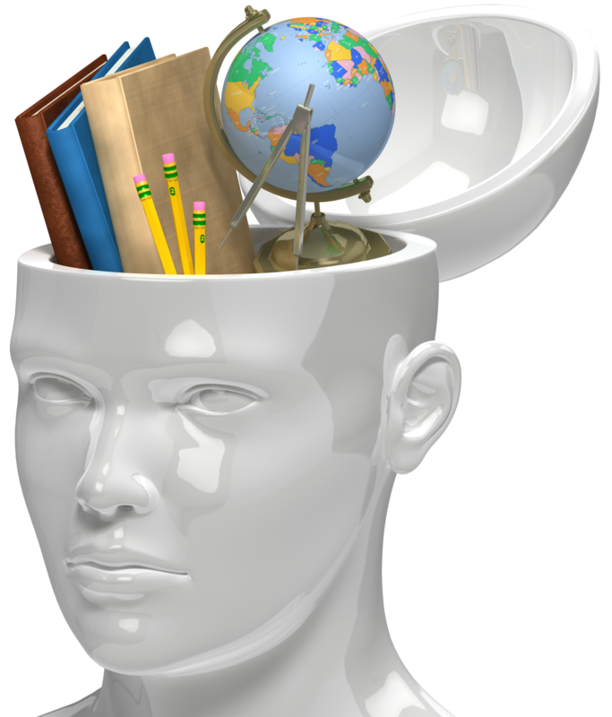
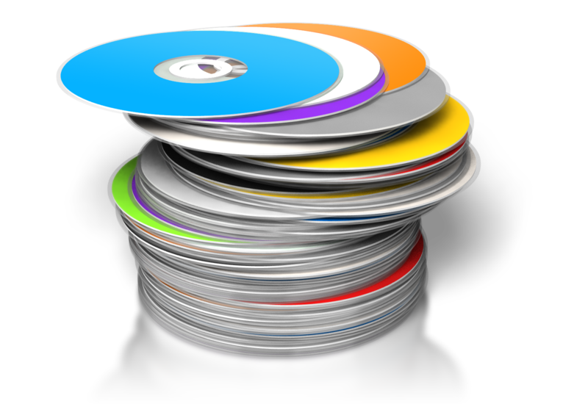
What is Backing Storage Devices
A type of devices allow you to store data permanently,
When the computer is switched off, data remain present
e.g., Disks, USB Flash Drive, Primary Memory etc.

Slide 5
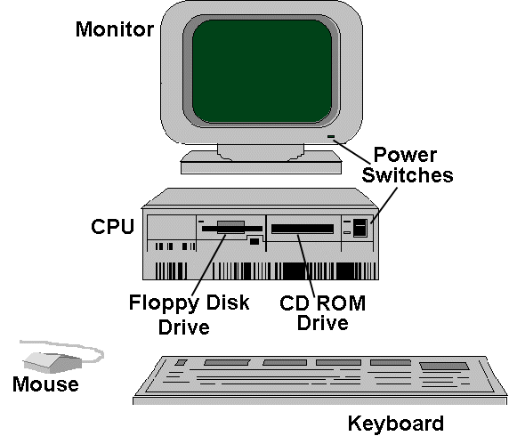
COMPONENTS OF COMPUTER

Slide 6
Computer Hardware
MOTHER BOARD
INPUT DEVICES
STORAGE DEVICES
OUTPUT DEVICES
OTHER PERIPHERALS

Slide 7
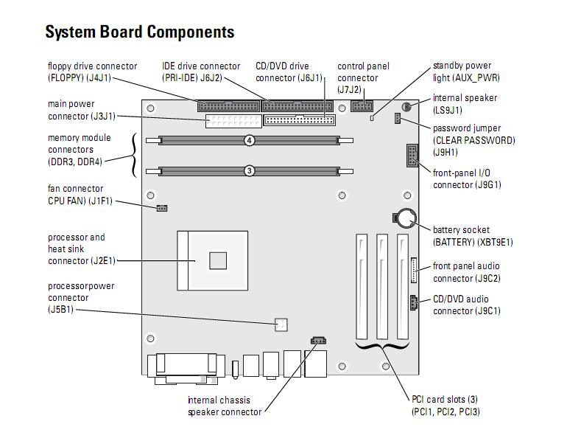

Slide 8
Motherboard
CPU
RAM
BIOS
Cooling system
PCI Slots

Slide 9
1. Central Processing Unit (CPU)
CPU or central processing unit is the main processing unit
It determines the performance of the computer (processor speed)
Can be said a BRAIN of computer
Currently Pentium Chip (Processor) are most popular

Slide 10
2.RAM
One of most important part of computer
Random Access Memory RAM stores information temporarily
More RAM in the computer more faster computer works
RAM is in the form of a chip and different vendors have developed the RAM of different capacities

Slide 11
3.BIOS
BIOS: Basic Input/Output system is a set of instructions in ROM
Used to start most basic services of computer system
Computer have more than one BIOS

Slide 12
4. Cooling system
A cooling mechanism prevent damage to computer from heat
Contains fans and sinks
The CPU, Computer case, power supply, some Hard disk, some adapter cards need cooling

Slide 13
5. PCI slots
Slot is the space provided on motherboard used to increase functionality of computer
There are RAM slots, AGP slots and expansion slots.

Slide 14
?
THANK YOU

