Slide 1
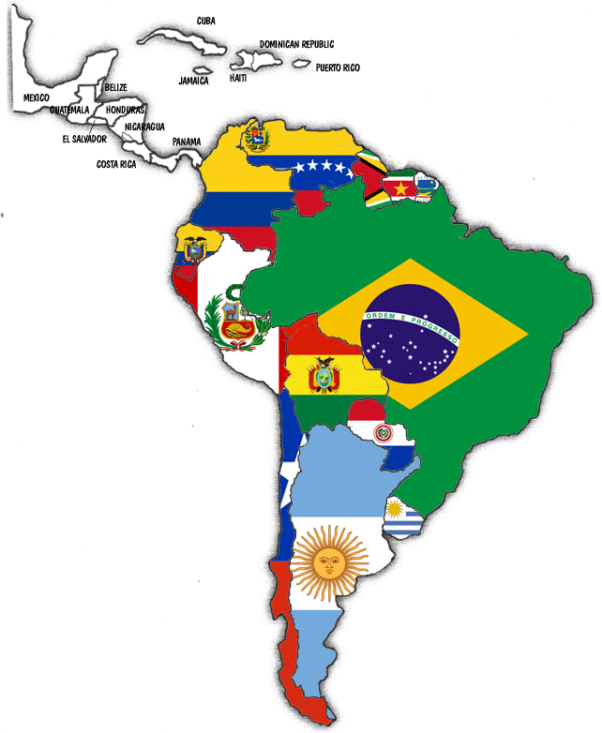
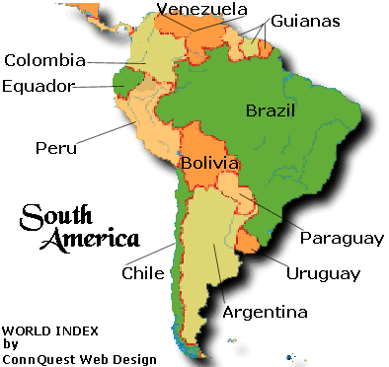
NEOTROPICAL REGION

Slide 2
Biogeography
Biogeography ------ study of the distribution of plants and animals over the surface of earth in both space and time
Biogeography describes the distributions of:
Particular species
Habitats (ecosystems)
Species or ecosystems mappings ------ very important from a conservation and land management viewpoint

Slide 3
Ecozone
Ecozones or biogeography realm represent large areas of the earth's surface where plants and animals developed in relative isolation over long periods of time.
They are separated from one another by geologic features:
oceans
deserts
high mountain ranges
They form barriers to plant and animal migration.

Slide 4
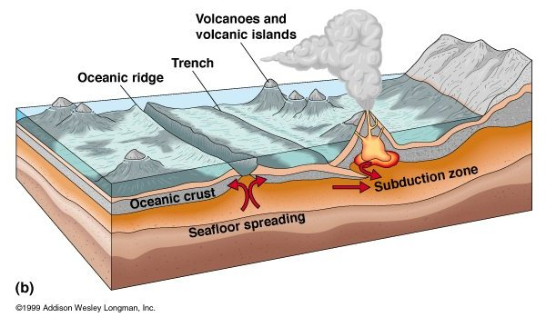
REDISTRIBUTION BY PLATE TECTONICS:
The patterns of plant and animal distribution in the world's ecozones was shaped by the process of plate tectonics, which has redistributed the world's land masses over geological history

Slide 5
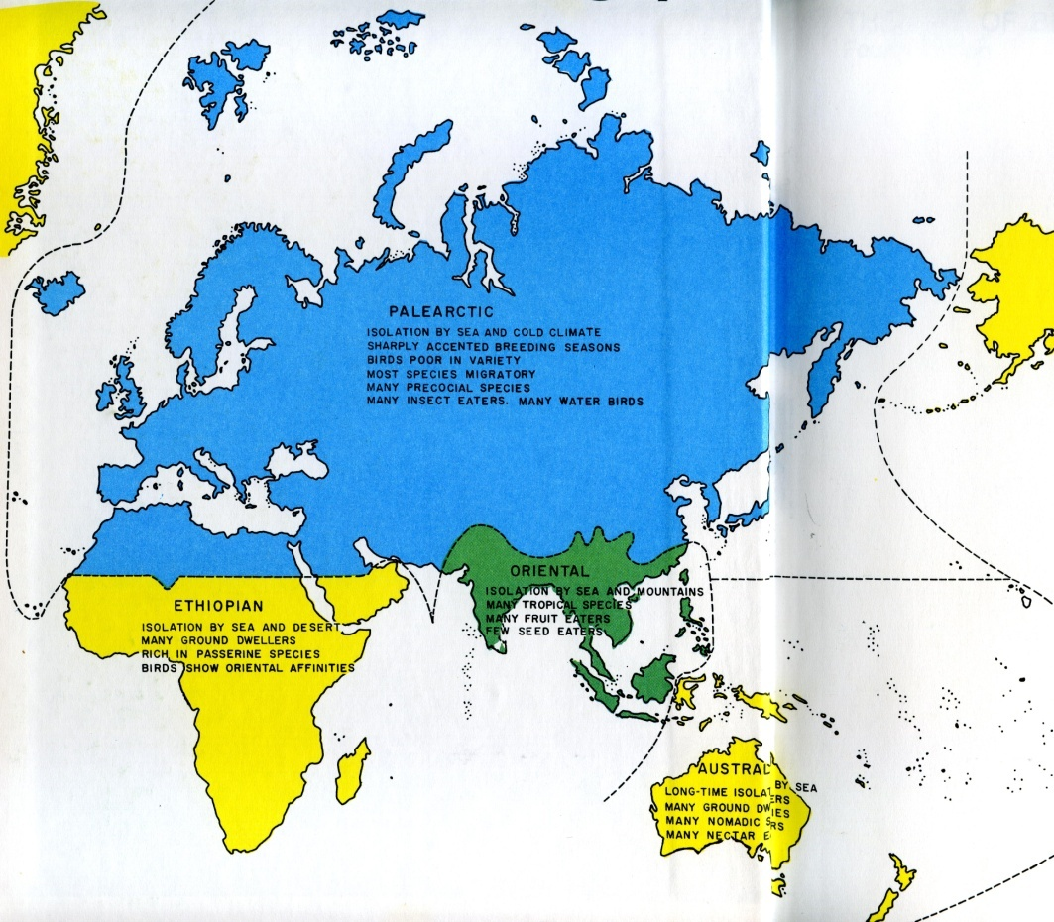
WWF Ecozones (8)
Palearctic :
87.7 mil. km²
Eurasia and North Africa

Slide 6
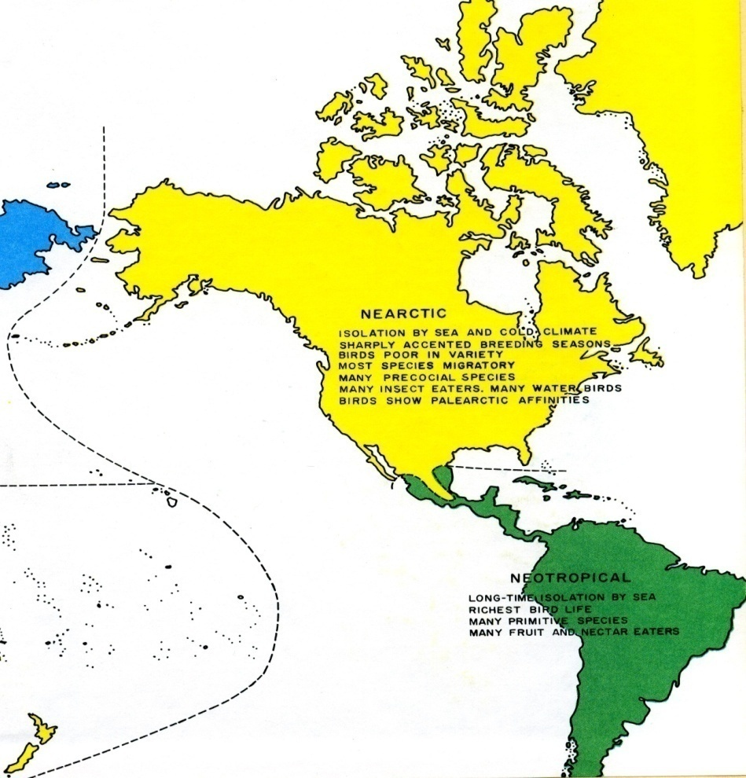
Nearctic :
54.1 mil. km²
North America
NEARCTIC

Slide 7
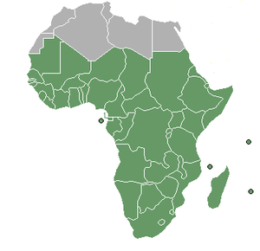
3) Afro tropic :
22.1 mil. km²
Sub-Saharan Africa
Sub Saharan Africa

Slide 8
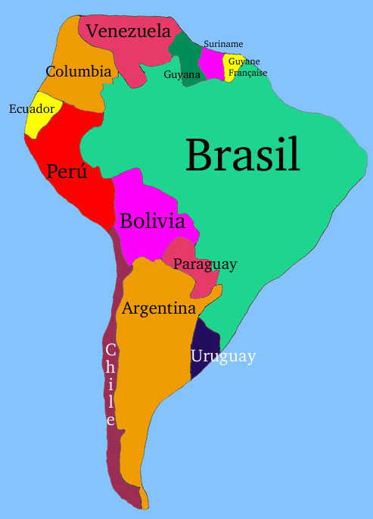
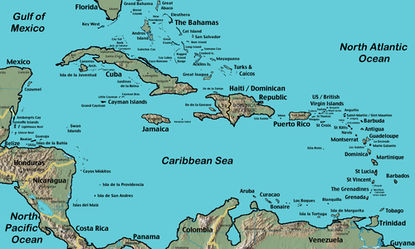
Neotropic :
19.0 mil. km²
South America and the Caribbean
Caribbean
South America

Slide 9
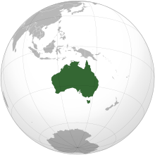
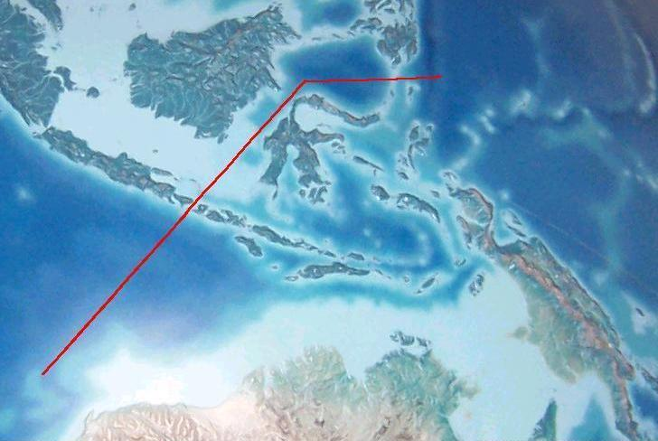
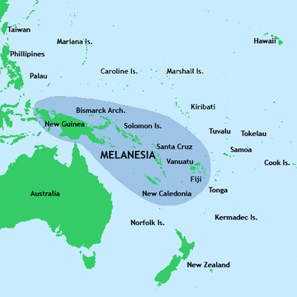
5) Australasia :
7.6 mil. km²
Australia, New Guinea, and neighboring islands
The northern boundary of this zone is known as the Wallace line.
New ginea

Slide 10
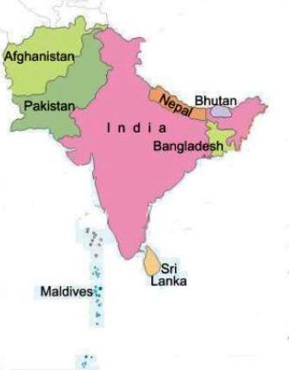
6) Indo-Malaya :
7.5 mil. km²
Afghanistan, Pakistan, India,
Bangladesh,Srilanka,Maldives
Bhutan and Nepal.

Slide 11
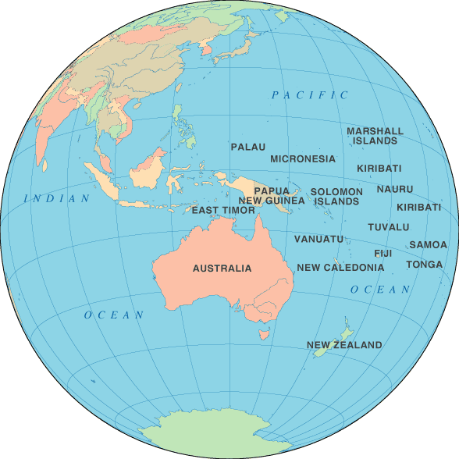
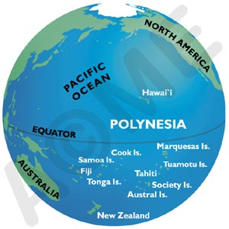
Oceania :
1.0 mil. km²
Polynesia, Fiji and Micronesia
Notes:
Polynesia is a sub region of Oceania, comprising a large grouping of over 1,000 islands.

Slide 12
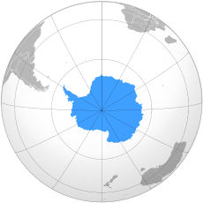
8) Antarctic :
0.3 mil. km²
Antarctica.
Antarctica

Slide 13
Bioregions
WWF scheme subdivides the ecozones into bioregions :
“Geographic clusters of ecoregions that may span several habitat types, but have strong biogeographic affinities, particularly at taxonomic levels higher than the species level (genus, family)."
1) Afrotropic
Eastren Africa
Western Africa
Southern Africa
Malagasy
2) Antarctic
Notes:
Malagasy is a language spoken in Madagascar

Slide 14
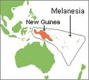
3) Australasia
Wallace
New Guinea
Melanesia
4) Indomalaya
Indian subcontinent
Indochina
Sunda Shelf and Philippines

Slide 15
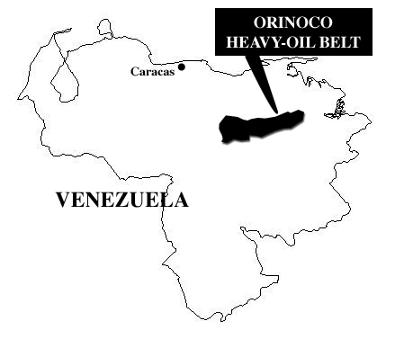
5) Nearctic
Canadian Shield
Eastern NA
Northern Mexico
Western NA
6)Neotropical
Amazonia
Caribbean
Central America
Central Andes
Eastern SA
Northern Andes
Orinoco
Southern SA
7)Oceania
8) Palearctic
European region
Mediterranean
region
Siberian region
Manchurian
region

Slide 16
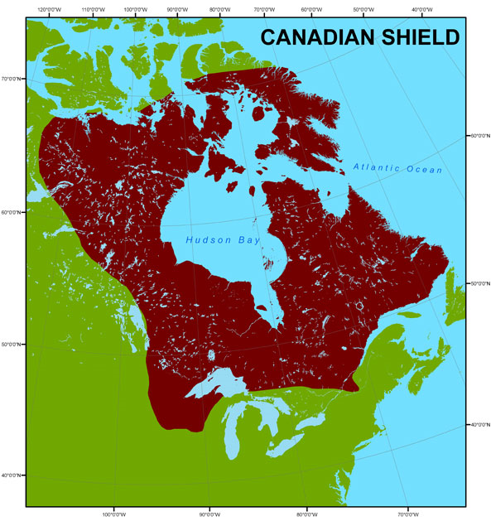
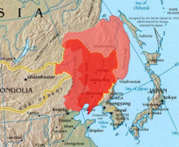
Manchurian
region
Notes:
Canadian Shield is a vast geological shield covered by a thin layer of soil. It is an area mostly composed of igneous rock

Slide 21
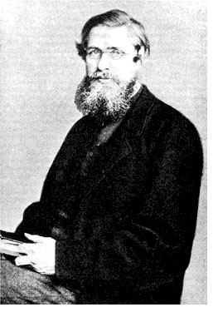
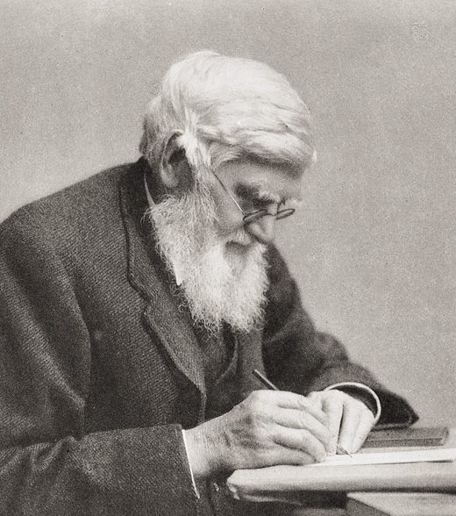
Alfred Russell Wallace

Slide 22
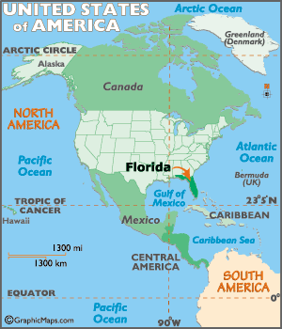
NEOTROPICAL REGION
EXTENT :
This region includes South and Central America, the Mexican lowlands, the Caribbean islands, and southern Florida

Slide 23
History
South America was originally part of the supercontinent of Gondwana, which included
Africa, Australia, India, New Zealand
and Antarctica.
Neotropic shares many plant and animal lineages with these other continents, including Marsupial mammals and the Antarctic flora.

Slide 24
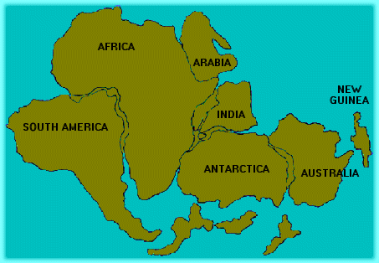
supercontinent of Gondwana

Slide 25
About 4 million years ago, South America was joined with North America by the formation of the Isthmus of Panama.
This junction allowed a biotic exchange between the two continents, the
Great American Interchange.
South American species like the Armadillo moved into North America.
North Americans species like the ancestors of South America's camelids, including the
Genus llama moved to south American.

Slide 26
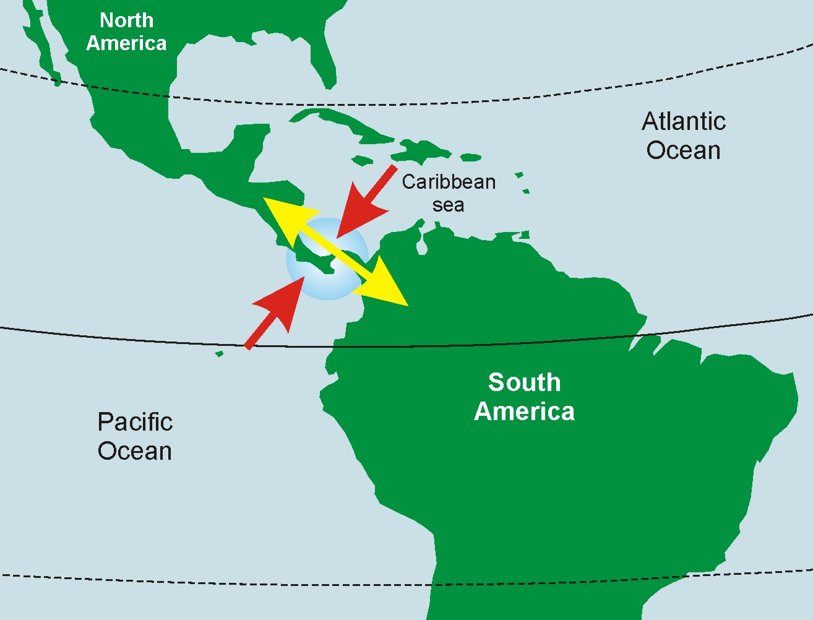
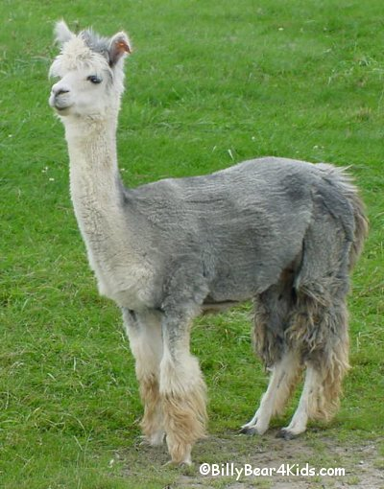
Isthmus of Panama.
llama

Slide 27
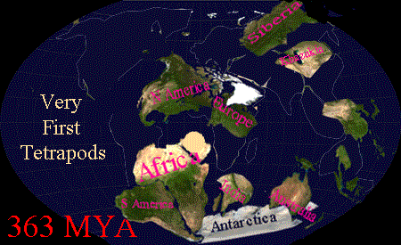
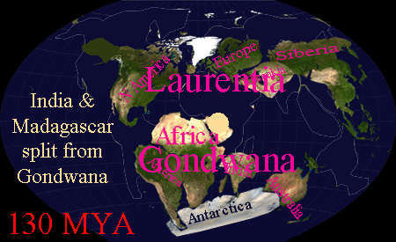
130 MYA
363 MYA

Slide 28
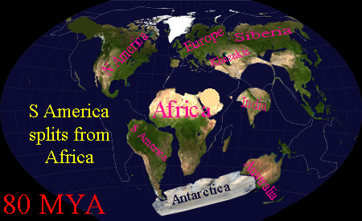
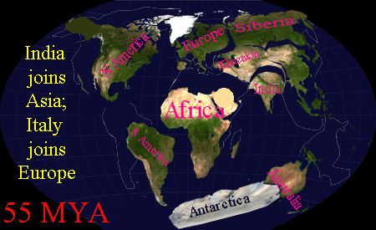
55 MYA
80 MYA

Slide 29
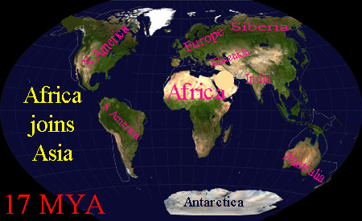
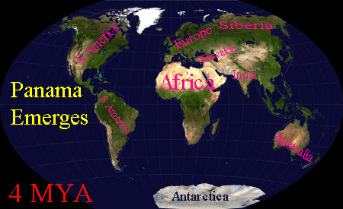
4 MYA
17 MYA

Slide 30
Physical feature & Climate:
Mostly tropical but southern region extends into
the southern tip, the temperate zone.
The Amazon River basin has high rain fall all
around the year.
The non –tropical part of S. America is covered
with treeless grassy plains ,the “Pampas”.
In extreme south there is severe climate of
southern Patogonia.
Notes:
Patagonia is a geographic region containing the southernmost portion of South America. It is located in Argentina and Chile

Slide 31
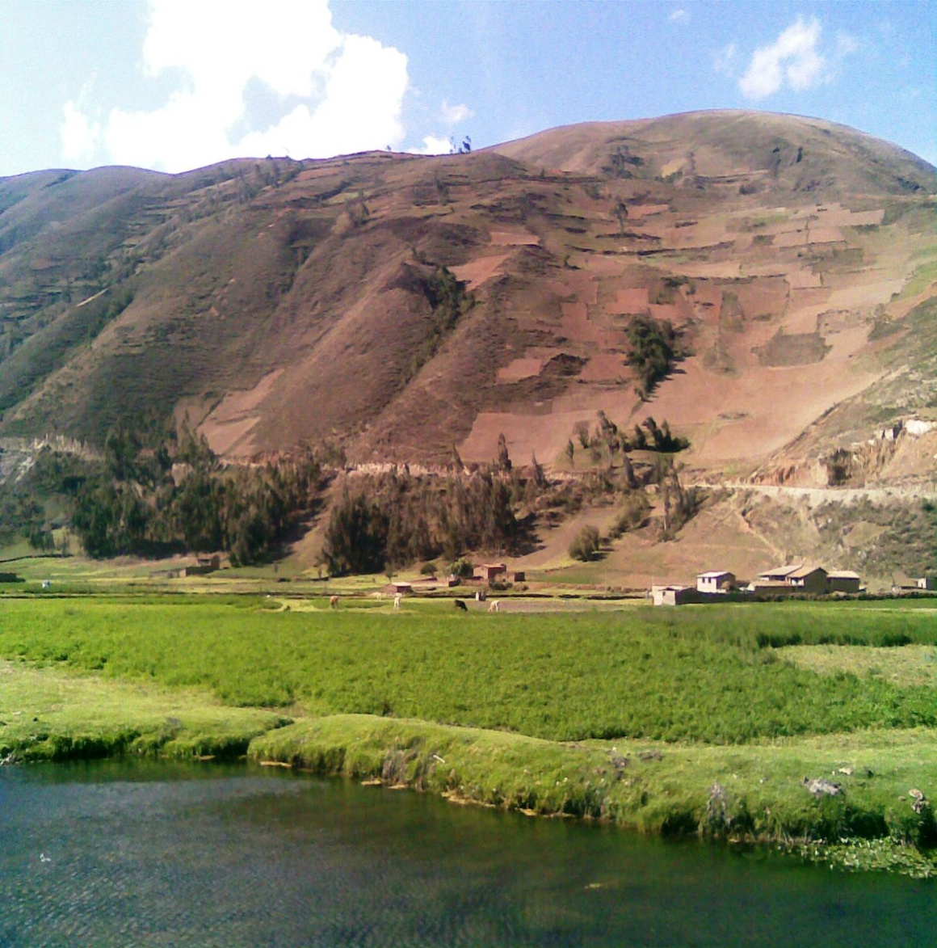
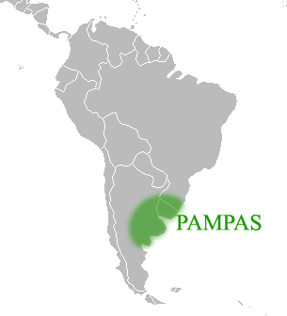

Slide 32
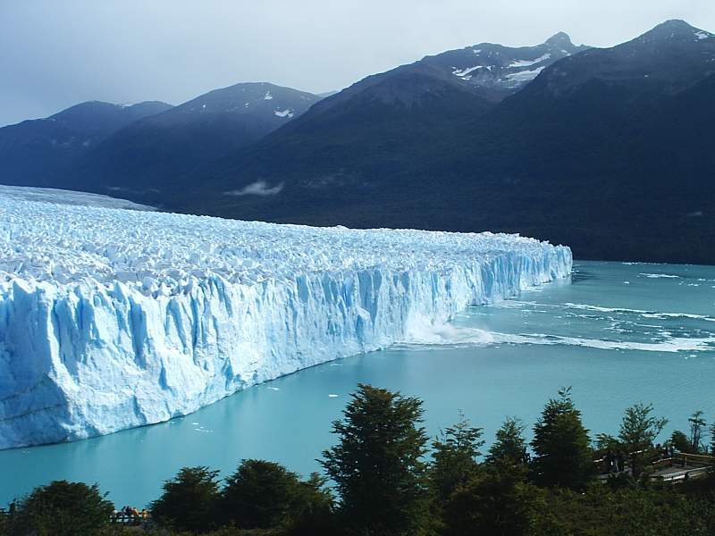
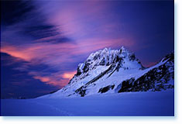

Slide 33
FACTS/ AFFINITIES :
Of all the regions ,Neotropical region has highest number of Endemic families of
vertebrates.
Many of the commonly occurring mammals are not present in this Region, like there are no hedge hogs ,moles, beavers, hyenas & native Horses.

Slide 34
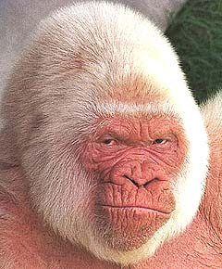
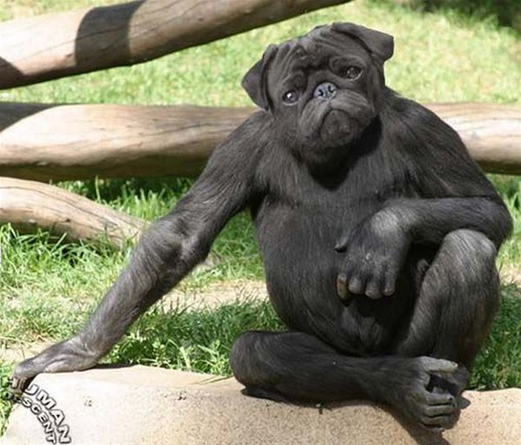
FACTS/ AFFINITIES
There are no anthropoid
apes & dog faced monkeys
Anthropoid apes
Dog faced monkey
Notes:
Anthropoid apes or manlike apes, the name given to the family of the Simiidae, because, of all the ape world, they most closely resemble man.

Slide 35
FACTS/ AFFINITIES
The Neotropic includes more tropical rainforest than any other ecozone.
These forests extends from southern Mexico through Central America and northern South America to southern Brazil, including the vast Amazon Rainforest.
These rainforest regions are one of the most important reserves of biodiversity on Earth.
There are no deserts in this region.

Slide 36
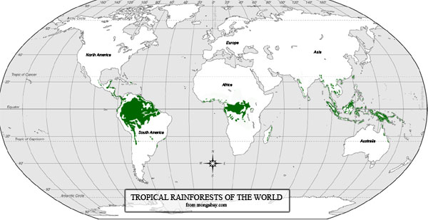
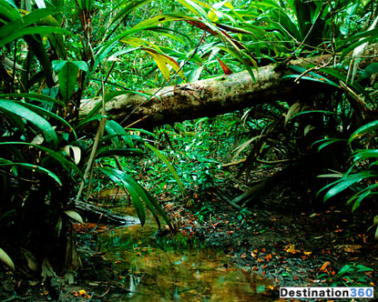
Amazon Rainforest

Slide 37
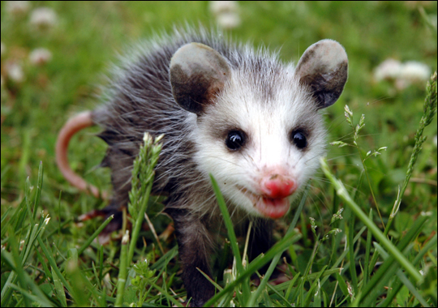
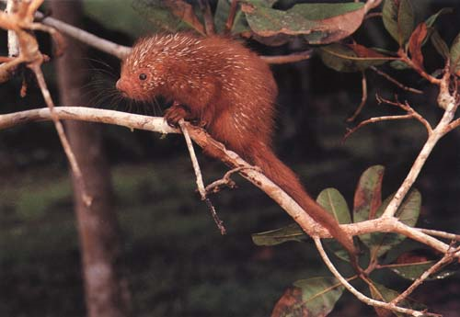
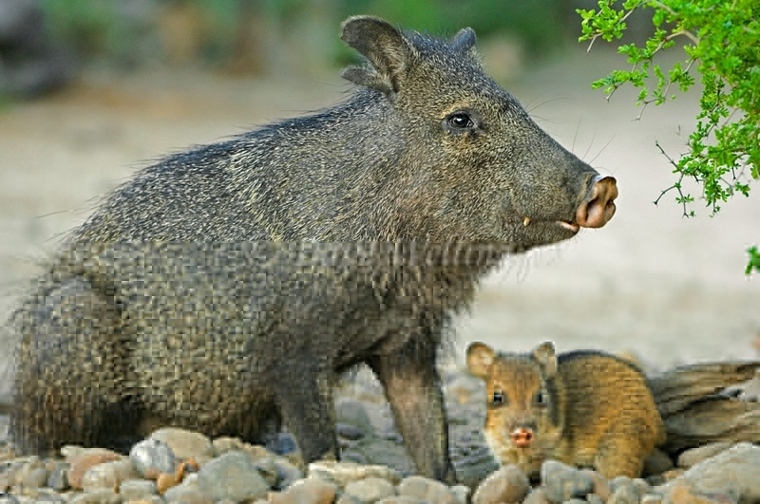
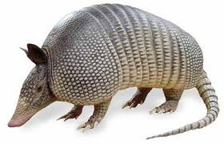
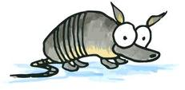
Shared fauna between Nearctic & Neotropical region:
Tree porcupine
opossum
Peccaries
Armadillo
Notes:
The tree porcupine is one of the largest rodents in North America. Peccaries is a medium-sized mammal of the family Tayassuidae, or New World Pigs.

Slide 38
Major ecological regions
divided into 4 sub- regions.
1) Chillian sub region
2 ) Brazilian sub region
3) Mexican sub-region
4) West Indies sub-region

Slide 39
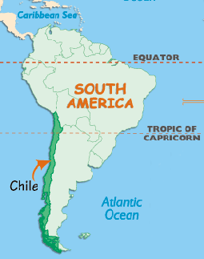
Chilean Sub-region :
It includes West Coast of
South America.
It contains Andes mountain
ranges in Bolivia, Peru &
Argentina.
Notes:
The Andes is the world's longest continental mountain range. It is a continual range of highlands along the western coast of South America.

Slide 40
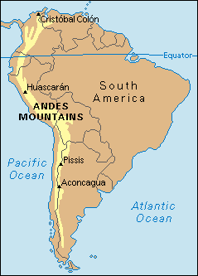
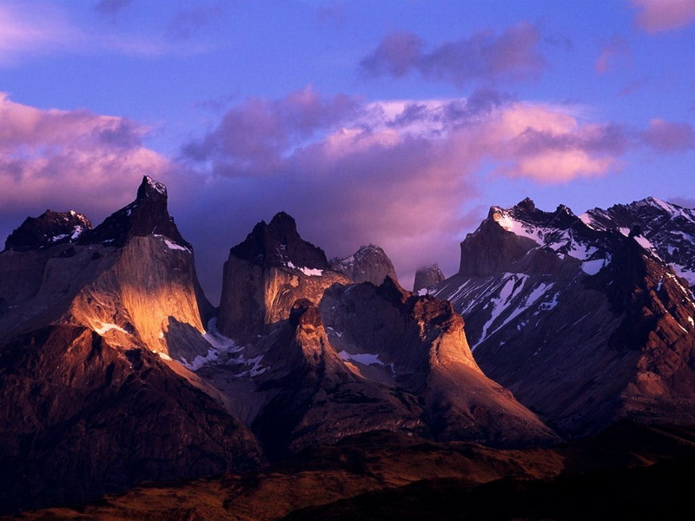
Andes mountain

Slide 41
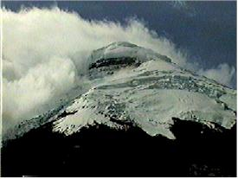
ACTIVE VOLCANO OF NEOTROPICAL REGION
At the highest elevations, there are volcanic peaks along the Andes Mountain chain.
Cotapaxi, at 19,342 feet, is the highest active volcano in the world , present in this sub region.

Slide 42
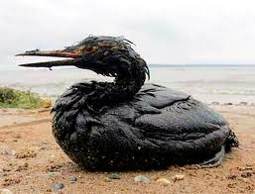
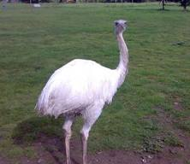
In this sub region
3 toed Ostrich
called Rhea Americana,
Clams & Oil birds are common
Oil birds
Clams
Rhea

Slide 43
2) Brazilian Sub region :
It includes tropical forests of South America.
It shows evergreen forests. Plains are also seen .Rivers are present hence more vegetation is seen.
Brazilian Sub region

Slide 44
It supports rich fauna. in this region American Monkey, Blood sucking bats (Vampire) & Armadillos are common. ‘
American Monkey
Armadillo
Vampire
Notes:
Armadillo is a borrowing mammal

Slide 45
3) Mexican Sub-region :
North of isthmus of Panama is called Mexican sub- region.
This region shows rocky mountains.
Mexican Sub-region
rocky mountains

Slide 46
In this region Tapiers, Mud terrapins etc. are common
Tapiers
.
Mud terrapins
Notes:
Tapiers are the pig like browsing mammals.
Mud terrapins are turltles.they hibernate underwater in mud.

Slide 47
4) West Indies or Antelian Sub-region:
The region contains West Indies, islands.
These islands contain mountains.
In this sub-region the Vertebrate fauna is poor.

Slide 48
5 MOST DANGEROUS VOLCANOS OF NEOTROPICAL REGION
A volcano is an opening, in crust, which allows hot magma, volcanic ash and gases to escape from below the surface.

Slide 50
1) Copahue that lies in both Argentina and Chile.
It’s elevation is 9.728 ft.
The volcano was formed approximately 0.6 million years ago

Slide 51
2) Parinacota, located in Chile and Bolivia.

Slide 52
3) Sajama, in Bolivia.
It has not erupted in the last 10,000 years.

Slide 53
4) Guallatir ,in Chile.
This volcano is still treated as the active one
(erupt regularly ).
Its recent eruption took place in 1985.

Slide 54
5) Lascar, in Chile.
It is an active one.
The last eruption was in 1993.

Slide 55
Fauna in Neotropical region :
This region has wealth of
Peculiar
Diverse
Specialized fauna .
Represented by155 families of terrestrial vertebrates.
Have highest number of endemic families of vertebrates i-e 39.

Slide 56
Fishes in Neotropical region:
Many fresh water fishes are present.
The important features of the regions are the absence of Carps.
In this region South American Fresh water Lung fish is present.
Cat fishes, Edi fishes, guppies, characins (shared by Ethiopian region) are
common.

Slide 57
guppy
guppy
Lung fish
Lung fish
characins
Cat fish
Notes:
Carracin family is shared with ethopian region.

Slide 58
Gymnotids ( electric eel) are not related to
mormyrids of Ethopian region.
Mormyrid
Gymnotid
Notes:
The family Mormyridae, sometimes called "elephantfish“,have large brain size and unusually high intelligence,have ability to generate weak electric fields .electric eel is capable of generating powerful electric shocks, which it uses for both hunting and self-defense. It is an apex predator in its South American range

Slide 59
Amphibians in Neotropical region:
greatest amphibian diversity.
In this zone 14 families of Amphibians are present.
82 species of caecilians & about 200 species of salamanders.
Tree frog & tailed amphibians are only represented by one family Oedipus in this region.
Notes:
The caecilians are an order (Gymnophiona) of amphibians that superficially resemble earthworms or snakes. They mostly live hidden in the ground, which makes them one of the least known orders of amphibians

Slide 60
14 families of Amphibians
Bufonidae
Centrolenidae
Dendrobatidae
Hylidae
Leptodactylidae
Microhylidae
Pipidae
8) Ranidae
9) Rhinophrynidae
10) Ambystomatidae
11) Plethodontidae
12) Salamandridae
13) Sirenidae
14) Caeciliidae

Slide 61
Harlequin frog
Pipa pipa
Tree frog
Poisonous dart frog

Slide 62
salamander
caecilian
Notes:
Salamander has slender bodies, short noses, and long tails

Slide 63
Reptiles in Neotropical regions :
The reptiles of the region will resemble those of Ethiopian and Oriental zone.
Alligator ,Crocodiles,
Many turtles, and Tortoises
are common.
Alligator
5 families of lizards are reported
in this region
1) Helodermidae ( Poisonous lizard)
2)Andidae
3) Crcosauridae etc.,
turtle

Slide 64
side necked turtles
tegus
Caimans
agamid
lizards
geckos
anaconda
Notes:
Caimans are crocodiles,tegus is a lizard ,side necked turtle has long and moveable neck.

Slide 65
Coral snake
Pit viper
Boas
Heloderma

Slide 66
Birds in Neotropical:
Avian fauna of this region is striking and peculiar.
Hence South America is called Bird continent.
It has
3300 species (dominated by non passerines)
>95 families
31 endemic families

Slide 67
There is scarcity of song birds in
this region.
Except quail there is no representative of
pheasant family.
Neotropical birds breed in Canada and the United States during the northern hemisphere’s summer and spends the rest of the year in the tropics.
quail

Slide 68
Rheas
Tinamus
Duck
Pigeon

Slide 69
Parrot
Wood peckers
toucan
macaws

Slide 70
trumpeters
hoatzins
Tanager
Humming bird

Slide 71
Oven bird
Ant birds
Notes:
Nest of oven bird is oven like, and ant birds feed on ants.

Slide 72
Mammals in Neotropical region:
32 families are available.
Nearly 16 families are endemic to this region.
Endemic mammalian order is Edentata, have 3 different families:
1) Sloths (Arboreal) : live upside down life
on trees .
2) Ant eaters :tubular toothless mouth.
3) Armadillos (Fossorial) :burrowing mammals.

Slide 73
2 families of marsupials occur in this region .
1) Caenoloestide is exclusive ,includes shrew opossums.
2) Didlephidae ,also found in Nearctic region;
includes opossums.
There are 11 endemic families of rodents in
this region .
There are 5 indigenous families of bats in
this region .
Notes:
shrew opossum: small, shrew-like marsupials which are confined to the Andesmountains of South America.

Slide 74
Armadillo
sloth

Slide 75
SOUTH AMERICAN MONKEYS :
South American monkeys are diverse as they are brilliantly colored with flat nose and prehensile tail. They are also smaller in size.
They belong to 2 families ,namely,
Cebidae and callithricidae.
New world monkey

Slide 76
DISCONTINOUS DISTRIBUTION OF MAMMALS
2 Neotropical families show discontinous distribution :
Camelidae
Tapirs
Camelidea is present in Paleartic region but in
Neotropical region it is represented by endemic Genus Llama.
Tapirs are found in Malaya, Java, & Sumatra on one side. Central & South America on the other.

Slide 77
MARSUPIALS
First radiated in South America and
migrated to Australia during Cenozoic
period.

Slide 78
S.American

Slide 79
Dispersed south to South America, Antactica and Australia, and East to Europe & north Africa
Marsupials in North America and Europe went extinct, possibly due to radiation and expansion of the Eutherians

Slide 80
There are two primary divisions of Marsupials:
American marsupials.
Australian marsupials.
The Order Microbiotheria is found in South America.
It has only one specie, the monito del monte.
The term opossums is properly used to refer to the American species.

Slide 81
More than 60 different kinds of opossums live in South America and 1 in North America, the Virginia opossum.
.
Virginia opossum.

Slide 82
American Marsupial
Opossum
Rat Opossums

Slide 83
Monito del Monte

Slide 84
Neotropic Terrestrial regions (11)
1) Tropical and subtropical moist broadleaf forests:
In Argentina,Brazil,Bolivia,Peru,Colombia,
Venezuela ,Mexico ,Ecuador, Panama.

Slide 85
2) Tropical and subtropical dry broadleaf forests :
Argentina,Brazil,Bolivia,Peru,Colombia,
Venezuela, Mexico, Ecuador, Panama.

Slide 86
3) Tropical and subtropical coniferous forests:
In Mexico, Cuba.

Slide 87
4) Temperate broadleaf and mixed forests:
In Chile, Argentina, Bolivia, Peru.

Slide 88
5) Tropical and subtropical grasslands, savannas, and scrublands :
In Bolivia, Brazil ,Paraguay.
6) Temperate grasslands, savannas, and shrub lands:
Temperature: warm to hot season
Soil: fertile with rich nutrients and minerals
Animals: have large, grazing
mammals & birds
In Argentina, Chile.
Notes:
Savannas is a region where herbaceous vegetation predominates and have dispersed vegetation.
Scrubland have low shrubs, uncultivated area covered with sparse stunted vegetation.

Slide 89
7) Flooded grasslands and savanna:
Flooded grasslands and savannas is characterized by:
temperature : warm
soil : nutrient rich soil
In Bolivia, Brazil, Paraguay.

Slide 90
8) Montane grasslands and shrub lands :
Montane grasslands and shrub lands is a biome defined by the WWF.
The biome includes high altitude ,grasslands and shrub lands around the world.
In Argentina, Bolivia, Chile, Ecuador, Peru.

Slide 91
Montane grasslands

Slide 92
9) Mediterranean forests, woodlands, and scrubland :
Characterized by dry summers and rainy winters.
In Chile.

Slide 93
10) Deserts and xeric shrub lands :
In Chile, Peru, Venezuela.

Slide 94
11) Mangrove:
In, Peru, Ecuador, ,Brazil, Panama, Mexico.
Notes:
MANGROVES ARE THE MEDIUM SIZED TREES & SHRUBS GROWN IN SALINE SEDIMENT HABITAT.

Slide 96
QUESTIONS ARE
GUARENTED
IN LIFE
BUT
ANSWERS ARE NOT

