Slide 1
Exploring the Oracle Database Architecture

Slide 2
Objectives
After completing this lesson, you should be able to:
List the major architectural components of Oracle Database
Explain the memory structures
Describe the background processes
Correlate the logical and physical storage structures

Slide 3
Oracle Database
The Oracle relational database management system (RDBMS) provides an open, comprehensive, integrated approach to information management.
Oracle Database
A database is a collection of data treated as a unit. The purpose of a database is to store and retrieve related information.
Oracle Database reliably manages a large amount of data in a multiuser environment so that many users can concurrently access the same data. This is accomplished while delivering high performance. At the same time, it prevents unauthorized access and provides efficient solutions for failure recovery.

Slide 4
Connecting to a Server
Multitier architecture shown
Client
Middle tier
Server

Slide 5
Connecting to a Server
A database user can connect to an Oracle server in one of three ways:
The user logs on to the operating system running the Oracle instance and starts an application or tool that accesses the database on that system. The communication pathway is established using the inter-process communication mechanisms available on the host operating system.
The user starts the application or tool on a local computer and connects over a network to the computer running the Oracle database. In this configuration (called client/server), network software is used to communicate between the user and the back-end server.

Slide 6
Oracle Database Architecture: Overview
Instance
SMON
PMON
RECO
Others
SGA
Shared pool
Library
Database
Redo log
cache
buffer
buffer
cache
Data dictionary
cache
PGA
Server
DBW
n
CKPT
LGWR
ARC
process
n
User
Archived
process
Control
Online redo
log files
Data files
files
log files
Database

Slide 7
Oracle Database Architecture
An Oracle database consists of an instance and its associated databases. The instance consists of memory structures and background processes. Every time an instance is started, a shared memory area called the System Global Area (SGA) is allocated and the background processes are started.
The database consists of both physical structures and logical structures. Because the physical and logical structures are separate, the physical storage of data can be managed without affecting access to logical storage structures.
Notes:
A DB instance is a set of memory structures that manage database files.

Slide 8
Connecting to the Database
Connection: Communication between a user process and an instance
Session: Specific connection of a user to an instance through a user process
User
Server
User
SQL> Select …
process
process
Session
Connection
Session

Slide 9
Connecting to the Database
Connections and sessions are closely related to user processes but are very different in meaning.
A connection is a communication pathway between a user process and an Oracle Database instance. A communication pathway is established using available inter-process communication mechanisms (on a computer that runs both the user process and Oracle Database) or network software (when different computers run the database application and Oracle Database, and communicate through a network).
A session represents the state of a current user login to the database instance. For example, when a user starts SQL*Plus, the user must provide a valid username and password, and then a session is established for that user. A session lasts from the time a user connects until the user disconnects or exits the database application.

Slide 10
Connecting to the Database
In the case of a dedicated connection, the session is serviced by a permanent dedicated process. The session is serviced by an available server process selected from a pool, either by the middle tier or by Oracle shared server architecture.
Multiple sessions can be created and exist concurrently for a single Oracle database user using the same username. For example, a user with the username/password of HR/HR can connect to the same Oracle Database instance several times.

Slide 11
Interacting with an Oracle Database
Instance
User
Server
process
process
SGA
Shared pool
Library
Database
Redo log
cache
buffer
buffer
cache
Data dictionary
cache
DBW
n
CKPT
LGWR
SMON
PMON
ARC
RECO
Others
n
User

Slide 12
Interacting with an Oracle Database
The following example describes Oracle database operations at the most basic level. It illustrates an Oracle database configuration in which the user and associated server process are on separate computers, connected through a network.
An instance has started on a node where Oracle Database is installed, often called the host or database server.
A user starts an application spawning a user process. The application attempts to establish a connection to the server. (The connection may be local, client/server, or a three-tier connection from a middle tier.)

Slide 13
Interacting with an Oracle Database
The server runs a listener that has the appropriate Oracle Net Services handler. The server detects the connection request from the application and creates a dedicated server process on behalf of the user process.
The user runs a DML-type SQL statement and commits the transaction. For example, the user changes the address of a customer in a table and commits the change.
The server process receives the statement and checks the shared pool (an SGA component) for any shared SQL area that contains a similar SQL statement. If a shared SQL area is found, the server process checks the user’s access privileges to the requested data, and the existing shared SQL area is used to process the statement. If a shared SQL area is not found, a new shared SQL area is allocated for the statement so that it can be parsed and processed.

Slide 14
Interacting with an Oracle Database
The server process retrieves any necessary data values, either from the actual data file (table) or from values stored in the SGA.
The server process modifies data in the SGA. Because the transaction is committed, the LogWriter process (LGWR) immediately records the transaction in the redo log file. The Database Writer process (DBWn) writes modified blocks permanently to disk when it is efficient to do so.
If the transaction is successful, the server process sends a message across the network to the application. If it is not successful, an error message is transmitted.
Throughout this entire procedure, the other background processes run, watching for conditions that require intervention. In addition, the database server manages other users’ transactions and prevents contention between transactions that request the same data.

Slide 15
Oracle Database Server Structures
Memory structures
Instance
SGA
Shared pool
Library
Database
Redo log
cache
User
Server
buffer
process
process
cache
buffer
Data dictionary
cache
Processes
DBW
n
CKPT
LGWR
SMON
PMON
ARC
n
RECO
Others
Database
Storage structures
Control
Online redo
Data files
files
log files

Slide 16
Oracle Database Server Structures
After starting an instance, the Oracle software associates the instance with a specific database. This is called mounting the database. The database is then ready to be opened, which makes it accessible to authorized users. Multiple instances can execute concurrently on the same computer, each accessing its own physical database.
You can look at the Oracle Database architecture as various interrelated structural components.
An Oracle instance uses memory structures and processes to manage and access the database. All memory structures exist in the main memory of the computers that constitute the database server. Processes are jobs that work in the memory of these computers. A process is defined as a “thread of control” or a mechanism in an operating system that can run a series of steps.

Slide 17
Oracle database:
An Oracle database consists of files.
Sometimes these are referred to as operating system files, but they are actually database files that store the database information that a firm or organization needs in order to operate.
The redo log files are used to recover the database in the event of application program failures, instance failures and other minor failures.
The archived redo log files are used to recover the database if a disk fails.
Other files not shown in the figure include:
The required parameter file that is used to specify parameters for configuring an Oracle instance when it starts up.
The optional password file authenticates special users of the database – these are termed privileged users and include database administrators.
Alert and Trace Log Files – these files store information about errors and actions taken that affect the configuration of the database.

Slide 18
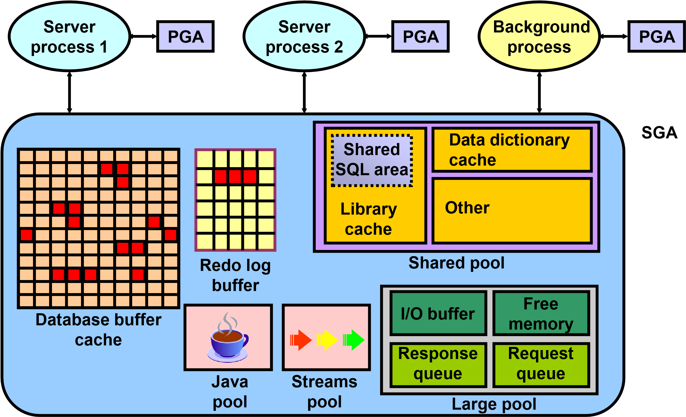
Oracle Database Memory Structures
DB structures à Memory Process Storage

Slide 19
Oracle Database Memory Structures (continued)
The SGA is the memory area that contains data and control information for the instance. The SGA includes the following data structures:
Database buffer cache: Caches blocks of data retrieved from the database
Redo log buffer: Caches redo information (used for instance recovery) until it can be written to the physical redo log files stored on the disk
Shared pool: Caches various constructs that can be shared among users
Large pool: Optional area that provides large memory allocations for certain large processes, such as Oracle backup and recovery operations, and I/O server processes
Java pool: Used for all session-specific Java code and data in the Java Virtual Machine (JVM)
Streams pool: Used by Oracle Streams to store information required by capture and apply

Slide 20
Oracle Database Memory Structures
When you start the instance by using Enterprise Manager or SQL*Plus, the amount of memory allocated for the SGA is displayed.
A Program Global Area (PGA) is a memory region that contains data and control information for each server process. An Oracle server process services a client’s requests. Each server process has its own private PGA that is created when the server process is started.

Slide 21
Oracle Database Memory Structures
Access to the PGA is exclusive to that server process, and the PGA is read and written only by the Oracle code acting on its behalf.
With the dynamic SGA infrastructure, the sizes of the database buffer cache, the shared pool, the large pool, the Java pool, and the Streams pool change without shutting down the instance.
The Oracle database uses initialization parameters to create and manage memory structures. The simplest way to manage memory is to allow the database to automatically manage and tune it for you. To do so (on most platforms), you only have to set a target memory size initialization parameter (MEMORY_TARGET) and a maximum memory size initialization parameter (MEMORY_MAX_TARGET).

