Slide 1
Tree Decline:
Dr. Salman Ahmad
April 06, 2020

Slide 2
Description and Importance:
Decline: Decline is term used to describe a tree that is generally deteriorating
Serious threat to timber & fruit tree plants
cause losses up to 50 %
More prevalent in Shisham, Guava, Mango

Slide 3
Etiology:
Complex problem
Fusarium solani
Botryodiplodia theobromae
Phytophthora cinnamomi

Slide 4
Symptoms:
Leaves from the top start to become yellow
Sometimes single branch show the decline symptoms first, some time whole plant
Vigour of the tree is retarded*(stunted growth)
Internal infected part of the tree show brown to gray discoloration
Roots become black & rotten*(disintegration of cells due to pathogenic attack followed by release fluid)

Slide 5
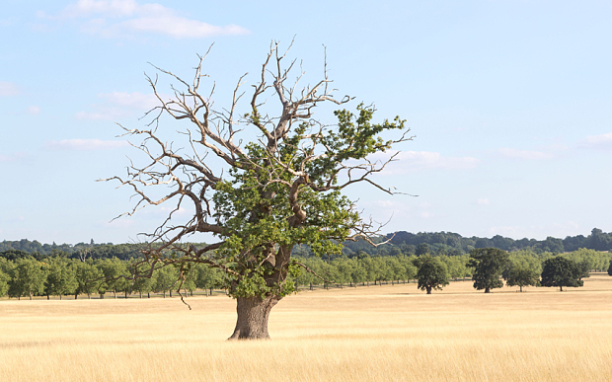
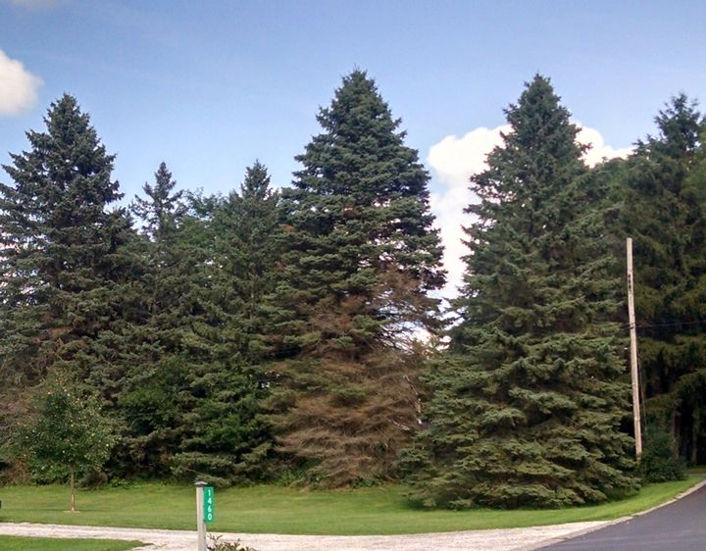
Tree Decline
Declined tree

Slide 6
Shisham Decline

Slide 7
Management:
Apply balanced nutrition to the trees
Avoid to grow crops in mango & guava orchards
Avoid injury to the roots of the plants
Apply irrigation water separately to each tree by making trench around the tree
Apply Ridomil + Ca(OH)2 mixture at collar region of the tree

