Slide 1
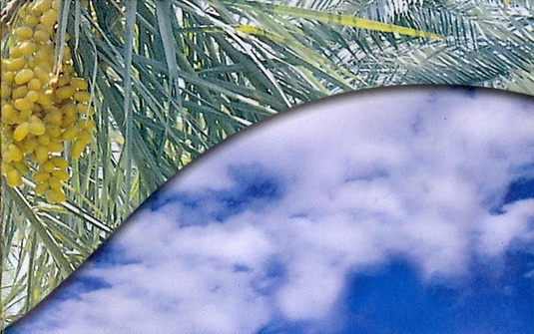
DATE PALM

Slide 2
Botanical name: Phoenix dactylifera L.
Closely related spp are: P. canariensis
P. sylvestris
P. humilis
Family: Palmae
Date has 4-6 m long pinnate leaves called fronds
Has conical mid-rib which tapers along the length of the frond

Slide 3
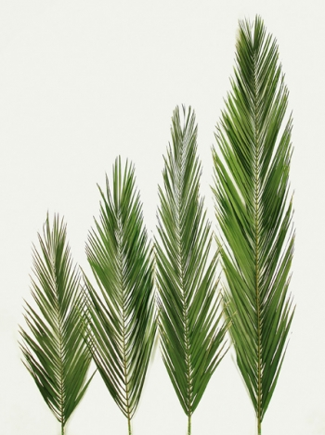
Fronds

Slide 4
Trunk is vertical having almost the same girth (100-150 cm)
Also covered with bases of pruned fronds
Being a monocot, tree has adventitious roots of roughly uniform thickness along their length
In cultivated date palm inflorescences are enveloped in spathes
Two types of spathes (Male and female)

Slide 5
Male Spathes
Shorter and wider than female spathes
Contain 10,000 to 15,000 flowers
Sweets
Scented
3 sepals
3 petals
6 stamens

Slide 6
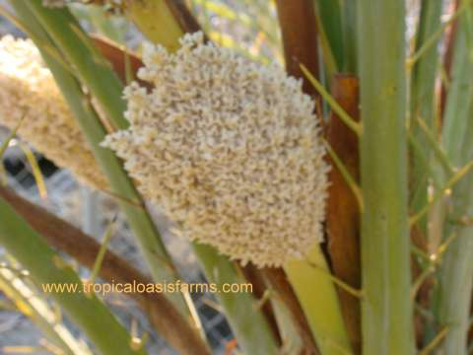

Slide 7
Female spathes
Contain 2000 to 3000 flowers
Longer and thinner than male spathes
Female flower are bead like structure
3 petal
3 sepals
3 carpels with hook like stigma
Only one developed into fruit
Other two universally abort during development

Slide 8
Fruit characters
Fruit vary in size
Weight 2-60 g
Length 18-110 mm
Width 8-32 mm
Single seed
Weight 0.5-4 g
Length 12-36 mm
Width 6-13 mm
Has groove
Hard endosperm composed of cellulose

Slide 9
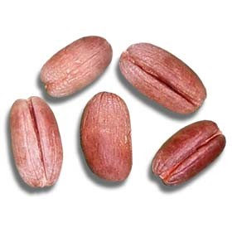

Slide 10
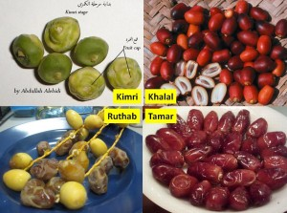
Stages of fruit

Slide 11
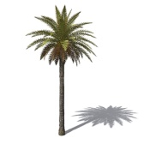
Distribution and history
Cultivated palm is dioecious
Independent male and female trees
It has been cultivated since 3000 BC
Almost all palms are indigenous to hot climate
Commercially grown in Asia and Africa
Iraq, Iran, Pakistan, Saudi Arabia, Morocco, Algeria, Tunis and Egypt
Some in Australia, USA and Mexico

Slide 12
Area (000 ha)
Production (000 Tonnes)
Total : 566.4
Agriculture Statistics of Pakistan 2008-09

Slide 13
Varieties
Punjab: Hillawi, Khardrawi and Zaidi
Sindh: Aseel
KPK: Dhaki , shakri, hussaini
Balochistan: Berni, Begum jangi
Notes:
:

Slide 14
Soil and Climate
Important climatic factors
Temperature
Rainfall
Humidity
Light
Wind
General requirement for date palm cultivation
High temperature
Much sunlight
Low humidity
Low rainfall
Absence of high winds
All these factors affect the growth and productivity

Slide 15
Tolerate quite low temperatures but the growth will be ceased at below 10ºC
Resistant to heat
May tolerate temperatures up to 58ºC for short period
Prevailing temperature during ripening: 45 – 50ºC
Blooming will occur when temperature rises above 18ºC
Fruit setting and development will take place only if temperature is above 25ºC
Earlier dates are produced where the temperature first rises above 18ºC, where it is attained later – late fruit production
Proper ripening and quality : interaction of temperature and humidity is important

Slide 16
Hot dry regions produce hard and dry dates rather than syrupy dates
High humidity may delay ripening
Rains during pollination and ripening are disturbing
Punjab : monsoon rains , a major obstacle to date culture because time of ripening coincides with the rainy season
Soil
Light, deep, well-drained soils are preferable
Rocky, calcareous soils and compact soils are not suitable
May also grown on soil affected by salinity but highly saline soils are not fit

Slide 17
Propagation
Both sexually and asexually
Through seeds doesn’t produce true-to-type fruit
Longer time to bloom
Asexually propagated through suckers (offshoots)
Generally emerge from the underground stem or some times from aerial parts
Rooted suckers carefully removed for further propagation
Suckers weighing 18-20 kg or 3-5 years old propagate successfully in orchards
Suckers removal: Feb – March / August – September
Planting system: Square system @ 7 m
Male trees @ 3% are also planted at various locations in orchard

Slide 18
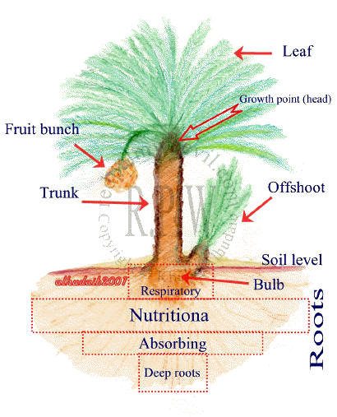

Slide 19
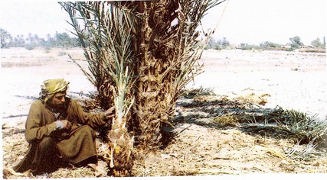
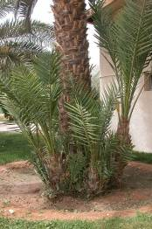
Date Palm

Slide 20
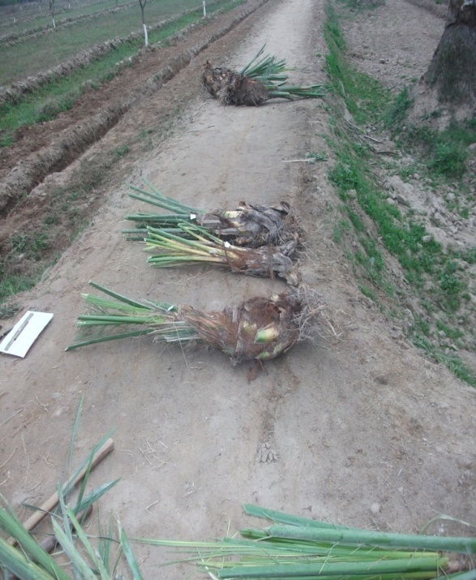
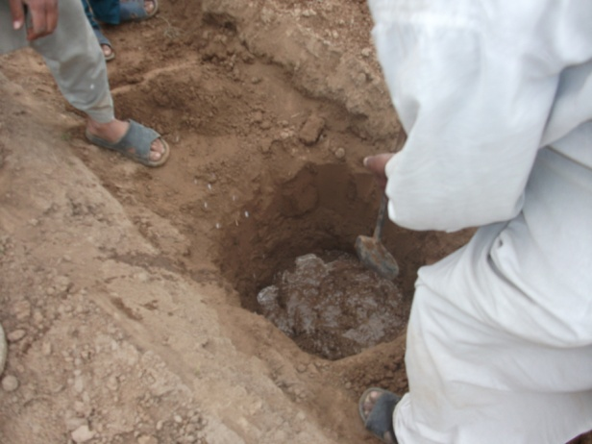
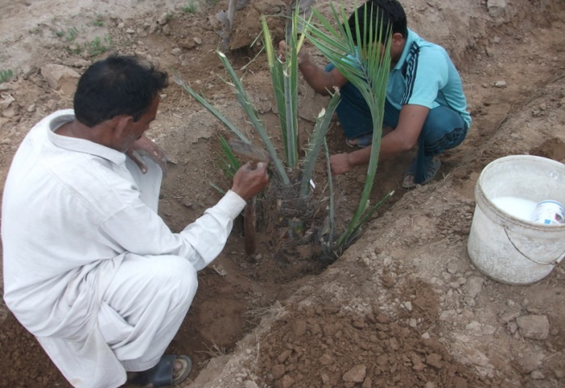
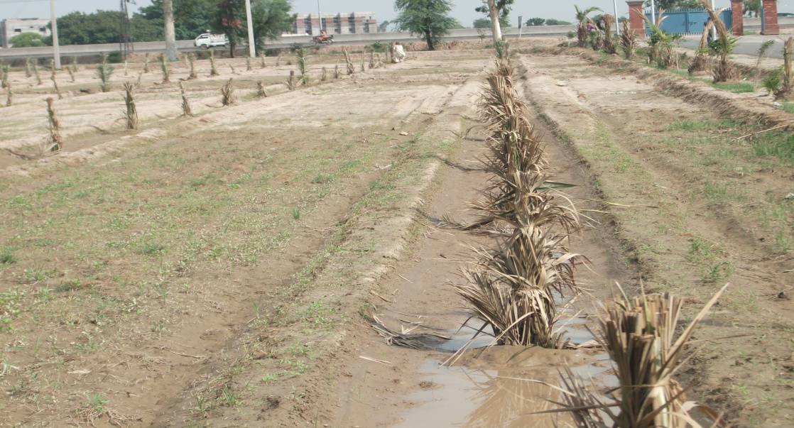

Slide 21
Pollination
Commercial orchards : artificial pollination
Several methods : Manual and Mechanical
Mechanical date pollinators
Spray of nutrients in nutrient solutions
Hand pollination
Pakistan : usually done by hands
Flowering strands separated from mature and ready to open male inflorescence in groups of two and three
Warmed in sunlight for short time so that when shaken they shed their pollen
A man carrying a bag of male sprigs climbs the tree and pollinate the opened female spathes by shaking the male sprigs
Laborious operation, repeated 4 – 5 times

Slide 22
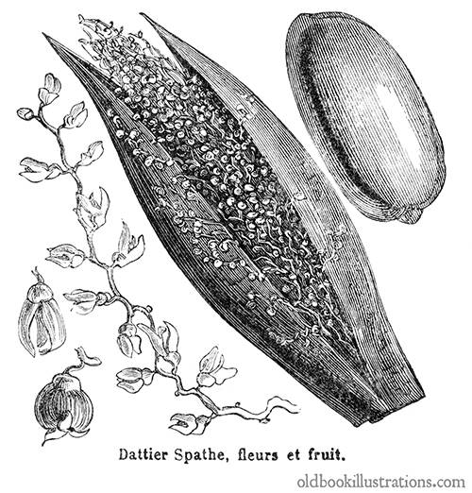
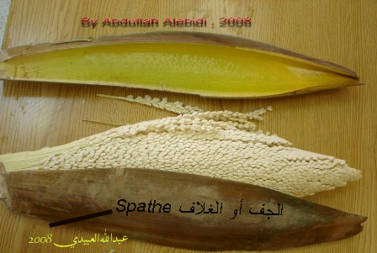

Slide 23
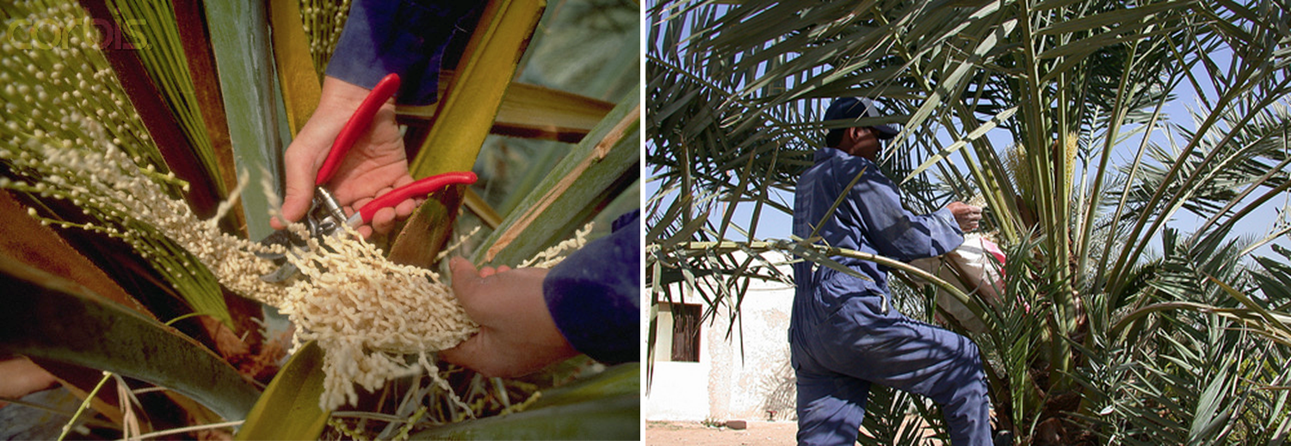

Slide 24
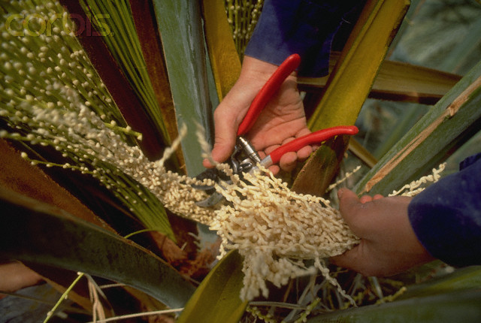
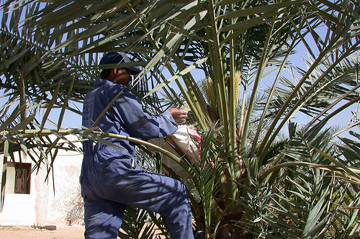
Pollination
Date Palm
Pollination
Dr. Saeed Ahmad. HORT.102 Institute of Horticultural Sciences

Slide 26
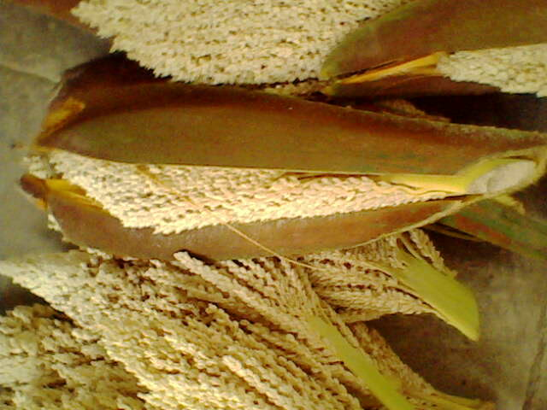
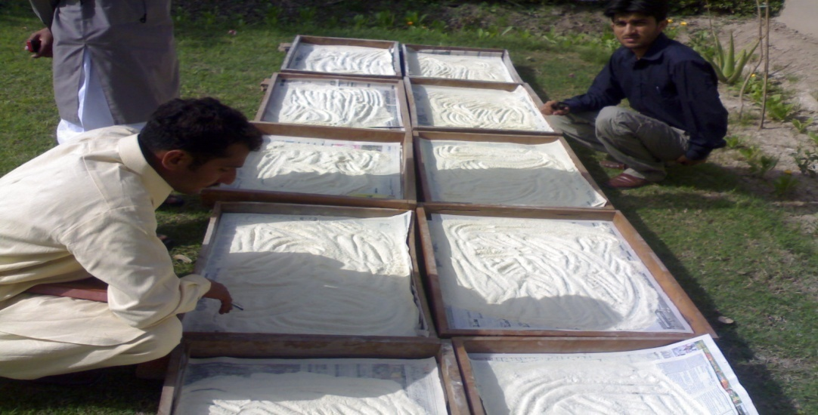
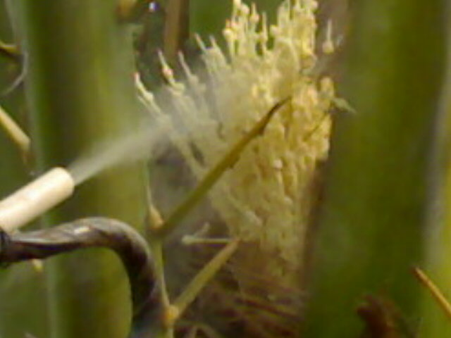
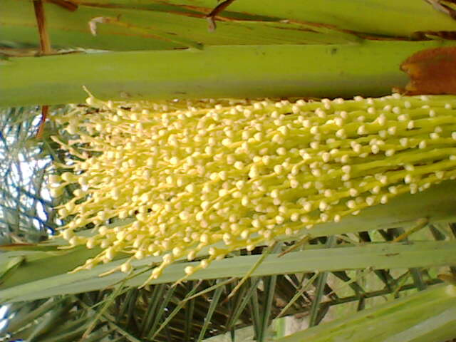
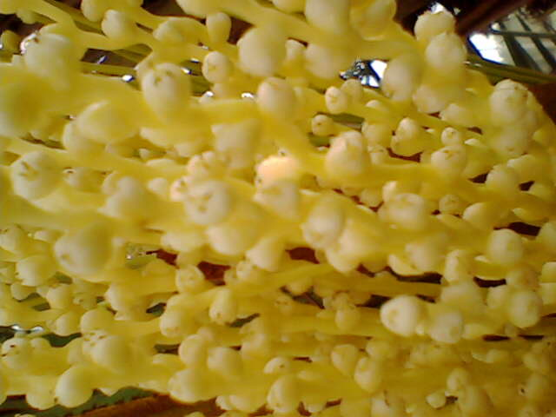
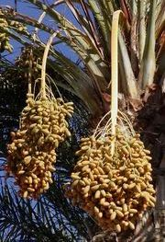
Male Spath
Pollen
Pollination
Fruit Setting
Fruit Setting
Dates

Slide 27
Cultural Practices
Water requirement varies with
climatic conditions
Water table
Soil type
Age of trees
Require more watering during fruit development
Newly planted orchards require daily watering at least for one month
Established orchards require irrigation weekly during fruit development and once a month during rest of the year
Deep cultivation around the trees will damage root system and should be avoided
Shallow ploughing and harrowing is helpful to control weeds

Slide 28
PRUNING:
No systemic pruning except removal of dropped leaves
In some vigorous trees/CVs green fronds are also removed to over come the humid micro-environment around the fruiting branches; e.g. Deglet Noor
Removal of spines from bases of fronds to facilitate pollination and minimizes puncturing of growing fruit
Removal of bunches not practiced

Slide 29
Fertilizers
Before Fruiting
Age of Plant | FYM | Urea | DAP | SoP
At the time of plantation | 20 kg
1 - 2 year old |  | ¼ kg
3 – 4 year old | 10 kg | 1/3 - 1/2 kg | ¼ kg | 100 g
4 – 6 year old | 20 kg | 1 ¾ kg | ½ kg | 1/3 kg
Bearing Trees
Age of Plant | FYM | Urea | DAP | SoP
7 – 10 year old | 35 – 40 kg | 2 kg | ¾ kg | ½ kg
10 – 12 year old | 35 – 40 kg | 2 ½ kg | 1 kg | ½ kg
> 12 year old | 35 – 40 kg | 3 kg | 1 ½ kg | 2 kg

Slide 30
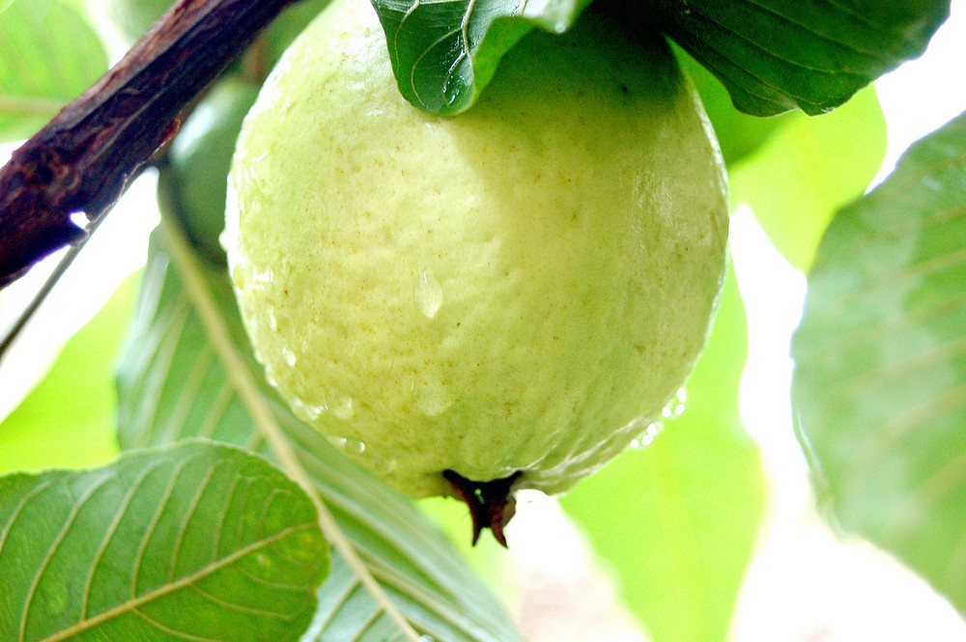
GUAVA

Slide 31
Introduction
Native to tropical America, Peru, Mexico and Cuba
High dietary value, good taste and rich source of vitamin C
Punjab: Shiekhupura, Gujranwala and Lahore district
Sindh: Pear shaped small seed core- Larkana, Dadu, Shikarpur and Hyderabad district
KPK: Mardan and Hazara district

Slide 32
Guava industry of Pakistan
Guava industry of Pakistan is not developed industry.
However, Punjab is the leading producer of guava in the country and total share in its production is 80% while rest of 20 % is contributed by other provinces of Pakistan.
According to fruit traders, guava industry of Pakistan generates about one billion rupees annually through the export of fresh as well as processed guava but foreign sales are not regular.
Canada was the largest importer of Pakistani guava from accounting 26% of the total exports during the year 2007-08.
Now a day, the major exporters are UAE, UK, Saudi Arabia and Qatar. However, the export of guava fruit can be increased by saving significant amount (40%) of fresh guava fruit by providing storage and processing facilities.

Slide 33
Area (000 ha)
Production (000 Tonnes)
Total : 512.3

Slide 34
B. name : Psidium guajava
Family name: Myrtaceae
P. Cattleianums (strawberry guava)
P. Araca (Feijoa)
P. Guineense (Brazilian Guava)

Slide 35
Tree
Naturally busy and spreading
Tree height is generally 4-5 m, but well-trained older trees may reach a height of 9 m.
Bark of the trunk tends to be bright, smooth and scaly
Leaves
Light green, 7-15 cm long
Oblong, and pubescent below
Flowers
Flower buds are mixed, complete
Born singly or in group of 2-3 in the axils of leaves
Fruit: berry with a large seedy core
Round or Pyriform
Red, yellowish and white fleshed
Skin may be smooth
Dominant musky flavor with mild acidity

Slide 36
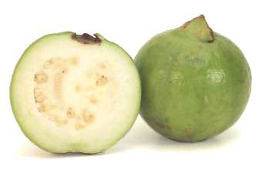
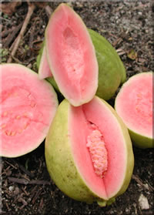
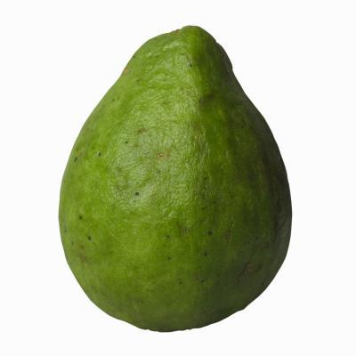

Slide 37
Soil and Climate
Grown in tropical and subtropical regions
Can be grown on wide range of soils – heavy clay to light sandy soil
pH range: 4.5 – 8.5
Tolerant to wet and saline conditions
Proper care and good soil will make guava trees highly productive
Cold sensitive and can't resist long periods of frost
Mean summer temperature requirement for commercial guava production – 20 ºC (Minimum requirement)
Temperature below this range may lead to complete crop loss
Optimum temperature: 23 ºC – 28ºC
Guava doesn’t tolerate high temperatures of desert regions
Rains and high humidity during ripening – skin damage

Slide 38
Propagation and Planting
Generally propagated through seeds
Selected fruits soaked in water for several days until the seeds separate and settle down
These seeds germinate better because testa is somewhat soft
Seed planted in beds
Some good varieties propagated vegetatively through budding and grafting and cuttings
Seedlings raised as rootstock and grafted/budded in March and August
Soft-wood stem cuttings
Plants grown in nursery will later shifted to orchards – square system
Also raised as Fillers in mango orchard – start bearing in 2 years

Slide 39
Cultural Practices
Careful irrigation
Young trees – irrigation frequency must be high
Heavy irrigation during fruiting – induce good fruit development
Withholding irrigation during spring – reduces bloom
Prolong drought conditions until summer - inhibit fruiting
Pruning frequently – only to remove suckers, dried and diseased woods
Age of Plant | FYM | Urea | DAP | SoP
One year old | 20 kg | 125 g
2 year | kg | 250 g | 250 g
3 year | 30 kg | 500 g | 500 g | 500 g
4 year | kg | 750 g | 750 g | 750 g
5 year and > 5 year | 50 kg | 1 kg | 1 kg | 1 kg

Slide 40
Problems
Fruit Fly
Very destructive to guava – summer crop particularly
Female punctures the fruit to lay eggs – larvae hatch after few days and start eating the fruit flesh
Fruit drops and quickly rots on the ground
Control: buried the fallen fruit
Diptrex – 250 g per 100 L water – spray
Traps 4-6 in one acre and used methyl euginol
Dieback
Occurs where spring and early irrigation stopped to discourage the summer crop
Lack of available moisture and foliage reduces transpiration

Slide 42
Dieback. This problem has been observed recently, particularly in those
orchards where spring and early summer irrigation is stopped to discourage
th~ summer crop in the hope of a good winter crop. Even when irrigation
is stopped, a few flowers appear and set fruit. To get rid of these young fruit
the branches are beaten manually, but in this process a large number of
leaves are also lost along with the fruit. Because of lack of available moisture
and foliage, these trees cannot transpire sufficiently and are severely
heat stressed. The high internal temperature affects the metabolic system of
the trees adversely, and as a result they start dying. So far no other reason for this serious problem has been proposed.

