Slide 1
ROLE OF NATURAL RESOURCES IN CONSERVATION ECOLOGY

Slide 2
Role Of Natural Resources in Conservation
Conservation of nature and natural resources has been a much challenging task in the present state of affairs where economy prevails over ecology.
Conserving the many forms and functions of nature and creating an equitable home for people on a finite planet. If we want to reverse this situation, we need, among other things, to:
Conserve natural capital
Improve production systems
Consume more responsibly
Reorient financial flows
Awareness raising
Law and policies.

Slide 3
Conserve natural capital
Restore degraded ecosystems and their services.
Halt the loss of priority habitats.
Significantly expand the global network of protected areas.
Ecological restoration
Is the process of repairing sites in nature whose biological communities and ecosystem have been degraded or destroyed.
It focuses on repairing the damage human activities have caused to natural ecosystems and seeks to return them to an earlier state or to another state that is closely related to one unaltered by human activities.

Slide 4
Restoration
Recovery can be:
removing an invasive species
reintroducing a lost species
as complex as altering landforms,
planting vegetation,
changing the hydrology,
and reintroducing wildlife

Slide 5
IN-Situ conservation
EX-Situ conservation
In situ conservation is the on-site conservation of genetic resources in natural populations of plants or animal species such as forest genetic resources, in natural populations of tree and animal species.
The process of protecting an endangered plant or animal species in its natural habitat is commonly known as in situ conservation.
In-situ conservation is being done by declaring area as protected area
Ex situ conservation is the relocation of endangered or rare species from their natural habitats to protected areas equipped for their protection and preservation.
It is an essential alternative strategy when in situ conservation is inadequate.
Such strategies include establishment of botanical gardens, zoos, conservation strands and gene, pollen seed, seedling, tissue culture and DNA banks

Slide 6
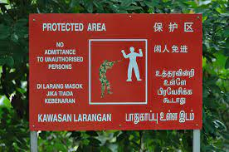
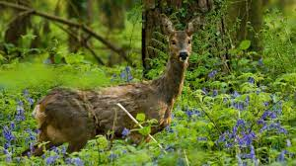
Protected area
A protected area is a clearly defined geographical space, recognized, dedicated and managed, through legal or other effective means, to achieve the long term conservation of nature with associated ecosystem services and cultural values. ( IUCN Definition 2008)

Slide 7
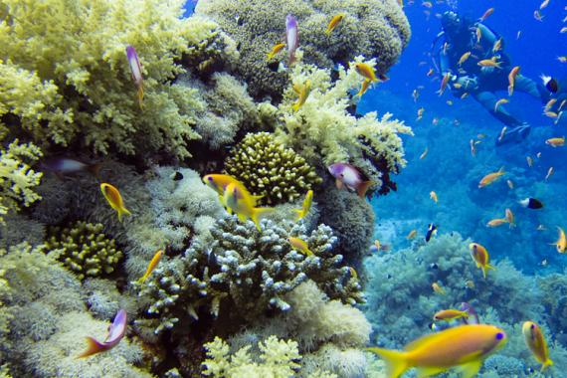
IUCN Green List of Protected and Conserved Areas
The IUCN Green List of Protected and Conserved Areas is the first global standard of best practice for area-based conservation. It is a programme of certification for protected and conserved areas (national parks, natural World Heritage sites, community conserved areas, nature reserves and so on) that are effectively managed and fairly governed.

Slide 8
Protected areas of Pakistan
National park =5
Wildlife sanctuaries=62
Protected landscape/seascape=5
Managed resource protected areas=2
Unclassified area= 83
As of present, there are around 157 protected areas in Pakistan that are recognized by IUCN.

Slide 9
01. Margallah Hills National Park: Islamabad, established 1980, area 15,883 ha. 02. Hazarganji Chiltan National Park: Balochistan, established 1980, area 15,555 ha. 03. Hingol National Park: Balochistan, established 1997, area 6, 19,043 ha. 04. Kirthar National Park: Sindh, established 1974, area 3, 08,733 ha. 05. Ayubia National Park: Khyber Pakhtunkhwa, established 1984, area 3,122 ha
National Parks of Pakistan

Slide 10
Wildlife sanctuaries
Argam Basti Wildlife Sanctuary.
Astore Wildlife Sanctuary.
Bajwat Wildlife Sanctuary.
Baltistan Wildlife Sanctuary.
Bijoro Chach Wildlife Sanctuary.
Chashma and Taunsa
Barrage Dolphin Sanctuary

Slide 11
Protected forest
Birir valley Coniferous forest ( Dodar Chilghoza Oak forest in chitral district)
Jhangar scrub forest in Chakwal District
Sulaiman coniferous forest (Sulaiman chilgoza pine forest) in chitral district
Ziarat Juniper forest in Ziarat District
Artificial resource manages forest
Changa manga forest in Lahore district
Chichawatni plantation in Sahiwal District

Slide 12
Improve production systems
Significantly reduce the objects, materials and resources used in the development of human life and the volume of waste in production systems.
Manage resources in a sustainable manner.
Promote the production of renewable energy.

Slide 13
Renewable energy
Renewable energy is generated using natural sources that will never run out, because they contain a massive quantity of energy (such as the sun or the wind) or because they regenerate in a quickly (such as biomass).
To meet a growing global demand for energy and the imperative need to halt climate change, renewables are now established as the best option for the future of the energy sector.
The most common types of renewable energy are:
Wind power
Photovoltaic energy
Hydroelectric power
Tidal power

Slide 14
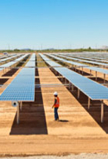
Wind power
It is a renewable, inexhaustible and
non-polluting source of energy
obtained by transforming the kinetic
energy of the wind into electricity.
Photovoltaic energy
It is renewable, inexhaustible and
non-polluting, and is obtained by
converting sunlight into electricity
using a technology based on the
photoelectric effect

Slide 15
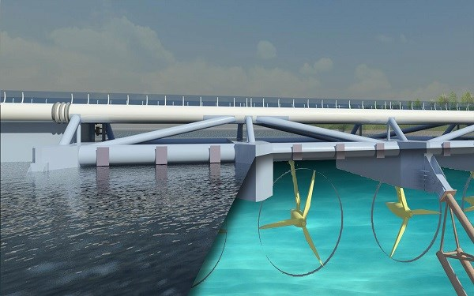
Hydroelectric power
It is a renewable energy source
generates electricity using the
force of falling water.
Tidal power
An inexhaustible, non-polluting
source of energy that converts
the energy obtained from tides
into electricity.

Slide 16
Consume more responsibly
Promote lifestyles, like sustainable mobility, that leave a smaller environmental footprint.
Change current energy consumption patterns.
Promote healthy and sustainable consumption patterns.

Slide 17
Reorient financial flows
Place a value on nature and natural resources.
Take responsibility for environmental and social costs.
Support and reward companies that promote conservation, sustainable resource management and innovation in their activities.

Slide 18
LAWS AND POLICIES
Develop legislation to regulate the exploitation of natural, resources and establish environmental impact assessment as an essential requirement for entire projects.
Support sustainable development and environmental protection initiatives.
Commit to renewable and non-polluting energies.
Promote environmental care to maintain ecosystem health.

Slide 19
A primary purpose of the Act is "to provide a means whereby the ecosystems upon which endangered or threatened species depend may be conserved.
It was conservation law that came first, in manifestations like the US Endangered Species Act (1973) and the Convention on the International Trade in Endangered Species (1973)

Slide 20
AWARENESS-RAISING
Encourage the use of public transport and bicycles.
Foster a culture of recycling: reduce, reuse and recycle.
Promote environmental education in schools.
Promote agriculture and ecological tourism.

Slide 21
RESPONSIBLE CONSUMPTION
Use water and electricity responsibly.
Buy fewer unnecessary products.
Avoid non-biodegradable products.
Choose to buy local or organic products

Slide 23
Tips to protecting the environment
Freeze leftovers, take-away food and fresh products that you are not going to eat before they spoil.
Use waste as fertilizer, you will recycle nutrients and lessen the effects of climate change.
Turn off the light you do not need and unplug electrical house appliances when you are not using them.
Fill up your washing machine and forget the clothes dryer and hair dryer. Better in the open air.
Buy product with little packaging
Put down carpets to keep the house warm

Slide 24
Tips to protecting the environment
Do not rinse the dishes before putting them in the dishwasher.
Avoid preheating the oven unless it is essential.
Insulate window and doors, and adjust the thermostat for summer and winter.
Replace the old electrical household appliance with others more energy efficient.

Slide 25
THANK YOU

