Slide 1
Introduction to Computer
Chapter # 5

Slide 2
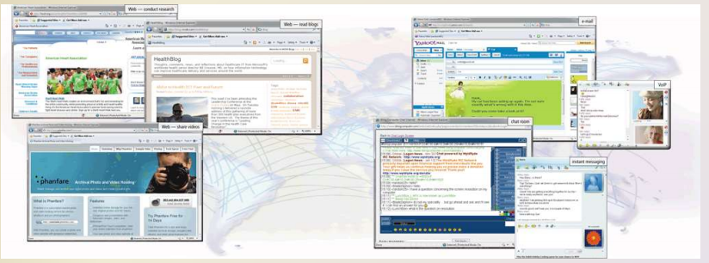
The Internet
The Internet is a worldwide collection of networks that links millions of businesses, government agencies, educational institutions, and individuals.

Slide 3
Evolution of the Internet
The Internet originated as ARPANET in September 1969 and had two main goals:

Slide 4
Continue..
Notes:
Advanced Research Projects Agency Network (APRANET)
U.S. National Science Foundation (NSF)

Slide 5
Continue..
Each organization is responsible only for maintaining its own network
The World Wide Web Consortium (W3C) oversees research and sets guidelines and standards
Internet2 connects more than 200 universities and 115 companies via a high-speed private network.
Many home and small business users connect to the Internet via high-speed broadband Internet service.

Slide 6
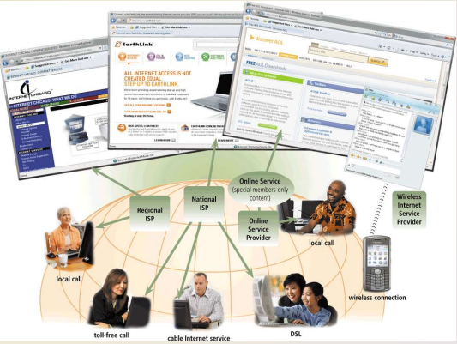
Access Provider
An access provider is a business that provides individuals and organizations access to the Internet free or for a fee.

Slide 8
How Data and Information Travel the Internet
Computers connected to the Internet work together to transfer data and information around the world using various wired and wireless transmission media.
Several main transmission media carry the heaviest amount of traffic on the Internet. These major carriers of network traffic are known collectively as the Internet backbone.

Slide 10
Internet Addresses
The Internet relies on an addressing system much like the postal service to send data and information to a computer at a specific destination.
Types of Internet Addresses:
An IP address is a number that uniquely identifies each computer or device connected to the Internet
A domain name is the text version of an IP address – Top-level domain (TLD)
A DNS server translates the domain name into its associated IP address.
Notes:
Domain Name System (DNS)

Slide 12
World Wide Web
The World Wide Web, or Web, consists of a worldwide collection of electronic documents (Web pages)
A Web site is a collection of related Web pages and associated items
A Web server is a computer that delivers requested Web pages to your computer
Web 2.0 refers to Web sites that provide a means for users to interact on of electronic documents.

Slide 13
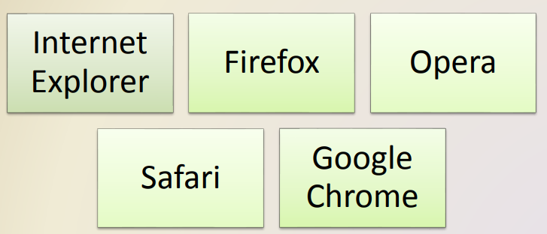
Web Browser
A Web browser, or browser, is an application software that allows users to access and view Web pages or access Web 2.0 programs.
Web pages or access Web 2.0 programs. To browse the Web, you need a computer or mobile device that is connected to the Internet and that has a Web browser.
The more widely used Web browsers for personal computers are

Slide 14
Continue..

Slide 15
How a Web Browser Displays a Home Page

Slide 16
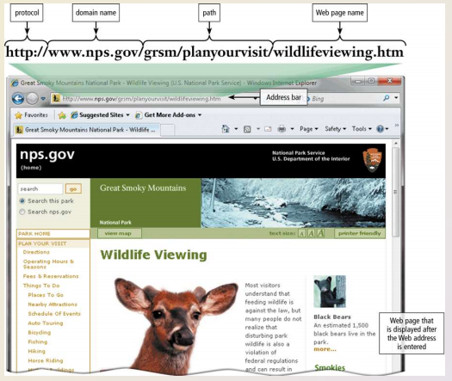
Web Address/URL
A Web page has a unique address, which is called a URL (Uniform Resource Locator) or Web address.

Slide 17
Continue..
For example, the home page for the United States National Park Service Web site has a Web address of http://www.nps.gov.
A Web browser retrieves a Web page using its Web address. If you know the Web address of a Web page, you can type it in the Address bar at the top of the browser window. If you type http://www.nps.gov/grsm/planyourvisit/wildlifeviewing.htm as the Web address in the Address bar and then press the enter key, the browser downloads and displays the Web page.
A Web address consists of a protocol, domain name, and sometimes the path to a specific Web page or location on a Web page. Many Web page addresses begin with http://.
The http, which stands for Hypertext Transfer Protocol, is a set of rules that defines how pages transfer on the Internet.
To help minimize errors, many browsers and Web sites do not require you enter the http:// and www portions of the Web address.

Slide 18
Continue..
When you enter the Web address, http://www.nps.gov/grsm/planyourvisit/wildlifeviewing.htm in the Web browser, it sends a request to the Web server that contains the nps.com Web site.
The server then retrieves the Web page that is named wildlifeviewing.htm in the grsm/planyourvisit path and delivers it to your browser, which then displays the Web page on the screen.
To save time, many users create bookmarks for their frequently visited Web pages.
A bookmark, or favorite, is a saved Web address that you access by clicking the bookmark name in a list. That is, instead of entering a Web address to display a Web page, you can click a previously saved bookmark

Slide 19
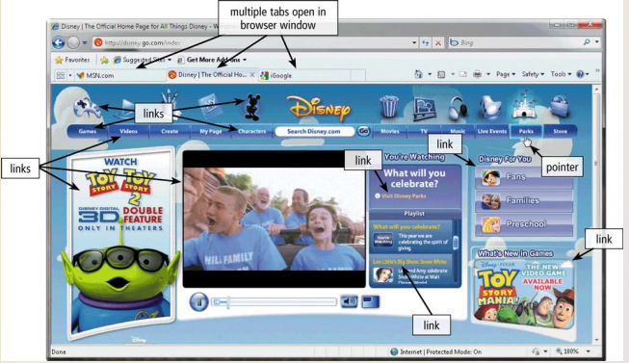
Tabbed browsing
Tabbed browsing allows you to open and view multiple Web pages in a single Web browser window.

