Slide 1
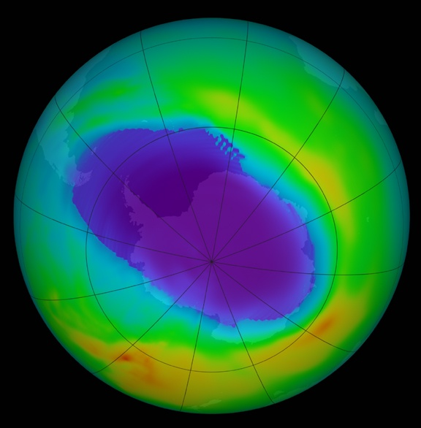
Ozone
Ozone
Ozone depletion
Causes & Effects

Slide 2
Ozone
Inorganic molecule.
Allotrope of oxygen
Less stable than the diatomic allotrope.
It is an irritating, pale-blue gas and toxic, even at low concentration.
The name ozone derives from Greek word ozein, that mean “To smell” also known as trioxygen.

Slide 3
Ozone
Ozone is slightly soluble in water and much more soluble in inert non-polar solvents such as carbon tetrachloride CCl4.
At -193.2°C it condenses to form a dark blue liquid, below −193.2°C it forms a violet-black solid.

Slide 4
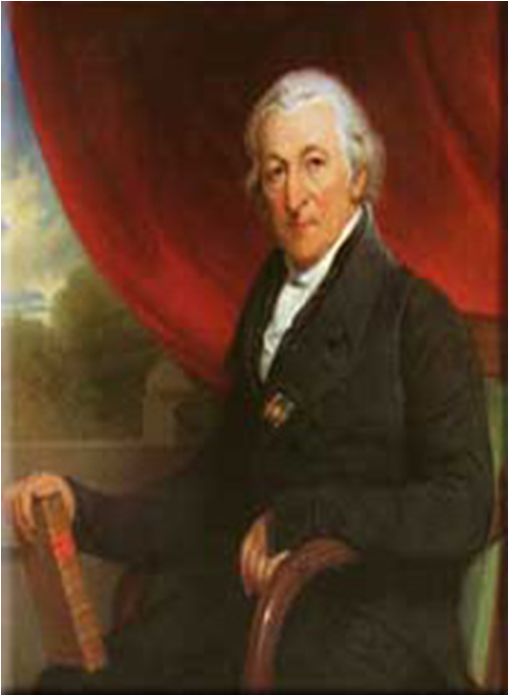
Discovery of Ozone
In 1785, chemist M. V. Marum was conducting experiments involving electrical sparking above water when he noticed an unusual smell, a half century later,

Slide 5
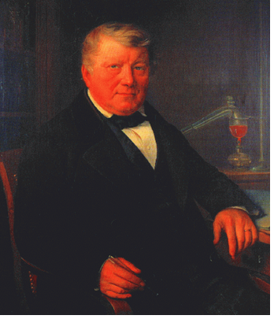
Discovery of Ozone
Schonbein noticed the same pungent smell during a bolt of lightning.
In 1839, he succeeded in isolating the gaseous chemical and named it "ozone", from the Greek word ozein.

Slide 6
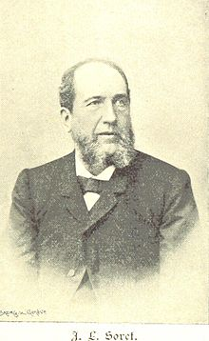
Discovery of Ozone
The formula for ozone, O₃, was not determined until 1865 by J. L. Soret and confirmed by Sochonbein in 1867

Slide 7
Structure of ozone
Molecule consisting of three oxygen.
Ozone is a bent molecule
The O – O distances are 127.2 pm.
The O – O – O angle is 116.78°
Resonance hybrid with two contributing structures.

Slide 8
Ozone type and Location
Ozone has 2 type
1- Bad ozone
2- Good ozone

Slide 9
Low level ozone
1- Bad ozone;
Located within 10 Kilometer in troposphere
Usually present in troposphere in form of smog
Contributes to global warming
atmospheric pollutant.

Slide 10
Low level ozone
Formed by the reaction of hydrocarbons and nitrogen oxides ( presence of sun light) that react to form ozone directly.
The atmospheric lifetime of tropospheric ozone is about 22 days.

Slide 11
Ozone as a greenhouse gas
Ozone acts as a greenhouse gas, absorbing some of the infrared energy emitted by the earth.
Because of its short-lived nature, Bad ozone does not have strong global effects.

Slide 12
Stratospheric ozone
1- Good ozone
Present in the stratosphere, it absorbs some of the harmful ultra-violet (UV) radiation from the sun (at wavelengths between 240 and 320 nm, 1nm = 10⁻⁹m).
Most of the Earth’s atmosphere ozone (about 90%) is found in the stratosphere.

Slide 13
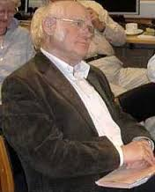
Dobson unit
The Dobson spectrophotometer for measuring ozone, invented by the English scientist George M.B. Dobson in 1927.
.

Slide 14
Dobson unit
A network of 85 Dobson stations were established to measure global ozone.
Total ozone values range from about 290 to 310 DU over the globe
Measurement is also conducted by rockets & UV- photometer.

Slide 15
ozone concentrations
Typical ozone concentrations:
A- In very clean troposphere: 10 – 40 ppb.
B- In stratosphere about 10 ppm.

Slide 16
Formation of Ozone

Slide 17
Chapman mechanism
In 1930 S. Chapman, a British scientist, proposed a theory of the formation of ozone in the stratosphere (known as Chapman mechanism).
1. Molecular oxygen absorbs solar radiation (wavelength < 242 nm) and form two atom of oxygen.
O2 + hν -----------------> O + O
2. The oxygen atom, O, reacts rapidly with O2 in the presence of UV light to form ozone:
O2 + O ----------------> O3

Slide 18
Chapman mechanism
1. Ozone absorbs solar radiation (in the wavelength range of 240 to 320 nm) and decomposes back to O2 and O:
O3 + hν ---------------> O2 + O
Additionally, ozone can react with atomic oxygen to regenerate two molecules of O2:
O3 + O --------------> O2 + O2

Slide 19
Ozone Depleting Chemicals
Ozone layer is being destroyed by a group of manufactured chemicals that are called ODS or Ozone-Depleting Substances.
Chlorofluorocarbons
(CFC 11, CFC 12)
Halons
(Halon-1211, halon-1301, halon-2402)
Carbon tetrachloride
(CCI4)
Hydrogen chloride
(HCl)
Methyl bromide
(CH3Br, CH3Cl)
Methyl chloroform (CH3CCl3)

Slide 20
Uses of CFCs
These chemicals invented in the 1920.
Air Conditioners
Refrigerators
Spray cans
Cleaners for electronic parts
Sterilizing medical instruments

Slide 21
Catalytic Ozone destruction
Cycle
Nitrogen mono xide react with ozone to form nitroge di oxide and oxygen molecule.
In next step Nitrogen dioxide react with oxygen atom to form nitrogen mono oxide and oxygen molecule
1- NO + O3 → NO2 + O2
2- O + NO2 → NO + O2

Slide 22
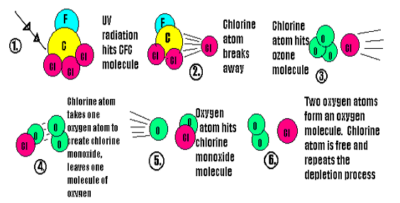
Catalytic Ozone destruction
Cycle

Slide 23
Chlorofluorocarbons are not "washed" back to Earth by rain.
Not destroyed in reactions with other chemicals.
They can remain in the atmosphere from 20 to 120 years or more.

Slide 24
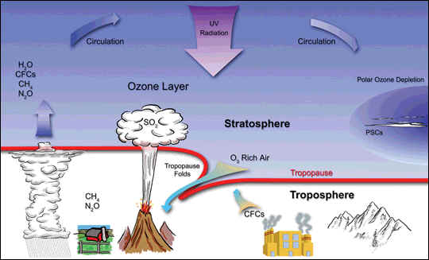
Natural causes of ozone depletion
Volcanoes release large amounts of chlorine.
Chlorofluorocarbons or CFCs are non-toxic, non-flammable and non-carcinogenic. They contain F, Cl and C atoms.

Slide 25
Ozone hole

Slide 26
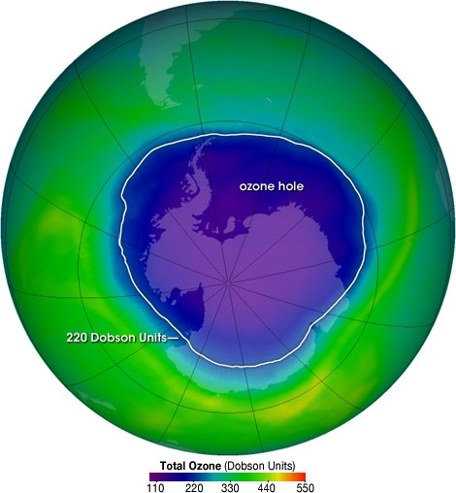
Ozone hole
Any area where ozone present below 220 DU that area is called ozone hole.
Antarctic Ozone Hole was discovered in 1985
20-30% loss of the ozone

Slide 27
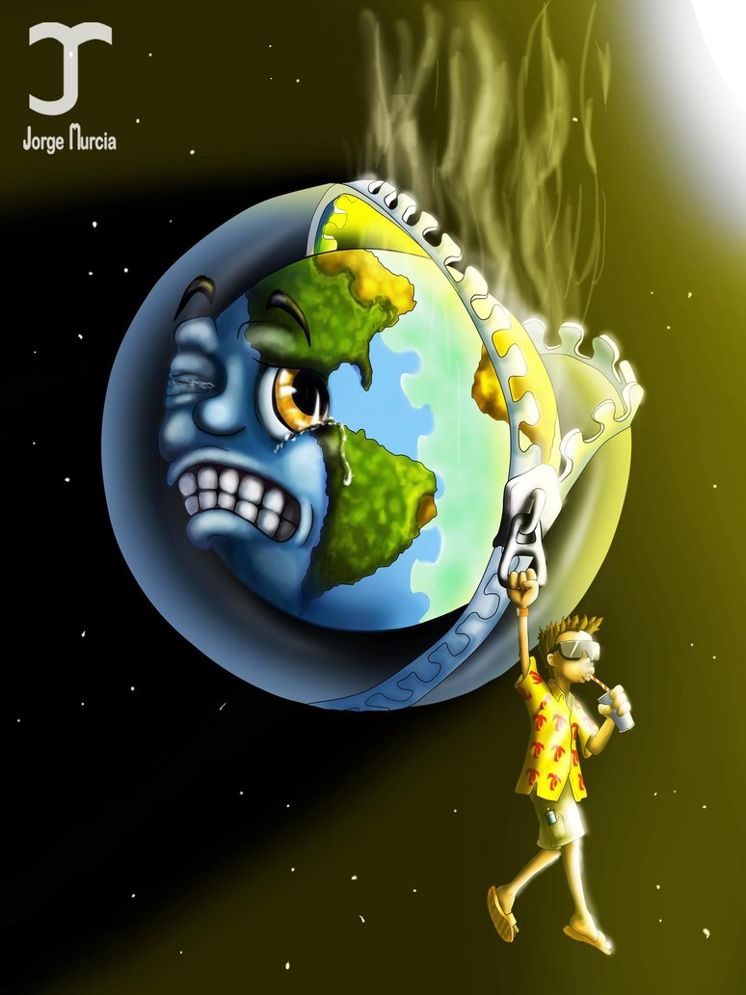
What’s Eating the Ozone
Scientists in the 1960s realized that something was going wrong in the ozone layer.
They soon figured out that human actions were damaging Earth's shield against harmful radiation

Slide 28
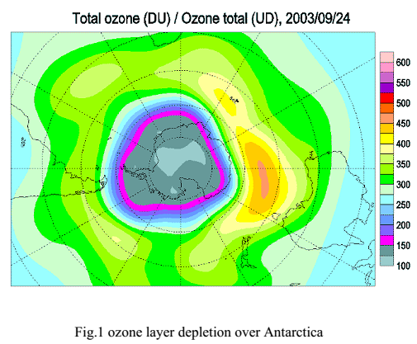
Ozone hole

Slide 29
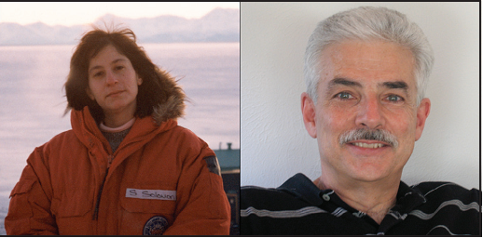
Atmospheric chemist Susan Solomon suspected that some unknown chemical like CFCs or CFC products were causing ozone losses.
Solomon and Garcia proposed reactions that PSC clouds could not only released free ozone-destroying chlorine, but also tie up the chemicals that could neutralized chlorine radical like nitrogen dioxide
Researchers Susan Solomon
Rolando Garcia

Slide 30
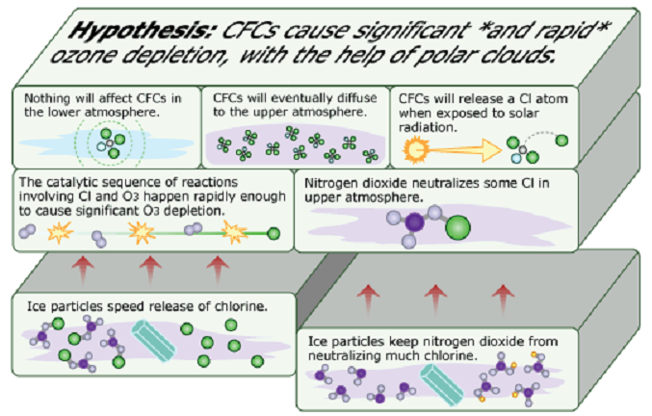
Ozone Hole Formation

Slide 31
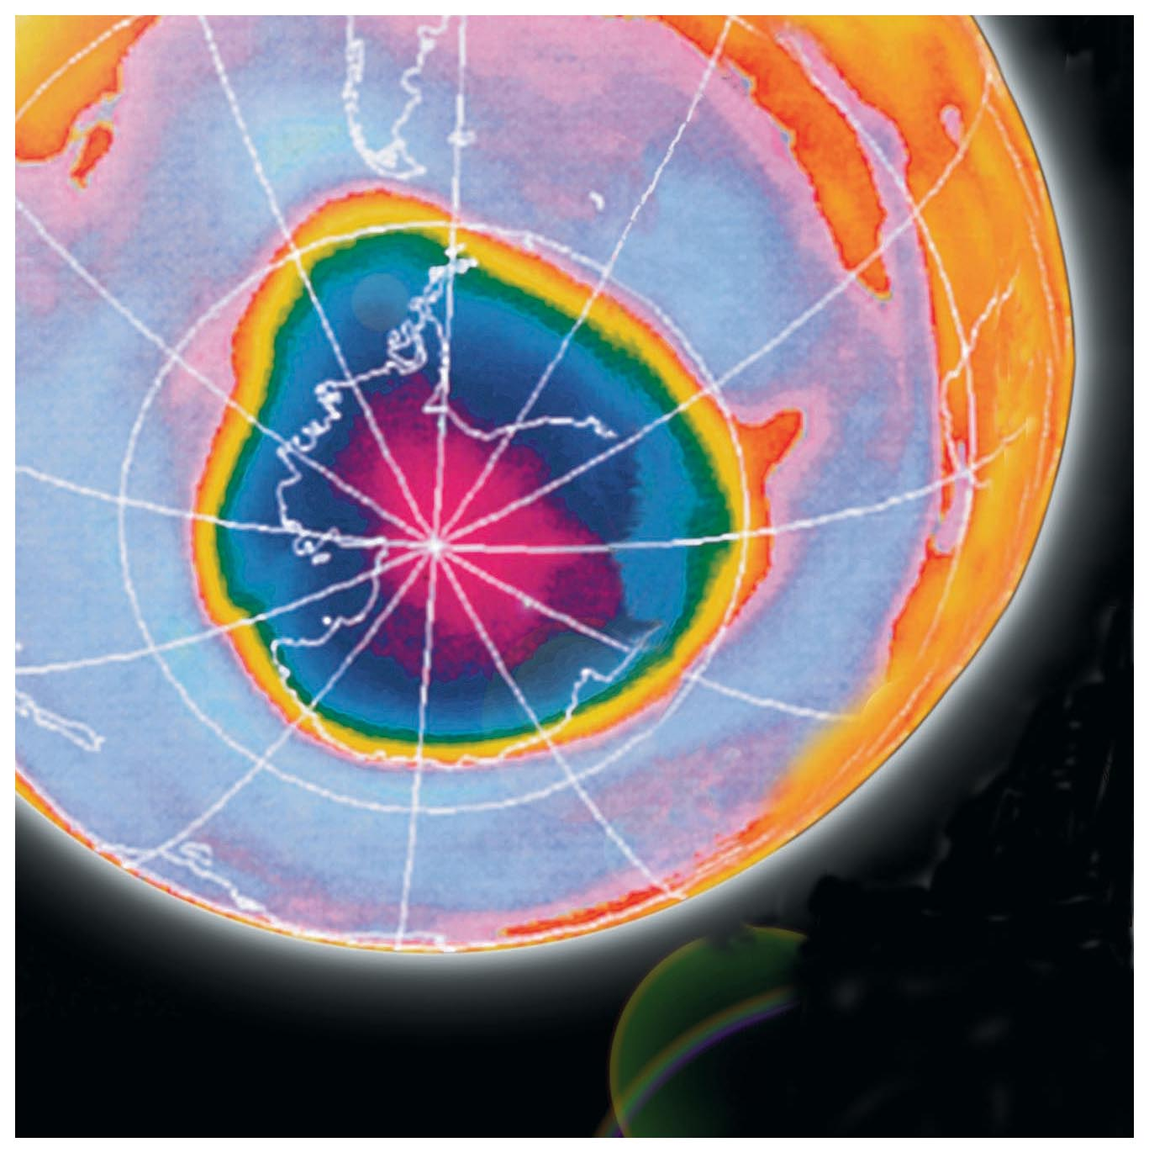
Polar vortex.
In the wintertime over the South Pole the circulating cold and dense air form cloud called the polar vortex.

Slide 32
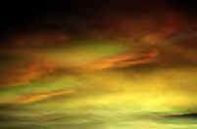
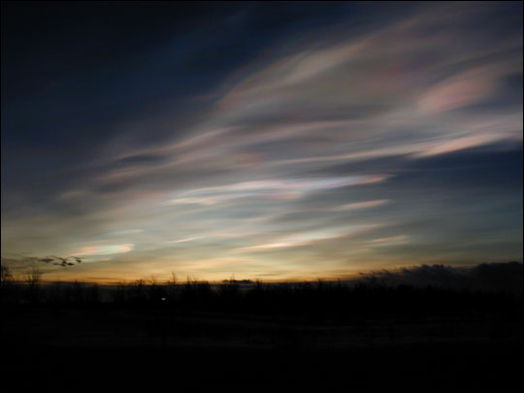
Recipe for the Ozone Hole Formation
Polar vortex is formed in winter -90°C.
Nitric acid and water are frozen to form violet clouds (PSC).
In spring when UV light fall on PSC, active chlorine radical generated which deplete ozone.

Slide 33
1) HCl + ClONO₂ → HNO₃ + Cl₂
2) Cl₂ + sunlight → Cl + Cl
3) 2Cl + O₃ → 2ClO + 2O₂
4) 2ClO + 2O → 2Cl + 2O₂

Slide 34
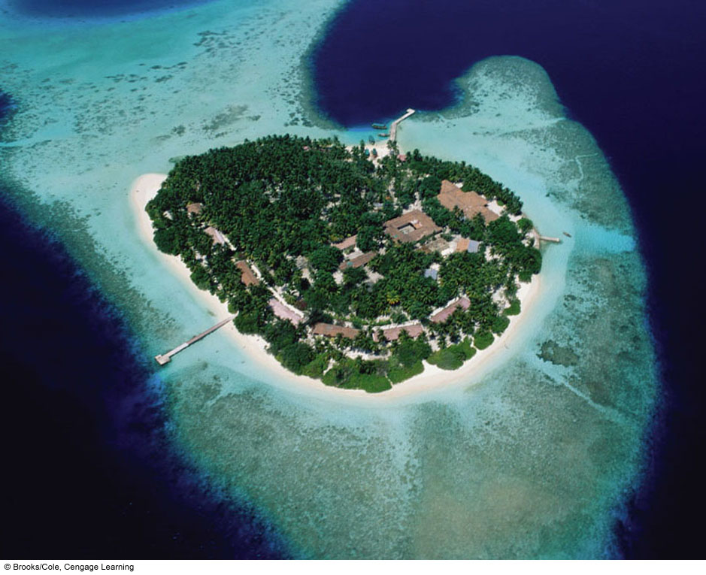
Effects of ozone depletion

Slide 35
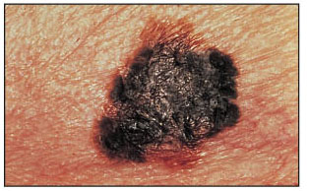
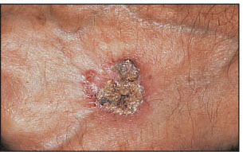
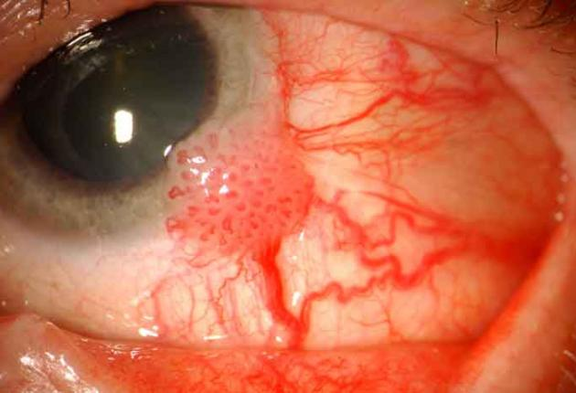
Effects on Human
Sunburn.
Skin cancer.
Premature aging
Wrinkling of skin
Immune system damage
lip cancer
Cancer of the cornea

Slide 36
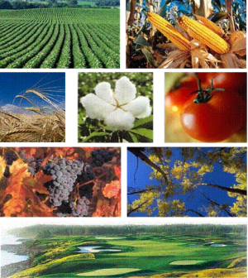
Effects on Plants
Reduces productivity
Damages DNA
Alters nitrogen
metabolism

Slide 37
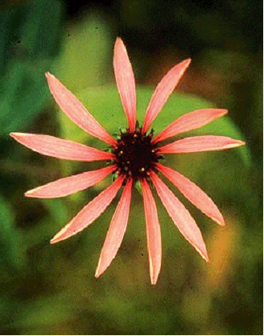
Effects on Plants
Alter both the time of flowering & number of flowers
inhibition of photosynthesis

Slide 38
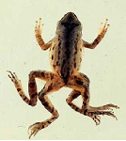
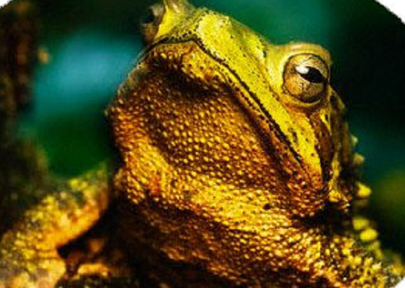
Effects on Amphibians
Causes damage to many species of amphibians at any stage of their life cycle from egg to adult.
Affects growth and development in larvae.
Causes (1) Changes in behavior  (2) Become vulnerable to disease and death (4) causes retinal damage and blindness

Slide 39
Effects on Marine Ecosystems
High exposure to UV radiation can.
• Reduce phytoplankton numbers.
• Damage the early developmental stages of fish and other marine life.

Slide 40
Effects on Materials
Degradation of outdoor paints and plastics.
Increased acid deposition

Slide 41
INTERNATIONAL ACTIONS

Slide 42
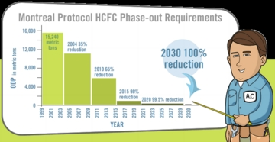
Montreal Protocol
The Montreal Protocol is a international agreement designed to protect the stratospheric ozone layer in 1987.
The Montreal Protocol says that the production and consumption of compounds that deplete ozone are to be phased out till 2030.

Slide 43
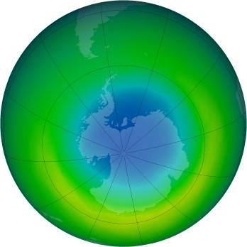
The Future of the Ozone Hole
As a result of the Montreal Protocol, atmospheric concentrations of some ozone-depleting substances, such as CFC-11, have begun to decline

Slide 44
Environmental Protection (Ozone Protection) Policy2000
The aims of this policy to minimize the discharge of ozone-depleting substances into the environment.
United Nations Environment Programme
Has published several assessments of the environmental effects of ozone depletion 2002.

Slide 45
Current Situation of ozone in
Pakistan
Pakistan is located in an area with values of ozone layer around 300 Dobson units.
Pakistan does not manufacture any ozone depleting substances
CFC-12, Halon, Carbon tetrachloride (CCl3), Methyl bromide are used in different industries

Slide 46
International Day for the Preservation of the Ozone Layer 16 September

Slide 47
Prevention of ozone depletion
Always use lead free fuels.
Avoid smoking.
Use of catalytic converter in vehicles.
Use eco-friendly household cleaning products.
Reduce use of dangerous nitrous oxide

Slide 48
Thanks

Slide 49
Refferences:
Allen, D.J., S. Nogues, and N. Baker. 1998. Ozone depletion and increased UV-B radiation: is there a real threat to photosynthesis? Journal of Experimental Botany. Vol. 49, No. 328, pp. 1775 – 1788.
Executive: summary: Scientific Assessment of Ozone Depletion: 1994, World Meteorological Organization,Geneva, [World Meteorological Organization Global Ozone Research and Monitoring Project – Report No. 37].
Antarctic Ozone Bulletin: 2005, World Meteorological Organization, 2006. [Antarctic Ozone Bulletin No 8/2005 Winter/spring summary]
Bojkov, R.D., V.E. Fioletov. 1996. Total ozone variations in the tropical belt: An application for quality of ground based measurements. Meteorology and Atmospheric Physics, - Springer Britt, A.B.2000. Plant Biology: An unbearable beating by light? Nature. 406, 30 – 31.
Descamps, F.J., E. Martens, P. Proost, S. Starckx, P. E. VandenSteen, J.VanDamme and G. Opdenakker. 2005.The FASEB Journal. 19:29-35.
Progress Report 2003. United Nations Environmental programme, Environmental Effects Assessment Panel 2003. [The Royal Society of Chemistry and Owner Societies 2004] Photochemistry and Photobiology Science 2004, 3, 1 – 5.

