Slide 2
Accountability
Patient
Health care organization
other professionals
the government
third-party payers
Professional associations
Lawyers and courts etc

Slide 3
Models of Professionalism

Slide 4
Professionals
provide professional expertise,
have the freedom to act on their clients’/Pt behalf,
practice ethical principles,
demonstrate accountability in their actions.

Slide 5
Three models of Professionalism
Ozar’s
1. COMMERCIAL MODEL
professionalism is a commercial interchange in which physical therapy is a product or commodity and the therapist must compete with the patient and other professionals to sell services and maximize profit.
Any duties of the therapist toward the patient are based on contractual agreements.
Notes:
Commodity(Marketable item)

Slide 6
Guild Model
the profession is the transmitter of expertise, competence, and moral standards.
The PT functions in a paternalistic role, providing services to a patient who is the uninformed, passive recipient of professional expertise
Notes:
Guild: An association of persons of the same trade or pursuits, formed to protect mutual interests and maintain standards
Paternalistic :A policy or practice of treating or governing people in a fatherly manner, especially by providing for their needs without giving them rights or responsibilities.

Slide 7
Interactive model
PT ,Patient each have different function
Because the community has given professional status, the PT is obligated to care for the patient in need
Dialogue ,mutual decisions ,discussion ,autonomy of Pt
Ideal model for patient care.
“Enhancing and supporting the patient’s capacity to make choices”

Slide 8
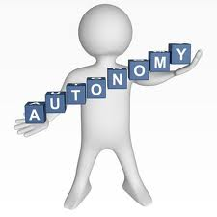
Physical Therapy & concept of Professionalism
In early years Physical Therapy’s effort to professionalize field concentrated on
gaining increased autonomy

Slide 9
Expertise through improving education and scholarship,

Slide 10
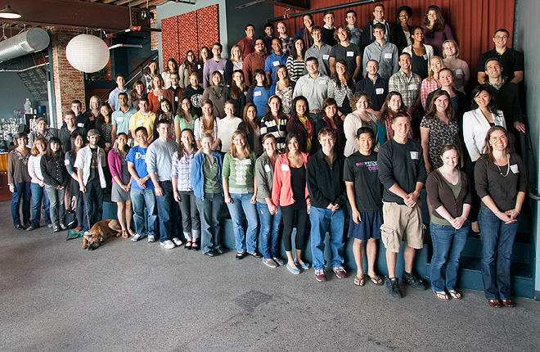
To Gain public recognition

Slide 11
enhancing political power through lobbying efforts

Slide 12
Public image
1960 to 1990
PTs wondered whether
physical therapy was a profession
concerned with public image of physical therapy
Same time struggle for appropriate degree to offer
baccalaureate…..masters…DPT degree

Slide 13
DPT degree links various aspects of professionalization:
autonomy, attainment of adequate power, and status.
The perception is that the DPT will enhance professionalization,
enabling physical therapy to enjoy the
professional status and powers

Slide 14
Core values of professionalism
Accountability
Altruism
compassion/caring
Excellence
integrity
professional duty
social responsibility

Slide 15
Accountability
A process by which a party justifies its actions & policies
active acceptance
of the responsibility
for the diverse roles,
obligations,
and actions of the
physical therapist

Slide 16
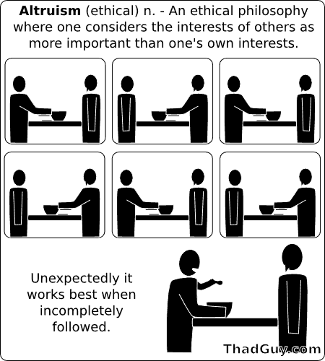
Alturism
Notes:
placing the needs of the patient/client ahead of the physical therapist’s self interest.

Slide 17
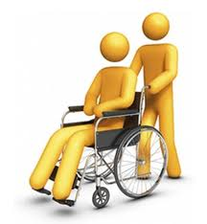
compassion/caring
Desire to identify/care

Slide 18
Excellence
consistently using current knowledge and theory while understanding personal limits
development of new knowledge.

Slide 19
Integrity
Integrity is steadfast adherence to high ethical principles or professional standards

Slide 20
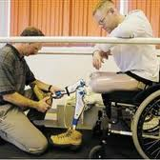
Professional duty
Optimal care
Facilitation of
General health
Safety ,security,
confidentiality

Slide 21
Social responsibility
Social needs of Pt
Social/community volunteer
Collaboration e other health professionals

Slide 22
PROFESSIONALISM AS DESCRIBED IN THE PHYSICAL THERAPY LITERATURE
The seven core values of professionalism
Accountability
Altruism
compassion/caring
Excellence
integrity
professional duty
social responsibility

Slide 23
Individual professionalism
whether professionals are living up to professional ideals
reflection on the personal meaning of professionalism is crucial for every professional
Why Oath in PT practice.
the process of formulating or revising an oath can be helpful in conceptualizing the obligations and commitments that a person or group believe are involved in professional life

Slide 24
Professional organization
Offers number of functions for its members and profession ,making structure for meeting responsibilities
Functions:
Ecnomic & social welfare
Practitionaire to ind.organization
Social & moral support
Reinforcing members
Enabling practice easy for Professionals
Help for professional role & education

Slide 25
Obligations
Setting standards for practice & research
Ensuring qualification for recruiting in profession
Maintaining professional traditions
Anticipating future ,raising expectations
Advancing well found research , establishing journals for researches
Justifying scope of practice
Spoke person on behalf of profession
Provide opportunities by selecting representatives

Slide 26
THE WORLD CONFEDERATION FOR PHYSICAL THERAPY (WCPT)
11 founding members (Australia ,Canada , Denmark, England , Finland, New Zealand, Norway, South Africa, Sweden, United States, and West Germany)
first session in 1951
82 member organizations,
more than 225,000 PTs worldwide
Representing PT internationally
Collaboration e organization
Encouraging high standard edu,research,practice
Communication & exchange of info b/w regions, members

