Slide 1
Retinal Detachment (Presentation and Principle of Management)
By
Dr. Suhail Mushtaq Boobak
MBBS,DOMS,MCPS,ICO(UK) FCPS,FRCS (UK)
Associate Professor Ophthalmology
Sargodha Medical College, University of Sargodha

Slide 2
Retinal Detachment
Separation of neurosensory retina from the retinal pigment epithelium.

Slide 3
INTRODUCTION TO RETINAL
DETACHMENT (RD)
1. Definitions and classifications
Retinal breaks
Retinal detachment
2. Anatomy
Anatomical landmarks
Variants of ora serrata
Vitreous base
3. Examination techniques
Indirect ophthalmology
Scleral indentation
Fundus drawing
Slitlamp biomicroscopy

Slide 4
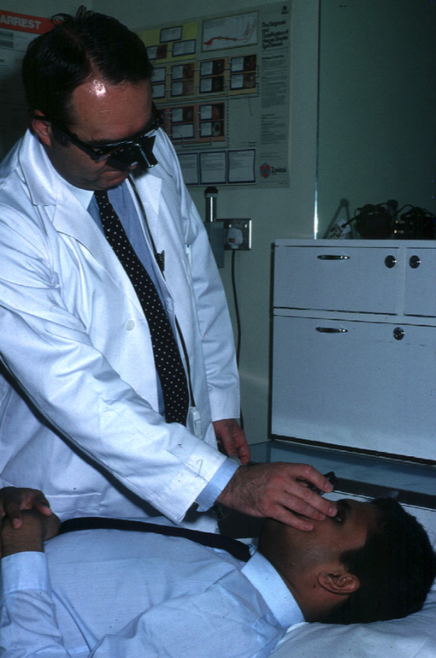
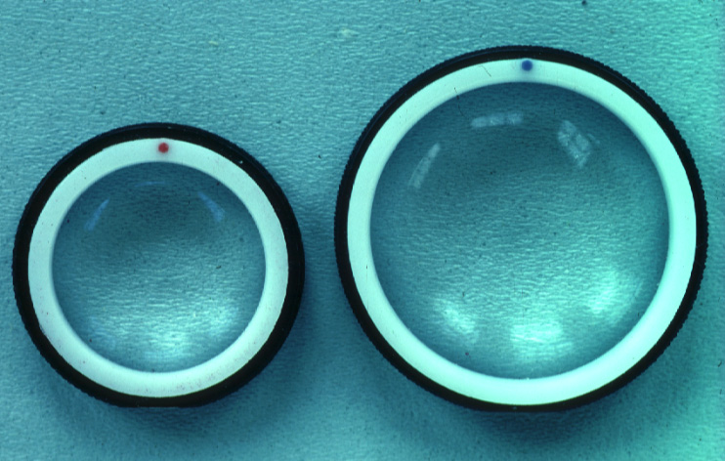
Indirect ophthalmology
Condensing lenses
Technique
The higher the power, the less the
magnification, the shorter the working
distance but the greater the field of view
Keep lens parallel to patient’s iris plane
Avoid tendency to move towards patient
Ask the patient to move eyes and head
into optimal positions for examination

Slide 5
Classification
1- Rhegmatogenous ( Simple ,Primary )
2- Tractional
3- Exudative ( Serous,Secondary )
4- Combined tractional-rhegmatogenous.

Slide 6
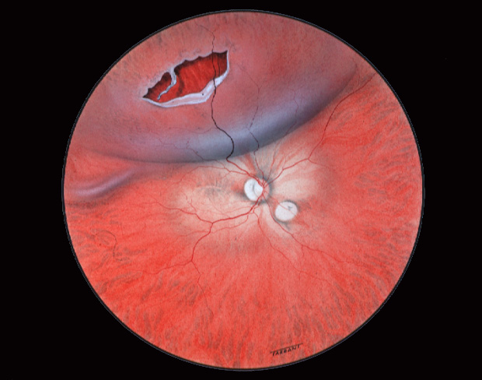
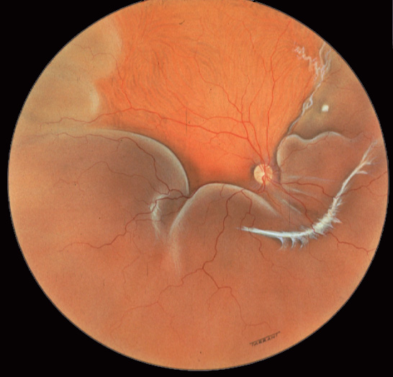
Separation of sensory retina from RPE by subretinal fluid (SRF)
Rhegmatogenous - caused by a
retinal break
Non-rhegmatogenous - tractional or
exudative

Slide 8
Pathogenesis of rhegmatogenous retinal detachment
a- Vitreoretinal traction
b-Predisposing peripheral retinal degeneration
c-Myopia
d-Trauma

Slide 12
Pathogenesis of tractional retinal detachment
a- Diabetic tractional retinal detachment
b- Traumatic tractional retinal detachment
Pathogenesis of exudative retinal detachment
a- Vascular diseases
b- Inflammatory diseases
c- Neoplastic diseases.

Slide 14
Diagnosis of Rhegmatogenous retinal detachment
Symptoms
1- Photopsia 2- Floaters 3- Visual Field Defects
Signs
1- Marcus Gunn pupil 2- Low IOP 3-Mild iritis
3- Tobacco dust 4- Retinal break 5-Convex configration & Subretinal fluid(Fresh RD)
6-Retinal thinning,2ndary intraretinal cysts,subretinal demarcation lines(Old RD)

Slide 16
Diagnosis of tractional retinal detachment
Symptoms
Visual field defects
Signs
a - Retinal detachment –Concave configuration
b - Retinal mobility is severely reduced.

Slide 18
Diagnosis of exudative retinal detachment
Symptoms
Floaters may be present
Signs
a - Retinal detachment –Convex configuration
b - Retinal mobility is present

Slide 20
Treatment
1-Pneumatic retinopexy(SF6-sulphur hexafluoride,
C3F8-perfluoropropane)
2-Scleral buckling 3-Drainage of SRF
4-Pars Plana Vitrectomy

Slide 24
Causes of failure
1-Missed breaks
2-Buckle failure
3-PVR(Proferative vitreoretinopathy)
4-Reopening of retinal break

Slide 25
Postoperative complications
1-Raised itnraocular pressure
2-Cataract
3-Band keratopathy

Slide 26
Thanks

