Slide 1
HORT 308
MEDICINAL AND AROMATIC PLANTS

Slide 2
Clove

Slide 3
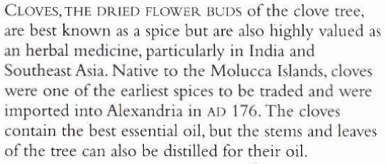
B.N Eugenia carophyllata Family: Myrtaceae

Slide 4
Habitat & Cultivation
Native to Molucca Island (Indonessia)
Now extensively grown in Tanzania
Madagascar
West India
Brazil
Twice a year unopened flowers are picked and dried

Slide 5
Key Constituents
Volatile Oil (eugenol 85%), acetyl eugnol, methyl salicylate, pinene, vanillin
Gum
Tannins

Slide 6
Key Actions
Antiseptic
Carminative
Stimulant
Analgesic
Prevents vomiting
Antispasmodic
Eliminates parasites

Slide 7
Research
Proved in Argentinian research in 1994, volatile oil as strong antibacterial and antiseptic used in toothache

Slide 8
Traditional & Current Uses
Ancient all purpose remedy
Antiseptic (Malaria, cholera, T.B)
Antispasmodic
Mind & body stimulant (Aphrodisiac in India & West)
Treats acne, skin ulcers, sores, mosquito repellent, mouth wash and toothache.

Slide 9
Parts used
Flower buds (Dried)

Slide 10
Key Preparations
Infusion
Tincture
Essential oil

Slide 11
Ginkgo

Slide 12
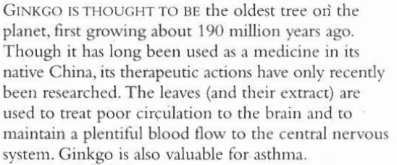
B.N Ginkgo biloba Family: Ginkgoaceae

Slide 13
Habitat & Cultivation
Native to China
Extensively grown in China
France
South Carolina
Leaves & fruits are harvested in autumn

Slide 14
Key Constituents
Flavonoids
Ginkgolides
Bilobalides

Slide 15
Key Actions
Circulatory stimulant & tonic
Antiasthamic
Antispasmodic
Antiallergenic
Anti-inflammatory

Slide 16
Research
Circulation improves (1960)
Anti-inflammatory Action
Platelet activating factor (Inhibit PAF leads to blood clot)

Slide 17
Traditional & Current Uses
In China relieve wheezing, to treat vaginal discharge for weak bladder, for Asthma
In Western for improved circulation, anti-allergenic & anti-inflammatory, asthma
Taken by millions of people in middle age onward to improve cerebral circulation memory & reduce risks of stroke

Slide 18
Parts Used
Fresh and Dried Leaves
Seeds

Slide 19
Key Preparations
Tincture
Decoction
Tablets
Fluid extract (leaves)

