Slide 1
TRUST UPON EVIDENCE
CRITICAL APPRAISAL

Slide 2
Well VS Poorly designed research
Unbiased results about clinical question
Discrimination amongst two
Asking questions about procedures/methods while performing study.
Intervention: detail about groups
Experience
Prognosis (representative)
Diagnosis (blind element)
Systematic reviews

Slide 3
Process of critical appraisal
Right type of study in hand?
Searching in quest for answer to clinical question.
You are facing a situation in which you have different results for the same clinical question.
Contradictory conclusion
Now what to do?
One study favors any intervention and other negates.
Both are true?
Both are false?

Slide 4
Possible options of inconsistency among results
Type of patients
Way of administration of intervention
Way of measurement of outcome
Element of Bias
So findings of poorly designed studies and well controlled studies of the same interventions can differ markedly

Slide 5
Fung et al (1986: 1419) concluded ‘acupuncture provided better protection against exercise-induced asthma than did sham acupuncture’.
Gruber et al (2002: 222) concluded: ‘acupuncture treatment offers no protection against exercise-induced bronchoconstriction’.

Slide 6
Gruber et al (2002) blinded the participants and assessors of outcomes
study by Gruber and colleagues provides a relatively unbiased estimate of the effects of acupuncture, whereas the study by Fung et al (1986) may have been subject to a range of biases

Slide 7
Does every published research is a high quality one?
Methodologists conducted surveys about quality of published research conclusion much of the published research is of poor quality
Same is the case after screening systematic reviews
There is some evidence that the quality of the research literature is slowly improving (Kjaergard et al 2002, Moher et al 2002, Moseley et al 2002, Quinones et al 2003).

Slide 8
General perception regarding research
Research is always conducted by experts
Peer reviewed by person/persons having methodological expertise.
So research paper are usually high standard one

Slide 9
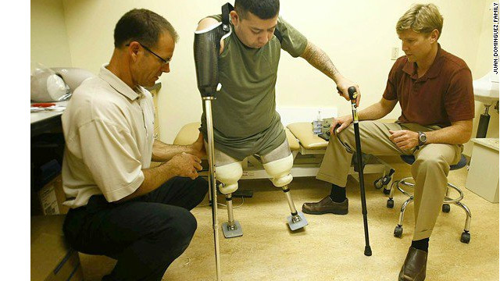

Slide 10
Research is conducted by people with little understanding of research design.
Some are inclined toward proving their point rather than objectively proving hypothesis.
Sometimes expert remain unsuccessful due to practical limitations(delay in progress).e.g. inadequate no of subjects for research
Low quality journals
Issue of persons peer reviewing.(less expert than performing study)
Editors are sometimes forced to publish research

Slide 11
Methodological criteria
Quantitative estimate
Ranking to check quality of randomized trials in PEDro
Point score for each methodological characteristics
Total of 10 scores.
5/10 show satisfactory points
A condition of failing/inability of blinding element
Effective score comes to 08

Slide 12
There should be an easy to apply formula/criteria to differentiate b/w high or low quality research.
Opinion of expert is an option.
Set of criteria developed by experts.
Delphi list of criteria for assessing the quality of clinical trials, developed by Verhagen and colleagues (1998a)

Slide 13
Methodological filters
Asking key questions about study design before checking study findings.
These questions are methodological filters b/c they filter studies of low methodological quality .
We should not demand perfection from clinical research because it is not generally attainable. Instead, we should look for studies that are good enough for clinical decision making
Good research enough to show certainty.

