Slide 1
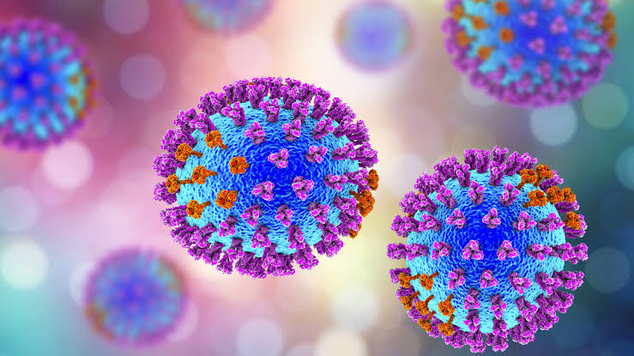
Mechanism of resistance to viral infections

Slide 2
Viral infection
A viral infection is the proliferation of a harmful virus inside your body. Viruses cannot reproduce without the assistance of host.
Viruses infect a host by introducing their genetic material into the cells and hijacking cell’s internal machinery to make more virus particles.

Slide 3
Types of infections
Viruses infect all cellular life and, although viruses occur universally, each cellular species has its own specific range that often infect only that species. Some viruses called satellites, can replicate only within cells that have already been infected by another virus.
Animal viruses
Plant viruses
Bacterial viruses

Slide 4
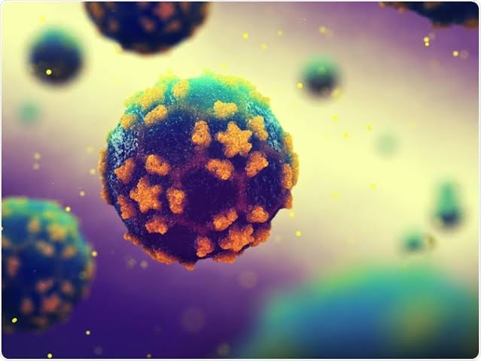
Animals viruses
Viruses are important pathogens of livestock. Diseases such as foot-and-mouth disease and bluetongue are caused by viruses. Companion animals such as cats, dogs, and hirses, if not vaccinated are susceptible to serious viral infections. Canine parvovirus is caused by a small DNA virus and infections are often fatal in pups. Like all invertebrates, the honeybee is susceptible to many viral infections. However, most viruses co-exist harmlessly in their host and cause no signs or symptoms of disease.

Slide 5
Plant viruses
There are many types of plant viruses, but often they cause only a loss of yield, and it is not economically viable to try to control them. Plant viruses are often spread from plant to plant by organisms known as VICTORS.
These are normally insects but some fungi, nematode worms and single celled organisms have been shown to be vectors.
Plants have elaborate and effective defence mechanisms against viruses. One of the most effective is the presence of so called resistance ® genes. Each R gene confers resistance to a particular virus by triggering localised areas of cell death around the infected cell, which can often be seen with the unaided eye.

Slide 6
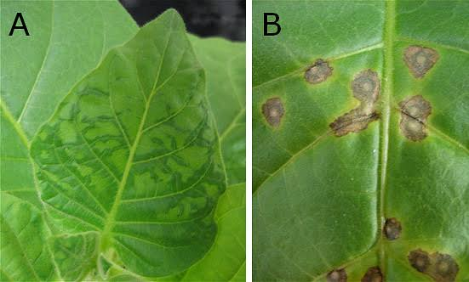
Plant viruses
Plant viruse particles or virus like particles (VLPs) have applications in bith biotechnology and nanotechnology. The capsids of most plant viruses are simple and robust structures and can be produced in large quantities either by the infection of plants or by expression in a variety of heterologous systems.

Slide 7
Bacterial viruses
Bacteriophages are a common and diverse group of viruses and are the most abundant form of biological entity in aquatic environments. These viruses infect specific bacteria by binding to surface receptor molecules and then entering the cells. Within a short amount of time, in some cases just minutes, bacterial polymerase starts translating viral mRNA into proteins.
These proteins go on to become either new virions within the cells, heloer proteins, which can help assembly of new virions.
Viral enzymes aid in the breakdown of the cell membrane and in the case of T4 phage, in just over 20 minutes after infection over 300 phages could be released.

Slide 8
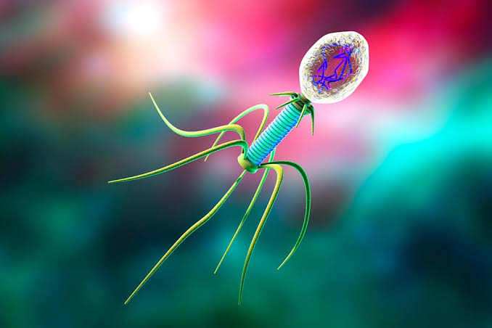
Bacterial viruses
The major way bacteria defend themselves from bacteriophages is by producing enzymes that destroy foreign DNA. These enzymes called restriction endonucleases cut up the viral DNA that bacteriophages inject into bacterial cells. Bacteria also contain a system that uses CSISPR SEQUENCES.

Slide 9
Mechanism of plants resistance to viruses
There are approximately 450 species of plant pathogenic viruses,which cause a range of diseases.
The plants shows two types of antiviral defence resistance mechanisms are:
R gene mediated
RNA slicing

Slide 10
R-gene mediated responses
Plant R genes confer resistance to many pathogens, including viruses.
Each R gene confers resistance to specific pathogen.
The first phenotype of defence in R gene mediated responses is the hypersensitive response (HR) and the HR includes programmed cell death (PCD).
The second phenotype of R gene mediated resistance response is the system acquired response (SAR).

Slide 11
R protein structure
last decades, several R genes that confer resistance ti unrelated plant viruses can be cloned.
Strikingly, they all belong to the NB-ARC-LRR ti the superfamily of plant R genes.
The NB-ARC-LRR R protein can be further subdivided based on the structure of their N terminal.
TIR-NB-ARC-LRR Proteins have an N terminal
The other subfamily if cloned viral R genes encodes NN-NB-ARC-LRC.

Slide 12
Recognition of Avr determinant
RECEPTOR LIGAND MODEl proposed to describe the interaction between R proteins and Avr
However, this model simple model does not apply ply to any viral R-avr Pair.
GUARD HYPOTHESIS Postulates that R proteins are associated with host cellular proteins. That are required by pathogens for infection.
This activates the guard to initiate a, signaling cascadethat culminates in the resistance response.

Slide 13
Recognition of Avr determinant
To date the most convincing evidence, for the guard hypothesis ha been found in A.thaliana Bacterial R proteins Avr systems.
In an elagant series of experiments, RIN4 (RPM 1 interacting protein 4) was identified as a cellular protein that is required for the resistance to Pseudomonas Syringae Pv tomato carries several Avr proteins.
RIN4 is modified in several ways depending on the Avr tha is associated with these modifications then serve to activate the corresponding R proteins.

Slide 14
R-protein complexes
Recent data supports existence of R protein containing complexes. The conserved heat shock protein 90 a molecular CHAPERONE is required for the resistance that is meditated by the Rx1 and N.
Hsp90 might also be required for the stability of R protein, perhaps preventing their degradation , as some R proteins including Rx1 fails to accumulate in the absence of Hsp90.

Slide 15
Rna silencing
RNA slicing, an ancient cellular mechanism of defence against foreign nucleic acid that also functions in gene regulation.
The RNA slicing pathway is found in organisms that are separated by millions years of evolution.
RNA slicing is a biological process in which RNA molecule inhibits gene expression by neutralising targeting mRNA molecule.
RNA slicing has been observed in all eukaryotes from yeast to mammals.

Slide 16
Initiation of RNA silencing of viruses
Double stranded RNA is the triggering for RNA slicing, so where does the dsRNA that initiates RNA slicing in cells.
Most plant viruses are RNA viruses. These viruses encode RNA-dependent RNA polymerase RdRPs that, in the first step of replication produces opposite sense copies of viral genome.
A 2nd hypothesis is that of viral replication generates RNA molecules that ectopically activate and are replicated by host RdRPs to produce dsRNA.

Slide 17
RNA silencing
There are 2 types of RNA silencing:
Micro RNA (miRNA)
Small interfering RNA (siRNA)

Slide 18
RNA slicing

Slide 19
RNA slicing

Slide 20
RNA silencing and R gene Signalling intersect
Both RNA slicing antiviral defence mechanisms.
It seems probable that plants these pathways that communicate with each other to effectively limit viral infections.
Evidence suggests that there is only limited cross talks Between these two important pathways. The same viral protein can function as a suppressor of RNA splicing and as an Avr determinant in R gene defense.
TCV coat protein, the Avr determinant of HRT is also a suppressor of RNA slicing.

Slide 21
RNA silencing
As the activation of many R genes results in the production of salicylic acid RNA gene mediated resistance might cause the induction of these RdRPs.
Although cross talks might be limited, the biological concept of redundancy in defence responses might again be used by the plants to ensure survival.

