Slide 1
PRESENTATION
MORAL REASONING

Slide 2
Human development and learning
PRESENTED TO:
SIR MOIN
PRESENTED BY :
ANAM ZAHRA
ROLL NO:
MBGF19M010

Slide 3
Morality
Principle concerning the distinction between right and wrong good or bad behavior on the basis of perception.
Moral dilemma
It is conflict in which you have to choose between two or more option and you have moral reason for choosing each option.

Slide 4
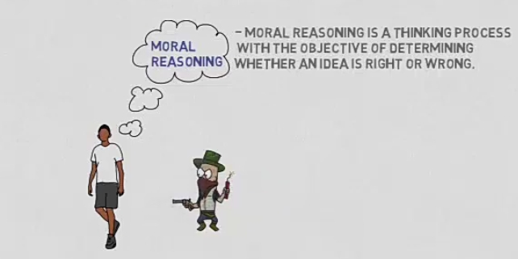
Moral reasoning
It is a thinking process with the objective of determining whether an idea is right or wrong to know whether something is right and wrong one must know what that something is intended to accomplish.

Slide 5
Heniz dilemma
Kholbergs question series
Heniz should steal the drug and no go to prison as this unfair.
Heniz should not steal the drugs since he would breaking the law.
Heniz should steal the drug and accept any prison sentence.

Slide 6
Kohlberg’s stages of development
1.Preconventional stage
Obedience and punishment
Individualism and exchange
2. Conventional stage
Interpersonal stage
Maintaining the social order
3.Post conventional stage
Social contract
Universal principles

Slide 7
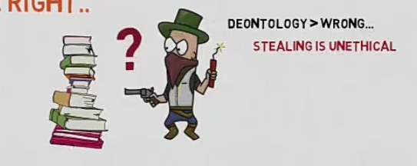
Principles of moral reasoning
There three principles of moral reasoning.
Deontology
An action is wrong because its intrinsically wrong.
The good or bad consequences is not taken into account.

Slide 8
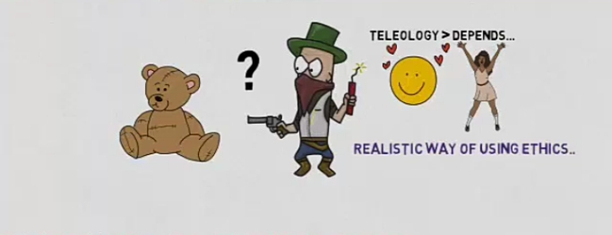
Teleological
Interparate the consequences

Slide 9
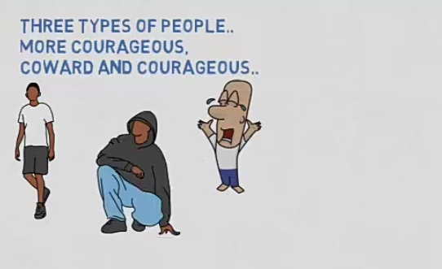
Ontological reasoning
Focus or on character rather than action.
Three types of people
More courageous
Coward
Courageous

