Slide 1
BREEDS
SHEEPS / GOATS

Slide 2
THIN TAILED
KPK

Slide 3
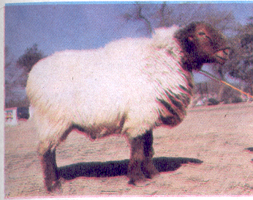
DAMANI RAM

Slide 4
DAMANI EWE

Slide 5
PUNJAB

Slide 6
CHOLISTANI RAM

Slide 7
CHOLISTANI EWE

Slide 8
KAJLI RAM

Slide 9
KAJLI EWE

Slide 10
LOHI RAM

Slide 11
LOHI EWE

Slide 12
SIPLI RAM

Slide 13
SIPLI EWE

Slide 14
THALLI RAM

Slide 15
THALLI EWE

Slide 16
SINDH

Slide 17
KACHHI RAM

Slide 18
KACHHI EWE

Slide 19
KOOKA RAM

Slide 20
KOOKA EWE

Slide 21
FAT TAILED
KPK

Slide 22
BALKHI RAM

Slide 23
BALKHI EWE

Slide 24
WAZIRI RAM

Slide 25
WAZIRI EWE

Slide 26
BALOCHISTAN

Slide 27
BALUCHI EWE

Slide 28
BIBRIK EWE

Slide 29
RAKHSHANI EWE

Slide 30
SINDH

Slide 31
DUMBI EWE

Slide 32
GOATS
PUNJAB

Slide 33
BEETAL MALE (BUCK)

Slide 34
BEETAL FEMALE (DOE)

Slide 35
DERA DIN PANAH MALE

Slide 36
DERA DIN PANAH FEMALE

Slide 37
NACHI MALE

Slide 38
NACHI FEMALE

Slide 39
TEDDY MALE

Slide 40
TEDDY FEMALE

Slide 41
SINDH

Slide 42
BARI GOAT

Slide 43
BUGRI GOAT

Slide 44
CHAPPAR MALE

Slide 45
JATTAN MALE

Slide 46
KAMORI MALE

Slide 47
PATERI MALE

Slide 48
ANGORA GOAT

