Slide 1
Electronics Lab
Muhammad Amer Mustafa
Lecturer UOS Sub Campus Bhakkar

Slide 2
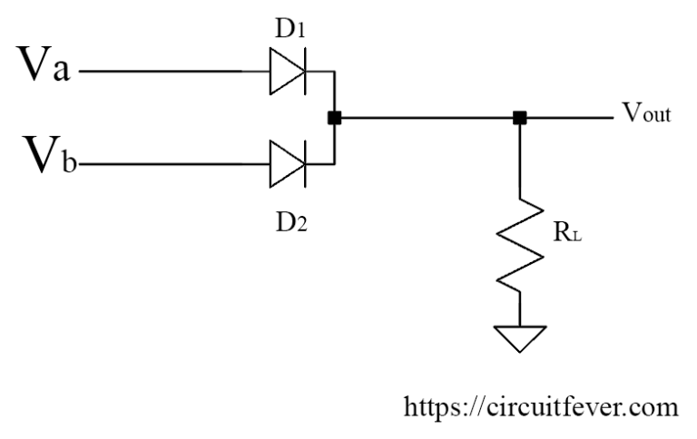
OR Gate
OR gate has two or more inputs and only one output. The output of the OR gate is HIGH if one or more inputs are HIGH. Circuit diagram of two input, positive logic OR gate using diodes and a resistor is shown below:
In this logic gate circuit, Va and Vb
are inputs and Vout is output.
These symbols can take only two values either
LOW or HIGH.

Slide 3
Working of OR Gate
Let us understand the working of this circuit.
If all inputs are in LOW, both the diode becomes in reverse biased hence acts as an open switch. Hence the output voltage is 0V.
If A is HIGH and B is LOW, the diode D1 becomes in forward biased hence act as the closed switch. (Neglecting diode forward resistance and voltage drop across the diode) Hence the output is HIGH.

Slide 4
Working of OR Gate
Also, If A is LOW and B is HIGH. Diode D2 becomes in forward biased and act as an open switch. Hence the output is HIGH.
If both the input is in HIGH then the output is equal to the more positive value of the input.
Hence OR function has been implemented.

Slide 5
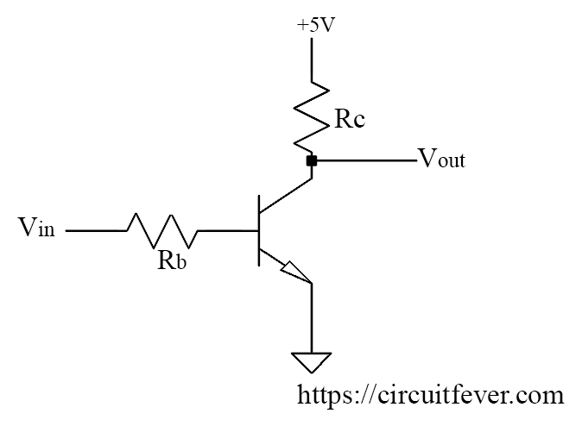
NOT gate using a transistor
NOT gate It is also known as an inverter because the output is opposite to the input. It has one input and one output. Circuit diagram of NOT gate using transistor is shown below:
Here, Vin is input and Vout is
output. Output must be LOW
if the input is HIGH.
Also, the output must be HIGH if
the input is LOW.

Slide 6
Working of NOT Gate
If the input is LOW, the parameter is chosen so that the output is V(sat). Also, if the input is HIGH, the parameter is chosen so that the output is LOW.
If the input is LOW, the transistor act as an open switch. Hence the output is LOW.
If the input is HIGH, the transistor act as the closed switch. Hence the output is HIGH (Neglecting voltage drop).

Slide 7
NAND Gate

