Slide 1
CPU, block diagram
Welcome to
IT Expertise
with
Munim akhtar
Free online quality educational tutorials.

Slide 3
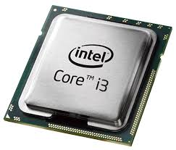
What is CPU (Processor)
BRAIN OF COMPUTER.
Carries out the instructions
It perform the basic function like
Arithmetical,
Logical and
input and output operations of the system.

Slide 4
HISTORY OF CPU
Early CPUs were custom-designed as a part of a larger.
A specific kind of computer.
For particular application
e.g., Calculator, MP3 player, ECG etc.

Slide 5
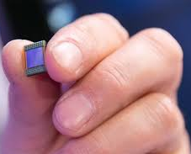
HISTORY of CPU…
Micro computer is due to ICs and ICs lead to designed nanometres CPU.
CPU is made using billions of tiny transistors, electrical gate
One nanometer is one billionth of a meter
Dedicated computing machines in every field.
Modern microprocessors appear in every field like:
Automobiles
Cell phones
Children's toy,
Medical equipment's etc.
7 nanometer processor

Slide 6
What is Microchip / Microprocessor
A microchip is a unit of computer circuit (integrated circuit)
Chip is made of silicon at a very small scale.
Microchips made for program logic (logic or microprocessor chips)
What is program logic:
Program logic is the instructions used to instruct computer software on how to perform a specific task properly.

Slide 7
Example of Program logic
2 + 2

Slide 8
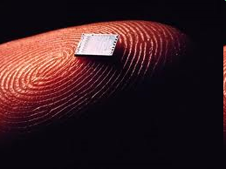
IMAGES OF MICROCHIP

Slide 9
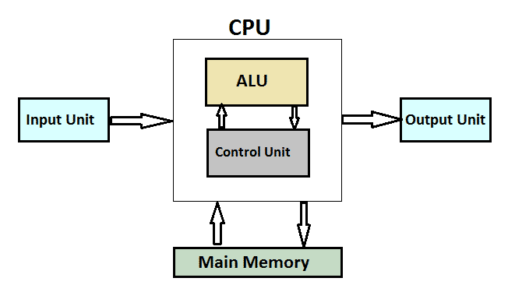
CPU / System Block Diagram
ALU: carries out arithmetic and logic operations on the operands in computer instruction
CU: directs the operation to the processor.

Slide 10
CPU/SYSTEM BLOCK DIAGRAM…
Cache is a portion of memory made of high-speed static RAM (SRAM) instead of the slower DRAM used for main memory.
It reduce the average cost (time or energy) to access data from the main memory.[

Slide 11
COMPONENTS OF CPU
It have following parts:
CONTROL UNIT(CU)
ARITHEMATIC LOGIC UNIT (ALU)
A NUMBER of REGISTERS

Slide 12
1- CONTROL UNIT (CU)
CU controls operations of other parts of CPU, e.g., I,O operation
Control sequence of instruction to be executed
Control flow of data among all parts of CPU.
Interpret instructions.
Regulate timing of processor
Send & receive control single from peripheral
devices to CPU.

Slide 13
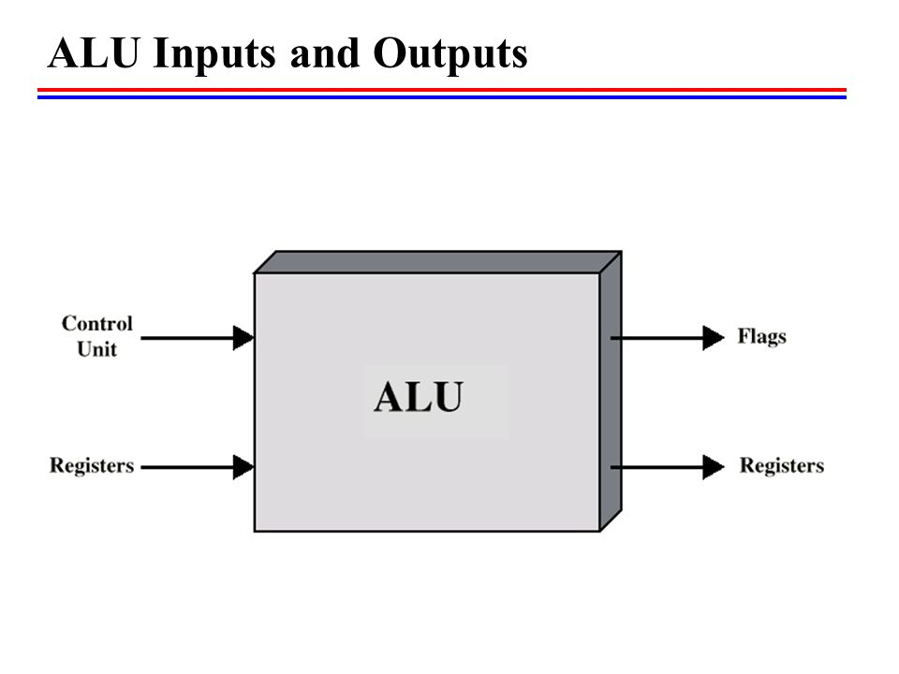
Arithmetic and Logical UNIT (ALU)
ALU consists of a complicated set of logic circuit.
It is mainly responsible for :
Calculation like +, -, x, /
Logical comparison and decision e.g.
>,<, <=, >=, = sign.

Slide 14
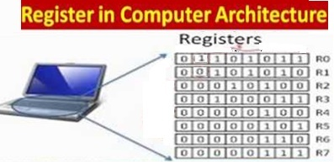
REGISTERS
Register is a special memory area used by the CPU for temporarily storing data during execution of instructions.
Have 3 type:
Program Counter (PC): It holds the address of next instruction to be executed.
Instruction Register (IR): It holds the instruction being executed.
Process Status Register: It holds “processor bit" about operation done by ALU.

Slide 15
End Note
Difficult road often lead to
beautiful destinations.

Slide 16
?

