Slide 1
Topic:
Methods of analysis:
Measuring of cost effectiveness
Constant Effect Method,
Constant Cost Method,

Slide 2
Cost Effectiveness Analysis
Cost-effectiveness analysis (CEA) is an alternative to cost-benefit analysis (CBA). The technique compares the relative costs to the outcomes (effects) of two or more courses of action.
An appraisal and program monitoring technique used primarily in social programs and projects

Slide 3
Objective
The objective is to compare costs per unit of outcome of two programs for purposes of capital budgeting

Slide 4
Example:
CEA is commonly used in healthcare, for example, where it is difficult to put a value on outcomes, but where outcomes themselves can be counted and compared, e.g. ‘the number of lives saved’.
Note:
Health, nutrition and education where identification and quantification of benefits in money terms is not straightforward but, at the same time, the desirability of the activity is not in question.

Slide 5
Cost Effectiveness Analysis
This approach is very useful where aim is to choose from a set of alternative technologies and approaches that will provide the same service.
Examples:
Choosing from two school systems that give same educational benefits - Centralized schools that require bus transportation and more expensive smaller schools to which students can walk
Two systems of electricity generation - Thermal versus hydro
Two types of court systems with same disposal of cases - More court rooms at the headquarters or mobile courts
Choosing amongst alternative ways of supplying potable water to communities
Two or more kinds of health treatment to save lives

Slide 6
Cost Effectiveness Analysis
Cost effectiveness analysis involves a series of steps similar to those of a normal investment appraisal except that the benefits are not measured as monetary values, but as quantitative impacts.
The focus is on evaluating the costs of the alternatives
Comparison of economic costs of alternatives - cost per unit outcome of a program

Slide 7
Cost effectiveness Analysis Can be Used in Two Forms:
Method 1: Constant Effects
Uses least-cost analysis to determine the lowest cost alternative for meeting the same level of benefits.
Example: - choosing from two water pipes of different sizes that yield the same quality of water per day (smaller pipe has lower investment cost but higher operating or pumping costs)

Slide 8
Cont.…
Selecting from two alternatives for generating the same amount of electricity (thermal and hydro generation units, the former with a lower investment and higher operating cost compared to the latter)

Slide 9
Method 2: Cost-Effectiveness Ratio
Calculates the cost per unit of benefit –
Example: Benefits are simply measured as effectiveness (the number of Premature Deaths Prevented)
Two different health programs: DPT-BCG vaccination campaign for children or AIDS treatment program.
The cost per child vaccination and per patient will be computed in this case. Here the purpose is to see which programs yield more value per dollar of expenditure

Slide 10
Cont.…
CEA measures costs in a common monetary value and the effectiveness of an option in terms of physical units. Because the two are incommensurable, they cannot be added or subtracted to obtain a single criterion measure. One can only compute the ratio of costs to effectiveness in the following ways:
CE ratio = C1/E1
EC ratio = E1/C1

Slide 11
Cont.….
where: C1 = the cost of option 1 (in £); and E1 = the effectiveness of option 1 (in physical units).
The first equation above represents the cost per unit of effectiveness (e.g. £s spent per life saved). Projects can be rank ordered by CE ratio from lowest to highest. The most cost-effective project has the lowest CE ratio. The second equation is the effectiveness per unit of cost (e.g. lives saved per £ spent). Projects should be ranked from highest to lowest EC ratios.

Slide 12
Incremental (or Marginal) Cost-Effectiveness Ratio
The decision makers need to compute marginal cost-effectiveness ratios.
This need arises when a new alternative is compared with existing situation.
The numerator now contains the difference between the cost of the new and old alternatives, and the denominator is also the difference between the effectiveness of the new and old alternatives

Slide 13
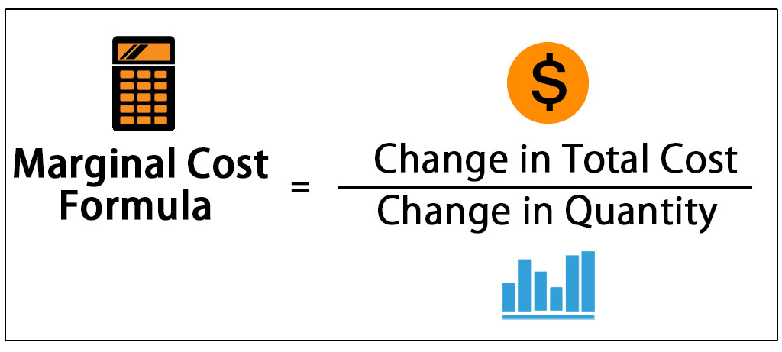
Cont.…
This ratio can be interpreted as the incremental cost per unit of effectiveness. When there are several alternatives available, the marginal cost-effectiveness ratio can be used to rank the new measures versus the existing one.

Slide 14
Cont.…

Slide 15
Limitations of CEA
1; Does not measure WTP
Cost-effectiveness ratios are a poor measure of consumers’ WTP.
The taxpayers, most probably, would be happy to pay for additional number of deaths prevented on the roads, as a measure of effectiveness.
The link between the intermediate measure of effectiveness and final output, such as reduction in crime, is not explicitly stated.
Faced with this kind of situation, the analyst must make sure that this link is properly established

Slide 16
CONT…
2: Excludes some external benefits
The concept of cost-effectiveness analysis excludes most externalities on the benefit side.
An improvement in education will not only increase lifetime earnings of the students but also likely to contribute to a reduction in the rates of unemployment and crime.
In healthcare, there are external benefits due to such treatments as the vaccination of children, i.e., other people do not catch the infectious diseases.
If a complete cost-benefit analysis does not seem possible, the analyst doing the evaluation should be careful not to exclude important benefits arising from a particular project

Slide 17
CONT…
3. Excludes some external costs
While computing the cost-effectiveness ratio for a particular project, attention should be paid to the treatment of costs, which may include not only financial but also social costs.
In the education sector, the enhancement of primary schooling is sometimes viewed in terms of the additional number of school blocks and improvement of their physical condition. Many other costs must be included to get the desired outcome.
Different types of projects often have some of the costs in non-monetary terms, such as waiting time, coping costs, enforcement costs, regulatory costs, compliance costs, etc. ▪ The economic cost-effectiveness analysis carried out for such projects must account for all costs, and should also be based on the economic instead of financial prices of goods and services.

Slide 18
CONT…
4. Does not account for scale of project
Scale difference may distort the choice of an “optimal” decision.
A project with smaller size but higher efficiency level may get accepted, while another project may provide more quantity of output at a reasonable cost.
A strict cost effectiveness analysis fails to overcome this problem.
A complete cost benefit analysis does not have this problem because the net present value already accounts for the difference in size among alternatives.

