Slide 1
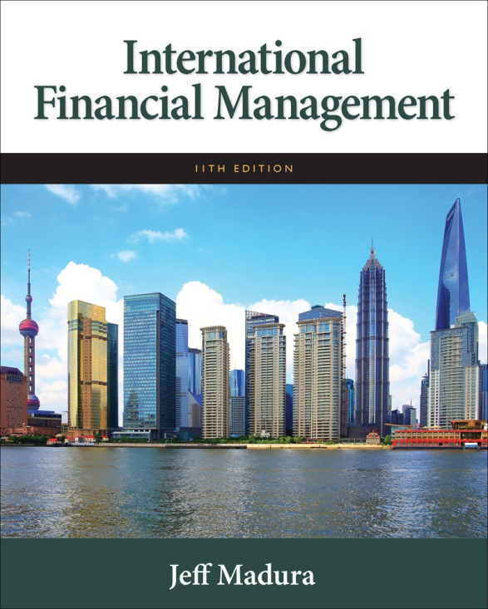

Slide 2
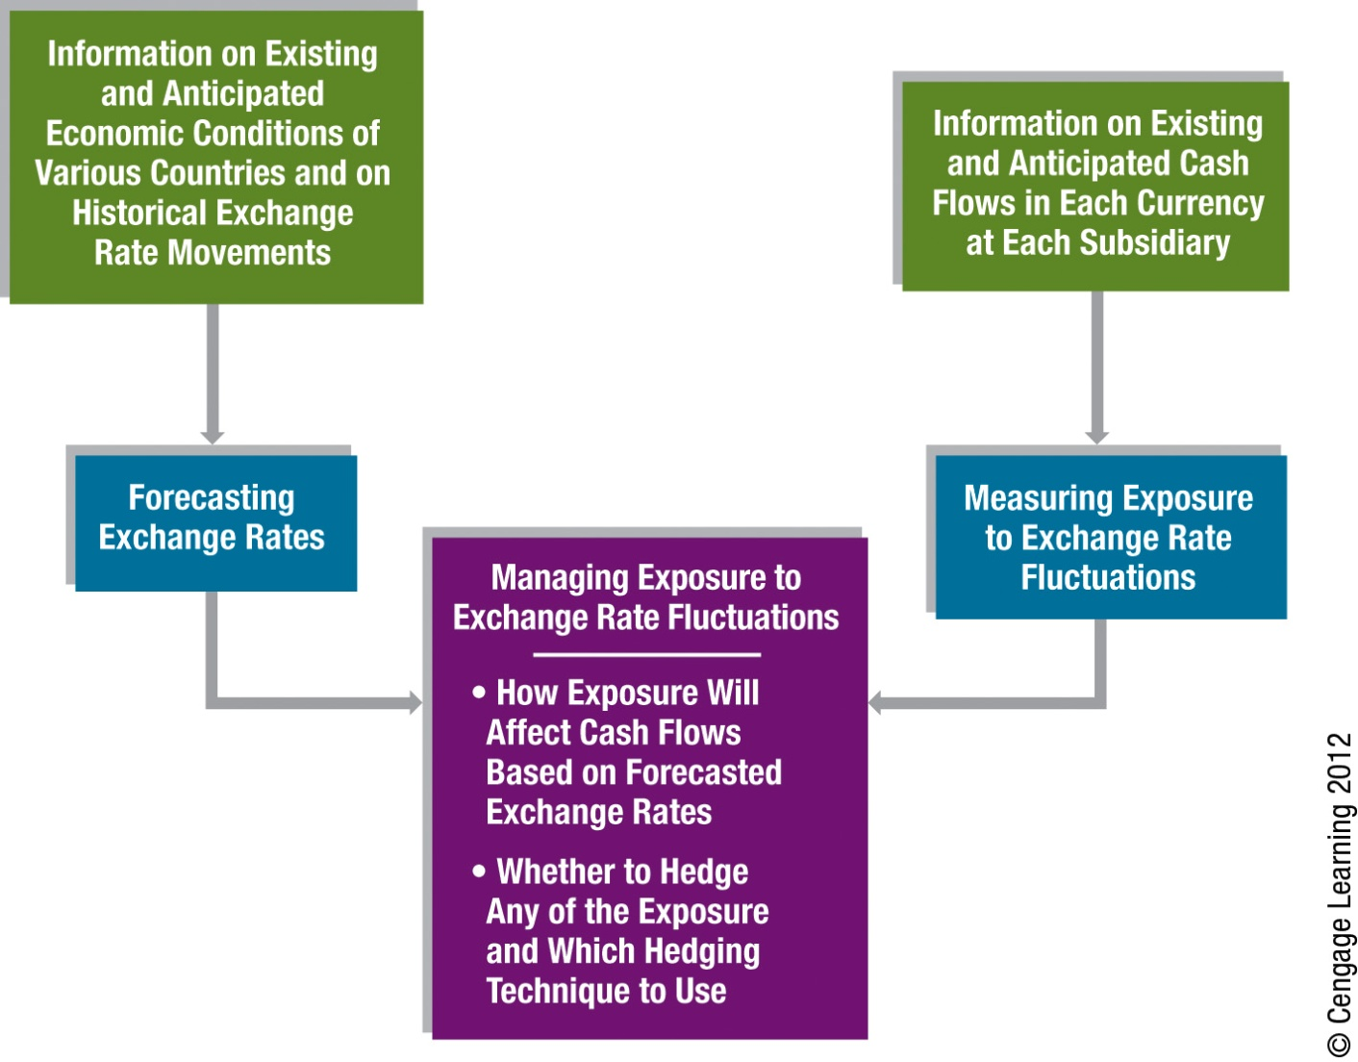
Part 3 Exchange Rate Risk Management

Slide 3
9
Forecasting Exchange Rates
Chapter Objectives
Explain how firms can benefit from forecasting exchange rates
Describe the common techniques used for forecasting
Explain how forecasting performance can be evaluated
explain how interval forecasts can be applied
3

Slide 4
Why Firms Forecast Exchange Rates
Hedging decisions
Whether a firm hedges may be determined by its forecasts of foreign currency values.
Short-term investment decisions
Corporations sometimes have a substantial amount of excess cash available for a short time period. Large deposits can be established in several currencies.
Capital budgeting decisions
When an MNC’s parent assesses whether to invest funds in a foreign project, the firm takes into account that the project may periodically require the exchange of currencies.

Slide 5
Why Firms Forecast Exchange Rates (Cont.)
Earnings assessment
The parent’s decision about whether a foreign subsidiary should reinvest earnings in a foreign country or remit earnings back to the parent may be influenced by exchange rate forecasts.
Long-term financing decisions
MNCs that issue bonds to secure long-term funds may consider denominating the bonds in foreign currencies.

Slide 6
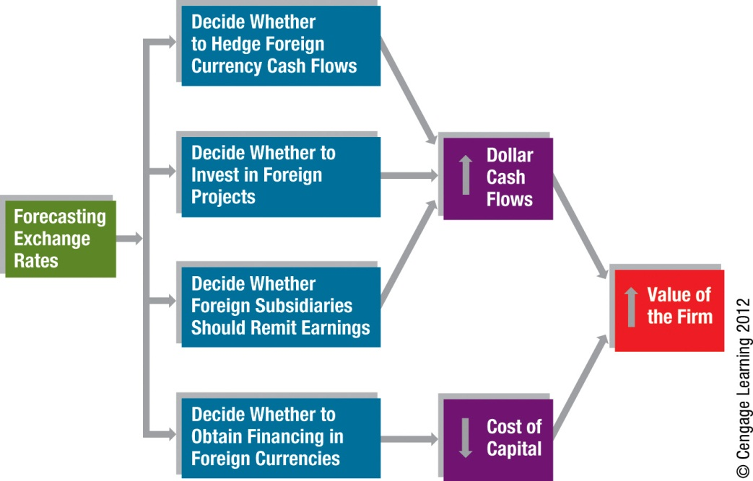
Exhibit 9.1 Corporate Motives for Forecasting Exchange Rates

Slide 7
Forecasting Techniques
Technical Forecasting
Fundamental Forecasting
Market-Based Forecasting

Slide 8
Technical Forecasting
Involves the use of historical exchange rate data to predict future values
Limitations of technical forecasting:
Focuses on the near future
Rarely provides point estimates or range of possible future values
Technical forecasting model that worked well in one period may not work well in another

Slide 9
Fundamental Forecasting
Based on fundamental relationships between economic variables and exchange rates
Use of sensitivity analysis
Considers more than one possible outcome for the factors exhibiting uncertainty.
Use of PPP
While the inflation differential by itself is not sufficient to accurately forecast exchange rate movements, it should be included in any fundamental forecasting model.
Limitations of fundamental forecasting include:
Unknown timing of the impact of some factors
Forecasts of some factors may be difficult to obtain
Some factors are not easily quantified
Regression coefficients may not remain constant

Slide 10
Market-Based Forecasting
Use of the spot rate to forecast the future spot rate.
Use of the forward rate to forecast the future spot rate.
The forward rate should serve as a reasonable forecast for the future spot rate because otherwise speculators would trade forward contracts (or futures contracts) to capitalize on the difference between the forward rate and the expected future spot rate.

Slide 11
Market-Based Forecasting (Cont.)
Long-Term Forecasting with Forward Rates
Long-term exchange rate forecasts can be derived from long-term forward rates. Like any method of forecasting exchange rates, the forward rate is typically more accurate when forecasting exchange rates for short-term horizons than for long-term horizons.
Implications of the IFE for Forecasts
Since the forward rate captures the interest rate differential (and therefore the expected inflation rate differential) between two countries, it should provide more accurate forecasts for currencies in high-inflation countries than the spot rate.

Slide 12
Mixed Forecasting
Use a combination of forecasting techniques. (Exhibit 9.2)
Mixed forecast is then a weighted average of the various forecasts developed.
Guidelines for Implementing a Forecast
All managers of an MNC should rely on the same exchange rate forecasts.
MNCs may complement their forecast by hiring forecasting services to obtain exchange rate forecasts.

Slide 13
Exhibit 9.2 Forecasts of the Mexican Peso Drawn from Each Forecasting Technique

Slide 14
Forecast Error
Measurement of forecast error
Absolute forecast error as a percentage of the realized value = (forecasted value – realized value) / realized value
Forecast error among time horizons
The potential forecast error for a particular currency depends on the forecast horizon.
Forecast error over time periods (Exhibit 9.3 next slide)
The forecast error for a given currency changes over time.
Forecast errors among currencies (Exhibit 9.4 second slide)
The ability to forecast currency values may vary with the currency of concern.
Forecast bias
When a forecast error is measured as the forecasted value minus the realized value, negative errors indicate underestimating, while positive errors indicate overestimating.

Slide 15
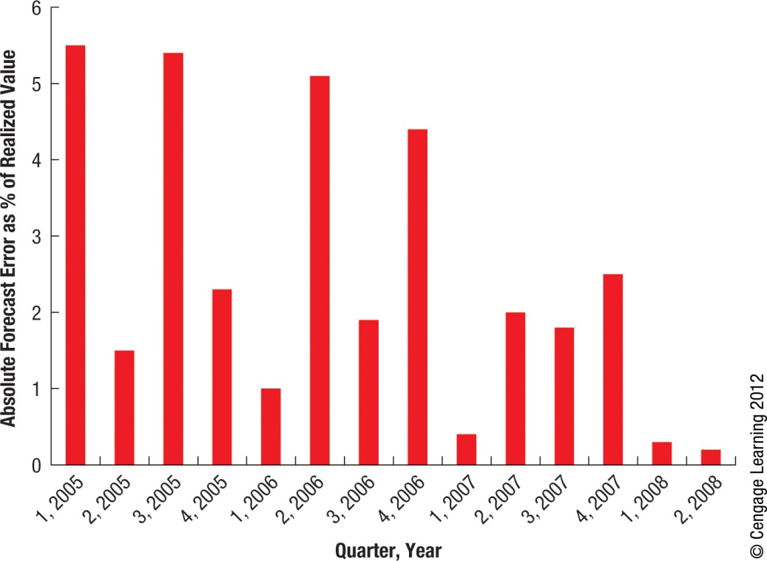
Exhibit 9.3 Absolute Forecast Error (as % of Realized Value) for the British Pound over Time

Slide 16
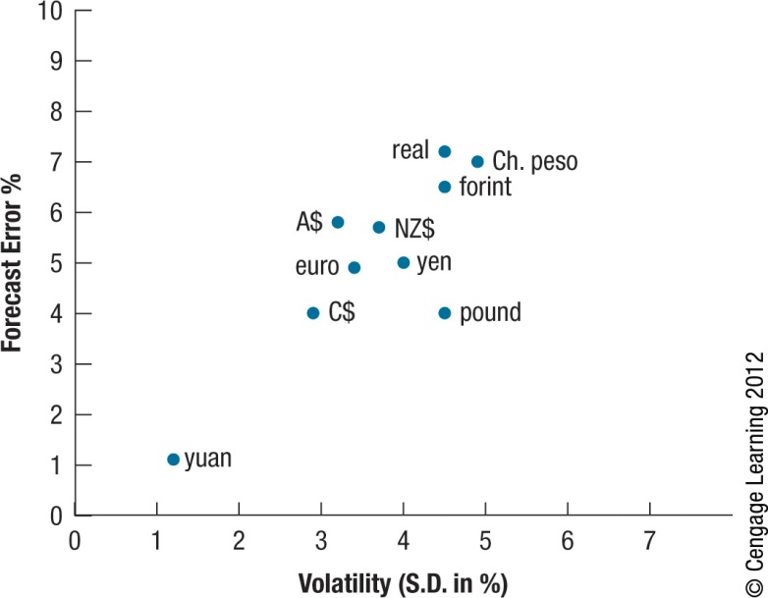
Exhibit 9.4 How the Forecast Error Is Influenced by Volatility

Slide 17
Statistical Test of Forecast Bias
A conventional method of testing for a forecast bias is to apply the following regression model to historical data.

Slide 18
Graphic Evaluation of Forecast Bias
Forecast bias can be examined with the use of a graph that compares forecasted values with the realized values for various time periods. (Exhibits 9.5 & 9.6)
Shifts in Forecast Bias over Time
Because the forecast bias can change over time, refining a forecast to adjust for a forecast bias detected in the past is not a perfect solution.

Slide 19
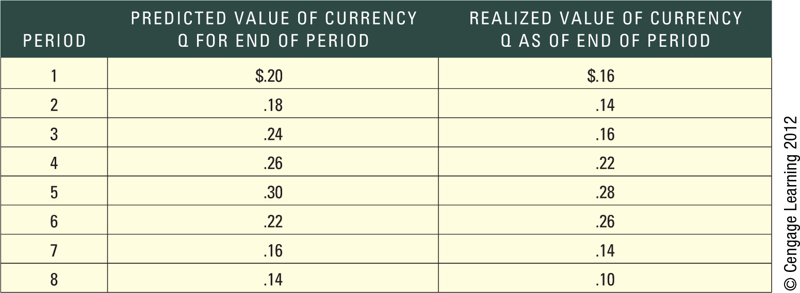
Exhibit 9.5 Evaluation of Forecast Performance

Slide 20
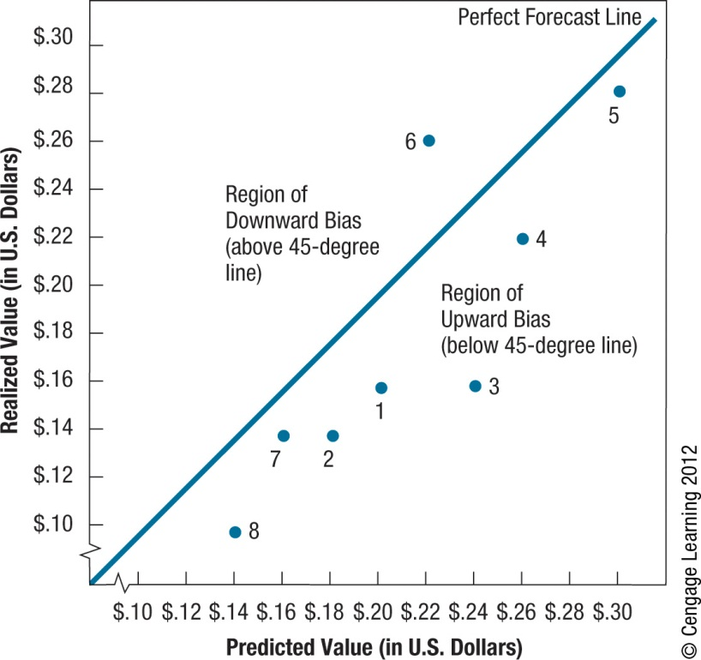
Exhibit 9.6 Graphic Evaluation of Forecast Performance

Slide 21
Comparison of Forecasting Methods
An MNC can compare forecasting methods by plotting the points relating to two methods on a graph similar to Exhibit 9.6.
The performance of the two methods can be evaluated by comparing distances of points from the 45-degree line.
In some cases, neither forecasting method may stand out as superior when compared graphically.

Slide 22
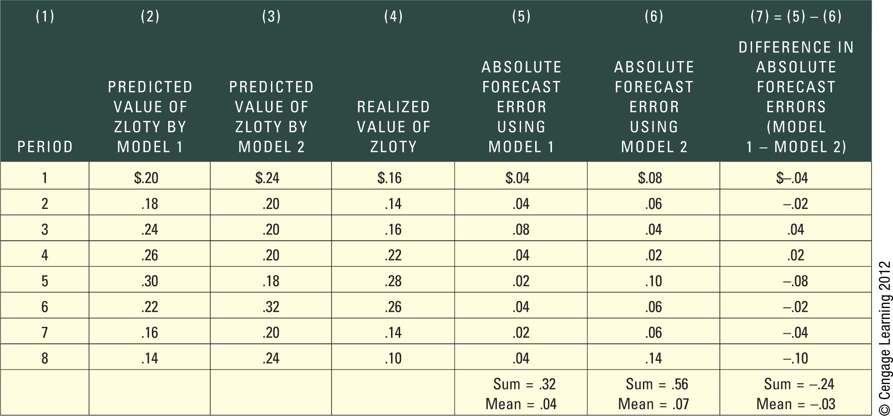
Exhibit 9.7 Comparison of Forecast Techniques

Slide 23
Forecasting under Market Efficiency
Weak-form efficiency: historical and current exchange rate information is already reflected in today’s exchange rate and is not useful for forecasting.
Semistrong-form efficiency: all relevant public information is already reflected in today’s exchange rate.
Strong-form efficiency: all relevant public and private information is already reflected in today’s exchange rate.

Slide 24
Methods of Forecasting Exchange Rate Volatility
Use of recent volatility level
The volatility of historical exchange rate movements over a recent period can be used to forecast the future.
Use of historical pattern of volatilities
If there is a pattern to the changes in exchange rate volatility over time, a series of time periods may be used to forecast volatility in the next period.
Implied standard deviation
Derive the exchange rate’s implied standard deviation (ISD) from the currency option pricing model.

Slide 25
SUMMARY
Multinational corporations need exchange rate forecasts to make decisions on hedging payables and receivables, short-term financing and investment, capital budgeting, and long-term financing.
The most common forecasting techniques can be classified as (1) technical, (2) fundamental, (3) market based, and (4) mixed. Each technique has limitations, and the quality of the forecasts produced varies. Yet due to the high variability in exchange rates, each technique has limited accuracy.

Slide 26
SUMMARY (Cont.)
Forecasting methods can be evaluated by comparing the actual values of currencies to the values predicted by the forecasting method. To be meaningful, this comparison should be conducted over several periods. Two criteria used to evaluate performance of a forecast method are bias and accuracy. When comparing the accuracy of forecasts for two currencies, the absolute forecast error should be divided by the realized value of the currency to control for differences in the relative values of currencies.

